Slide 1



DevOps Assessment Proposal

Slide 2
InTRODUCTION
Introduction
The purpose of this document is to describe the high-level solution for implementing continuous integration and continuous deployment on AWS Cloud. This document covers overall technical strategy for architecting AWS Cloud infrastructure. Aspire Systems transforms the existing Applications into DevOps model. Deliver a detailed roadmap and Implementation plan to Capture the current As-is state of release management processes and production operations. Improvements of Automated CICD process Containerization of the Applications Improvements in monitoring and logging solutions

Slide 3
Scope
Scope
During the workshop Aspire team Analyze the Pothy’s Project and understand the number of Applications to build the continuous Integration and Continuous deployment which are in scope. Understand the existing Tech stack and deployment process. Dependency Identification

Slide 4
DevOps - Why us?
Why do organizations approach us?
How do we help?
Experience deploying applications with over 500 self managed containers.
Experience with most of the popular tools and frameworks
Over 50 Seasoned Engineers who can help with automation of deployments and infrastructure management.
Experience in deploying and managing micro-services based application.
Have helped numerous products and services in increasing the speed of testing cycles, reducing bug count with automated regression testing and improved delivery speed
Have done tight integrations with project management tools such as Atlassian toolset.
Long Testing Cycles
Too Many Delivered Bugs
Too Many Releases Before Build
Difficulty Managing Release Notes And Stories
Difficulty Migrating To On-Premises/Cloud
To Improve Logging And Auditing
To Implement A Workflow For Releases
To Migrate Into A Cloud Agnostic Deployment
To Migrate To A Microservices Architecture

Slide 5
Assessment and GAP ANALYSIS
Assessment
Gap Analysis and Solution Plan
Solution
GO Live Operations
Knowledge Transfer on
Applications which are running on Pothy’s Project
Tools & Deployment and Release Process
How the Artifacts stored in the repository.
How the docker Images are stored in ECR repo.
Monitoring the Applications.
Understand the pain points to deploy the Pothy’s project applications
Provide the design and solution plan to Build the continuous Integration and Continuous pipeline to automate the deployment process.
Design Build the branching strategy.
Design CICD Pipeline Implementation Strategy
Containerization of the Application using docker.
Moniotor the Application using CloudWatch
Deliverables
Gap Report
KT Document
Tools and CICD Process Recommendation
Design and Solution Plan
Final Solution document
Sign Off

Slide 6
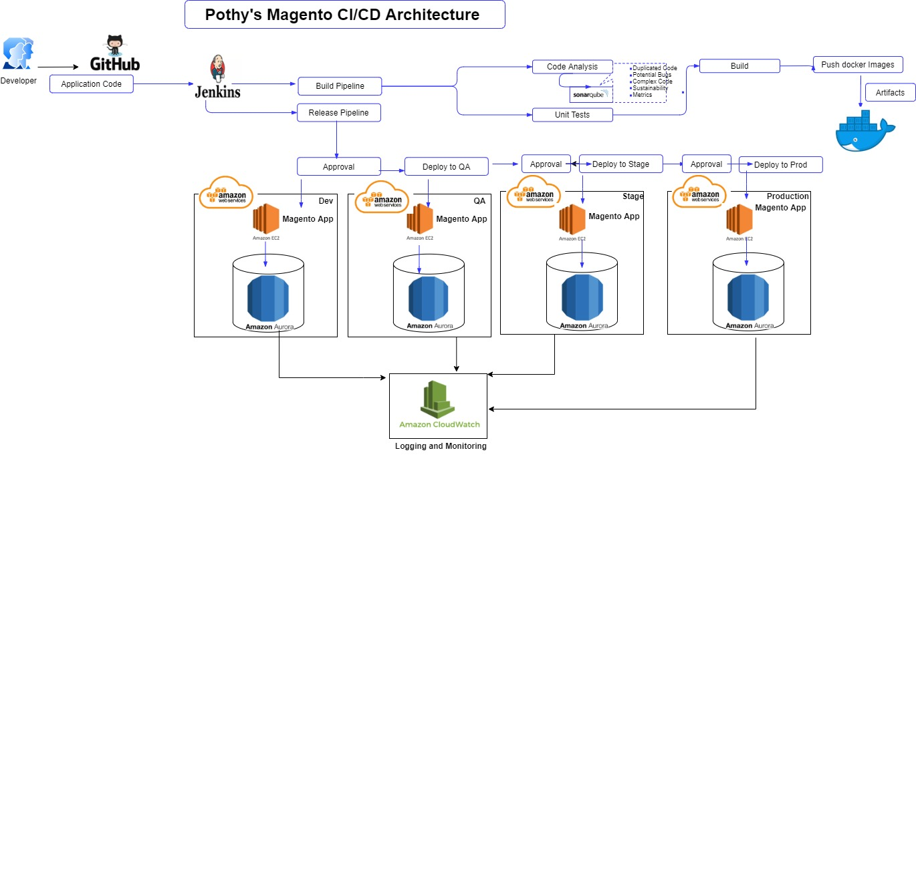
CI/CD Architecture

Slide 7
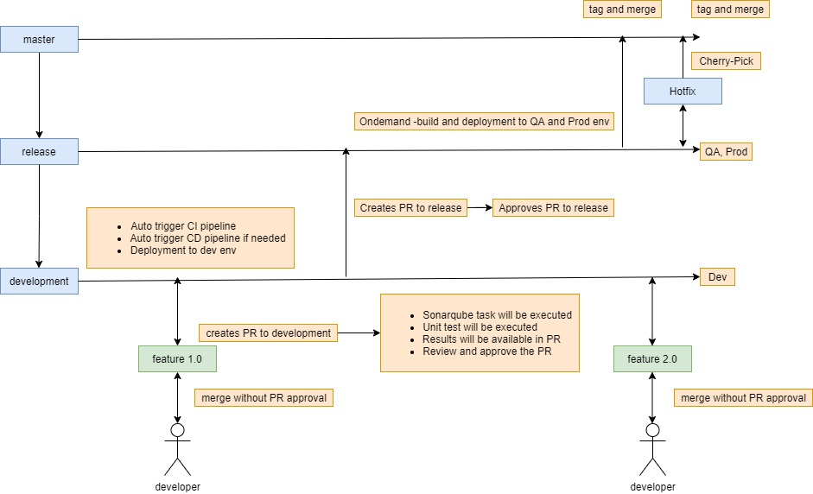
BraNCHING STRATEGY

Slide 8
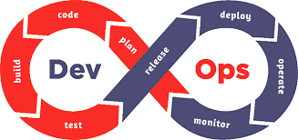
Philosophy & Approach
EA, security
Developers
Ops
Precommit checks
Static code analysis
Peer code review
Build
IaC
Unit test
Developers
Merge to trunk
QA
VCS
Business
Integrated build
Backlog
Design ideas
RM
Artifact repository
laC
Application and operational analytics
Customer
Release automation
Release decision
Manual QA
API-based test automation
Release automation
Service and network virtualization
Test data management
EA
TDM
EA
Deployed applications
Business
QA
Developers
Ops

Slide 9
DevOps Road Map
Identify Business requirements, Technical Risk.
Customer Application team Input
Design deployment strategy.
Design the CICD Pipeiine Solution
Project Handover, Kick off
Implementation of CICD Pipeline on Premises in Dev/QA/Stage/Prod Env
Initiation
Release Sign Off
Operational readiness
Discover
Project Closure & Post Impl. Review
Kick Off
Design
Deliver
Analysis Workshop
Go Live
Closure
Aspire Deliverables
Proposal Review
Analysis of
AS-IS Process.
Design Deployment Strategy
Deliverables
Reports
Release notes
Project Handover
Training
Post Implementation
Review Report

Slide 10

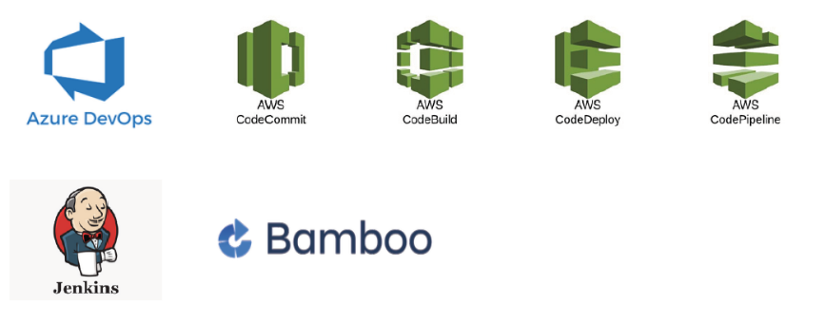
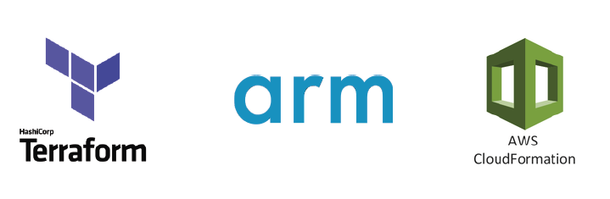
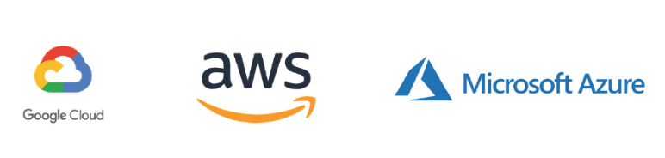
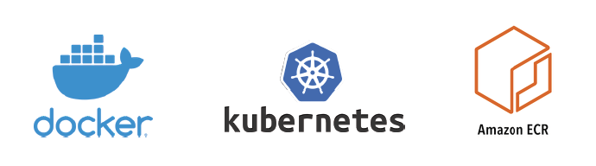
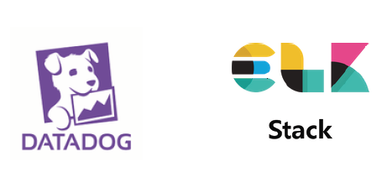
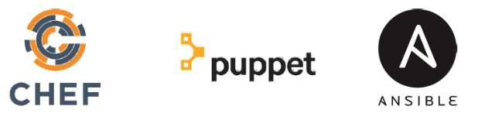
Tools and Skillsets
ORCHESTRATION & CI/CD TOOLS
MULTI-CLOUD DEPLOYMENT & IAC
CLOUD AND INFRA MANAGEMENT
CONTAINERIZATION
LOG AND SEARCH FRAMEWORKS
CONFIGURATION MANAGEMENT

Slide 11
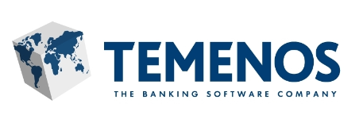
Case Study1 - Custom Product for a Banking and Financial Services Company
Our client provides software for banks and financial services like retail, corporate, universal, community banks and
microfinance with its headquarters in Geneva, Switzerland.
Scope
Challenges
Solution
Aspire developed an unique self-service platform that supports the banking software’s deployment in a multi-cloud environments (Azure, AWS) which brought more business values to customer
Supported multiple technology stack which were complex in nature – Websphere 8.5.5, Websphere 9.0, Jboss, Weblogic, Oracle 12 and installing them automatically along with customer preferred test frameworks (HP-UFT, Selenium based custom frameworks, etc.).
Workflow/pipeline configuration in which the user can tailor the bank software they want to test.
Automated artifacts promotion to Dev, Test, Stage and Prod
Centralized dashboard management
Our client releases their product upgrade every month and it consumes a lot of time for the customer to deploy it to their production environment due to the lengthy testing cycles. The custom development also took time to adapt to the changes in the upgrades
Regression testing had huge number of test cases to be executed from the banking sector in real time for each product and hence they faced the following challenges
Vast amount of local development packages
Distributed development and testing team
Inability to do perform regressions
Automation test suite compatibility matrix should be up to date to support different products and packages
Relying on IT operations to provide required infrastructure
Unmanageable operations costs
Higher Real-time test case execution time

Slide 12
Case Study 2 - Migration to AWS on Containers - US courseware division to a private equity Firm
Aspire worked with a world’s leading education publishing and assessment service provider that recently sold-off its US courseware division to a private equity firm. This strategical move, required that some of their applications had to be moved to AWS cloud in a containerized . Aspire systems came up with a program called “Trio Migration” involving administrative migration, data center migration and Database migration.
Container based micro-services architecture
The applications that were migrated were refactored and rebuilt as Docker containers that were then pushed to ECR. The containers are part of a larger micro-services architecture that provides for resilience of the application.
Centralized Log Management
Application logs are streamed from containers to Cloudwatch using Fluentd. Once logs reach Cloudwatch, lambda functions are used to stream the logs from Cloudwatch to Elastic search. Here we use AWS native service (combination of Elastic search & Kibana)
Kubernetes managed deployments
All container deployments and clusters are managed by Kubernetes (Amazon EKS) where machines are monitored, auto-scaled and auto-healed.
Scope
Features

Slide 13
Assumptions
Aspire assumes all the necessary access to Dev, Test and Prod Environments
Aspire assumes access to Docker repository for storing the docker images.
Provide timely approval/sign-off for each phases.
Any change or additional scope of work, if identified, by the Project Team, would be subjected to further discussion and would result in addition of further scope of work.
AWS Subscription, monitoring tool and other software licenses are handled by the customer

Slide 14
Dependencies
Access to Pothy’s Account and Machines
Access to VPN Connectivity
Access to Amazon resources
Access to SCM

Slide 15
Thank you :)

