Slide 1



DevOps Assessment Proposal

Slide 2
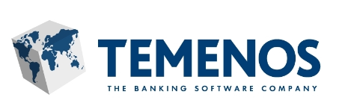
Case Study1 - Custom Product for a Banking and Financial Services Company
Our client provides software for banks and financial services like retail, corporate, universal, community banks and
microfinance with its headquarters in Geneva, Switzerland.
Scope
Challenges
Solution
Aspire developed an unique self-service platform that supports the banking software’s deployment in a multi-cloud environments (Azure, AWS) which brought more business values to customer
Supported multiple technology stack which were complex in nature – Websphere 8.5.5, Websphere 9.0, Jboss, Weblogic, Oracle 12 and installing them automatically along with customer preferred test frameworks (HP-UFT, Selenium based custom frameworks, etc.).
Workflow/pipeline configuration in which the user can tailor the bank software they want to test.
Automated artifacts promotion to Dev, Test, Stage and Prod
Centralized dashboard management
Our client releases their product upgrade every month and it consumes a lot of time for the customer to deploy it to their production environment due to the lengthy testing cycles. The custom development also took time to adapt to the changes in the upgrades
Regression testing had huge number of test cases to be executed from the banking sector in real time for each product and hence they faced the following challenges
Vast amount of local development packages
Distributed development and testing team
Inability to do perform regressions
Automation test suite compatibility matrix should be up to date to support different products and packages
Relying on IT operations to provide required infrastructure
Unmanageable operations costs
Higher Real-time test case execution time

Slide 3
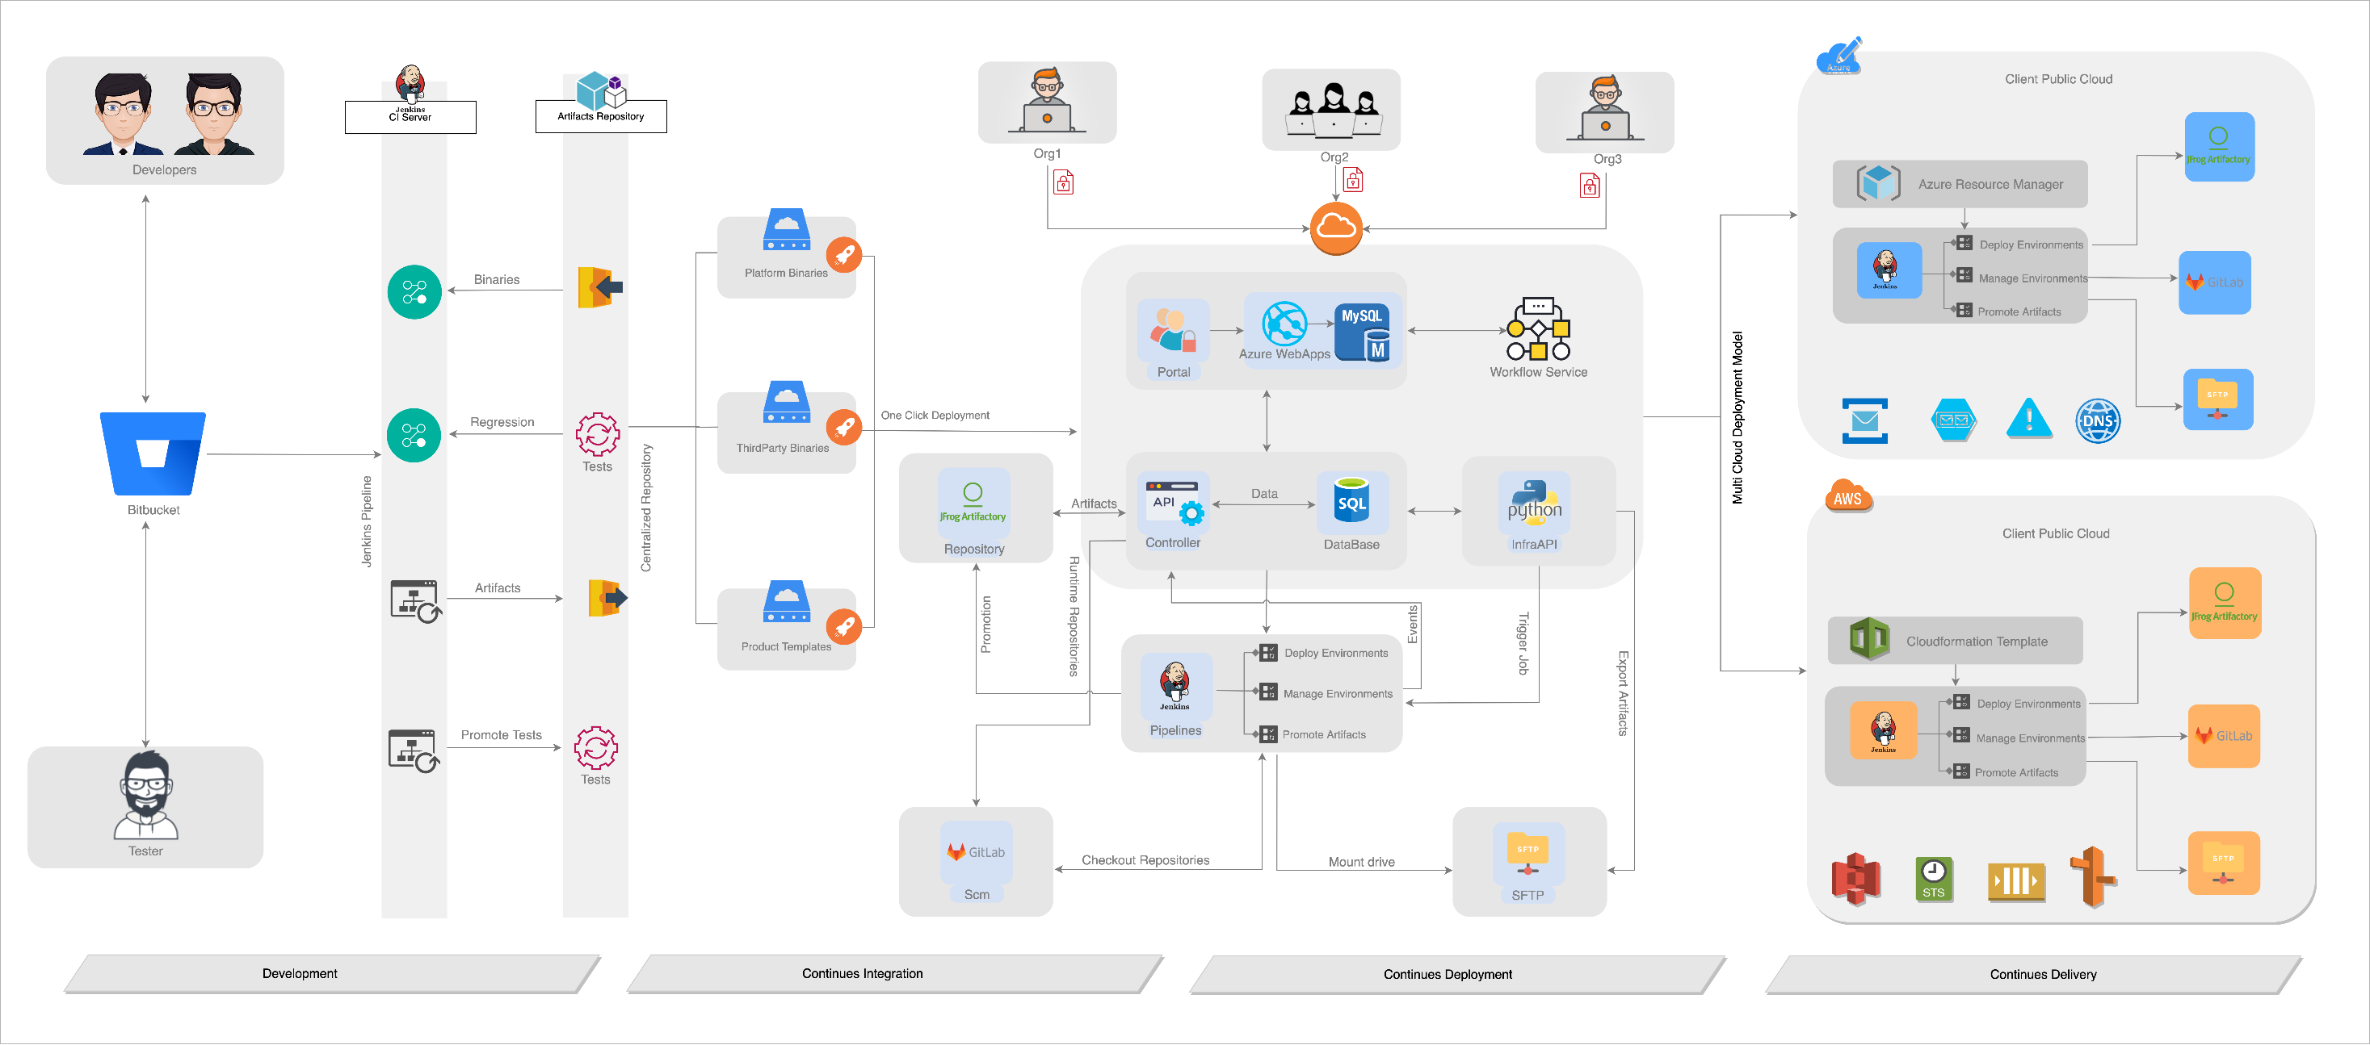
Solution Diagram

Slide 4
Case Study 2 - Migration to AWS on Containers - US courseware division to a private equity Firm
Aspire worked with a world’s leading education publishing and assessment service provider that recently sold-off its US courseware division to a private equity firm. This strategical move, required that some of their applications had to be moved to AWS cloud in a containerized . Aspire systems came up with a program called “Trio Migration” involving administrative migration, data center migration and Database migration.
Container based micro-services architecture
The applications that were migrated were refactored and rebuilt as Docker containers that were then pushed to ECR. The containers are part of a larger micro-services architecture that provides for resilience of the application.
Centralized Log Management
Application logs are streamed from containers to Cloudwatch using Fluentd. Once logs reach Cloudwatch, lambda functions are used to stream the logs from Cloudwatch to Elastic search. Here we use AWS native service (combination of Elastic search & Kibana)
Kubernetes managed deployments
All container deployments and clusters are managed by Kubernetes (Amazon EKS) where machines are monitored, auto-scaled and auto-healed.
Scope
Features

Slide 5

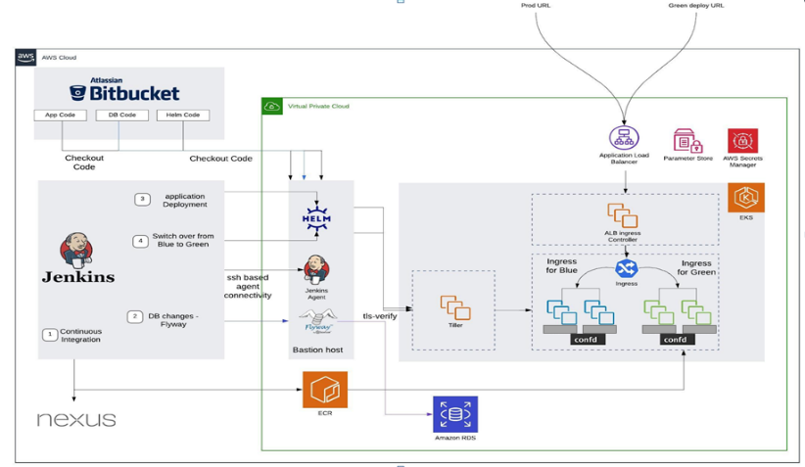
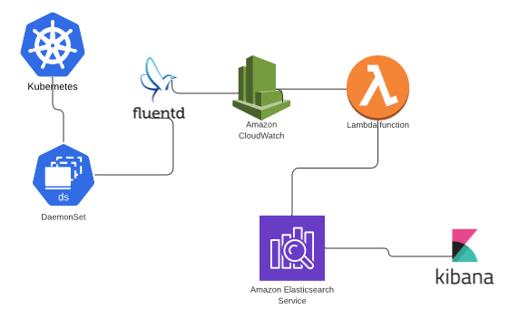
Solution Diagram
Deployment Architecture
Log Aggregation

Slide 6
DevOps - Why us?
Why do organizations approach us?
How do we help?
Experience deploying applications with over 500 self managed containers.
Experience with most of the popular tools and frameworks
Over 50 Seasoned Engineers who can help with automation of deployments and infrastructure management.
Experience in deploying and managing micro-services based application.
Have helped numerous products and services in increasing the speed of testing cycles, reducing bug count with automated regression testing and improved delivery speed
Have done tight integrations with project management tools such as Atlassian toolset.
Long Testing Cycles
Too Many Delivered Bugs
Too Many Releases Before Build
Difficulty Managing Release Notes And Stories
Difficulty Migrating To Cloud
Insufficient Cloud Strategy
To Improve Logging And Auditing
To Implement A Workflow For Releases
To Migrate To Cloud Services
To Migrate Into A Cloud Agnostic Deployment
To Migrate To A Microservices Architecture

Slide 7
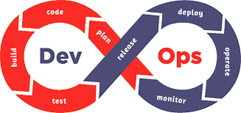
Philosophy & Approach
EA, security
Developers
Ops
Precommit checks
Static code analysis
Peer code review
Build
IaC
Unit test
Developers
Merge to trunk
QA
VCS
Business
Integrated build
Backlog
Design ideas
RM
Artifact repository
laC
Application and operational analytics
Customer
Release automation
Release decision
Manual QA
API-based test automation
Release automation
Service and network virtualization
Test data management
EA
TDM
EA
Deployed applications
Business
QA
Developers
Ops

Slide 8
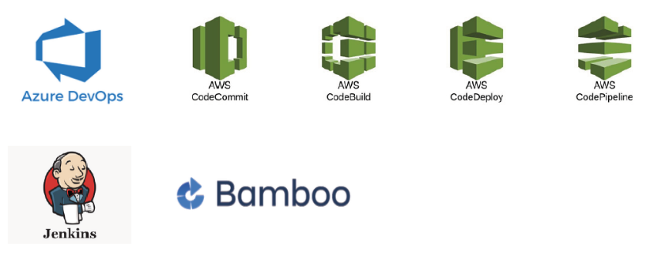
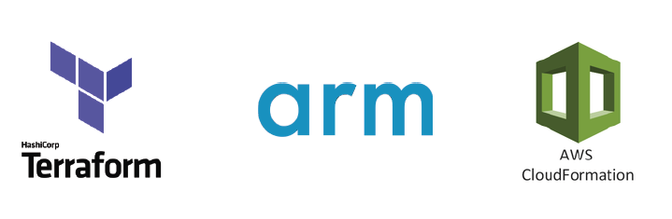
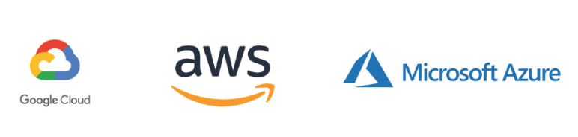
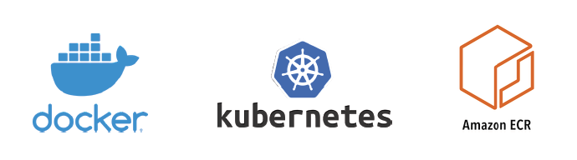
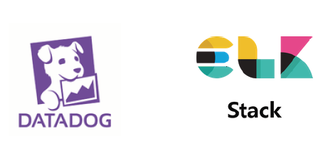
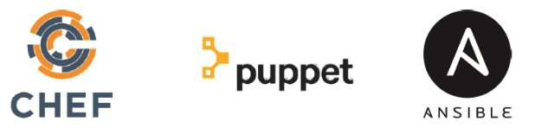
Tools and Skillsets
ORCHESTRATION & CI/CD TOOLS
MULTI-CLOUD DEPLOYMENT & IAC
CLOUD AND INFRA MANAGEMENT
CONTAINERIZATION
LOG AND SEARCH FRAMEWORKS
CONFIGURATION MANAGEMENT

Slide 9
Proposal Plan
Notes:
Press CTRL and grab the side border to resize the title box without decentering it.

Slide 10
Our Understanding
The purpose of this document is to describe the high-level plan for implementing continuous integration and continuous deployment in AWS cloud for Nexon Project. The Nexon Project running on the framework Java &.NET and below is the tech stack used.
Technology | Details
Cloud | AWS
Technology | Java and .Net
SCM | GIT
CI/CD | Jenkins
Test Coverage | Jest JS
Database | Oracle

Slide 11
Possible Recommendations
The purpose of this document is to describe the high-level plan for implementing continuous integration and continuous deployment in AWS cloud for Nexon Project. The Nexon Project running on the framework Java &.NET and below is the tech stack used.
Technology | Details
CI/CD | We will incorporate Jenkins or similar CI/CD tools for continuous integration and continuous deployment on Dev/CIT/SIT Environments in AWS cloud.

Slide 12
Possible Recommendation's
Aspire team will make necessary recommendation to Incorporate after the workshop
The branching starategy and Promotion strategy and Approval process to deploy in to CIT and SIT Environments after the workshop.
We will use the existing JestJS for test Ccde coverage.
We will incorporate Jenkins or similar CI/CD tools for continuous integration and continuous deployment on Dev/CIT/SIT Environments in AWS cloud.
Artifacts to store in AWS S3 bucket.
Containerized Application using Docker.
Implement IAC using Terraform/Cloudformation.
Implement Security controls for Code and Infrastructure.
Implement Monitoring strategy.

Slide 13
Scope of Services
Phase-1 ( DevOps Consulting )
Implementation of CI/CD Pipeline on AWS cloud on Dev/QA/Stage/Production.
Understand the existing Tech stack and deployment process.
Dependency Identification
Phase 2 ( DevOps Implementations)
During the workshop Aspire team will Analyze the SCB Project and understand the number of Applications to build the continuous Integration and Continuous deployment which are in scope.
Present the DevOps Technical Solution to the customer
Implement and Deploy the Application’s on cluster using Orchestration tool Kubernetes
Monitor Servers, Cluster, VM’s, Database using Prometheus and Grafana.

Slide 14
Consulting Approach
Assessment
Technical Solutioning
Sign off
GO Live Operations
Assessment on
Applications which are running on SCB Project
Tools & Deployment and Release Process
How the Artifacts stored in the repository.
How the docker Images are stored in repo.
Oracle database information
Monitoring the Applications.
Understand the pain points to deploy the SCB project applications
Provide the design and solution plan to Build the continuous Integration and Continuous pipeline to automate the deployment process.
Design Build the branching strategy.
Design CICD Pipeline Implementation Strategy
Present DevOps Solution to SCB
Taking Sign- off
2 weeks
1 Day
Deliverables
Gap Report
Tools and CICD Process Recommendation
Design and Solution Plan
Final Solution document
Sign Off

Slide 15
Assumptions & Out of Scope
Assumptions
Out of Scope
Aspire assumes all the necessary access to Dev, Test and Prod Environments
Aspire assumes access to Docker repository for storing the docker images.
Provide timely approval/sign-off for each phases.
Only the technical solutioning plan will be provided in the phase 1
The CI/CD implementation will be considered in the next phase 2.
All the licensing requirements for the project will be handled by SCB

Slide 16
Thank you :)

