Slide 1



DevOps Support Case Studies
Notes:
Click on the icon to add background picture.
Right click on the photo and use CROP option to adjust its position.
Please only use photos with a clean, bright background so the title, date and Aspire logo stands out.
Samples with photos are in the last section of this template.

Slide 2
Case Study 1 - Migration to AWS on Containers - US courseware division to a private equity Firm
Aspire worked with a world’s leading education publishing and assessment service provider that recently sold-off its US courseware division to a private equity firm. This strategical move, required that some of their applications had to be moved to AWS cloud in a containerized . Aspire systems came up with a program called “Trio Migration” involving administrative migration, data center migration and Database migration.
Container based micro-services architecture
The applications that were migrated were refactored and rebuilt as Docker containers that were then pushed to ECR. The containers are part of a larger micro-services architecture that provides for resilience of the application.
Centralized Log Management
Application logs are streamed from containers to Cloudwatch using Fluentd. Once logs reach Cloudwatch, lambda functions are used to stream the logs from Cloudwatch to Elastic search. Here we use AWS native service (combination of Elastic search & Kibana)
Kubernetes managed deployments
All container deployments and clusters are managed by Kubernetes (Amazon EKS) where machines are monitored, auto-scaled and auto-healed.
Scope
Features

Slide 3

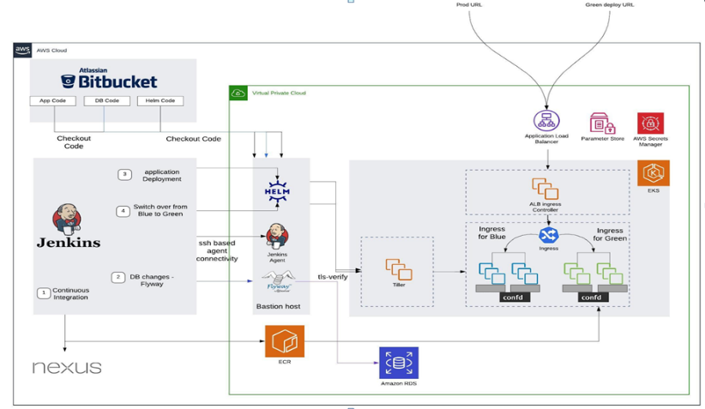
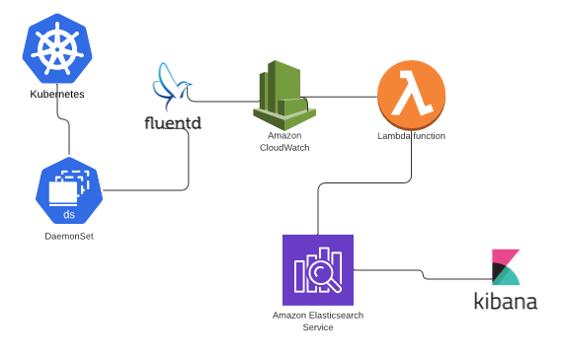
Case Study 1 - Migration to AWS on Containers - US courseware Architecture
Deployment Architecture
Log Aggregation

Slide 4

Case Study 1 - Migration to AWS on Containers - US courseware Technology USED
Container & Orchestration: Docker, Kubernetes ,Helm
Platform: Amazon AWS, Microsoft Azure
Continuous Integration: Jenkins
SCM: Bitbucket
Configuration Management Tools: Confd
Artifacts Repository: Nexus
Operating System: Windows/Linux Servers
Languages: Python, Net.java
Database Migration: Amazon RDS, Flyway
Monitoring Tools: CloudWatch, Kibana, Amazon Elastic Search, Fluentd
Technology

Slide 5
Case Study 1 - Migration to AWS on Containers - US courseware Benefits
There are around forty Jobs Automated by Implementing CICD pipeline which reduces the releases time.
Full fledged micro-services architecture
6
1
Cost reduction of 50-60% for running/ managing/ maintaining (support)
Benefits
Containers that enable auto scaling and self healing
5
2
Centralized Logging
4
3
Easy upgrades

Slide 6

Case Study 2 - AWS Cloud Migration
Our client is a leading Fintech solution provider specializing in loan and mortgage. They have expertise in automating life cycle of loans which includes origination, servicing and recovery. The solutions are delivered as (certified) SaaS in the market.
Scope
Challenges
Solution
The client was running applications across different environments (QA/Dev/stage/Prod) on premise which required a lot of physical servers taking up space, increasing maintenance costs and requiring a lot of people to run and solve the complexities.
The running and maintenance cost for these several different servers were high.
The client had to follow a lengthy release cycle process for fixes to be deployed on production.
More dependency on hardware (physical servers) led to more manual efforts at maintenance, configuring and making updates.
Migrated the application to AWS Cloud
Implementing Docker containerization on AWS solved the challenge of server dependency with added benefits of cloud.
Multiple isolated virtual operating environments created with containerization helped in updating, making changes to the solutions and lighter shipping in each environment, since every change will be made to that specific container and not to the whole server.
We put the idea into action by developing a solution for an application over AWS cloud with Universal image structure which the client could use across different environments.

Slide 7
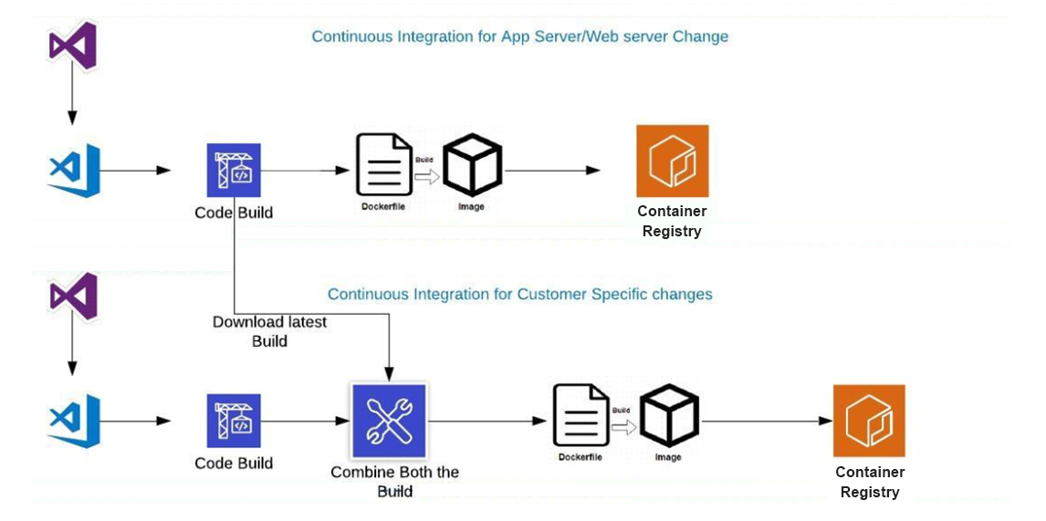
Case Study 2 - AWS Cloud Migration - Architecture

Slide 8
Case Study 2 - AWS Cloud Migration – Technology USED
Container : Docker
Platform: AWS (ECS/Windows 2016R2)
Operating System: Windows
Languages: Python, .Net
Monitoring Tools: NewRelic/Splunk/ Octopus
Technology

Slide 9

Case Study 2 - AWS Cloud Migration - Benefits
Benefits
Applications are now easy to configure, update and enhance for future need.
Future customizations like migration to MicroServices were made possible.
Enhanced manageability from development to test to production stage
Cost reduction 50 -60% for running/ managing/ maintaining (support).
The Jobs are Automated by Implementing CICD Pipeline
Docker being an open source application is a cost effective solution.
The applications are more secure and scalable on the cloud. Application of Docker containerization on cloud helped the client in providing better support for their end customers.

Slide 10
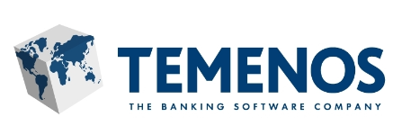
Case Study3 - Custom Product for a Banking and Financial Services Company
Our client provides software for banks and financial services like retail, corporate, universal, community banks and
microfinance with its headquarters in Geneva, Switzerland.
Scope
Challenges
Solution
Aspire developed an unique self-service platform that supports the banking software’s deployment in a multi-cloud environments (Azure, AWS) which brought more business values to customer
Supported multiple technology stack which were complex in nature – Websphere 8.5.5, Websphere 9.0, Jboss, Weblogic, Oracle 12 and installing them automatically along with customer preferred test frameworks (HP-UFT, Selenium based custom frameworks, etc.).
Workflow/pipeline configuration in which the user can tailor the bank software they want to test.
Automated artifacts promotion to Dev, Test, Stage and Prod
Centralized dashboard management
Our client releases their product upgrade every month and it consumes a lot of time for the customer to deploy it to their production environment due to the lengthy testing cycles. The custom development also took time to adapt to the changes in the upgrades
Regression testing had huge number of test cases to be executed from the banking sector in real time for each product and hence they faced the following challenges
Vast amount of local development packages
Distributed development and testing team
Inability to do perform regressions
Automation test suite compatibility matrix should be up to date to support different products and packages
Relying on IT operations to provide required infrastructure
Unmanageable operations costs
Higher Real-time test case execution time

Slide 11
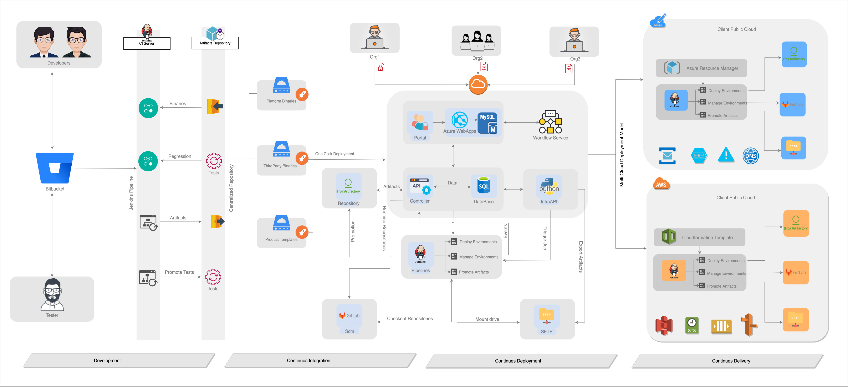
Case Study 3 - Custom Product for a Banking and Financial Services Company Architecture

Slide 12
Case Study 3 - Custom Product for a Banking and Financial Services Company Technology USED
Container & Orchestration: Docker, Kubernetes
Cloud Platform: Azure, AWS
Configuration Management Tools: Ansible
Operating System: Windows/Linux Servers
Languages/Scripting: Java, Python, Angular, Jbpm,Groovy,Powershell,bash
Testing Frameworks and Tools: Selenium, HP-UFT
Application/Middleware: Websphere, Jboss,Nginx
Database: Azure SQL, MySQL
Monitoring Tools: Cloud Watch, Azure Monitor
Technology

Slide 13
Case Study 3 - Custom Product for a Banking and Financial Services Company Benefits
Benefits
Due to the conventional development process, the go-to-market time increased to a huge extent, which was resolved by our solution as the development process was modernized and the respective platforms were set up. This has largely increased the efficiency of the process.
Our solution automated the infra provisioning and made the tests integrated with strong promotion strategy of product.
Testing time drastically reduced by 91% and
56% of defects are identified early
Got a multi-million (dollar) contract with a leading bank in Europe
Reduced time taken from weeks to few hours
Saved 40% cost

Slide 14
Case Study4 – SAAS based Custom Product for a Electric Company- YoKOGawa
Our client provides software product & IOT Services for Electric Company
headquarters in Japan.
Scope
Challenges
Solution
Our client releases their product consumes a lot of time for the customer to deploy it to various Cloud Environments
Enabling Infrastructure Provisioning & governance and Centralized Application deployment and Monitoring.
Implementing of Micro Services & deploy in Multi Cloud in different AZ’s In minimal time.
Regression testing had huge number of test cases to be executed from the real time for each product and hence they faced the challenges
Long testing hours
Build and deployment taking longer time
End-to-end regression had manual dependencies
Time, effort and cost were high due to these factors.
Environmental configuration changes leading to human errors.
Migration of scripts is taking too long.
Automated continuous Integration,continuous deployment & continuous testing where product suites were tested with strong promotion strategy.
Spinnaker is used for Multi Cloud Continuous Deployments.
Rancher is used for Fully managed Kubernetes Clusters deployment on On-Premises.
Supports for Multi Cloud and Hybrid Deployments .
Maintained single source of source code in all the Environments
Blue/Green or Canary is Implemented deployment s for rolling updates.

Slide 15
Case Study4 -– SAAS based Custom Product Electric Company- YoKOGawa Technology USED
Container & Orchestration: Docker, Kubernetes, AKS, Cisco Vsphere, EKS, Helm,Istio,Opa
Continuous Integration: Jenkins
Continuous Deployment: Spinnaker
SCM: Github
Platform: Azure, AWS, On-Premises
Configuration Management Tools: Ansible, Terraform,Confd, HashiCorp Vault
Operating System: Windows/Linux Servers
Languages/Scripting: .Net, Angular
RDBMS/NO SQL: PostgreSQL, Cassandra, InfluxDB, MangoDB,
Storage: Azure Cloud Storage, NFS, MinIO
Monitoring Tools: Prometheus, Grafana, ElasticSearch, KIALA, Rancher
Technology

Slide 16
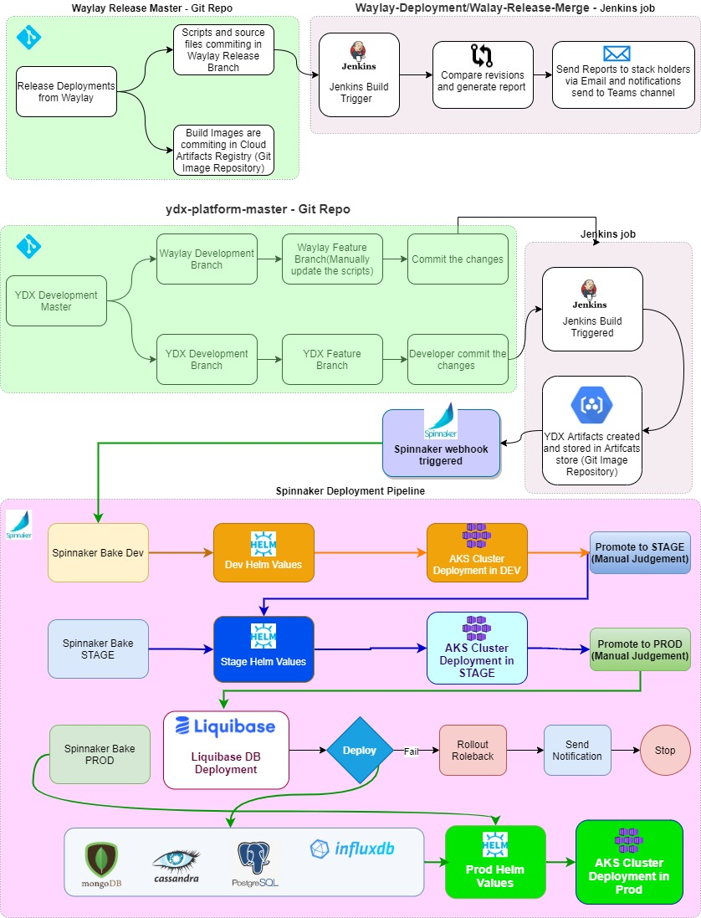
Case Study 4 - - SAAS based Custom Product Electric Company -YoKOGawa Architecture

Slide 17
Case Study4 - - SAAS based Custom Product Electric Company -YoKOGawa Benefits
Benefits
Reduced Deployment and Release time
Centralized Infrastructure Goverance
Saved 45% cost

Slide 18
Thank you :)

