Slide 1
Case Studies

Slide 2




AWS Cloud Migration
Our client is a leading Fintech solution provider specializing in loan and mortgage. They have expertise in automating life cycle of loans which includes origination, servicing and recovery. The solutions are delivered as (certified) SaaS in the market.
TECHNOLOGY :Docker Containerization | TOOLS :Docker/NewRelic/Splunk/ Octopus | PLATFORM: AWS (ECS/Windows 2016R2)|LANGUAGES: Python,.Net
Scope
Solution
Benefits
The client was running applications across different environments (QA/Dev/stage/Prod) on premise which required a lot of physical servers taking up space, increasing maintenance costs and requiring a lot of people to run and solve the complexities.
Migrated the application to AWS Cloud
Implementing Docker containerization on AWS solved the challenge of server dependency with added benefits of cloud.
Multiple isolated virtual operating environments created with containerization helped in updating, making changes to the solutions and lighter shipping in each environment, since every change will be made to that specific container and not to the whole server.
We put the idea into action by developing a solution for an application over AWS cloud with Universal image structure which the client could use across different environments.
Applications are now easy to configure, update and enhance for future need.
Future customizations like migration to MicroServices were made possible.
Enhanced manageability from development to test to production stage
Cost reduction of 50-60% for running/ managing/ maintaining (support).
Docker being an open source application is a cost effective solution.
The applications are more secure and scalable on the cloud. Application of Docker containerization on cloud helped the client in providing better support for their end customers.
Challenges
The running and maintenance cost for these several different servers were high.
The client had to follow a lengthy release cycle process for fixes to be deployed on production.
More dependency on hardware (physical servers) led to more manual efforts at maintenance, configuring and making updates.

Slide 3
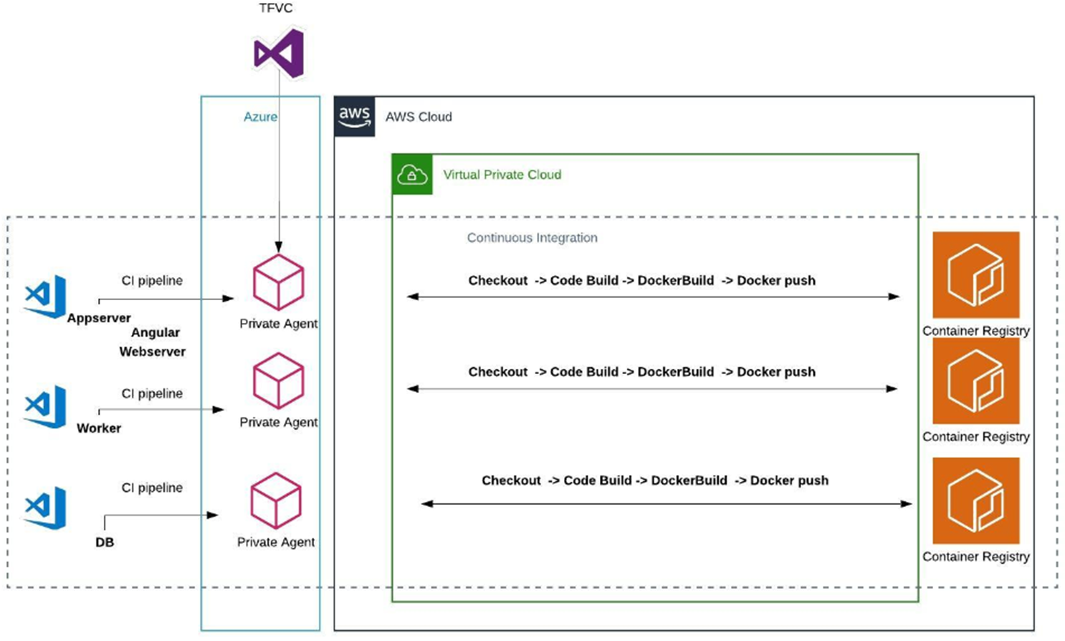
Solution Diagram

Slide 4
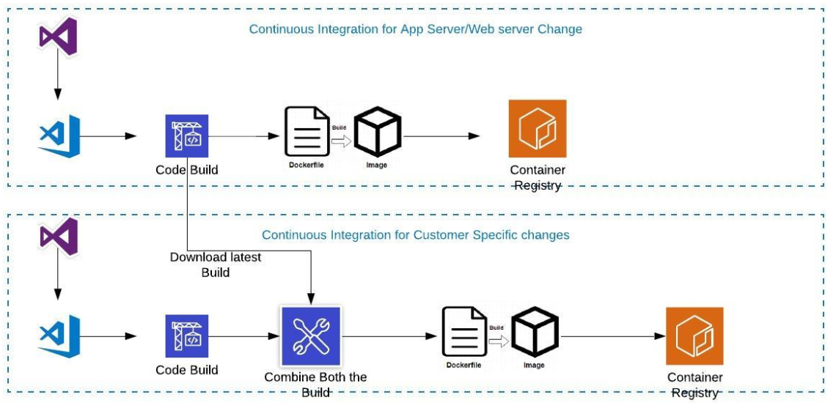
Solution Diagram

Slide 5

Guidewire Support
Headquartered in California, United States, the client is a software publisher who provides core back-end software for P&C insurance carriers across the globe.
Tools : Jenkins, Schedulix, PagerDuty, Sumo, SQL Developer, Putty Platform: AWS, RH Linux, Oracle, SQL Server, MySQL Aurora Languages: sql, pl/sql
Scope
Solution
Benefits
The customer, in order to effectively adapt to industry changes ,had deployed a cloud-ops solution with a dedicated set of internal resources. The team was in charge of manual provisioning of cloud-based resources to the developers and testers anytime resulting in increased demand and dependency on the team.
Aspire Systems’ DevOps team designed Dynamic Environment Provisioning (DEP), a self-servicing portal that can automate deployment, configuration and management applications on AWS environments.
DEP portal allows individual project members to design and deploy the setup to work within AWS in a matter of few clicks.
With the portal, Aspire’s team has automated the complex multi-applications deployment function thereby facilitating smoother transition when users want to launch their setup.
To effectively manage resources, DEP allows users to define the time period after which the instances will be shutdown automatically. It also provides an overview of instances deployed and its usage to the decision-makers so they can have greater control of the resources.
By enabling a master corporate login, the portal has ensured that the users need not login to the actual AWS console every single time.
Aspire’s idea to deploy a separate portal to automate the entire cloud provisioning routine has reduced dependency on the cloud-ops team thereby improving overall project coordination.
As the portal automates most of the manual procedures, the development and QA teams are now able to bring down the instances creation and deployment time by over 80%.
The automation solution, along with features like auto-shutdown timers, has decreased the cloud-usage costs incurred by the company by 65%.
Challenges
As a single team was involved in everything related to cloud-ops, it proved to be time and resource-consuming. This had a direct, negative impact on business deadlines for major and minor release cycles.
With manual procedures for majority of the provisioning jobs, the company incurred greater running costs for AWS cloud instances.
Co-ordination between different teams for every cloud provisioning request became a cumbersome activity

Slide 6
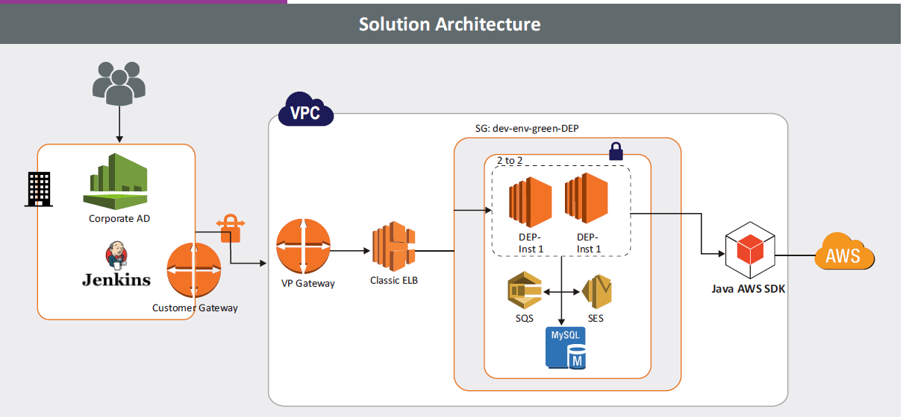
Solution Diagram

Slide 7
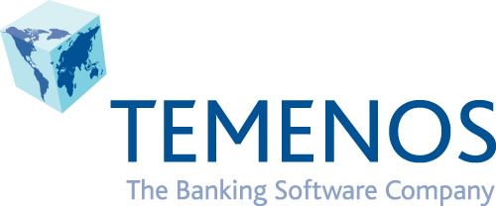
Custom Product for a BFS company
Our client provides software for banks and financial services like retail, corporate, universal, community banks and microfinance with its headquarters in Geneva, Switzerland.
Angular, node, Python, Websphere, Jboss, Weblogic, Ansible, ARM, Terraform, Azure, AWS, HP-UFT, Selenium based custom framework
Scope
Solution
Benefits
TEAM LOCATION
Our client release their upgraded product every month and it consumed a lot of time for the customer to deploy it to their production environment due to the lengthy testing cycles and the custom development took time to adapt to the changes in the upgrades.
Regression testing had huge number of test cases to be executed from the banking sector in real time for each product and hence they faced the following challenges
Long testing hours
Higher Real-time test case execution rate
End-to-end regression had manual dependencies
Time, effort and cost were high due to these factors.
Aspire provided following key solutions:
Made continuous delivery or continuous testing where product suites were tested with strong promotion strategy
Supported multiple technology stack which were complex in nature – Websphere 8.5.5, websphere 9.0, Jboss, Weblogic, Oracle 12 and installing automatically along with customer preferred test frameworks (HP-UFT, Selenium based custom frameworks etc.,)
Worked on templated approach where Jenkins pipelines are written as lengthy Groovy code and the same pipelines works for the entire scenario by parsing technology stack as dynamic user inputs.
Due to the conventional development process, the go-to-market time increased to a huge extent, which was resolved by our solution as the development process was modernized and the respective platforms were set up. This has largely increased the efficiency of the process.
Our solution automated the infra provisioning and made the tests integrated with strong promotion strategy of product code, further it
Reduced the overall testing/upgrade effort
Reduced time taken from weeks to few hours
Saved cost
Got a 3 billion(dollar) contract with a leading banking customer.
Challenges

Slide 8
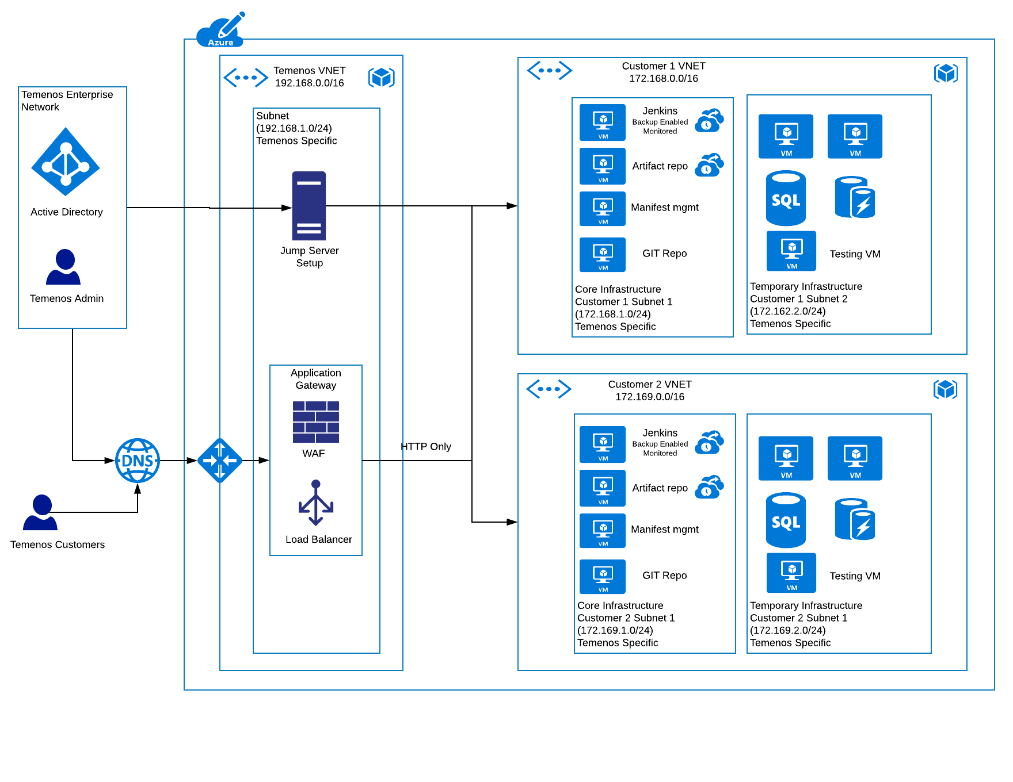
Solution Diagram

Slide 9
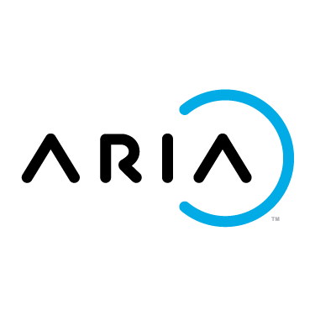
AWS Cloud Migration For One Of The Leading Billing Software Firm
About the Customer
Challenges
Solution
Benefits
This enterprise is one of the leading provides a billing and monetization platform for enterprise companies that wish to sell products via subscription and usage-based and other recurring revenue business models
Initially, IT infrastructure setup was associated with On-Premises and faced following real time challenges
No high availability for applications & databases
Scalability during the peak loads
Security issues
Cost and Resource Efficiency
For ongoing development projects they need a CI/CD model where infrastructure get ready with the required build artifacts.
This was a huge time consuming task and any manual error will lead to improper results from their testing.
Moved the IT Infrastructure setup from On-Premises to Amazon web services
Migrated the servers using AWS SMS
Ensured auto scalability of application during the peak load
Implemented RDS for high availability of production database
Implemented PCI-DSS compliance
Implemented an IAC ( Infrastructure as a code ) model in AWS
Through cloud formations the required infrastructure will get ready with the required stack like APP server. Databases.
For new development activity the integration tool Jenkins will trigger the template and creates a new testing environment in the cloud where relevant code will get deployed and ready for immediate testing
Utilized tools such as;
AWS Migration Hub, SMS, DMS, CloudEndure
15+ AWS services were used
High Availability of applications & databases
Scalability during the peak load
Leveraged the cloud resources
No manual operation to spin up the environment
Reduced testing time

Slide 10
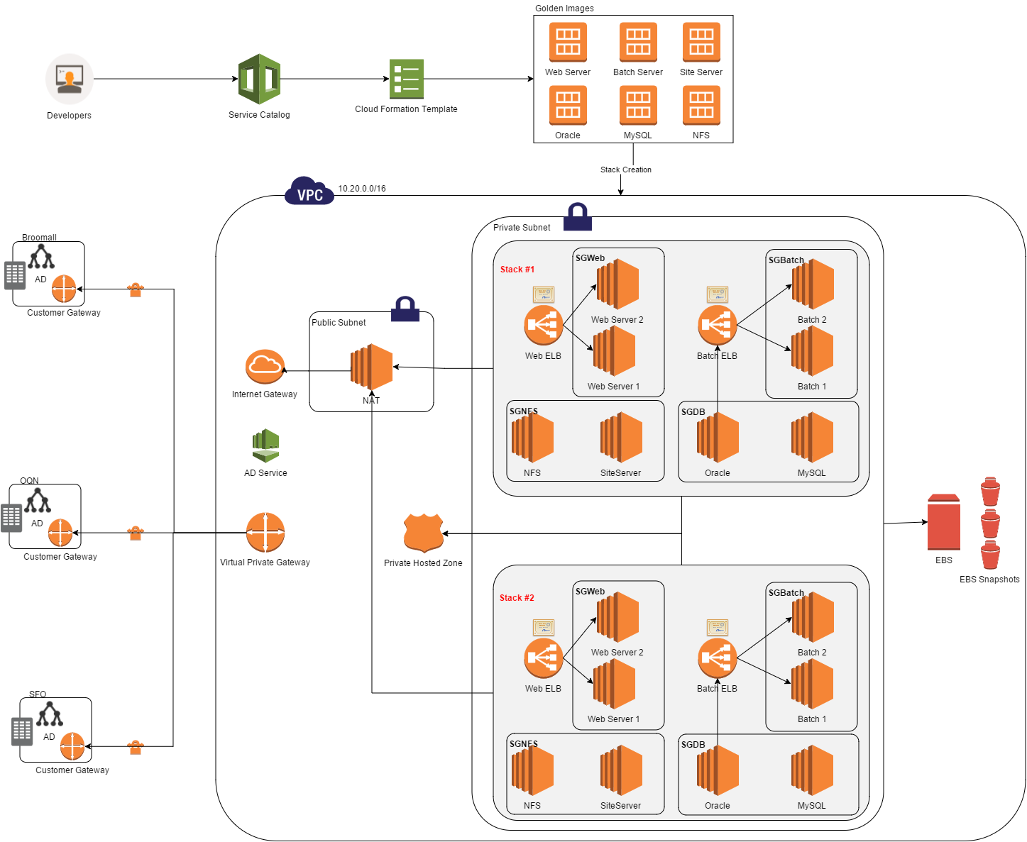
Solution Diagram

Slide 11


