Slide 1
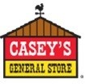
Self Service Portal Proposal

Slide 2
Casey’s Self Service Portal Roadmap

Slide 3



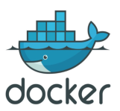


Aspire Systems DevSecOps Practice Overview
Plus Years mature dedicated Devops practices with cross industry experience with large global companies
Full Stack Service Offering
20+ Fortune 500 Companies
Practice Size and Scale
Tools Expertise & Alliances
DevOps training and coaching
Process workflow and metrics design & implementation
Devops Automation-E2E pipeline solution across application stack.
Devops on Cloud
Toll Migration and Support
SW release management
List the companies with Icon
50 + Agile Devops Engineers
20+ Devops tools architects
100 + Devops tools and automation engineers.

Slide 4


Proposed Solution Architecture
Release Automation to TEST/UAT/PROD
Ticket Management
Agile project Management and Collaboration
Continuous Integration
Continuous test
Code
Code quality
Unit testing
Build & package
Integration test
Functional & system test
User acceptance
Env Test in Prod

Slide 5




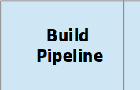




Self Service Portal Proposed Solution Azure Devops Architecture
MuleSoft CICD Deployment
GIT Repository
Dev release
QA/Prod release
Maven build and generate artifacts
Push
Push
Pull
Push
Pull
Pull
Dev/Master Branch
PR Approves Code commits to DEV branch
Commit
Raise pull request
Feature Branch

Slide 6
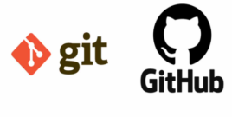

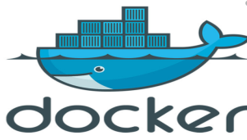

Self Service Portal Proposed Solution Azure Architecture
Jenkins CICD Deployment
Deploy Apps to Dev/QA/Prod
Build and Push Docker Image
Build and Test
Code Commit

Slide 7
Self Service Portal Proposed Solution Azure Architecture
Jenkins CICD Deployment
Deploy Apps to Dev/QA/Prod
Build and Push Docker Image
Build and Test
Code Commit

Slide 8
CICD Pipeline and Technical Solution
Solution Element
Enable the tracebility between JIRA user story and Jenkins build deployment plans.
Enable gated releases with Code Quality,Security Checks for tracebility and quality code promotion.
Jfrog/Nexus/Dockerhub/ECR Artifact repository for Artifact version management.
SonarQube for checking code quality and code coverage.
Container orchestration tools like Docker Swarm /Kubernetes is leveraged to manage lifecycles of containers.
Automation of test scripts using selenium.
Splunk/Cloudwatch used to monitor the Applications running in Production.

Slide 9
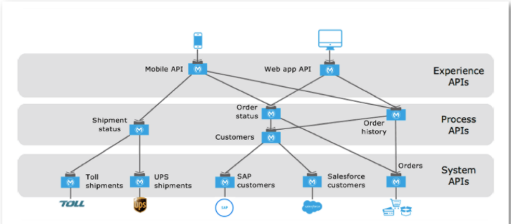
Integration of data from different systems using a layer of APIs

