Slide 1
Bankruptcy Prevention Project
Model Validation & Deployment
Presented By: ExcelR Group-2
Garnimitta Venkateswarlu
Baruri Manoj
Tanguturi Sai Pravallika
Bhargavi Rageeru
Varun Ramavtar Pareek
Shital Manik Chavan
Byrebanda Gireesh
Under The Guidance Of
Karthik Muskula

Slide 2
Business Objective:
This project aims to classify whether a business is likely to go bankrupt or not based on various risk factors. The target variable is binary, indicating either bankruptcy or non-bankruptcy. The goal is to model the probability of a business going bankrupt using the given features.
Data Description:
The dataset contains 7 features for around 250 companies, each representing different business risks and flexibility.
Below is a description of the variables in the dataset:
Feature | Values
Industrial Risk | 0 = Low, 0.5 = Medium, 1 = High
Management Risk | 0 = Low, 0.5 = Medium, 1 = High
Financial Flexibility | 0 = Low, 0.5 = Medium, 1 = High
Credibility | 0 = Low, 0.5 = Medium, 1 = High
Competitiveness | 0 = Low, 0.5 = Medium, 1 = High
Operating Risk | 0 = Low, 0.5 = Medium, 1 = High
Class (Target Variable) | Bankruptcy, Non-Bankruptcy

Slide 3
Data Preprocessing
1. Data Cleaning
Handling Missing values : Checked for the missing values in the data but there are no null values or missing values in the data set.
Handling Replicated records : There are 147 replicated (duplicated ) rows , those are removed from the dataset to avoid overfitting of the model.
2. Handling Outliers
Here there are only categorical features in the dataset so there are no outliers in the dataset.
3. Encoding Categorical Variables
All the features are categorical and independent features are already in the format of label encoded data, hence the dependent (target) feature is Label Encoded.
4. Feature Scaling
Scale of each features is same ( 0 to 1 ) Hence the scaling is not performed, if necessary the normalization is preferred.

Slide 4
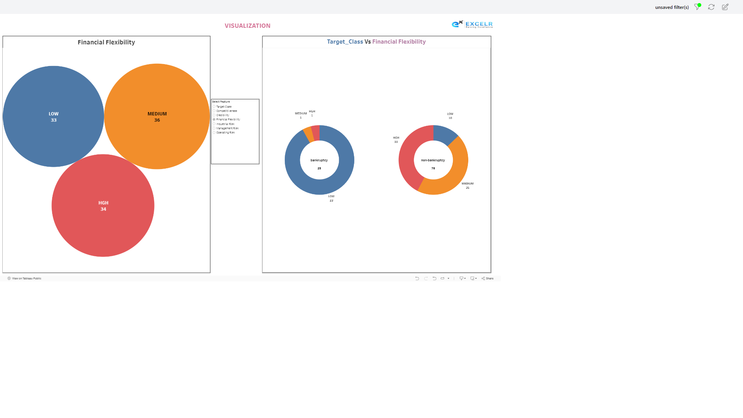

Slide 5
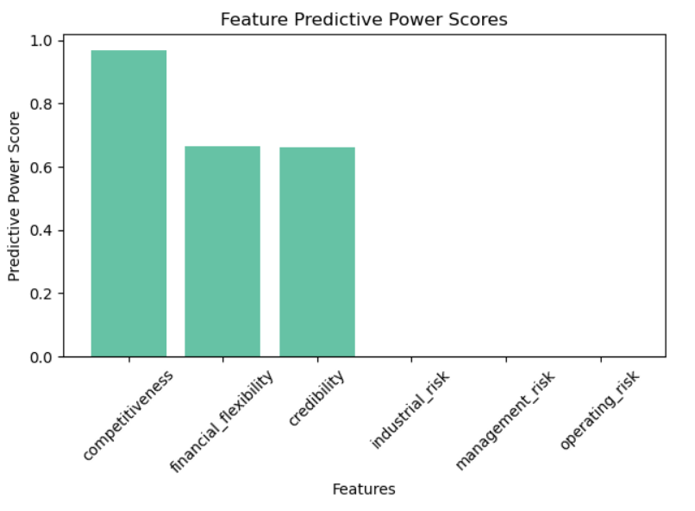
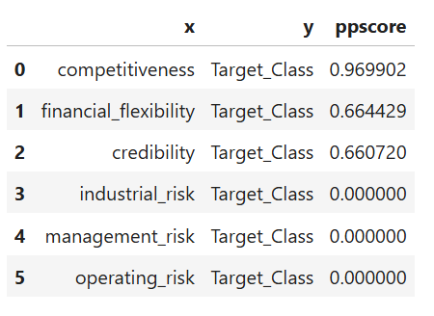
Feature Selection
We applied feature selection to remove redundant and less important features, aiming to improve model accuracy and reduce complexity
Methods Used
PPS Matrix
Hence all the features are categorial in nature so we have performed correlation between Target feature and Independent features using PPS

Slide 6
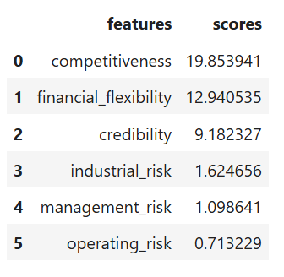
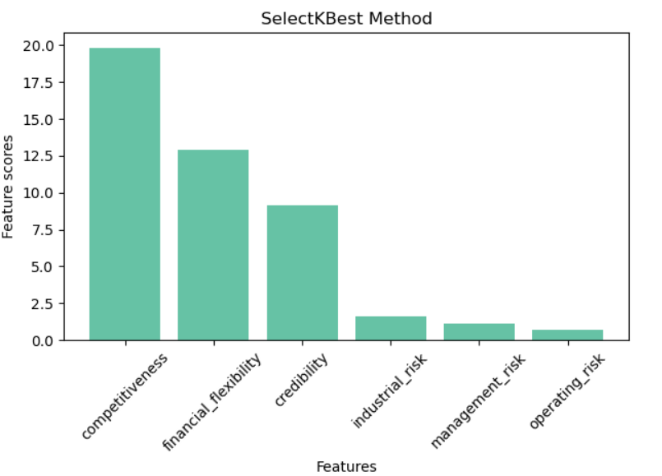
Feature Selection Contd..
2. SelectKBest Method
SelectKBest selects the top K most relevant features based on statistical tests like Chi-Square or ANOVA. It helps improve model performance by focusing on the best features and reducing noise.

Slide 7
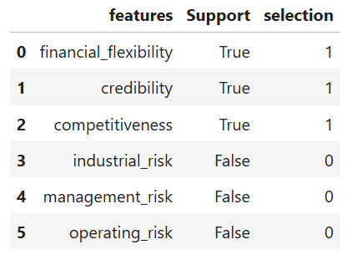
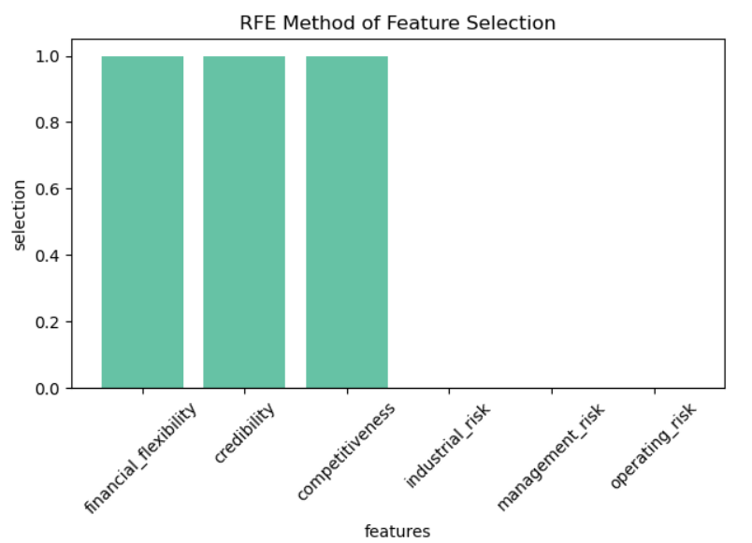
Feature Selection Contd..
3. Recursive Feature Elimination (RFE)
Recursive Feature Elimination (RFE) is a feature selection method that iteratively removes the least important features based on a model's performance. It retains the most significant features to improve model accuracy and reduce complexity.

Slide 8
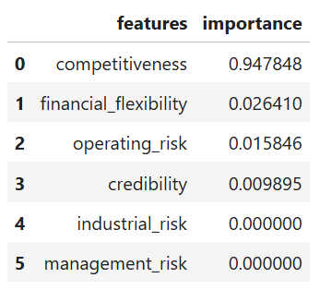
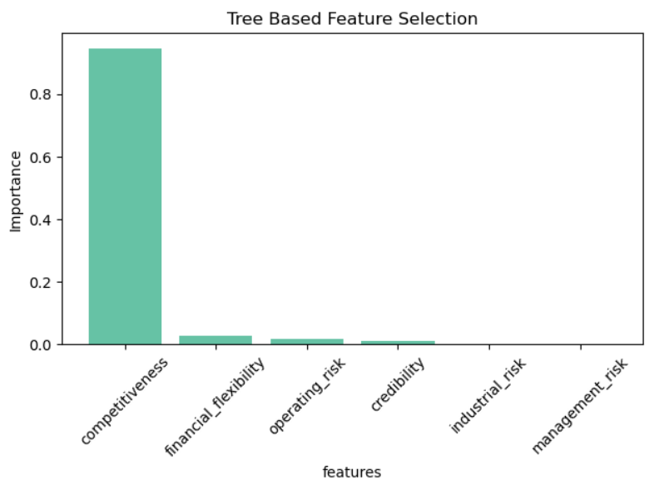
Feature Selection Contd..
4. Tree-Based Feature Selection
Tree-Based Feature Selection uses algorithms like decision tree, random forest etc. to evaluate feature importance based on how well they contribute to model predictions. Features are ranked by their impact on reducing impurity or improving accuracy.

Slide 9
Handling Imbalance Data
After dropping the duplicated rows the dataset has only 103 records , among them 78 records are related to non_bankruptcy and only 25 records are related to bankruptcy so we have to handle this imbalance data to avoid bias in prediction.
Down Sampling
Balancing the dataset by decreasing the class which has highest number of records to number of records in lowest class.
but dataset size is small if we perform down sampling the data set reduced to 50 points thus the model building becomes complicated thus avoid down sampling and go with upsampling.
Up Sampling
Up sampling increases the number of data points in the minority class to match the majority class.
we have used the SMOTE method which generates synthetic data by analyzing the existing data points.
After applying SMOTE, the dataset was balanced, resulting in a total of 156 records—78 for the majority class and 78 for the minority class.

Slide 10
IMPROVING IMBALANCED DATA HANDLING: FROM SMOTE TO KNN
Initial Approach: SMOTE
Overview: Generates synthetic samples for minority class.
Challenges: The data set was of classification data but it generated the data in terms of numerical data.
Transition to KNN
Reason for Change: KNN offers a more adaptable method using actual data points.
Implementation: Developed custom KNN-based code for synthetic sample generation.
DATA PREPARATION: SPLITTING INTO FEATURES AND LABELS
Step 1: Define Features (X) and Labels (Y)
X: Input variables (features)
Y: Target variable (labels)
Step 2: Split Data into Training and Testing Sets
Training Set: Used to train the model (e.g., 80% of the data).
Testing Set: Used to evaluate model performance (e.g., 20% of the data)

Slide 11
MODEL BUILDING
We have utilized various models to build our framework and employed a stacked model approach to integrate all of them effectively. This allows us to leverage the strengths of each individual model, enhancing overall performance and accuracy.
THE MODELS USED ARE:
LOGISTIC REGRESSION:
Simple and interpretable model for binary classification. Logistic regression is a statistical method for binary classification that predicts the probability of an outcome using the logistic (sigmoid) function. It provides interpretable coefficients as odds ratios and assumes a linear relationship between the log-odds of the outcome and predictor variables.
DECISION TREES:
A decision tree is a flowchart-like model used for classification and regression tasks. It splits data into branches based on feature values, leading to decision nodes and leaf nodes that represent outcomes. Decision trees are easy to interpret, handle both numerical and categorical data, and can capture complex interactions, but they may overfit if not properly pruned.

Slide 12
MODEL BUILDING contd..
ENSEMBLED TECHNIQUES:
Ensemble techniques improve predictive performance by combining multiple models. Methods like bagging (e.g., Random Forest) and boosting (e.g., AdaBoost) reduce errors and overfitting, leveraging the strengths of individual algorithms for better accuracy.
RANDOM FOREST:
Random Forest is an ensemble learning method that constructs multiple decision trees during training and merges their predictions for improved accuracy and robustness. It reduces overfitting by averaging the results of diverse trees, each built on random subsets of data and features. This method is effective for both classification and regression tasks, handling large datasets and maintaining high performance even with noisy data.
1.ADA BOOST :
AdaBoost (Adaptive Boosting) is an ensemble method that combines weak classifiers to form a strong classifier. It focuses on misclassified instances by adjusting their weights, improving accuracy through iterative training. This approach enhances model performance while reducing bias and is effective for various classification tasks.
2.GRADIENT BOOSTING :
Gradient Boosting is an ensemble technique that builds models sequentially, correcting errors from previous models. It optimizes a loss function using gradient descent, allowing flexibility with different data types. Effective for both classification and regression, it often achieves high performance. However, it requires careful tuning to prevent overfitting.

Slide 13
MODEL BUILDING Contd..
3.XGBM:
XGBoost (Extreme Gradient Boosting) is an optimized gradient boosting framework known for its speed and performance. It includes regularization to reduce overfitting and supports parallel processing for efficiency. Widely used in competitions and applications, XGBoost is effective for both classification and regression, with customizable hyperparameters.
4.LGBM:
LightGBM (Light Gradient Boosting Machine) is an efficient gradient boosting framework optimized for speed and memory usage. It effectively handles large datasets and supports categorical features directly. Known for high performance in classification and regression, it often requires minimal tuning. Its design enables faster training and lower resource consumption, making it popular in competitions.
NAIVE BAYES :
Naive Bayes is a probabilistic classifier based on Bayes' theorem, assuming independence among features. It calculates the probability of each class given the input features and selects the class with the highest probability. This model is particularly effective for text classification and spam detection due to its simplicity and efficiency.
KNN:
K-Nearest Neighbors (KNN) is a non-parametric classification algorithm that assigns a class based on the majority class of its k nearest neighbors. While easy to implement, it can be computationally intensive for large datasets.

Slide 14
MODEL BUILDING Contd..
SVM:
Support Vector Machine (SVM) is a supervised learning algorithm used for classification and regression tasks. It works by finding the optimal hyperplane that separates data points of different classes with the maximum margin. SVM can efficiently handle high-dimensional data and is effective for both linear and non-linear problems using kernel functions. It is particularly useful in applications like image recognition and bioinformatics.
NEURAL NETWORKS(ANN):
Artificial Neural Networks (ANNs) are computational models inspired by the human brain, consisting of interconnected layers of nodes (neurons) that process information. They learn patterns in data through training by adjusting weights based on input-output relationships. ANNs are versatile and can be used for tasks such as classification, regression, and image recognition. Their ability to capture complex relationships makes them powerful for various applications, including deep learning.
STACKED MODEL :
Stacked models, or stacking, is an ensemble learning technique that combines multiple base models to improve predictive performance. It involves training several different models (like decision trees, logistic regression, or neural networks) on the same dataset, then using their predictions as inputs for a higher-level model, often referred to as the meta-model. This approach leverages the strengths of diverse algorithms and helps mitigate individual model weaknesses. Stacking is effective in various applications, particularly in machine learning competitions where maximizing accuracy is crucial.

Slide 15
MODEL VALIDATION TECHNIQUES:
CLASSIFICATION REPORT:
A classification report is a performance evaluation tool that summarizes the precision, recall, F1-score, and support for each class in a classification task.
ACCURACY SCORE:
Accuracy score is the ratio of correctly predicted instances to the total instances in a classification model, indicating overall performance.
CONFUSION MATRIX:
A confusion matrix is a table that displays the true positive, true negative, false positive, and false negative predictions of a classification model, helping to evaluate its performance.
ROC CURVE:
The ROC curve (Receiver Operating Characteristic curve) is a graphical representation of a classifier's performance, plotting the true positive rate against the false positive rate at various threshold settings.
CROSS VALIDATION:
Cross-validation is a technique used to assess the generalization performance of a model by partitioning the data into subsets, training on some, and validating on others, to reduce overfitting.

Slide 16
Comparing the Models
Model | Precision | Recall | F1 score | Train Accuracy % | Test Accuracy %
Logistic Regression | 1.0 | 1.0 | 1.0 | 100 | 100
Bagging Model | 1.0 | 1.0 | 1.0 | 100 | 100
AdaBoost Model | 1.0 | 1.0 | 1.0 | 100 | 100
GradientBoost Model | 1.0 | 1.0 | 1.0 | 100 | 100
XGBoost Model | 1.0 | 1.0 | 1.0 | 100 | 100
LGBM Model | 1.0 | 1.0 | 1.0 | 100 | 100
Stacked Model | 1.0 | 1.0 | 1.0 | 100 | 100
DecisionTree Model | 1.0 | 1.0 | 1.0 | 99.11 | 100
SVM Model | 1.0 | 1.0 | 1.0 | 99.11 | 100
NaiveBayes Model | 1.0 | 1.0 | 1.0 | 99.11 | 100
KNN Model | 1.0 | 1.0 | 1.0 | 99.11 | 100
ANN Model | 1.0 | 1.0 | 1.0 | 98.21 | 100
RandomForest Model | 1.0 | 1.0 | 1.0 | 93.75 | 100

Slide 17
Project Deployment
Project Setup: Structured the Flask app with necessary folders (`app.py`, `templates/`, `static/`) and installed required libraries like Flask and pandas.
2. Model Integration: Trained a bankruptcy prediction model and saved it as `model.pkl` using joblib.
3. Flask Application: Set up routes to handle user input, loaded the model for predictions, and built a user interface with an HTML form.
4. Local Testing: Tested the application locally to ensure the model integration and form submission worked correctly.
5. Deployment: Deployed the Flask app to a cloud platform (e.g., Render).
6. Version Control: Uploaded the project to GitHub for version control and collaboration.

Slide 18
Challenges faced and Solutions
1. Handling Imbalanced Dataset:
- Challenge: SMOTE was generating numerical values instead of categorical for all categorical features.
- Solution: We applied the Nearest Neighbors method to handle the imbalanced data effectively.
2. Feature Selection:
- Challenge: We were initially confused about whether to use all features or a subset.
- Solution: We performed various feature selection techniques (PPS, RFE, SelectKBest, tree-based methods) and concluded by selecting 4 features out of 6.
3. Model Selection:
- Challenge: Multiple models performed well, making it difficult to choose the best one.
- Solution: We opted for a stacked model to combine the strengths of each individual model.
4. Deployment:
- Challenge: Deciding between Streamlit and Flask for deployment.
- Solution: Flask was chosen for its user interface flexibility and competitiveness over Streamlit.

Slide 19
Conclusion
Understood the problem- Predicting bankruptcy using business risk features.
Tackled imbalanced data with the Nearest Neighbors method.
Applied various feature selection techniques, selecting the best 4 out of 6 features.
Built and evaluated 12 different models to find the best-performing ones.
Combined model strengths by implementing a stacked model.
Deployed the final solution using Flask for better UI flexibility and functionality.

Slide 20


