Slide 1
ARM:

Slide 2
Differences in RISC and CISC Architecture
RISC | CISC
It stands for Reduced Instruction Set Computer.(1975 John Cocke) | It stands for Complex Instruction Set Computer.
It is a microprocessor architecture that uses small instruction set of uniform length. | This offers hundreds of instructions of different sizes to the users.
These simple instructions are executed in one clock cycle. | These simple instructions are executed in more than one clock cycle.
It has less number of instructions. | It has more number of instructions.
Uses of the pipeline are simple in RISC. | Uses of the pipeline are difficult in CISC.
The execution time of RISC is very short. | The execution time of CISC is longer.

Slide 3
ARM INTRODUCTION:
ARM Originally Arcon RISC Machine.
Later Advanced RISC Machine.
It is family of Reduced Instruction Set Computer(RISC).
British Company ARM Holding develops the architecture and licences it to companies, who design their own product implement one of those architectures.
ARM do not make IC’s.
ARM grant licences of core to different silicon vendors like NXP,Atmel, Cirrus Logic, etc.
Example : LPC2148 from NXP.
AT91RM9200 form Atmel.

Slide 4
History Of ARM
180
nm
65
nm
10
nm
5
nm
1995
2005
2015
2022

Slide 5
Pathway
PROCESSOR NAME | INSTRUCTION SET NAME
ARM7 TDMI Processor (T- Thumb, D-Hardware Debugging, M-multiplying instr. I - Breakpoint and watch point program) | ARMv4 Thumb (16 bit)
ARM9 Processor | ARMv5 Thumb VFPV2 (This is advanced Instruction set) Jazelle (java compatible instruction set)
ARM 11 | ARM v6 Thumb – 2 ( 32 bit ) Trustzone (added security features) SIMD (single instruction with multiple data) VFPV2 Jazelle Thumb

Slide 6
PROCESSOR NAME | INSTRUCTION SET NAME
ARM Cortex A9 | ARMv7, Thumb, Jazelle, VFPV2, SIMD, Trustzone, Thumb-2, Neon (added Graphics based instru. & gaming experience enhanced), Virtualization (we can run multiple OS in same system)
Advanced Cortex A50 (Cortex Series) | ARMv8, All previous set, Scalar floating point instr. Set, Advanced SIMD, Backward capability

Slide 7
ARM PROCESSORS:
ARM Processors can be divided into 3 parts:
1) ARM Classic Processors.
2) ARM Embedded Processors.
3) ARM Applications Processors.

Slide 8
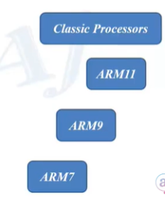
ARM Classic Processors:
ARM Classic Processors include ARM7, ARM9, ARM11 families.
ARM7TDMI is still still highest shipping 32-bit processors.
ARM7 based processors are still used in many small and simple 32-bit devices.

Slide 9
ARM Embedded Processors:
Even though ARM7 and other Classic ARM Processor can be used for small scale embedded systems, never embedded systems are build using the advanced ARM Embedded Processors.
Such as Cortex-M processors and Cortex-R Processors.
ARM Cortex-M have a Microcontroller profile while the ARM Cortex-R have a Real time profile.

Slide 10
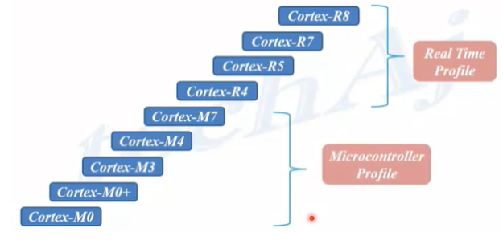
ARM Embedded Processors:

Slide 11
ARM Applications Processors:
ARM Cortex A series of Processors are Applications Processors.
They are Highest Performance processors from ARM.
They are used in powerful mobile, compelling technology products like network devices, consumers applications, automation system, automobile and other embedded system.
The Cortex-A processors are again divided into high performance, high efficiency and ultra-high efficiency type processors.

Slide 12
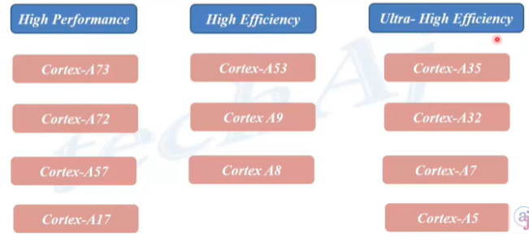
ARM Applications Processors:

Slide 13
Differences in ARM Cortex A-R-M
Parameter | Cortex-A | Cortex-R | Cortex-M
Performance | Highest | Very good | Medium
Response Time | Very good | Highest | Medium
Power Consumption | 80uw/Mhz | 120 uw/Mhz | 8uw/Mhz
Processor | Application based | RTOS based | Embedded based
Pipeline | Long | Medium | Short
Clock | High | High | Relatively less
Memory | Cache with more size | Cache with medium size | Cache with less size
Application | Automobiles, Router | Robotic, Hard-drive | Smart devices, embedded device

Slide 14
ARM 7 Pipelining
F1 | D1 | E1 | F2 | D2 | E2 | F3 | D3 | E3
9
F1 | D1 | E1
F2 | D2 | E2
F3 | D2 | E3
5
ARM7 uses 3 stage pipeline: fetch, decode ,execute.
ARM9 uses 5 stage pipeline: fetch, decode, execute, memory write, register write.
ARM10 uses 6 stage pipeline: f,d,e,mw,rw,issue

Slide 15
LPC2148

Slide 16
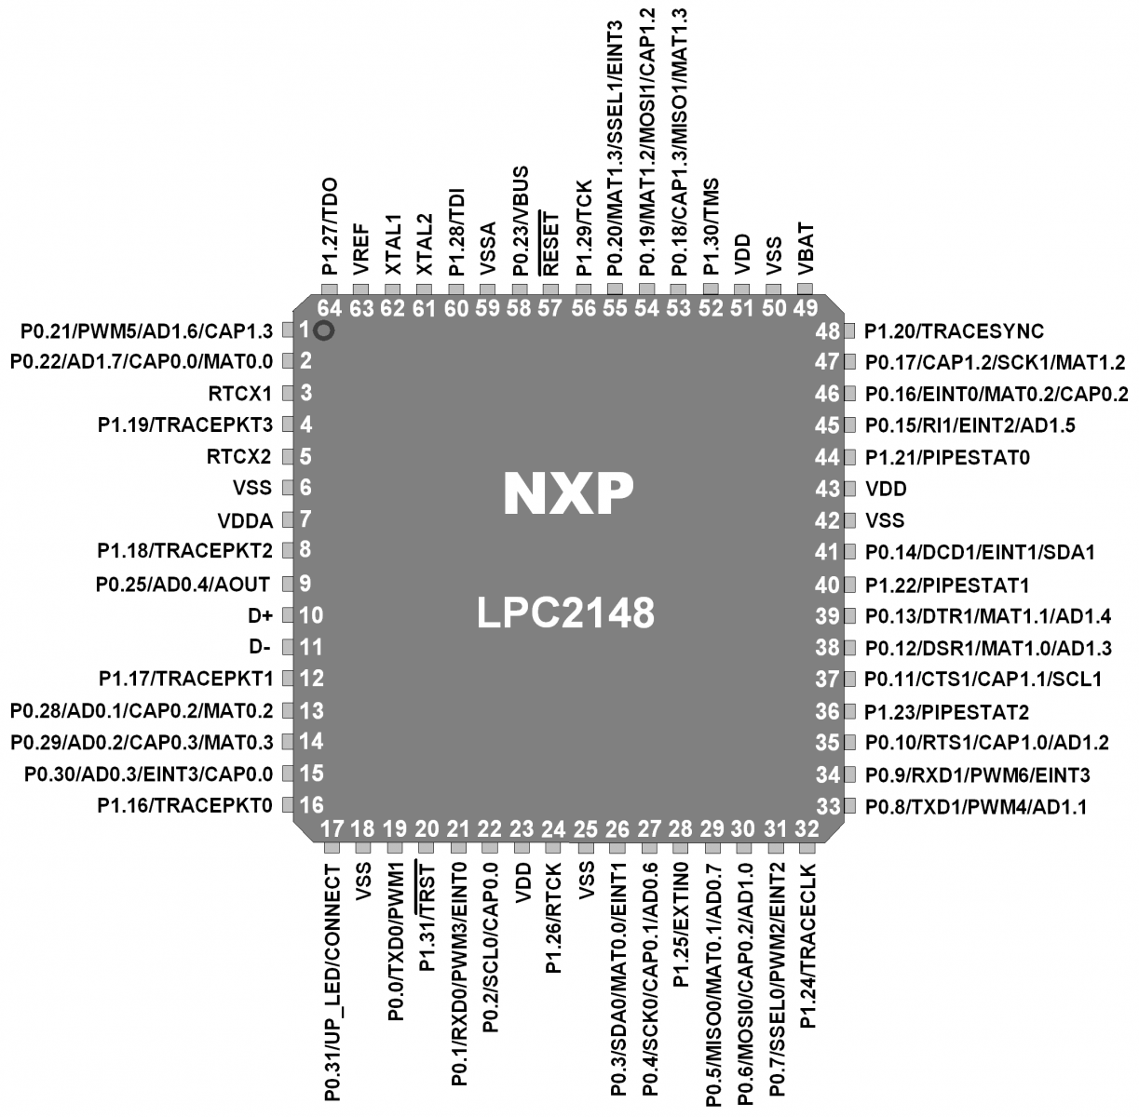
PIN DIAGRAM:

Slide 17
What is LPC?
It is “LOW PIN COUNT” refer to relatively small numbers of pins required for interfacing. Thus it makes circuit very cost effective and space saving.

Slide 18
Features of LPC2148:
• CPU = ARM 7 Core
• Word Length = 32 Bit
• ROM = 512 KB (flash memory)
• RAM = 40KB(32kb SRAM, 8kb USB shared memory)
• 2 Parallel Port (P0,P1 29+16 = 45 GPIO)
• 2 Timers (32 Bit) 4 Compare,4 Capture,6 PWM
• Interrupts sources = 22
• 1 WatchDog Timer
• 1 RTC
• 2 ADC (AD0,AD1) 8+6 = 14 Channels (10 Bit)
• 1 DAC (10 Bit)
• 2 - I2C-bus, 2 –UARTs, 2-SPI/ SSP, 1 USB

Slide 19
Types of Buses:
• In LPC2148 three types of busses are used to connect the core with other peripherals on chip.
1. Local Bus to connect the on-chip memory controllers and fast GPIO’s.
2. Advance High Performance Bus (AHB) for interrupt controller
3. VLSI Peripheral Bus (VPB) for other on-chip peripherals.
• AHB acts as a bridge for VPB.
• VPB is mainly meant for connecting slower peripherals with processor.

Slide 20
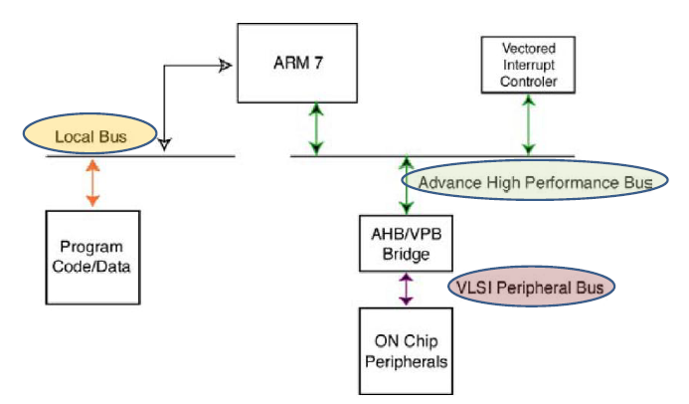
BUS Architecture:

Slide 21
Advanced High performance Bus (AHB)
• The ARM7 core is connected to the Advanced High performance Bus (AHB)
• This is the Fastest Bus in ARM7 core.
• vector interrupt controller is Connected to the AHB and it is bridge to a second bus called the VLSI peripheral bus (VPB).
• Since the Interrupt vector controller is responsible for managing all the device interrupt sources, it is connected to the ARM7 core by the fastest bus.

Slide 22
VLSI Peripheral Bus [VPB]
• All the user peripherals are connected to the VPB.
• The VBP bridge contains a clock divider, so the VPB bus can be run at a slower speed than the ARM7 core and the AHB.

Slide 23
Why VPB is operated at Slow Speeds
• For two reasons
• First, we can run the user peripherals at a slower clock rate than the main processor to conserve power.
Second, it gives Philips the option of adding a slower peripheral to the LPC2000 family without it becoming a bottleneck on the AHB bus.

Slide 24
What is the Optimum speed of VPB
• Currently all the on-chip peripherals are capable of running at 60 MHz so the VPB bus can be set to the same speed as the AHB bus.
• It is important to note that after reset the VPB
divider is set to divide down the AHB clock by four, so all the on-chip peripherals will be running at 1⁄4 the CPU clock frequency.

Slide 25
Local Bus:
There is a third local bus which is used to connect the on-chip Flash and RAMto the CPU.
Connection of the program code and data store to the ARM7 CPU via the AHB bus is possible, but this introduces some execution stalls because of contention on the bus.
Using a separate local bus removes the possibility of these stalls to give the best processor performance.

Slide 26
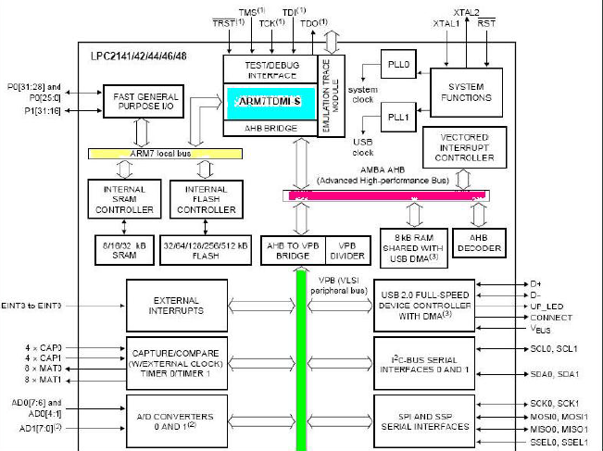

Slide 27
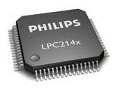
Activating LPC2148
Microcontroller:

Slide 28
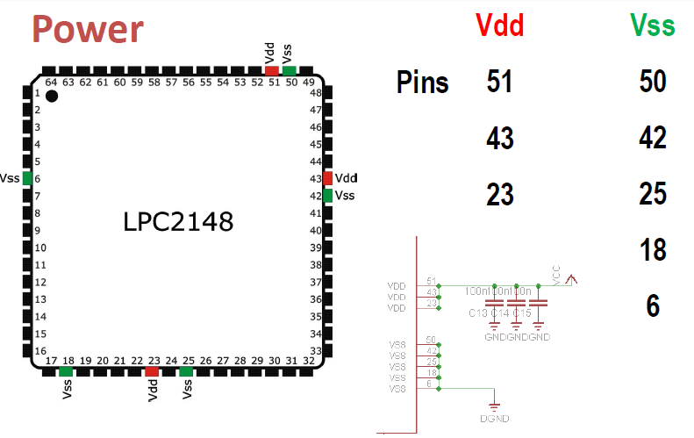

Slide 29
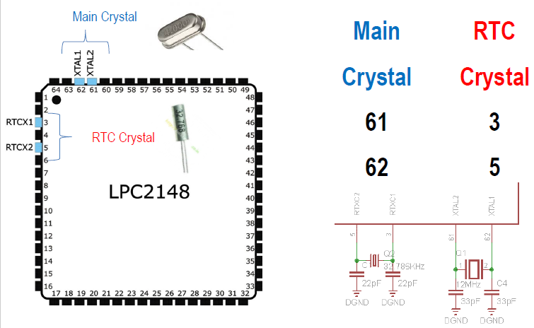

Slide 30
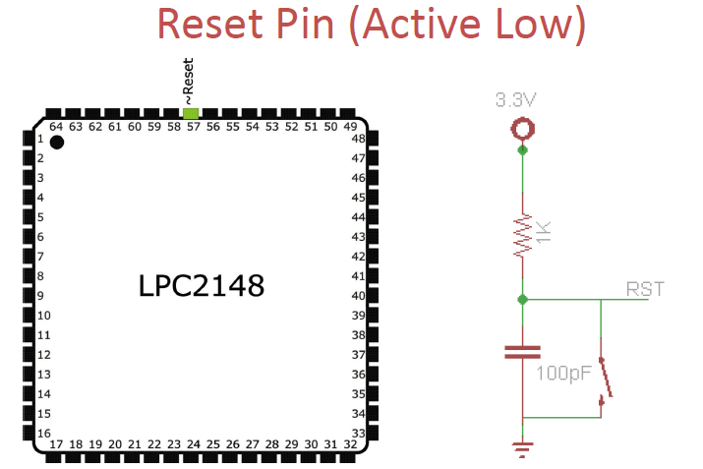

Slide 31
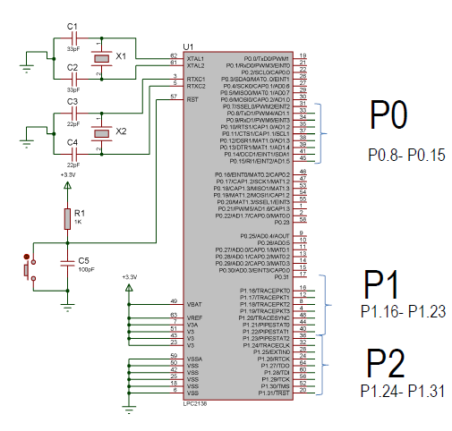

Slide 32
Parallel Port – Port 0:
• Port 0 = 32 Pins (P0.0 to P0.31)
• P0.24, P0.26 and P0.27 are not available
• So (32-3) = 29 Pins are Available
• Out of 29 Pins, 28 Pins → Bidirectional,
Pin 31 → O/P Only.

Slide 33
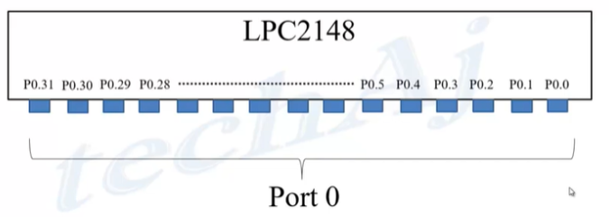
LPC2148 I/O Ports:

Slide 34
Parallel Port – Port 1:
• Port 1 = 16 Pins P1.16 to P1.31
• P1.0 to P1.15 of port 1 are not used
===========================================
• P0 = 29 (28 Bidirectional + 1 output only)
• P1 = 16 (16 Bidirectional)
• Total = 45 GPIOs

Slide 35
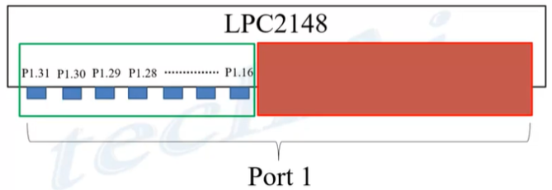
LPC2148 I/O Ports:

Slide 36
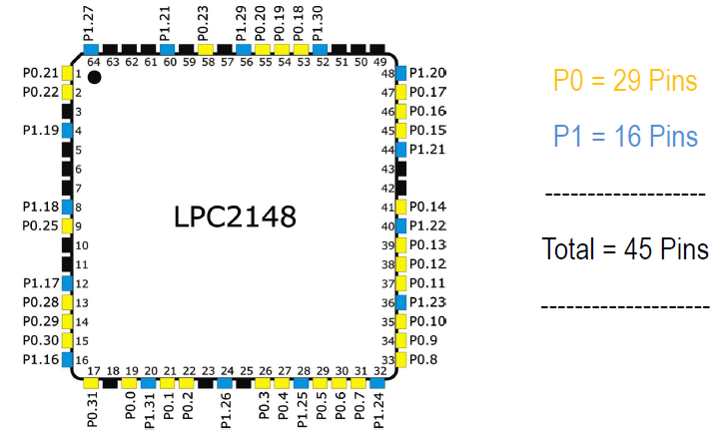
PARALLEL PORT:

Slide 37
SFR Programming in ARM:
• Each underlying SFR is controlled by three user registers.
• Set register which is used to set bits,
• Clear register which is used to clear bits by writing a logic 1 to the bits you wish to clear
• Status register which is used to read the current contents of the register.
• The most common mistake made when new to the LPC2100 is to write zero into the Clear register which has no effect.

Slide 38
SFRs Used:
P0
• IODIR0 → to set the direction
• IOSET0 → to set a Pin
• IOCLR0 → to clear a Pin
• IOPIN0 → to Read a Pin
P1
• IODIR1 → to set the direction
• IOSET1 → to set a Pin
• IOCLR1 → to clear a Pin
• IOPIN1 → to Read a Pin

Slide 39
IODIR:
1 → Output 0 → Input
• IODIR controls the 'direction' of the GPIO pin.
• You use this register to set a GPIO pin to either Input (0) or Output (1).
• To Configure GPIO 0.10 to 'Output' (1).
IODIR |= (1 << 10);
• To Configure GPIO 0.10 to ‘Input' (0).
IODIR &= ~(1 << 10);

Slide 40
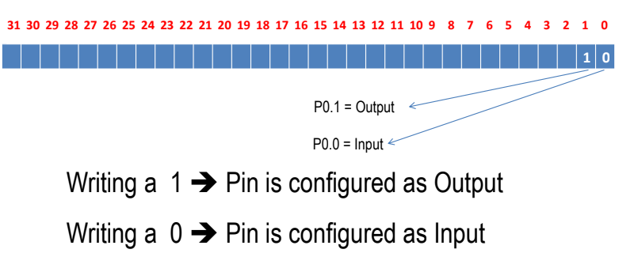
IODIR0:

Slide 41
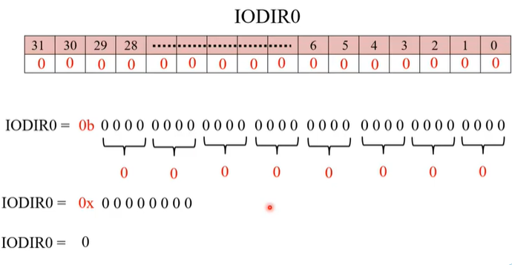

Slide 42
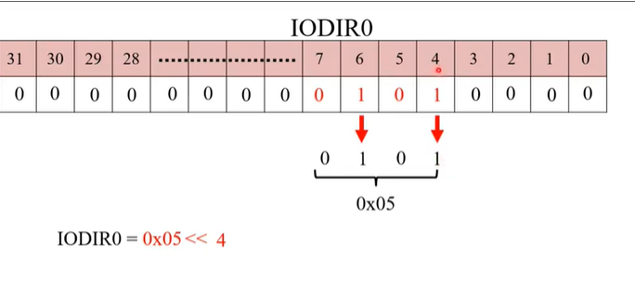

Slide 43
IOSET and IOCLR
• If GPIO pin is set as Output (using the IODIR register)
• IOSET is used to set GPIO pin to 'high' (providing a small 3.3V electrical output)
• IOCLR is used to clear it to 'low' (providing a connection to GND).

Slide 44
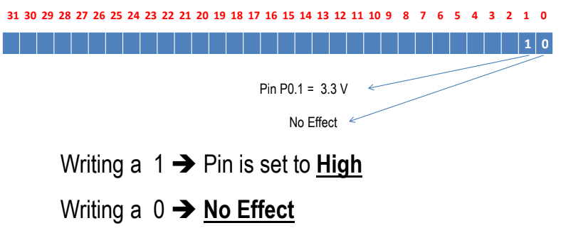
IOSET0

Slide 45
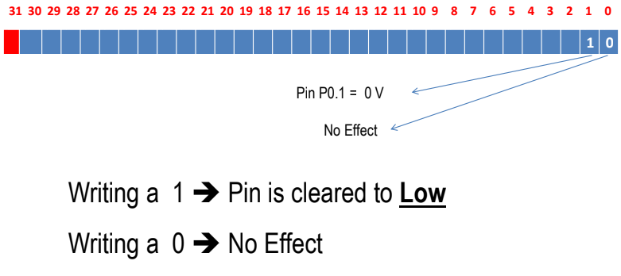
IOCLR0

Slide 46
A small Example
• Make sure GPIO 0.10 and 0.11 are set to output
• IODIR0 |= (1 << 10) | (1 << 11);
• Turn the LEDs off using IOCLR (which gives a GND connection)
• IOCLR0 |= (1 << 10) | (1 << 11);
• Turn the LEDs on using IOSET (which supplies 3.3V
• IOSET0 |= (1 << 10) | (1 << 11);

Slide 47
IOPIN:
• Regardless of whether GPIO pins direction is set to Input or Output.
• IOPIN register is used to read the current 'state' of every GPIO pin(all 32 pins in GPIO).
• A 1 value means that the pin is currently 'high', and a 0 value means the pin is currently 'low'.

Slide 48
A Small Example
int getPinState(int pinNumber)
{
// Read the current state of all pins in GPIO block 0
int pinBlockState = IO0_IOPIN;
// Read the value of 'pinNumber'
int pinState = (pinBlockState & (1 << pinNumber)) ? 1 : 0;
// Return the value of pinState
return pinState;
}

Slide 50
Applications of LPC2148:
• Industrial control
• Medical systems
• Access control
• Point-of-sale
• Communication gateway
• Embedded soft modem
• General purpose applications

Slide 51
ADC Calculations:
A/D Conv=PCLK / X+1
= 15MHz / X+1
= 15MHz / 3+1
= 3.75MHz
freq value must be < 4.5MHz
A/D Conv=pclk / x+1
= 10MHz / x+1
= 10MHz / 2+1
= 3.33MHz
freq value must be < 4.5MHz

Slide 52
TIMER 0
Delay=(PR+1)/operating frequency;
e.g
1ms=PR+1/60Mhz;
1x10^-3=PR+1/(60x10^6);
60000=PR+1;
PR=59999;

Slide 53
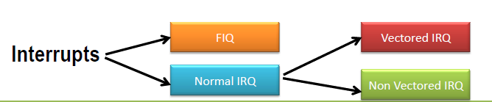
How We classify them ?
We Classify them as 2 types :
• Fast IRQs or FIQs
• Normal IRQs or IRQs which can be further classified as :
– Vectored IRQ
– Non-Vectored IRQ.

Slide 54
Types of Interrupts in LPC2148
Interrupts are Handled by Vectored Interrupt Controller(VIC)
Types of Interrupts in LPC2148
• Fast Interrupt Request i.e FIQ : which has highest priority
• Vectored Interrupt Request i.e Vectored IRQ : which has
‘middle’ or priority between FIQ and Non-Vectored IRQ.
• Non-Vectored IRQ : which has the lowest priority.

Slide 55
What does Vectored mean ?
• ‘Vectored‘ means that the CPU is aware of the address of the ISR when the interrupt occurs
• Non-Vectored means that CPU doesn’t know the address of the ISR (nor) the source of the IRQ when the interrupt occurs.
• For Non – Vectored interrupts,CPU needs to be supplied by the ISR address.
• For the Vectored interrupts , the System internally maintains a table called IVT or Interrupt Vector Table which contains the information about Interrupts sources and their corresponding ISR address.

Slide 56
How Non-Vectored Interrupts are handled?
• Non-Vectored ISRs doesn’t point to a unique ISR
• The CPU needs to be supplied with the address of the ‘default’ or a ‘common’ ISR that needs to be executed when the interrupt occurs.
• In LPC2148 this is facilitated by a register called ‘VICDefVectAddr‘.
• The user must assign the address of the default ISR to this register for handling Non-Vectored IRQs.

Slide 57
How Many Possible Interrupt Sources are there ?
• There are 22 Interrupt Sources in LPC2148
• But there are only 16 Slots in the Vectored Interrupt Controller (VIC) 0 to 15.
• These 22 possible sources have to be shared by using Slots 0 to 15 of VIC
• Slot 0 Highest Priority
• Slot 15 Lowest Priority

Slide 58
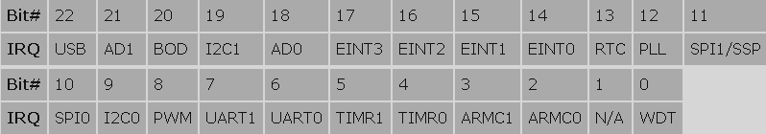

Slide 59
VICVectCntl0 to VICVectCntl15:
• These are the Vector Control registers.
• These are used to assign a particular interrupt source to a particular slot.
• As mentioned before slot 0 i.e VICVectCntl0 has highest priority and VICVectCntl15 has the lowest.
• Each of this registers can be divided into 3 parts : {Bit0 to bit4} , {Bit 5} , {and rest of the bits}.

Slide 60

• The first 5 bits i.e Bit 0 to Bit 4 contain the number of the interrupt request which is assigned to this slot. The interrupt source numbers are given in the table below :
• The 5th bit is used to enable the vectored IRQ slot by writing a 1

Slide 61
Important Note:
• Note that if the vectored IRQ slot is disabled it will not disable the interrupt but will change the corresponding interrupt to Non-Vectored IRQ.
• Enabling the slot here means that it can generate the address of the ‘dedicated Interrupt handling function (ISR)’
• Disabling it will generate the address of the ‘common/default Interrupt handling function (ISR)’ which is for Non-Vectored ISR.
• In simple words if the slot is enabled it points to ‘specific and dedicated interrupt handling function’ and if its disable it will point to the ‘default function’.

Slide 62
VICVectAddr0 to VICVectAddr15
(16 registers in all):
• For Vectored IRQs these register store the address of the function that must be called when an interrupt occurs.
• Note – If you assign slot 3 for TIMER0 IRQ then care must be taken that you assign the address of the interrupt function to corresponding address register .. i.e
VICVectAddr3 in this example.

Slide 63
VICVectAddr:
• This must not be confused with the above set of 16 VICVecAddrX registers.
• When an interrupt is Triggered this register holds the address of the associated ISR i.e the one which is currently active.
• Writing a value i.e dummy write to this register indicates to the VIC that current Interrupt has finished execution.
• The only place we’ll use this register .. is at the end of the ISR to signal end of ISR execution.

Slide 64
How to Write an ISR:
Method – 1
__irq void myISR (void)
{
...
}
For 8051
void myISR (void) interrupt 1
{
...
}
Method – 2
void myISR (void) __irq
{
...
}

Slide 65
A Simple 3 Step Process to Enable a Vectored IRQ:
• Step–1: Enable the IRQ by setting the appropriate bit of VICIntEnable to ’1′.
• Step-2: Identify the interrupt source number and assign it to VICVectCntlX.
• Step-3: Assign the address of the related ISR to VICVectAddrX.

Slide 66
PWM
Delay=(PWMPR+1)/operating frequency;
e.g
1us=PWMPR+1/60Mhz;
1x10^-6=PWMPR+1/(60x10^6);
60=PR+1;
PWMPR=59;

Slide 67
UART:
In LPC2148 there are 2 UART:
Uart 0
Uart 1

Slide 68
Registers associated with LPC2148:
Line control register (U0LCR,U1LCR)
DIVISOR LATCH Register (U0DLL, U0DLM) → BR
Transmit Buffer Register (U0THR and U1THR)
Receive Buffer Register (U0RBR, U1RBR)
Line Status Register (U0LSR and U1LSR)→ read only register where the data TX & RX or not
Fractional Divisor Register.

Slide 69
FORMULA:
UART0 baudrate= PCLK MulVal
-------------------------X—------------------
16X(U0DLM + U0DLL) (MulVal + DivAddVal)
As per Datasheet we can skip the fractional no.
UART0 baud rate = PCLK
-----------------------
16X(U0DLM + U0DLL)

Slide 70
(U0DLL+U0DLM)= PCLK
-----------
BR*16
= 15*10^6
------------
9600*16
= 97
= 0x0061
DLL=61
DLM=00

Slide 71
RTC
PREINT = int (PCLK / 32768) - 1.

