Slide 1




Analysis and optimization of the pricing of electric charging networks Technical presentation January 24th 2024
Bemo - CentraleSupelec Essec Corporate Research Project

Slide 2
Project guidelines
[MANDATORY] Quarter 1 2024 : Descriptive analysis of the pricing practices of the different European Charge Point Operators networks
Weight analysis of the different CPO price factors in the invoices : duration, energy quantity, power, locations, consuming uses…
Item 1 : Exploratory study and statistical description based on transactions dataset
CPO pricing formula analysis :
Item 2 : Comparison study to assess Bemo valuation (using Bemo Pricer) vs actual CPO price based on past transactions. Accuracy of Bemo valuation.
Item 3 : Few simple batch works to explore scope of application / degrees of freedom of one CPO formula modification of session params and formula params)
Item 4.1 : Batch computation to assess one CPO formula full domain using various consuming schemes (average consuming cart and past transactions). Assessment of theoretical formula vs actual price. → enriched CDR to replay
Item 4.2 : Batch computation to assess one consuming scheme (average consuming cart) over various CPO formula. Assessment of formula wideness.
Item 5 : Conclusion in terms of general overview, details per CPO and way of handling pricing formula for various departments which work on it.
Items 1,2,3 expected as intermediary deliverable by the end of April 2024.
Items 4,5 expected by the end of the project in Mid-June 2024.
[OPTIONAL] Quarter 2 2024 : Study of the application of yield management practices for optimization purposes
Item 6 : Find the best price by default for a given CPO with the conclusion of the first section

Slide 3
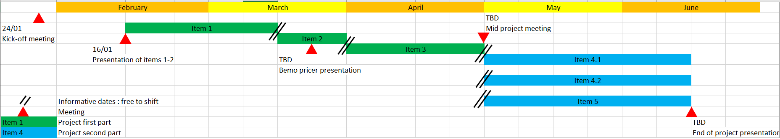
Informative scheduling

Slide 4
Item 1 description
Purpose : give conclusion about transaction price influence. Is it clearly distinct to be predictible ? Is it common to these countries/CPO ? Is it function of duration, quantity, CPO/MSP/Power segments, other features to create… ?
Whether general conclusion or numerical statement (% dependency, interpolation parameters) depending of the accuracy of the dataset, working time…
Informative schedule : February 16th to March 15th
Available datasets :
Transactions filtered to 3 countries (NL, DE, FR) and 3 CPOs (Last Mile Solutions, TotalEnergies, Charge Point)
Transactions over 2023 using mainly Bemo Pricer V1 (less accurate)
Sampled_Dataset_Transactions_PricerV1_2023_filt_1_3
Sampled_Dataset_Transactions_PricerV1_2023_filt_2_3
Sampled_Dataset_Transactions_PricerV1_2023_filt_3_3
Transactions over December 2023 and January 2024 using Bemo Pricer V2 (more accurate)
Optional : EVSE dataset can be found taking unique reference of EVSE_Id in these previous datasets. Physical features related to EVSE are just Latitude, Longitude, Country_Code, Country_Name, Power, Power_segment.
Hints : begin with V2 dataset and do simple correlations first of Transaction_Price with basic params like Duration, Quantity, Power_segment. Try correlation based on new features to assess a potential prediction. This can be done creating market segment feature using EVSE (for instance weekly median quantity value for each EVSE and then building ML clustering).

Slide 5
Known market segments are :
EV_hub : highway stations (DC high power segments)
B2G : on the road (low/high AC power segment, maybe also DC charge)
B2B hosting (Leclerc, Truffaut, Campanile...) : on a supermarket car park for instance (low/high AC power segment, maybe also DC charge)
« At home » : low AC power segment in a domestic charge connector
« At work » : in a company car park (low/high AC power segment, maybe also DC charge)

Slide 6
Features description
Quantity : consumed energy (kWh)
Duration : session whole duration (not just charging time) (h)
Power : EVSE max power (kW)
Country_Code : NL, FR, DE
Country_name, Zip_code, latitude, longitude : spatial data about EVSE
Backend operator : Big companies above CPO to operate EVSE for Maintenance, Repair and Overall
CPO : big companies or local actors who owe the brand name of the EVSE
CPO_connection : type of relationship between Bemo and CPO (P2P or roaming if using other data plateform for datalink)
Transaction_Id : created feature to identify each transaction
CPO_Id : CPO code
EVSE_Id : unique reference of each EVSE
Start_date, end_date, start_time, end_time : temporal features about session (Y-m-d H:M:S and H.M)
MSP_segment : type of Bemo customers / Mobility Service Provider
Mobility as a service
Car sharer
MSP of TotalEnergies

Slide 7
Power category (in-house definition) :
AC slow charge : AC type and power < 40 kW
AC fast charge : AC type and power ≥ 40 kW
DC charge : DC type and power ≤ 50 kW
DC high power charge : DC type and power > 50 kW
Transaction_Price_Bemo_Estimation : B2B transaction price (€) with the CPO estimated by Bemo using V1 or V2 pricer. Sum of these four parameters (available only with V2 pricer version):
Transaction_Price_Bemo_Flat_Component : fixed price once the session begins
Transaction_Price_Bemo_Energy_Component : price function of consumed energy
Transaction_Price_Bemo_Time_Component : price function of elapsed time while charging
Transaction_Price_Bemo_ParkingTime_Component : price function of elapsed time while not charging
Transaction_Price : final price (€) charged by the CPO at the end of a session. It is a B2B price excluding VAT and without CPO mark-up.
Delta_price : Transaction_Price - Transaction_Price_Bemo_Estimation (€)
Main_stat_all : 1 if the session is considered as physicilally realistic and 0 otherwise (whether short or long sessions).
IMPORTANT NOTE : The feature ‘Transaction_Price’ handles with B2B price for electricity amount bought by Bemo to CPOs (excluding VAT and MSP mark-up). It MUST not be considered as B2C final EV customer price on the invoice.

Slide 8
Item 2 description
Purpose : give conclusion about Bemo V2 pricer estimation. How is it accurate ? Can you define parameters of interest where the pricer should be improved ?
Reference value : Transaction_Price
Parameter to assess : Transaction_Price_Bemo_Estimation
Whether general conclusion or numerical statement (% dependency, error interpolation parameters, error set as trx_price – bemo_estim) depending of the accuracy of the dataset, working time…
Informative schedule : March 15th to March 31st
Available datasets :
Transactions filtered to 3 countries (NL, DE, FR) and 3 CPOs (Last Mile Solutions, TotalEnergies, Charge Point)
Transactions over December 2023, January and February 2024 using Bemo Pricer V2 (more accurate)
Sampled_Dataset_Transactions_PricerV2_filt_1_2
Sampled_Dataset_Transactions_PricerV2_filt_2_2
Optional : EVSE dataset can be found taking unique reference of EVSE_Id in these previous datasets. Physical features related to EVSE are just Latitude, Longitude, Country_Code, Country_Name, Power, Power_segment.
Features description : refer to section of item 1

Slide 9
Item 3 description
Purpose : handle Bemo Pricer V2 as a Python request tool. Please send me a test notebook where you describe this simple use case :
Single computation with a given transaction and its corresponding price formula considering filters described int the notebook.
Compare your results with the raw parameters (price components and Bemo price estimation) provided in the Transactions file.
Informative schedule : March 25th to April 14th
Available datasets and resources :
Datasets already include filters to 3 countries (NL, DE, FR) and 3 CPOs (Last Mile Solutions, TotalEnergies, Charge Point) from January 23 to March 24 :
Price formula :
15 files Price_Sampled_Dataset_PriceFormula_filt_X_Y.csv from
Transactions
5 files Sampled_Dataset_Transactions_PricerV2_filt_X_Y
This dataset already includes a merge with EVSE dataset (ie mainly EVSE and Connector ID).
Jupyter notebook ‘Pricer_Python_Request.ipynb’ to send Python request to Bemo V2 Pricer : several options are described as single and batch computations.

Slide 10
Features description
Same parameters as those from Item 1 in general. Further information are given below :
Price formula :
Connector_Id : ID of an EVSE connector. An EVSE can include on or more connectors. EVSE and Connector ID are unique.
Formula : body of the Json request in Python.
Country_Code : country where the tariff formula is valid.
Creation_Date : approximative date when the formula was created (considered UTC as other dates in Transactions file, no conversion needed).
Valid_From : start date when the tariff formula is valid (considered UTC as other dates in Transactions file, no conversion needed).
Valid_To : end date until when the tariff formula is valid (considered UTC as other dates in Transactions file, no conversion needed).
Id : tariff formula Id.
Transactions :
The transactions file has been filtered with Stat_tag=Main.
Start_Date : session start date
End_Date : session end date
EVSE_Id : ID of the EVSE where the charging session was done.
Connector_Id : ID of an EVSE connector. An EVSE can include on or more connectors. EVSE and Connector ID are unique.
Currency_Code : currency code of the transaction amount.
ChargingPeriodCollection_Body :charging period elements in a dictionary
Common parameters to perform a merge between datasets.
Caution : a price formula is valid for a specific Connector Id provided that its valid period comprises the Start date of the transaction.

Slide 11
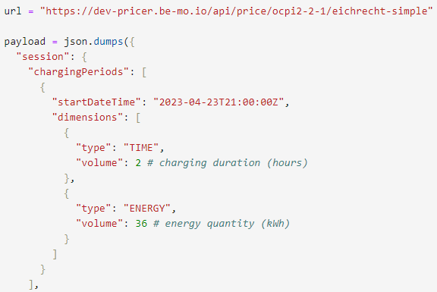
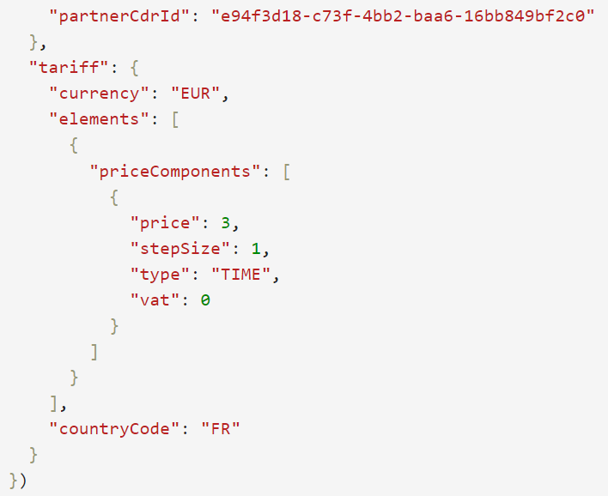
Python Json body description
Always take this URL adress for the bemo V2 Pricer
ChargingPeriodCollection_Body from Transactions file (one or more Dimensions, here 2h and 36 kWh consumed in this session )
Input not mandatory : adapt it as you want. Whether unique Id for your computation or always the same.
Currency code from Formula parameter in Price formula file.
‘Elements’ and ‘priceComponents’ from Formula parameter in Price formula file.
Country parameter from Country_Code in Price formula file.

Slide 12
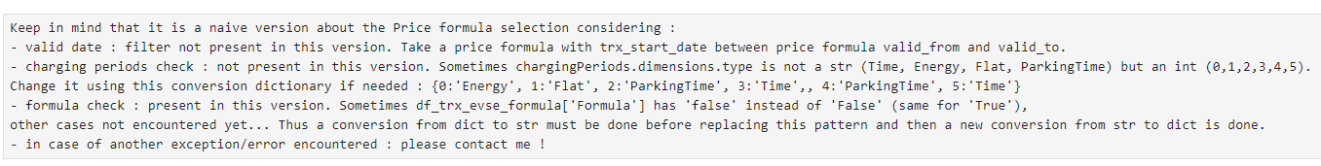
Python Json body description
Once the request was submitted to Bemo Pricer, an answer is given through the dictionary ‘Response’.
As described in item 1 features description, ‘flat’ corresponds to Transaction_Price_Bemo_Flat_Component ans so on… Up to you to handle exceptions (nan, None, computation not valid, etc…) when performing batch computation.
These are components of Transaction_Price_Bemo_Estimation which is the sum of them.
Please take Transaction_Price_Bemo_Flat_Component, Transaction_Price_Bemo_ParkingTime_Component, Transaction_Price_Bemo_Time_Component, Transaction_Price_Bemo_Estimation as ‘Raw’ parameters from our dataset. Your results from the Pricer are more reliable for this project because you have all the elements (inputs, controls, merge keys, etc…) needed for the computation. Normally they should be close from each other.
Additional filters should be implemented in the notebook (for this vanilla version, I wrote on of them, up to you to complete it). See dedicated section about this topic in the notebook :

Slide 13
Item 4.1 description
Purpose : Assessment of theoretical formula vs actual price. Batch computation to assess one CPO formula full domain using various consuming schemes.
Informative schedule : May 1st to June 15th
Available datasets and resources :
All datasets (transactions, EVSE and tariff formula) must be filtered for theses conditions : country = NL and FR ; Back end operator = LMS and TotalEnergies.
Same datasets provided in Item 3 folder
“Average_purchasing_cart.csv” : average data (consider charging quantity and session duration) to inject in a request to Bemo pricer.

Slide 14
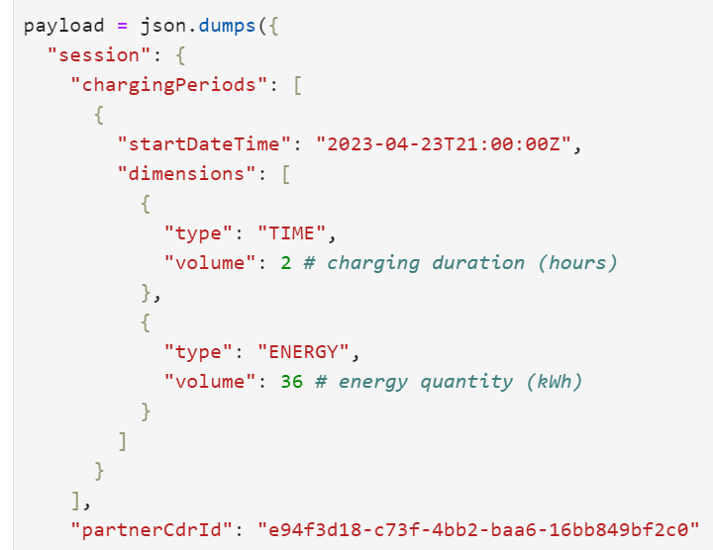
Explained tasks :
For a given CPO formula, first launch a batch computation exploring duration and quantity from a min to a max (these values are deducted from related past transactions) and then compare it to actual price from past transactions related to this CPO formula AND to the related average consuming scheme. It is a comparison of theoretical and actual to evaluate whether prices are always in a core target of CPO price formula or may vary according their update policy.
Caution : pas transactions taken for comparison must be related to the CPO price formula (in terms of power segments, dates and CPO/EVSE codes). Average consuming scheme are attached in the folder and can be inject for all price formula (whatever country and Backend operator…).
Choose the CPO formula code taking into account enough past transactions to compare with. All data (CPO price formula and past transactions) must refer to a unique CPO code to simplify the study : for instance FR*V75 and NL*LMS.
Repeat this scheme for a price formula (belonging to the same CPO code) at another date.
Compare all results in a duration-quantity-price-date view using numerical and graphic displays.
In a nutshell the degrees of freedom handle with Country - Backend operator (2), Power segments / Average schemes (4) and price formula dates (2).
Here is given a simple calculation for a naïve scheme based on 2h and 36 kWh
Injected in the Bemo pricer.

Slide 15
Item 4.2 description
Purpose : Batch computation to assess one consuming scheme (average consuming cart) over various CPO formula. Assessment of formula wideness.
Informative schedule : May 1st to June 15th
Available datasets and resources :
All datasets (transactions, EVSE and tariff formula) must be filtered for theses conditions : country = NL and FR ; Back end operator = LMS and TotalEnergies.
Same datasets provided in Item 3 folder
“Average_purchasing_cart.csv” : average data (consider charging quantity and session duration) to inject in a request to Bemo pricer.
Explained tasks :
Take one power segment based on enough price formula and past transactions available (for instance AC_slow_charge in the file “Average_purchasing_cart.csv”)
Inject it to various related CPO price formula and store the results.
Compare all results in a duration-quantity-price view using numerical and graphic displays.

Slide 16
Item 5 description
Purpose : Conclusion in terms of general overview, details per CPO and way of handling pricing formula for various departments which work on it.
Add any topic of interest you may identify to finish the project and to answer the subject : « is it worth to follow the update price policy from CPO ? »
Informative schedule : May 1st to June 15th
Available datasets and resources :
All datasets (transactions, EVSE and tariff formula) must be filtered for theses conditions : country = NL and FR ; Back end operator = LMS and TotalEnergies.
Same datasets provided in Item 3 folder
“Average_purchasing_cart.csv” : average data (consider charging quantity and session duration) to inject in a request to Bemo pricer.
Expected delivery :
One technical report explaining work on all items
One technical presentation for a data science public
One non technical presentation for a general public at TotalEnergies (data, marketing, top management…)

Slide 17
Next steps
Item 3 is under progress for review.
Weekly available time slots to share progress, difficulties, questions… Send me your team availabilities if you want to schedule a meeting.
Not mandatory but available : send me an email the day before and I will share a Teams link for an online meeting if needed
Milestones to share progress on items
Not mandatory but available : dates to plan at the end of each item. Send me your team availabilities if you want to schedule a meeting.
I will not be available from June 1st to 12th. Please send me your availabilities for an end of project meeting with me to organize your presentations.

Slide 18


Contact
For specific inquiries, additional displays or more details, please email me at :
pierre.chavanne@totalenergies.com
If you want to work further using these data, please indicate the author and the release date.

