Slide 1

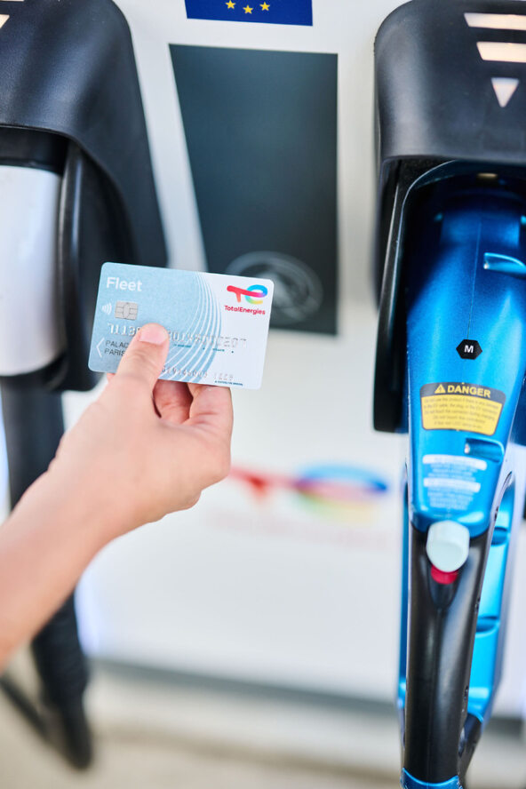


Analysis and optimization of the pricing of electric charging networks Technical presentation January 24th 2024
Bemo - CentraleSupelec Essec Corporate Research Project

Slide 2
Table of contents
Presentation of Bemo
Project overview
Project guidelines
Example of use case issue
Bemo pricer tool presentation
Appendices

Slide 3














Electromobility value chain
About Bemo
Prestataire CPO
Prestataire MSP
Gaz et Electricité
Charge Point Operator (CPO)
TECS
Energy supplier
Charging point
Mobility Service Provider (MSP)
EV driver
Plateforme de Roaming
SDM

Slide 4












Bemo platform
About Bemo
MSP TotalEnergies
External MSP
Fleet (MSP B2B)
ACT
Large charging points network across Europe
Contracts with 800+ CPOs
530k charge points available to EV drivers
Bemo purchases charging sessions from CPOs to resell it (including margin) to its customer
Valuation of charging sessions
Application of Customer pricing policy
Reconciliation of financial flows
Charge + (B2C)
Péagiste (SANEF)
Charge + Business (B2B)
Projets en cours
Car sharing
Madrid local MSP
MaaS belge (projet en cours)
Plateforme d’agrégation CPO (Girève, Hubject…)
CPO TotalEnergies
CPO Third-Party
CPO Third-Party
CPO Third-Party
CPO Third-Party

Slide 5



3 main missions
About Bemo
Enhance charging digital journey
Development of features to enable a smooth customer charging experience to our MSPs EV drivers (for TE applications and others)
Ensure EV charging session operation from end to end
Integration of 3rd party CPOs to increase charging point footprint.
Valuation, sanity checks and claims towards CPOs to ensure accuracy of EV transactions
Consolidate, improve and enrich data
Consolidation of CPOs data from various formats, improvement of data quality and enrichment of POIs information (accessibility, market-intelligence)

Slide 6
Project overview
General dynamic price formula
CPO
Past transactions parameters
Bemo
Average consuming cart
Customer
This CRM project aims at better assessing the data-financial link between Bemo and CPOs.
Link Bemo-CPO :
Lack of CPO pricing policy understanding
Lack of deep understanding of price factors for transactions done through Bemo
Basic estimators computed overall : quartiles, median…
Need for more precise factors for CPO price considering available parameters : duration, consumed energy, power, start time, locations, price, consumers habits…
Accuracy assessment of Bemo valuation vs CPO price using Bemo pricer
Charging point operators manage their pricing policies in a dynamic way with complex formula, fast and frequent updates without alerting…
Tricky to follow for Bemo as a MSP enabler : strategic leverage to change
Need for more precise overview of this policy

Slide 7
Project guidelines
[MANDATORY] Quarter 1 2024 : Descriptive analysis of the pricing practices of the different European Charge Point Operators networks
Weight analysis of the different CPO price factors in the invoices : duration, energy quantity, power, locations, consuming uses…
Item 1 : Exploratory study and statistical description based on transactions dataset
CPO pricing formula analysis :
Item 2 : Comparison study to assess Bemo valuation (using Bemo Pricer) vs actual CPO price based on past transactions. Accuracy of Bemo valuation.
Item 3 : Few simple batch works to explore scope of application / degrees of freedom of one CPO formula modification of session params and formula params)
Item 4.1 : Batch computation to assess one CPO formula full domain using various consuming schemes (average consuming cart and past transactions). Assessment of theoretical formula vs actual price. → enriched CDR to replay
Item 4.2 : Batch computation to assess one consuming scheme (average consuming cart) over various CPO formula. Assessment of formula wideness.
Item 5 : Conclusion in terms of general overview, details per CPO and way of handling pricing formula for various departments which work on it.
Items 1,2,3 expected as intermediary deliverable by the end of April 2024.
Items 4,5 expected by the end of the project in Mid-June 2024.
[OPTIONAL] Quarter 2 2024 : Study of the application of yield management practices for optimization purposes
Item 6 : Find the best price by default for a given CPO with the conclusion of the first section

Slide 8
Example of use case issue
Dataset of past transactions paid through TotalEnergies CPO network
Average consuming cart for various power segments : start time, duration, consumed energy, price
Dataset of various pricing formula for TotalEnergies CPO network
Country | « CPO » | Customer | Power segment | Median start time | Median duration | Median consumed energy
Iso 3166 1 alpha 2 | - | - | - | (UTC) | h | kWh
FR | TotalEnergies | MyCard-Fleet | AC slow charge | 12h30 | 2h54 | 11.0
FR | TotalEnergies | MyCard-Fleet | AC fast charge | 13h00 | 1h41 | 10.5
FR | TotalEnergies | MyCard-Fleet | DC charge | 12h30 | 48mn | 22.0
FR | TotalEnergies | MyCard-Fleet | DC HPC | 13h00 | 28mn | 26.1
Others | TBD

Slide 9
Various questions about pricing policy :
Can general trends based on consuming use be analysed ?
How do actual prices match theoretical formula given by the CPO ?
Can dynamic pricing formula be set in an interval for groups of CPO ?
Is it useful to update price formula so often ?

Slide 10
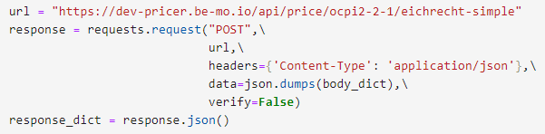
Bemo pricer tool presentation
Session inputs :
Type Duration : time (h)
Or type Consumed energy : quantity (kWh)
Start date time (UTC)
Unuseful parameters : session id
Tariff inputs :
Price formula : from simple to complex including parameters in time, energy. Listed in csv file for various CPOs.
Unuseful parameters : currency, country
All wrapped in json object (here called body_dict)
Computation submitted to Bemo pricer using HTTP request trough PostMan software.
All process coded in Python for this student project.

Slide 11
Next steps
End of January - Beginning of February : Physical meeting to launch the project
Answering questions about the CPOs-Bemo value chain, Bemo pricing process, parameters available in datasets…
Review of available documents : Github repo, datasets, presentations, calendar
Overview of the differents items and especially details on item #1
Weekly available time slots to share progress, difficulties, questions… please Runjia send me your team availabilities
Not mandatory but available : send me an email the day before and I will share a Teams link for an online meeting if needed
Milestones to share progress on items
Mandatory : dates to plan at the end of each month. please Runjia send me your team availabilities

Slide 12
Appendix : Use of PostMan tool for Pricer single request
If needed
Refer to Pierre Chavanne for more details.

Slide 13
Appendix : Use of PostMan tool for Pricer partial batch request
If needed
Refer to Pierre Chavanne for more details.

Slide 14


Contact
For specific inquiries, additional displays or more details, please email me at :
pierre.chavanne@totalenergies.com
If you want to work further using these data, please indicate the author and the release date.

