Slide 1
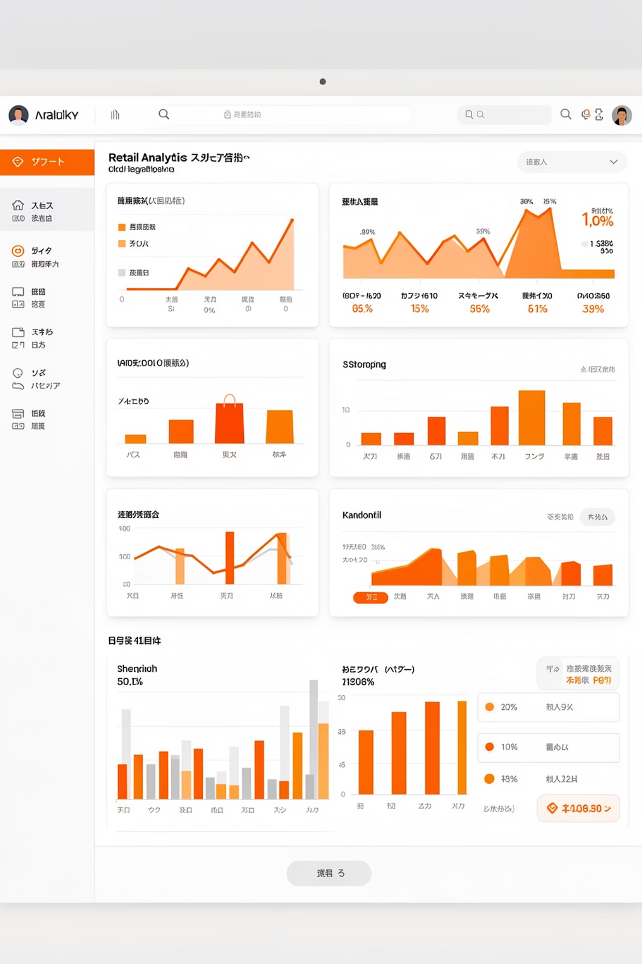
Customer Shopping Behavior Analysis
Uncovering insights from 3,900 purchases to guide strategic decisions

Slide 2
DATASET OVERVIEW
The Foundation
3,900
18
50
Total Purchases
Data Points
Locations
Transactions analyzed
Features per customer
Geographic coverage
Key Features Tracked
Customer demographics & subscription status
Purchase details & product categories
Shopping behavior & review ratings
Shipping preferences & payment methods

Slide 3

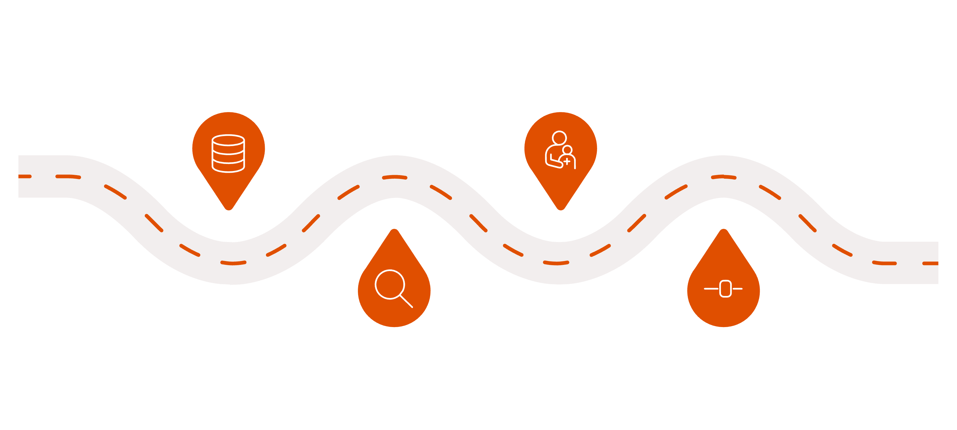
PYTHON ANALYSIS
Data Preparation Pipeline
Load Data
Handle Missing
Import raw tables and files
Impute or remove absent values
Engineer Features
Explore & Clean
Inspect structure and correct errors
Create derived and segmented fields
Cleaned and standardized 3,900 records, imputed 37 missing review ratings, and created age groups for segmentation analysis

Slide 4

Revenue Insights
Gender Split
Avg Purchase
Smart Spenders
Male: $157,890
$59.76 across all customers
839 customers used discounts but spent above average
Female: $75,191

Slide 5
Top Performers
Highest-Rated Products
3.86/5
3.84/5
3.82/5
Gloves
Sandals
Boots
3.80/5
3.78/5
Hat
Skirt

Slide 6



SEGMENTATION
Customer Segments
Returning
701 customers
Loyal
Growing engagement potential
3,116 customers
Repeat purchasers driving core revenue
New
83 customers
Fresh acquisition opportunities

Slide 7


Subscription Analysis
27%
73%
Subscribers
Non-Subscribers
1,053 customers
2,847 customers
Key Finding: Similar avg spend ($59.49 vs $59.87), but massive untapped subscription potential

Slide 8

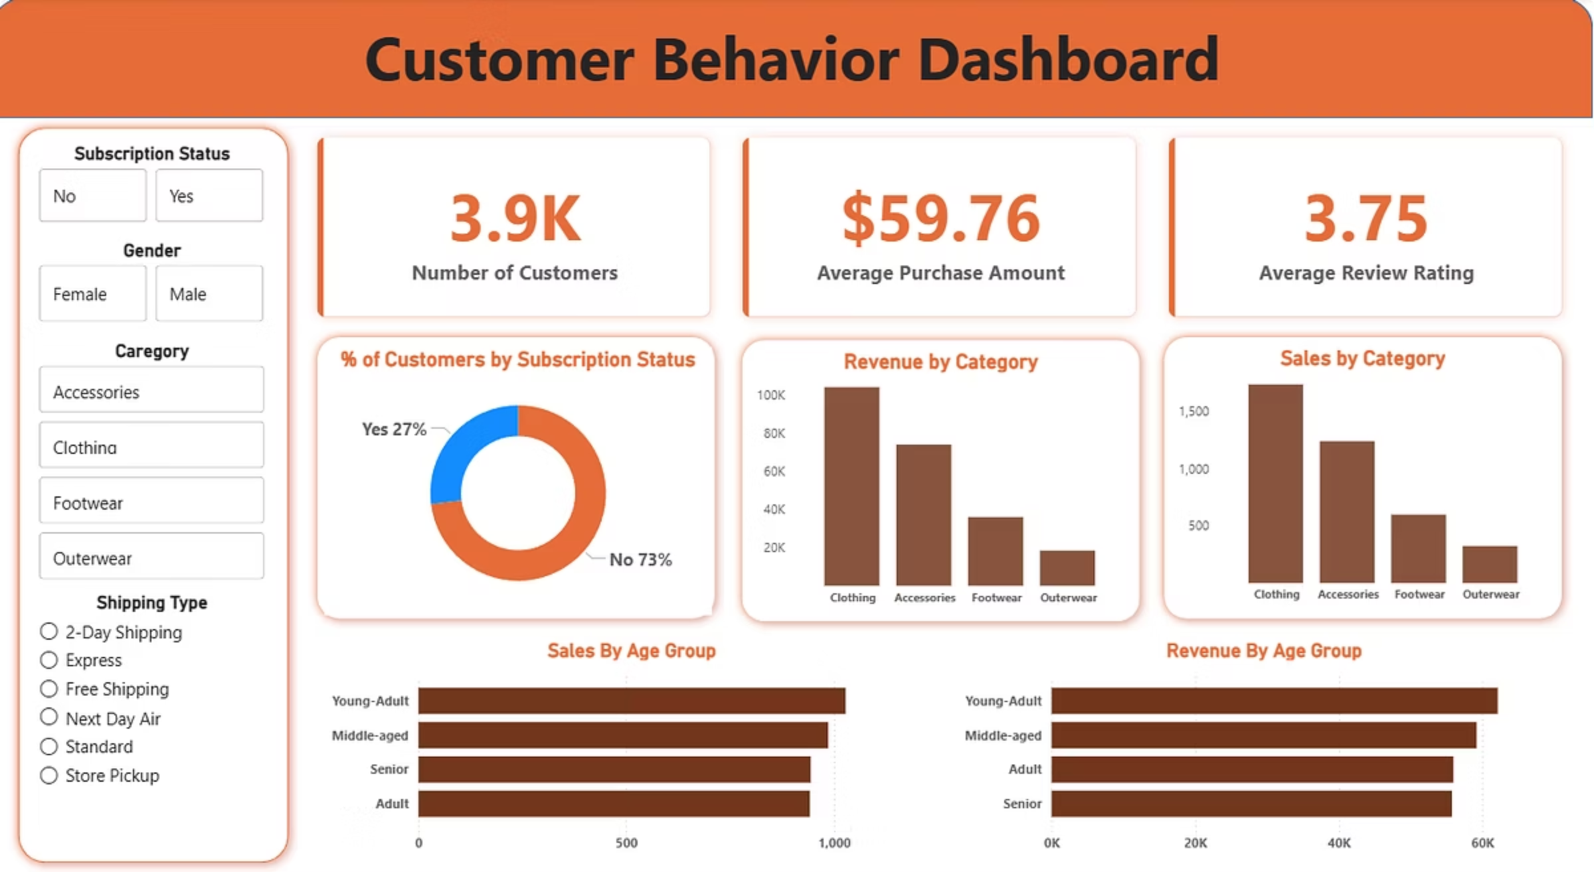
Power BI Dashboard
Interactive visualization tracking revenue by category, age demographics, and subscription metrics in real-time

Slide 9
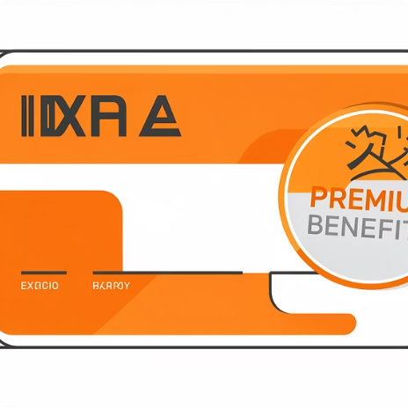
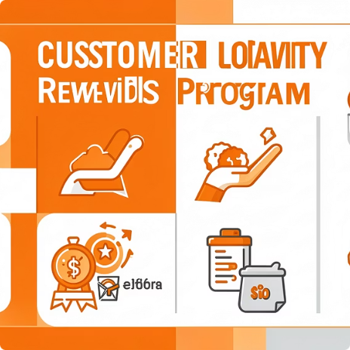
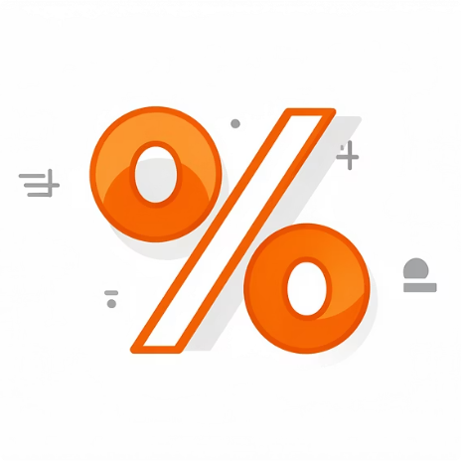

STRATEGY
Business Recommendations
Boost Subscriptions
Loyalty Programs
Review Discounts
Targeted Marketing
Promote exclusive benefits to convert 73% non-subscribers
Reward repeat buyers to grow loyal segment
Balance sales boosts with margin control
Focus on high-revenue age groups and express shipping users

Slide 10

Key Takeaways
Data-Driven Insights
Growth Opportunities
3,900 transactions reveal clear patterns in customer behavior
27% subscription rate shows massive expansion potential
Strategic Action
Targeted recommendations to boost loyalty and revenue

