Slide 1
DATA110 CAPSTONE ·
Engagement Efficiency Segmentation
& Growth Prediction for Twitch Channels
Beyond raw follower counts: what engagement behavior actually predicts channel growth
Submitted By: Viven Chavan Professor: Durga Ma’am

Slide 2
THE PROBLEM
Raw metrics conflate size with engagement
A channel with 10M followers who watch a few minutes a month isn't the same as a channel with 100K followers watching for hours every week. Raw follower and watch-time figures don't distinguish between them.
978 / 22
Partnered vs. Non-Partnered channels in this dataset
Most public analyses of this exact dataset predict one raw metric from another (e.g. Followers from Watch Time) — which mostly re-learns that bigger channels have bigger numbers.
A classifier hits 97.8% accuracy just by always guessing “True” — without learning anything.
This is the kind of surface-level trap raw-metric analysis falls into — and why this project engineers deeper features instead.
2

Slide 3
OBJECTIVES
Two research questions
01
Can channels be segmented by engagement quality — independent of size — using engineered ratio features?
02
Do these engagement features predict absolute follower growth, and which behaviors matter most?
Answered via the advanced-level primary research project, built on a basic and intermediate baseline (per project structure).
3

Slide 4
DATASET
Top 1,000 Twitch channels, 11 fields
1,000
11
0
485
channels
raw fields
missing values
English channels
Watch time · Stream time · Peak / Average viewers · Followers · Followers gained · Views gained · Partnered · Mature · Language
Key data-quality decision
Partnered is severely imbalanced (978/22) — rejected as a classification target. Mature (770/230) is well-balanced and used instead.
4

Slide 5
METHODOLOGY
A five-stage pipeline
1
2
3
4
5
Data
Cleaning
Feature
Engineering
Basic
Level
Intermediate
Level
Advanced
Level
The advanced level is the primary research contribution — the other four stages build toward it.
5

Slide 6
THE NOVEL CONTRIBUTION
Six engineered engagement ratios
Avg-to-Peak Ratio
Watch Time / Follower
Viewership consistency vs. one-off spikes
Cumulative attention per follower
Views / Follower
Follower Growth Rate
Reach efficiency vs. existing audience
Growth normalized by channel size
Viewers / Stream Hour
Stickiness
Audience density per hour streamed
Watch time beyond the expected baseline
6

Slide 7
THE NOVEL CONTRIBUTION
Engagement Efficiency Score (EES)
Outliers first — a handful of channels had ratio values 5–40× larger than the rest, which would dominate scaling.
6 raw ratios
Winsorize
(1st–99th pct.)
Min-Max
scale [0,1]
Equal-weight
average
EES
→
→
→
→
Why equal weighting? No prior theoretical basis favors one engagement dimension over another — a defensible, documented default.
7

Slide 8
BASELINE RESULTS
Basic & Intermediate levels
BASIC · Exploratory Regression
INTERMEDIATE · Classification
Watch Time → Average Viewers
Predicting the Mature flag
R² = 0.406
Acc 0.475 · F1 0.348
Watch time explains a moderate but incomplete share of viewership variance — motivating richer features later.
Modest, and honestly so: raw engagement stats carry limited signal about content-type flags — a genuine finding, not a failure.
8

Slide 9
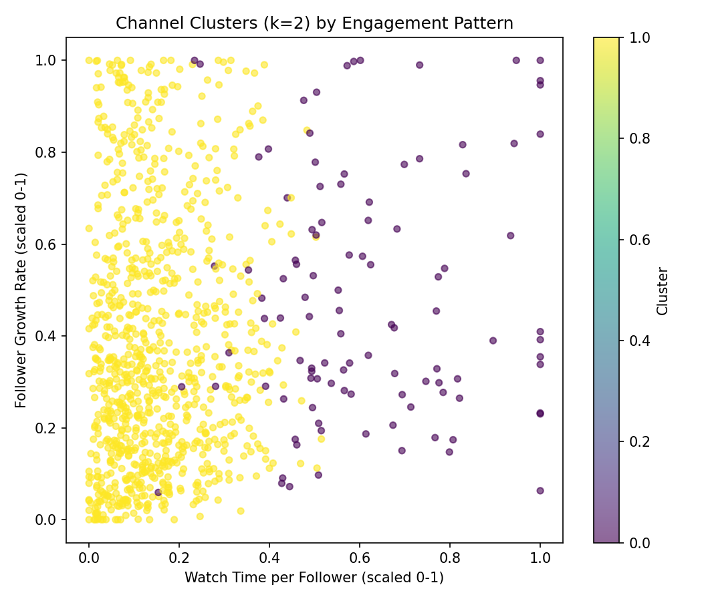
ADVANCED LEVEL
Segmenting channels by engagement
k = 2 selected by silhouette score
0.386 vs. 0.208–0.299 for k = 3–6
Cluster 0 — High-Efficiency
105 channels · mean EES = 0.338
Niche, highly retained audiences
Cluster 1 — Standard
895 channels · mean EES = 0.209
The typical channel profile
9

Slide 10
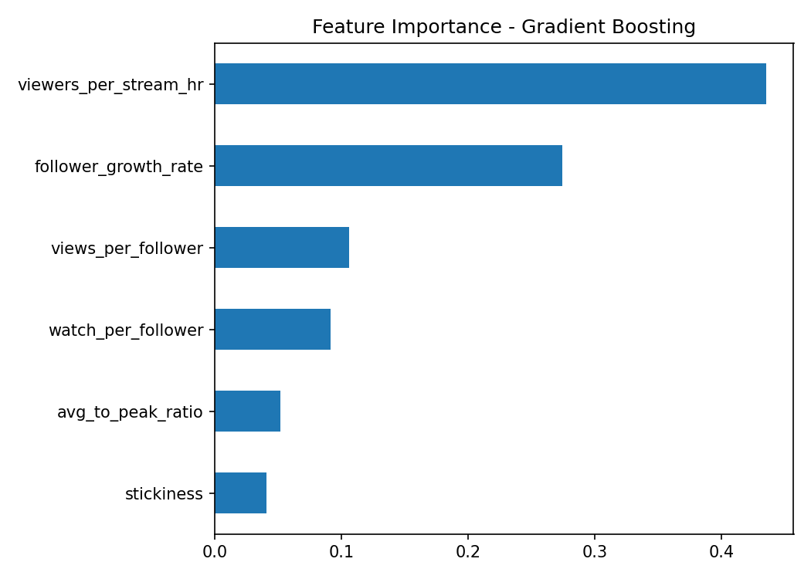
ADVANCED LEVEL
Predicting Followers Gained
Gradient Boosting wins · MAE 117,977 followers
10

Slide 11
THE KEY FINDING
The efficiency–growth paradox
High-Efficiency channels do NOT gain the most absolute followers.
~81,000
~220,000
avg. followers gained
avg. followers gained
High-Efficiency channels (Cluster 0)
Standard channels (Cluster 1)
Nearly 3× more absolute growth for the “less efficient” tier — raw follower growth is still partly a function of channel size, not engagement quality alone.
11

Slide 12
LOOKING AHEAD
Limitations & future work
LIMITATIONS
FUTURE WORK
Cross-sectional snapshot, not longitudinal — limits causal claims
Time-series data to test causality (e.g. lagged regression)
Equal-weighted EES — alternative weightings (e.g. PCA) untested
PCA-derived or expert-elicited feature weighting
No external variables — genre, sponsorships, esports events not captured
SHAP values for instance-level growth explanations
12

Slide 13
Thank you
This Concludes the Presentation.

