Slide 1
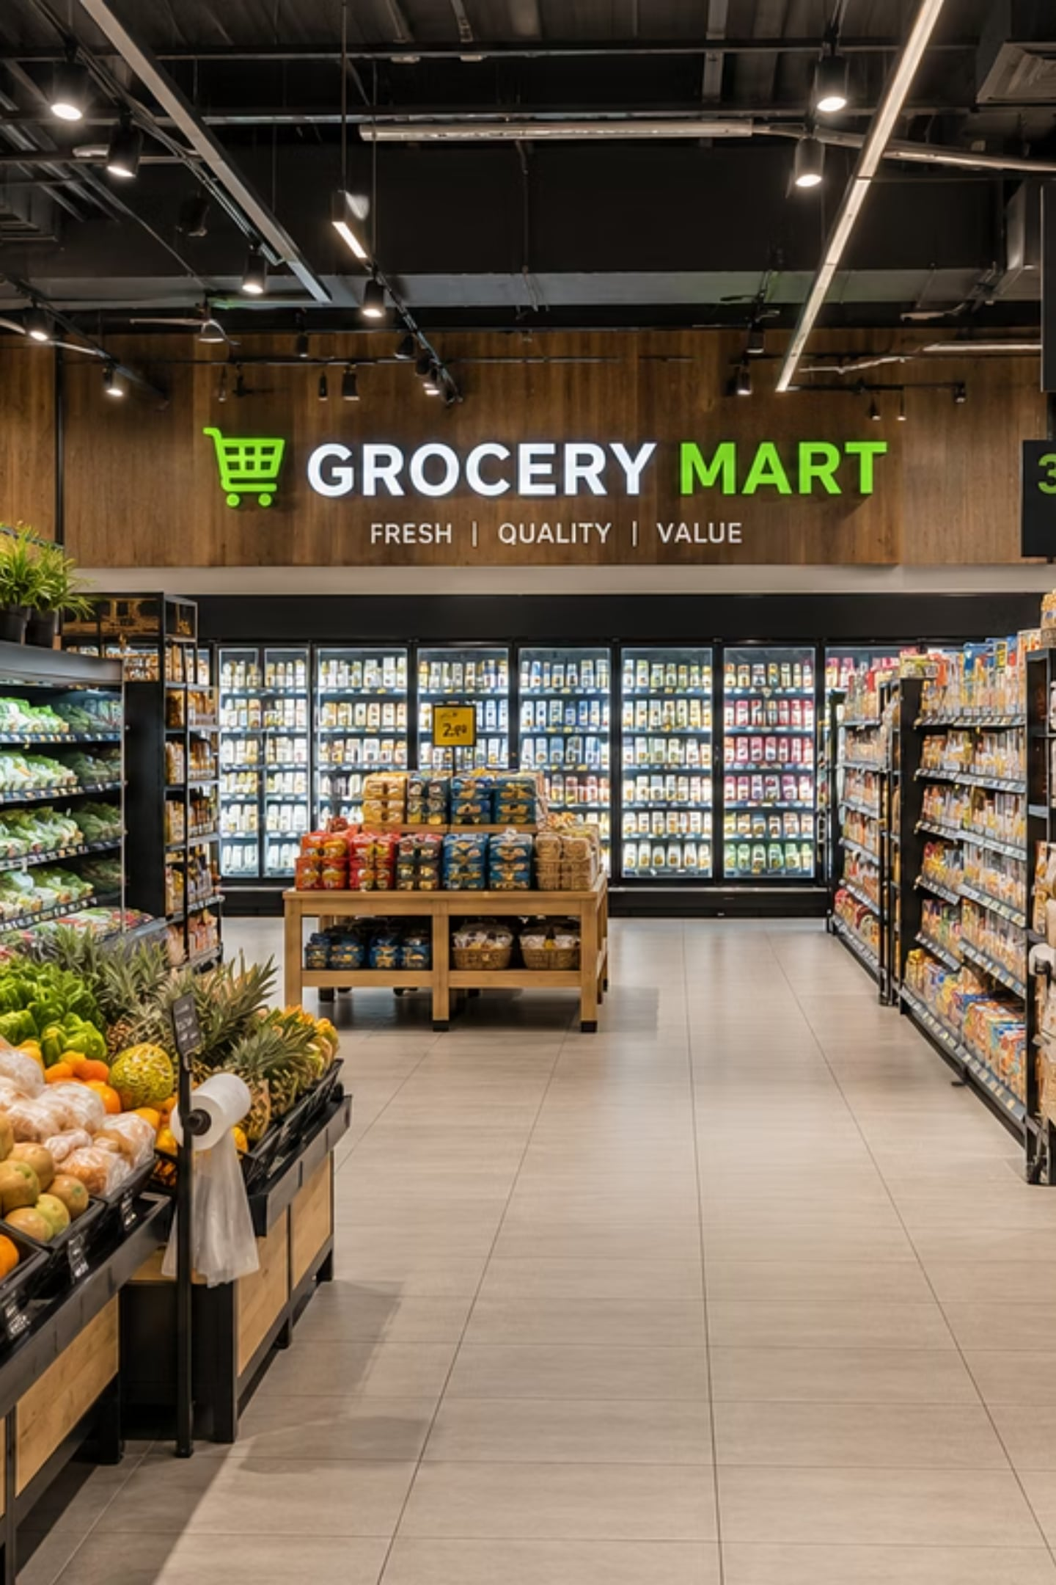
Grocery Management System Using SAP RAP
SAP ABAP & Cloud Development · Module Project Report
SUBMITTED: JULY 21, 2026
Sandeep Chava (100007689) · Nilesh Dokuparthi (100008372) · Vikas Vikas (100008525)

Slide 2


The Problem with Manual Grocery Management
Retail grocery operations manage hundreds of products across multiple stores and categories. Manual processes introduce critical business risks:
Duplicate Records
No semantic key enforcement leads to repeated product entries and data inconsistency.
Inconsistent Pricing
Unvalidated base prices and currency codes produce unreliable financial data.
Missing Details
No mandatory field checks allow incomplete records to enter the system.
No Transaction Safety
Without draft handling, accidental data loss and partial commits are common.

Slide 3
Project Objectives
The Grocery Management System demonstrates SAP RAP capabilities through a cloud-ready enterprise application on SAP Business Technology Platform.
1
Cloud-Ready SAP Application
Develop using SAP ABAP Cloud and the RESTful ABAP Programming Model.
2
Complete CRUD Operations
Implement Create, Read, Update, and Delete for all product records.
3
Draft Functionality
Enable save-as-draft to prevent accidental data loss before activation.
4
Business Validations
Enforce mandatory fields, semantic key checks, and price rules via RAP Behavior.
5
Fiori Elements UI
Expose data via OData V4 with a responsive SAP Fiori Elements interface.

Slide 4
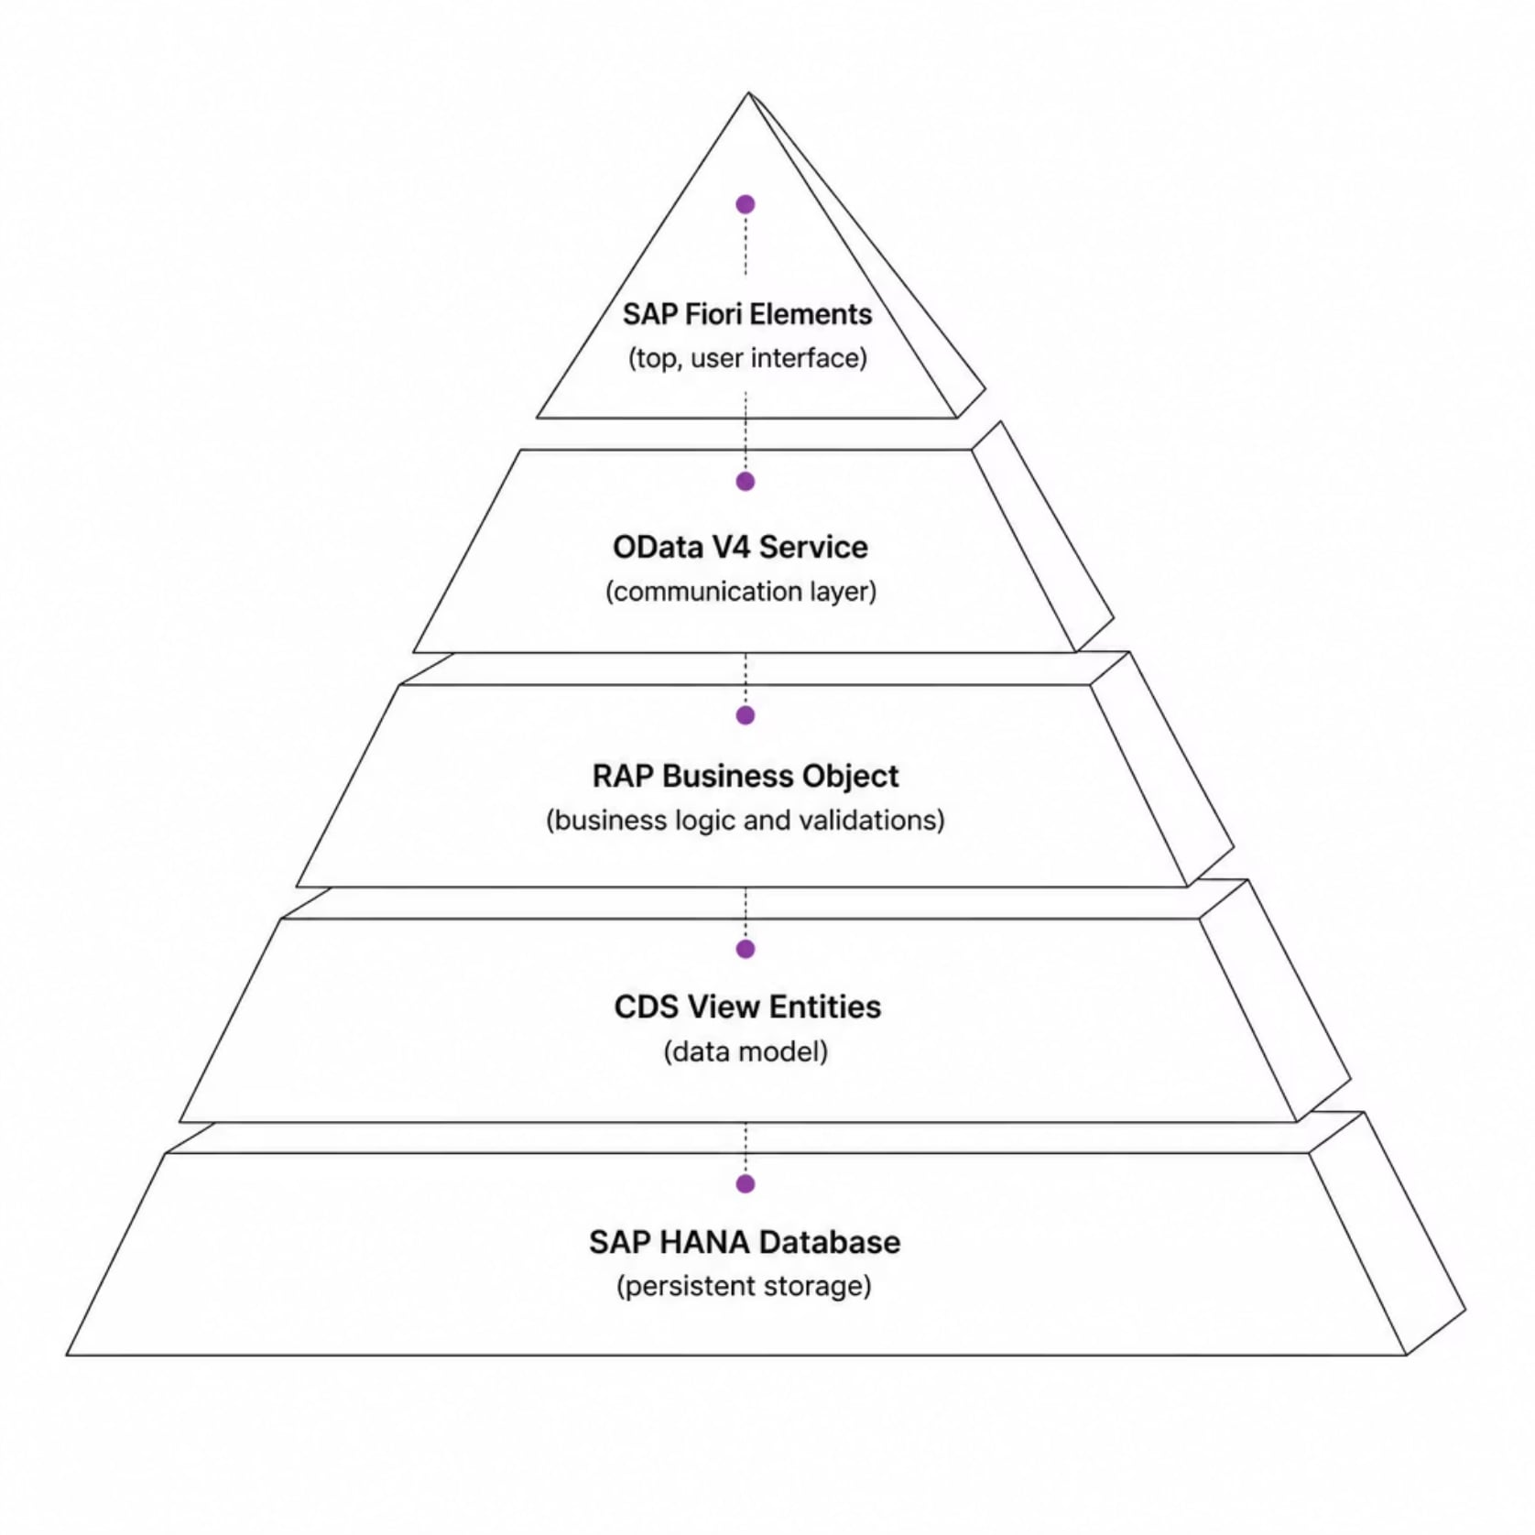
System Architecture
The application follows SAP RAP's layered architecture. All user requests pass through the RAP Business Object — ensuring validations, determinations, and transactional consistency before any data reaches SAP HANA.
SAP Fiori Elements
OData V4 Service
RAP Business Object
CDS View Entities
Responsive UI auto-generated from OData metadata.
Communication layer between frontend and backend.
Core logic: CRUD, validations, determinations, draft control.
Structured data model with UI annotations.
SAP HANA Database
In-memory storage with transactional consistency.

Slide 5
Technologies Used
Technology
Purpose
SAP ABAP Cloud
Backend programming with clean-core standards
SAP RAP
Business object framework for CRUD, drafts, and validations
CDS View Entities
Data modeling with UI annotations
Behavior Definition
Business rules, operations, and draft support
Behavior Implementation
Validation and determination logic
OData V4
Service exposure for Fiori Elements
SAP Fiori Elements
Auto-generated responsive web UI
SAP HANA Database
In-memory persistent storage
Eclipse ADT
Development environment

Slide 6
Functional Modules
Eight modules cover the full product lifecycle with clear separation of concerns.
Product Management
Store Management
CRUD operations for grocery products with semantic key validation.
Unique Store IDs with value help for product association.
Category Management
Product Update
Predefined categories with value help for product assignment.
Edit product details with draft-based transactional safety.
Search Module
Filter & Sort
Locate products by ID, name, store, or category.
Filter by store or category; sort by price or name.
Draft Management
Validation & Rules
Save incomplete work; activate or discard before commit.
Enforce field rules, price checks, and currency validation.

Slide 7
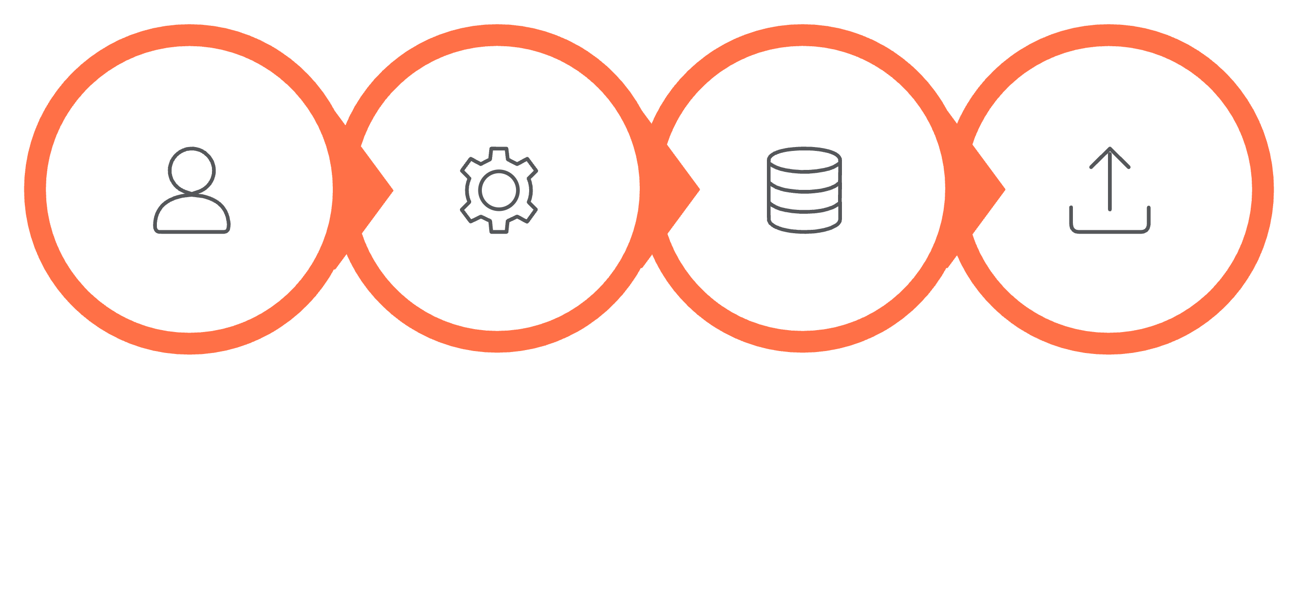
System Workflow
Active Commit
User
RAP Behavior
Draft Store
Every user action flows through the RAP Business Object layer. Validations and determinations execute before any data is persisted, ensuring business rules are enforced and draft integrity is maintained throughout the transaction lifecycle.

Slide 8

Validation Rules & Determinations
Validation Rules
Business Determinations
The RAP Business Object executes these checks before activation. Failed validations halt the transaction and display an error in SAP Fiori.
Default Currency
Price Classification
Automatically assigns EUR when the currency field is left empty during product creation.
Classifies products as Budget, Standard, or Premium based on the entered base price.
Validation
Purpose
Product Name
Cannot be empty
Semantic Key Check
Prevents duplicate Product IDs
Value Helps: Store (ZI_GS_STORE_VH) and Category (ZI_GS_CATEGORY_VH) let users select valid options without manual ID entry.
Store & Category
Selection is mandatory
Currency
Must exist in SAP standard list
Base Price
Must be greater than zero

Slide 9

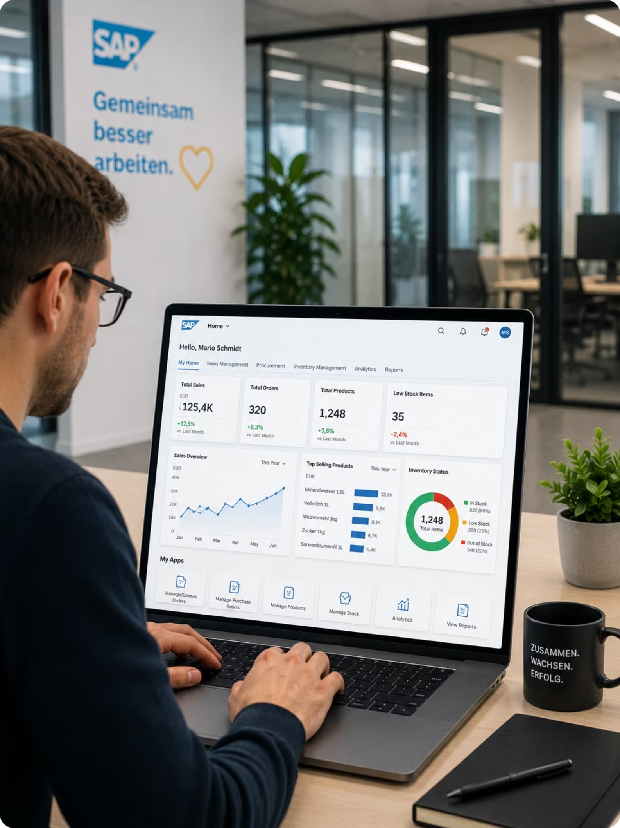

User Guide & Testing
01
Launch the Application
Open from SAP Fiori Launchpad — List Report displays all product records.
02
Create or Edit Records
Use Create or Edit; changes save as drafts until activated.
03
Search, Filter & Sort
Locate records by ID, name, store, or category; sort by price.
04
Delete Records
Remove obsolete items via confirmation dialog to prevent accidental deletion.
Testing: All CRUD, draft, validation, and UI test cases passed. Error handling verified for missing fields, duplicates, and invalid prices.

Slide 10

Conclusion & Future Enhancements
What We Delivered
Future Enhancements
The Grocery Store Management System demonstrates SAP RAP using ABAP Cloud, CDS View Entities, Behavior Definitions, OData V4, and SAP Fiori Elements — with full CRUD, draft management, semantic key validation, value helps, and business validations ensuring transactional consistency.
Inventory Management & Stock Availability Tracking
Supplier Management & Purchase Order Integration
This project provides a scalable foundation for future retail management enhancements and showcases modern SAP Cloud development practices.
Barcode Integration & Product Images
Discount & Offer Management
Role-Based Authorization & Analytics Dashboard

