Slide 1
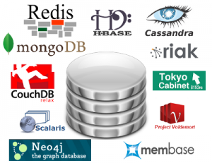

Notes:
NoSQL DEFINITION: Next Generation Databases mostly addressing some of the points: being non-relational, distributed, open-source and horizontally scalable. The original intention has been modern web-scale databases. The movement began early 2009 and is growing rapidly. Often more characteristics apply such as: schema-free, easy replication support, simple API, eventually consistent / BASE (not ACID), a huge amount of data and more. So the misleading term "nosql" (the community now translates it mostly with "not only sql") should be seen as an alias to something like the definition above. [based on 7 sources, 14 constructive feedback emails (thanks!) and 1 disliking comment . Agree / Disagree? Tell me so! By the way: this is a strong definition and it is out there here since 2009!]

Slide 2

www.mongodb.org
Document-Oriented Storage
Full Index Support
Replication & High Availability
Auto-Sharding
Querying
Fast In-Place Updates
Map/Reduce
GridFS
Commercial Support
Notes:
MongoDB (from "humongous") is an open-source document database, and the leading NoSQL database. Written in C++, MongoDB features:
Document-Oriented Storage » JSON-style documents with dynamic schemas offer simplicity and power.
Full Index Support » Index on any attribute, just like you're used to.
Replication & High Availability » Mirror across LANs and WANs for scale and peace of mind.
Auto-Sharding » Scale horizontally without compromising functionality.
Querying » Rich, document-based queries.
Fast In-Place Updates » Atomic modifiers for contention-free performance.
Map/Reduce » Flexible aggregation and data processing.
GridFS » Store files of any size without complicating your stack.
Commercial Support » Enterprise class support, training, and consulting available.

Slide 3
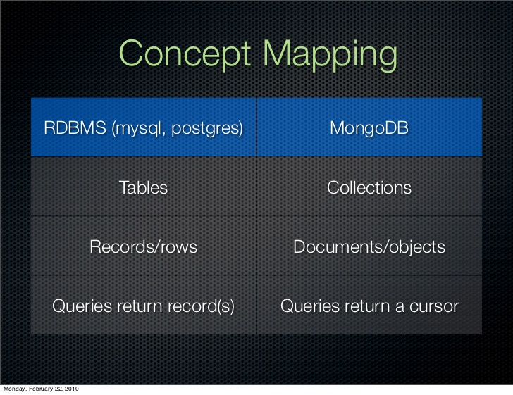
Notes:
Introduction to MongoDB
Overview
MongoDB is a document database that provides high performance, high availability, and easy scalability.
Document Database
Documents (objects) map nicely to programming language data types.
Embedded documents and arrays reduce need for joins.
Dynamic schema makes polymorphism easier.
High Performance
Embedding makes reads and writes fast.
Indexes can include keys from embedded documents and arrays.
Optional streaming writes (no acknowledgments).
High Availability
Replicated servers with automatic master failover.
Easy Scalability
Automatic sharding distributes collection data across machines.
Eventually-consistent reads can be distributed over replicated servers.
MongoDB Data Model
A MongoDB deployment hosts a number of databases. A database holds a set of collections. A collection holds a set of documents. A document is a set of key-value pairs. Documents have dynamic schema. Dynamic schema means that documents in the same collection do not need to have the same set of fields or structure, and common fields in a collection’s documents may hold different types of data.
See Document Structure and Data Modeling for more information.

Slide 4
Let’s try Mongo!
Mongo Server
Client
DB Model
CRUD operation
Notes:
http://www.informit.com/guides/content.aspx?g=java&seqNum=634
http://docs.mongodb.org/manual/core/read/

Slide 5
Mongo In Java
Java API
CRUD example
User Profile Data Application

Slide 6
Contest
HR Skills application
Users have simple profile data (as in sample app)
Describe skills in categories
Can attach certificates to skills (might be ‘txt’ file)
Skills have proficiency levels
Query users with specific skill
Query user with skill and level
Query for multiple skills

