Slide 1

The Geeky Quickies
NoSQL
Chavdar Baikov

Slide 2

In real life

Slide 3

In real life

Slide 4


Slide 5

www.mongodb.org
Document-Oriented Storage
Full Index Support
Replication & High Availability
Auto-Sharding
Querying
Fast In-Place Updates
Map/Reduce
GridFS
Commercial Support
Notes:
MongoDB (from "humongous") is an open-source document database, and the leading NoSQL database. Written in C++, MongoDB features:
Document-Oriented Storage » JSON-style documents with dynamic schemas offer simplicity and power.
Full Index Support » Index on any attribute, just like you're used to.
Replication & High Availability » Mirror across LANs and WANs for scale and peace of mind.
Auto-Sharding » Scale horizontally without compromising functionality.
Querying » Rich, document-based queries.
Fast In-Place Updates » Atomic modifiers for contention-free performance.
Map/Reduce » Flexible aggregation and data processing.
GridFS » Store files of any size without complicating your stack.
Commercial Support » Enterprise class support, training, and consulting available.

Slide 6
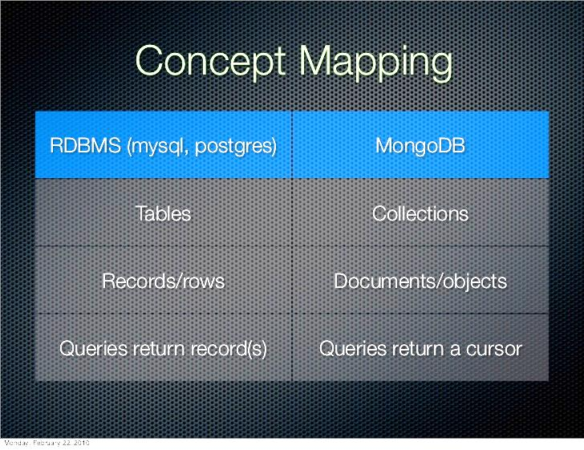

Slide 7
JSON/BSON Document
{ _id: ObjectID('12345...'),
message: 'Feeling good today',
user: 'shaines',
picture: {
url: 'http://media.geekcap.com/pictures/pic.jpg',
title: 'Beautiful Sunrise'
},
comments: [
{user: 'michael',
message: 'Good to hear'},
{user: 'rebecca',
message: 'That makes me happy'}
]
}

Slide 8
Let’s try Mongo!
Mongo Server
Client
DB Model
CRUD operation

Slide 9
Mongo In Java
Java API
CRUD example
User Profile Data Application

Slide 10

Open JDK 6
http://www.redhat.com/about/news/press-archive/2013/3/red-hat-reinforces-java-commitment

Slide 11

JBoss WildFly
http://www.redhat.com/about/news/press-archive/2013/4/red-hat-reveals-plans-for-its-next-generation-java-application-server-project

Slide 12
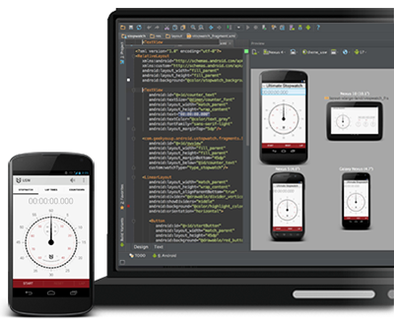
Android Studio
http://developer.android.com/sdk/installing/studio.html

Slide 13
Geeky Contest - ranking
Dimitar Valov 5
Petar Kazakov 3

Slide 14
Geeky Contest – task
Write an HR Skills Application
Users have simple profile data (as in sample app)
Describe skills in categories
Can attach certificates to skills (might be ‘txt’ file)
Skills have proficiency levels
Query users with specific skill
Query user with skill and level
Query for multiple skills

Slide 15
References
Mongo DB
http://www.mongodb.org/
Mongo tutorial
http://www.informit.com/guides/content.aspx?g=java&seqNum=631
MongoExample Project in GitHub
https://github.com/chavdarb/SAPHanaCloudApps

Slide 16

Thank you!

