Slide 1
Univariate Analysis

Slide 2
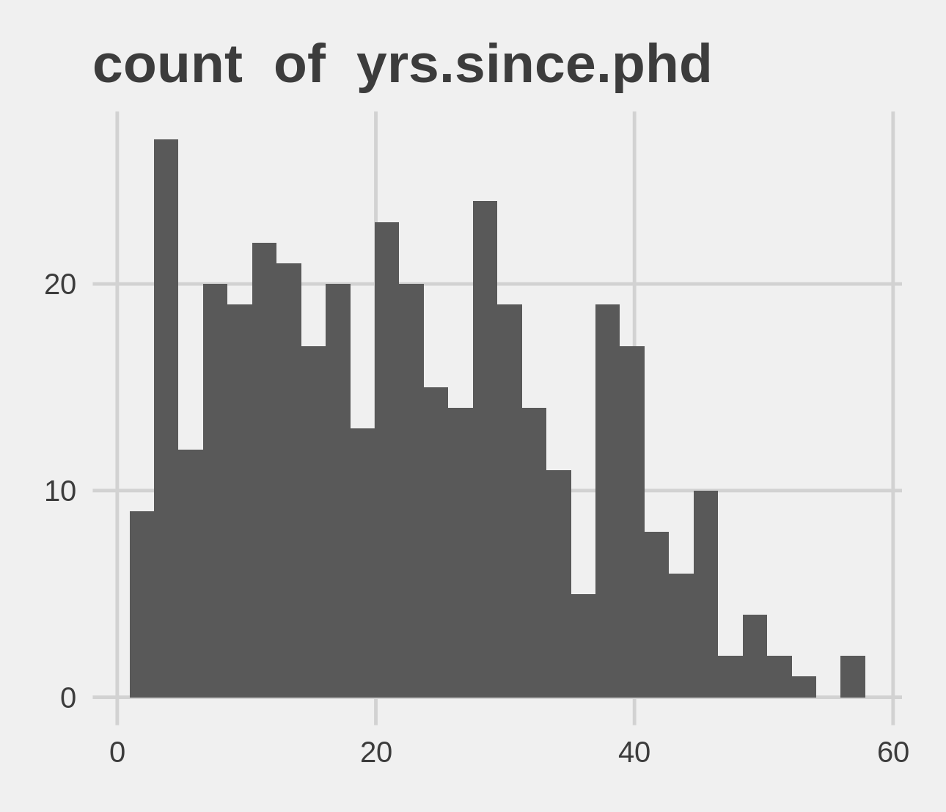
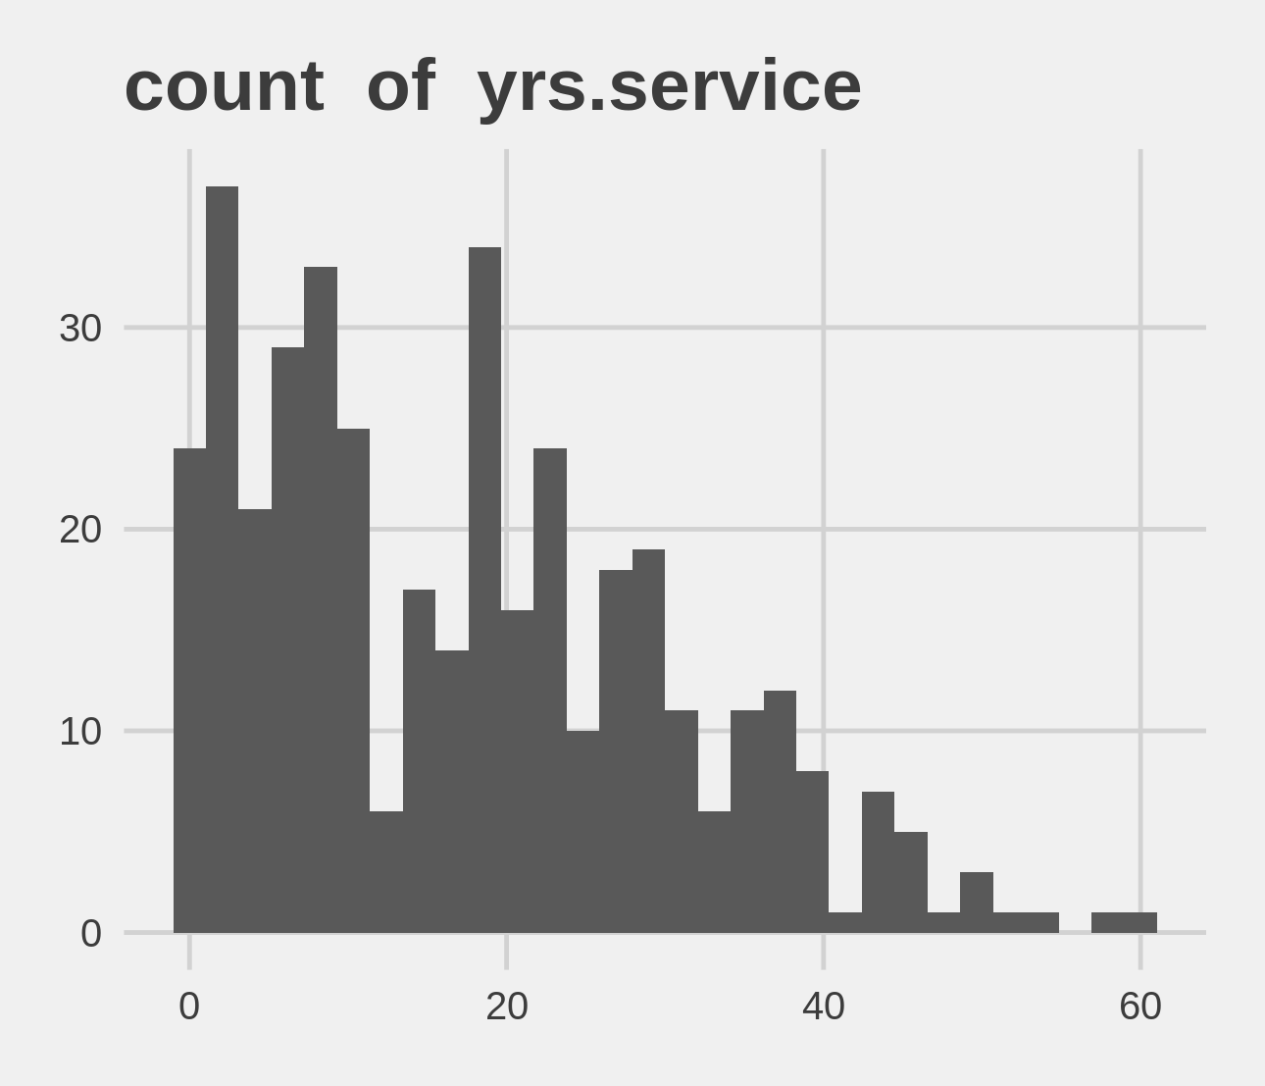
Univariate Analysis Slide 1 of 3
min | 25th | 50th | 75th | max
1 | 12 | 21 | 32 | 56
min | 25th | 50th | 75th | max
0 | 7 | 16 | 26.5 | 60

Slide 3
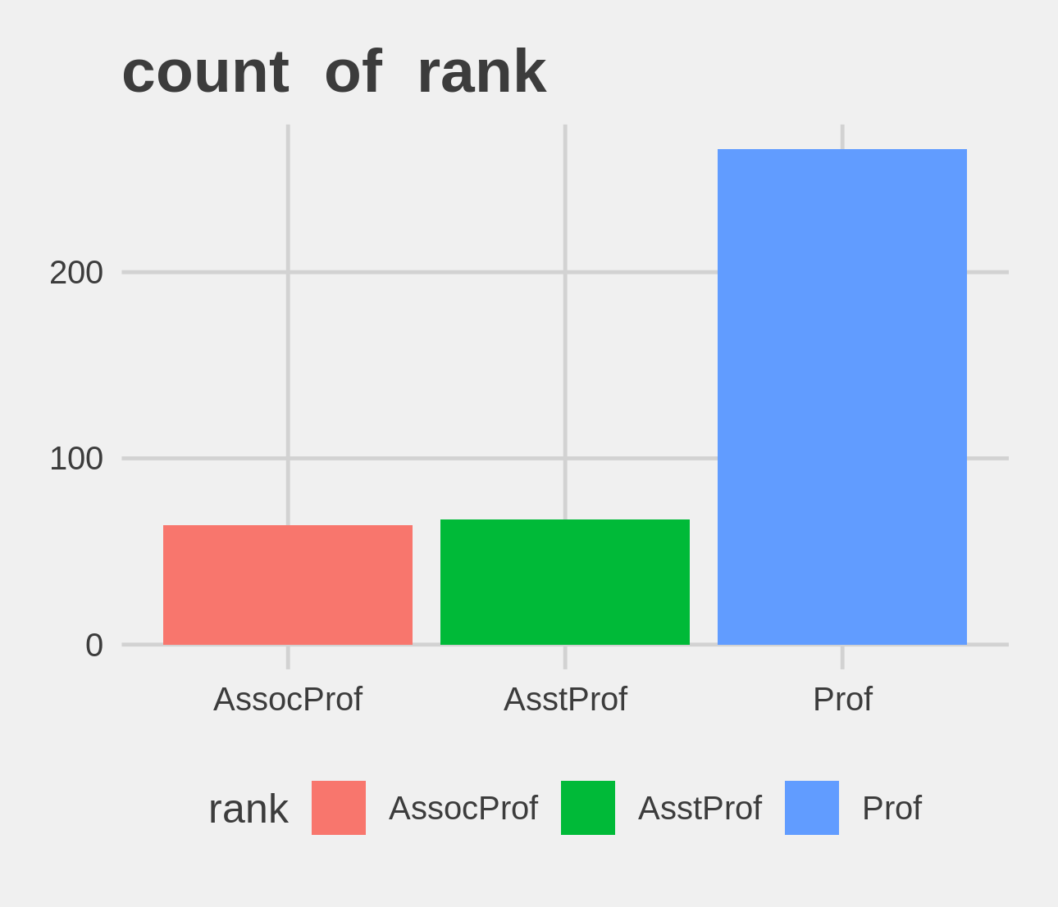
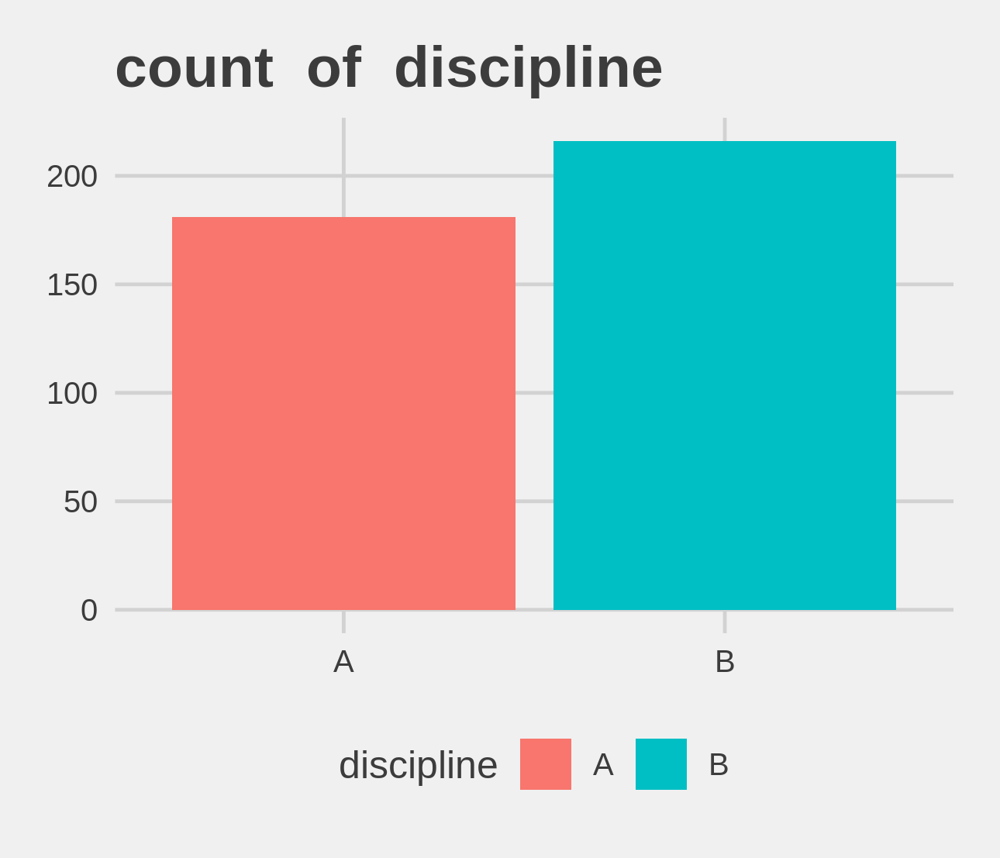
Univariate Analysis Slide 2 of 3
Metric | AssocProf | AsstProf | Prof
Count | 64 | 67 | 266
Perct. | 16.12% | 16.88% | 67%
Metric | A | B
Count | 181 | 216
Perct. | 45.59% | 54.41%

Slide 4
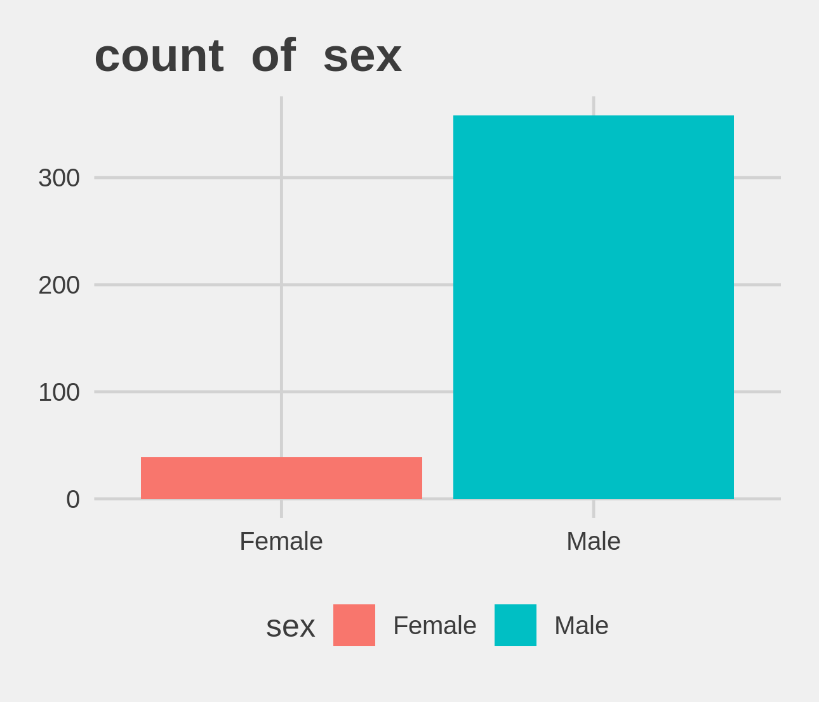
Univariate Analysis Slide 3 of 3
Metric | Female | Male
Count | 39 | 358
Perct. | 9.82% | 90.18%

Slide 5
Bi-variate analysis

Slide 6
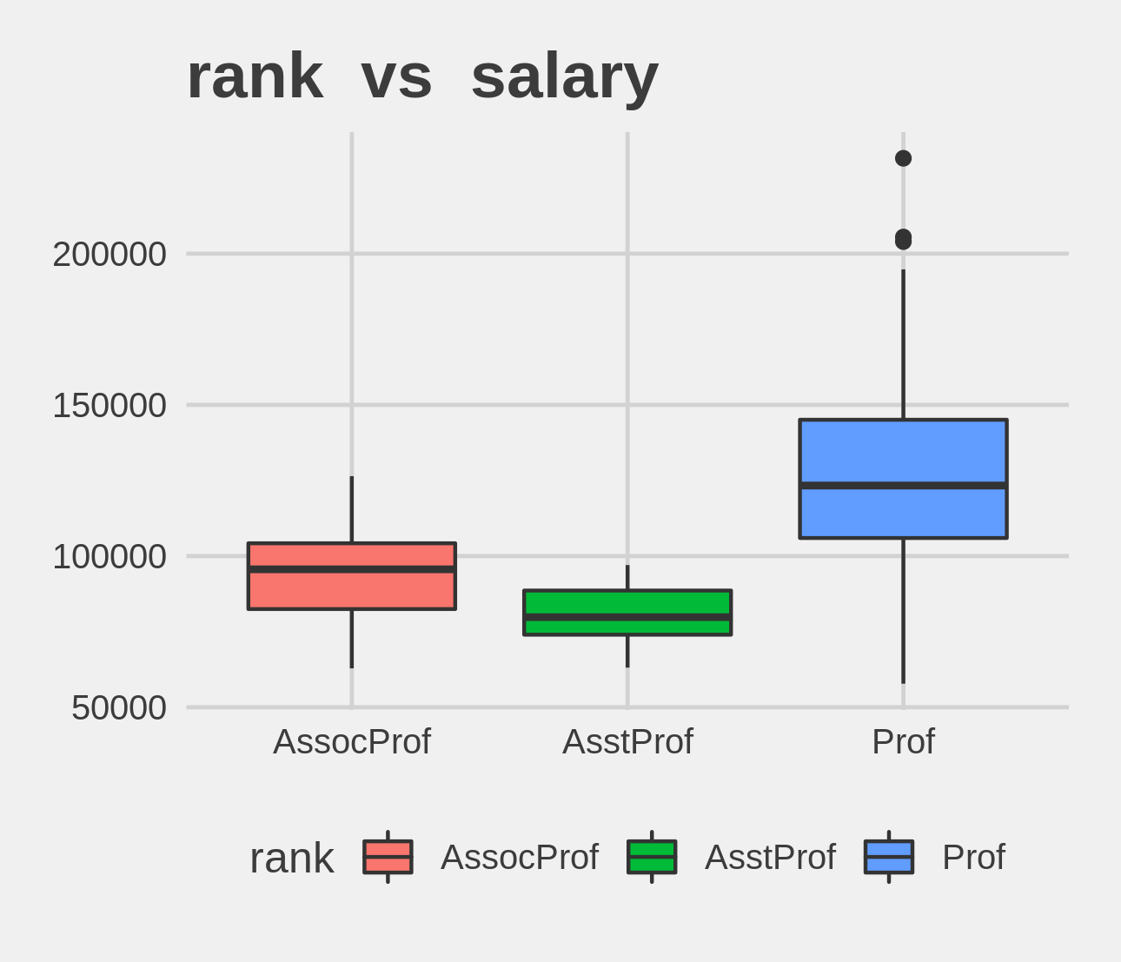
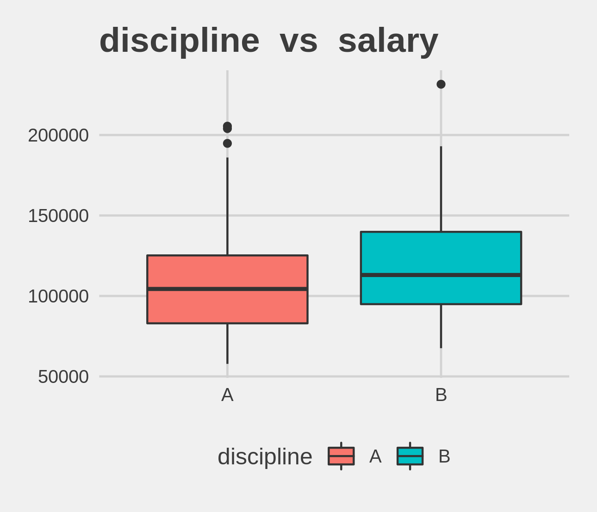
Bi-variate analysis Slide 1 of 3
rank | mean - salary | median - salary
AssocProf | 93876.44 | 95626.5
AsstProf | 80775.99 | 79800.0
Prof | 126772.11 | 123321.5
discipline | mean - salary | median - salary
A | 108548.4 | 104350.0
B | 118028.7 | 113018.5

Slide 7
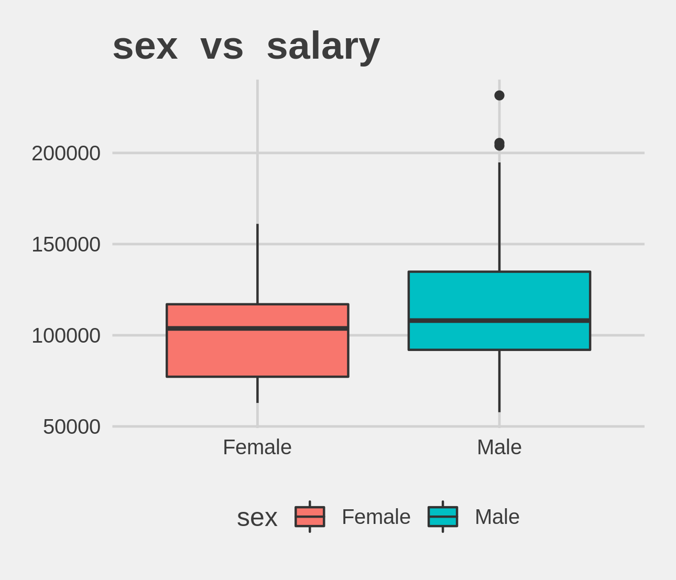
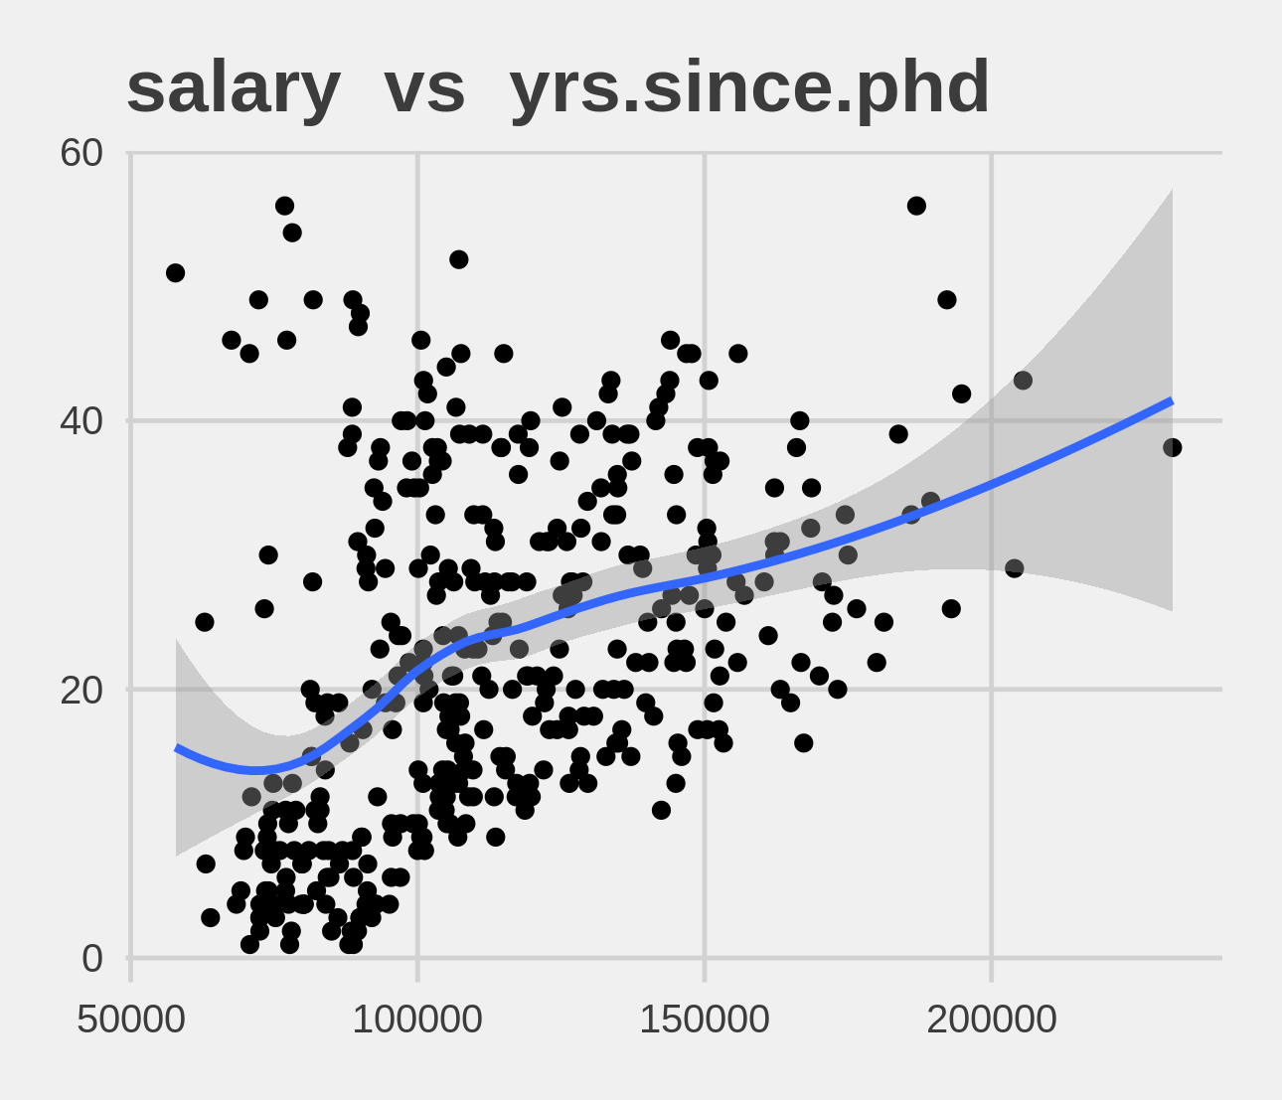
Bi-variate analysis Slide 2 of 3
sex | mean - salary | median - salary
Female | 101002.4 | 103750
Male | 115090.4 | 108043
Feature | Correlation with Target
yrs.since.phd | 0.419

Slide 8
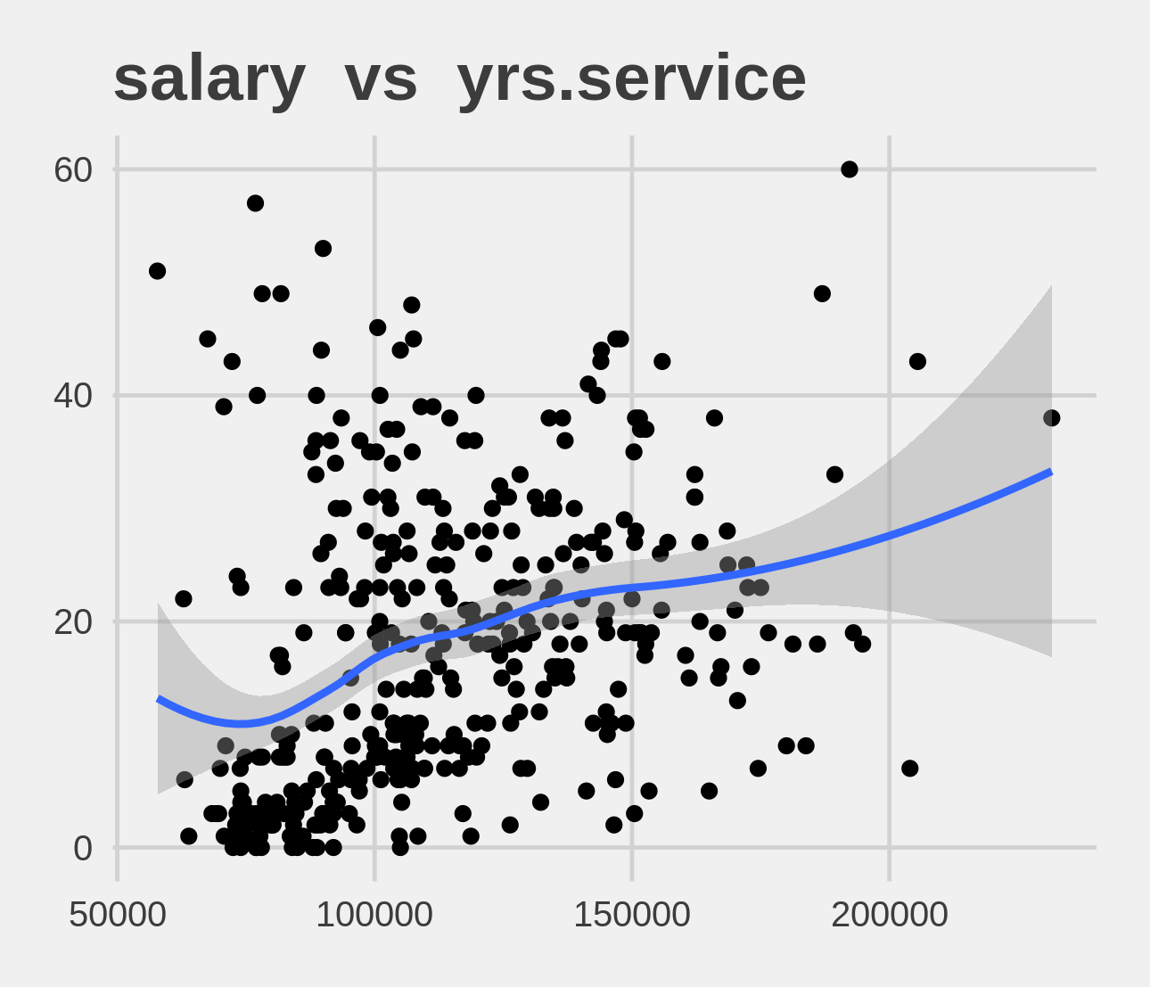
Bi-variate analysis Slide 3 of 3
Feature | Correlation with Target
yrs.service | 0.336

