Slide 1
Virtual File System & Disk Intelligence Simulator
An Integrated Operating System Simulation Platform
Submitted To : Prof. Sonia Relan
Submitted By : Chavi Maheshwari(N228)

Slide 2
INTRODUCTION TO VFS NEXUS
Operating Systems manage essential resources such as files, storage, threads, synchronization, and disk operations. Understanding these concepts individually can make it difficult to visualize how they work together in an actual system.
VFS NEXUS is a web-based simulation platform designed to provide a visual and interactive understanding of core Operating System concepts.
The simulator integrates:
Virtual File System — creation and management of virtual files
Disk Storage — virtual block allocation and storage tracking
Concurrency Control — Readers-Writers synchronization and mutex locks
Disk Scheduling — SCAN, C-SCAN, SSTF and FCFS algorithms
System Pipeline — connects these operations into one complete workflow

Slide 3
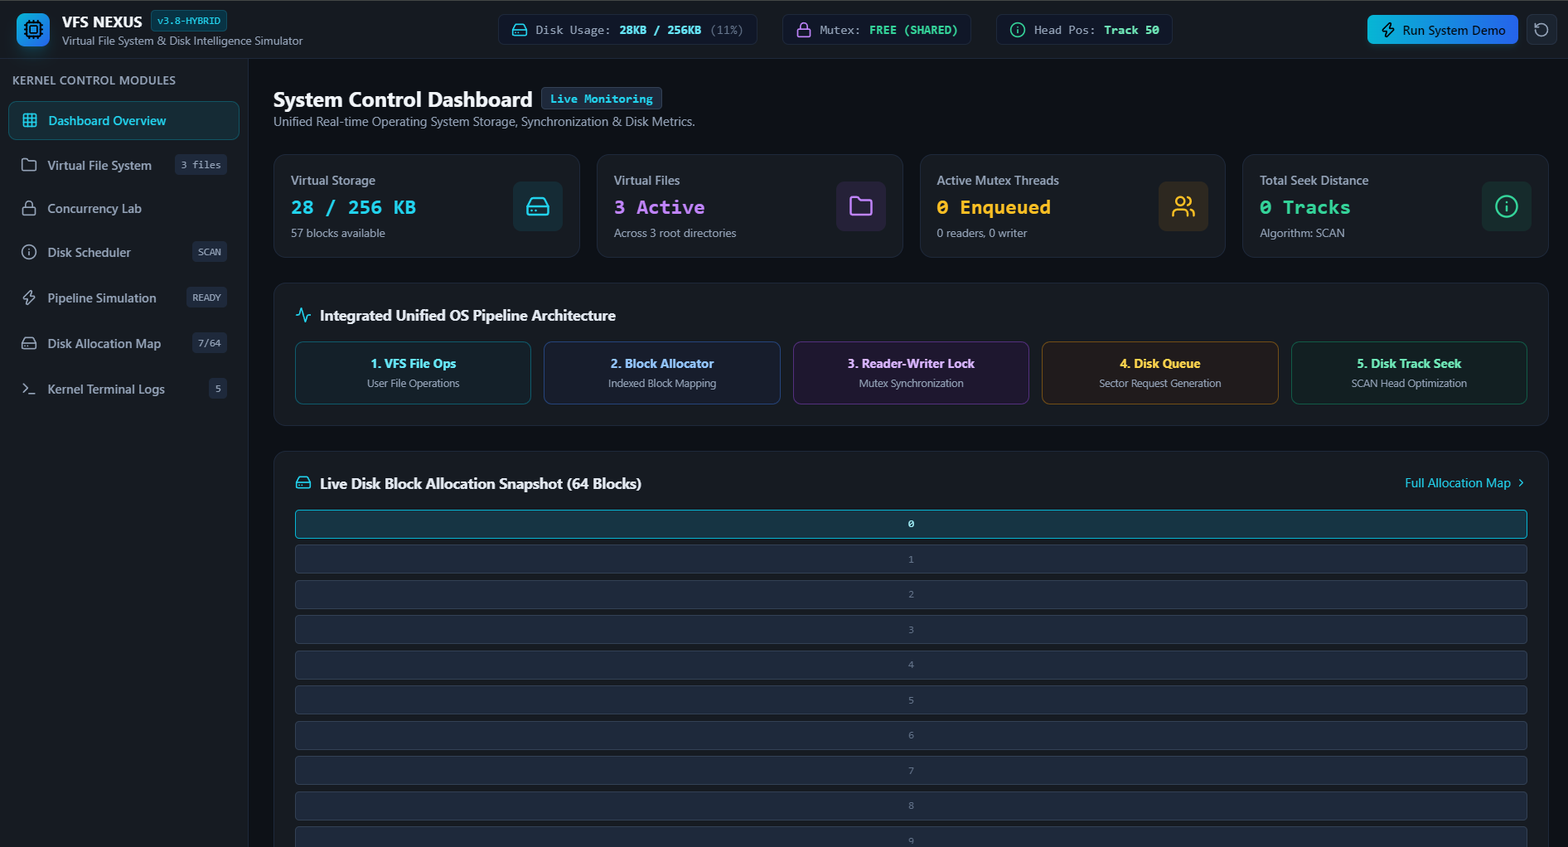
DASHBOARD

Slide 4
PROBLEM STATEMENT & OBJECTIVES
PROBLEM STATEMENT
Understanding Operating System concepts through theory alone can make it difficult to visualize how different components work during actual execution.
- Key Challenges
File management and disk storage are difficult to visualize.
Concurrent access by multiple readers and writers requires proper synchronization.
Mutex and locking mechanisms can be difficult to understand practically.
Disk scheduling algorithms involve complex head movement and request ordering.
These concepts are generally demonstrated separately, making their interaction difficult to observe.
PROJECT OBJECTIVES
VFS NEXUS aims to:
Simulate a Virtual File System
Demonstrate Indexed Block Allocation
Implement Readers-Writers Synchronization
Visualize Mutex and Thread Management
Implement Disk Scheduling Algorithms
Integrate all operations into one OS Pipeline

Slide 5
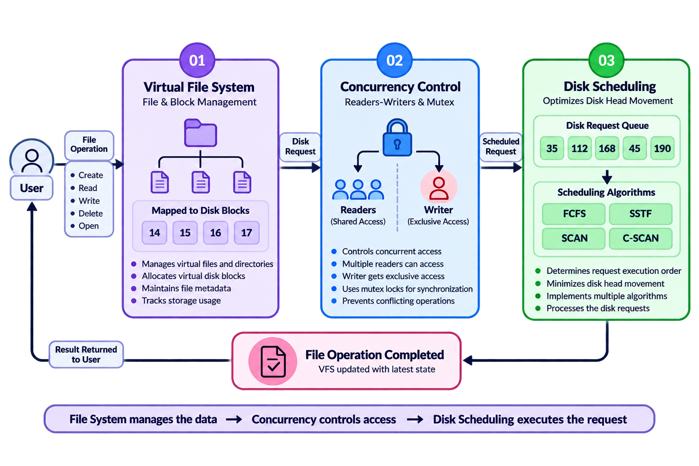
INTEGRATED WORKING OF VFS NEXUS

Slide 6
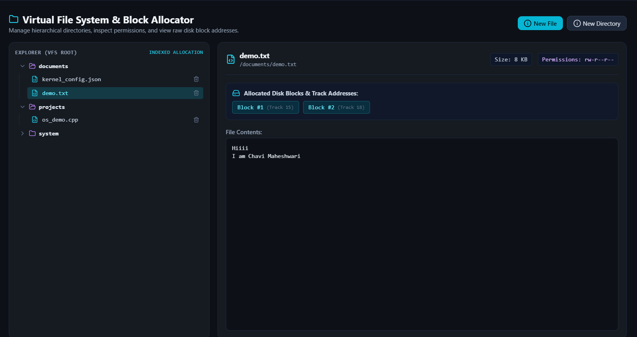
VIRTUAL FILE SYSTEM(VFS)
Managing Files, Directories & Disk Blocks
What VFS Does
Manages files & directories
Allocates virtual disk blocks
Maintains file metadata
Tracks used/free blocks
Indexed Block Allocation
Maps files to specific disk blocks
Example: demo.txt → 1,2
Enables efficient tracking of file storage

Slide 7
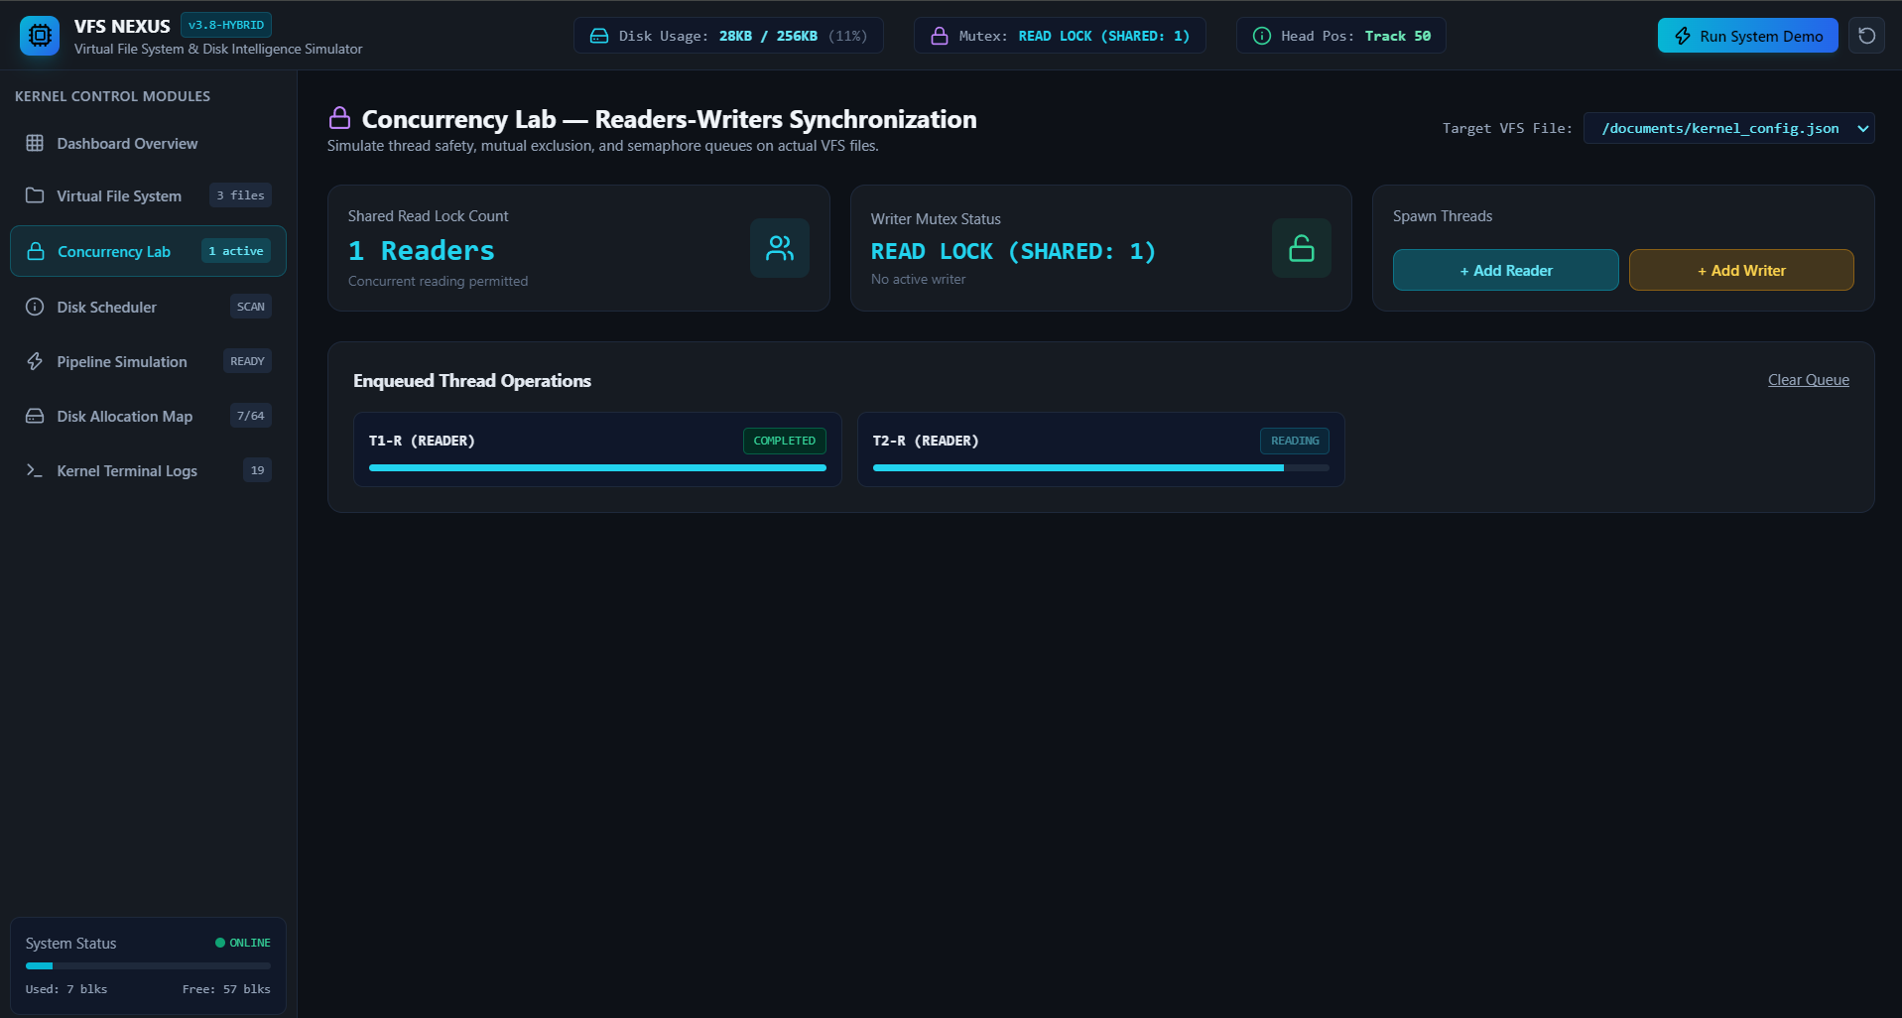
READER–WRITER SYNCHRONIZATION
Managing concurrent access to shared files
Why is it needed?
Multiple threads may access the same file simultaneously.
Readers can access the file together because they do not modify data.
A Writer needs exclusive access to prevent conflicts and inconsistent data.
The Reader–Writer Mutex controls which threads can access the file.
How It Works
Reader → Shared Lock → Concurrent Reading
Writer → Exclusive Lock → File Update

Slide 8
DISK SCHEDULING
Optimizing the movement of the disk head
Why is Disk Scheduling Needed?
Multiple file operations generate disk I/O requests.
The disk head must move between different track positions.
Poor request ordering can cause unnecessary head movement.
Disk scheduling algorithms determine the order in which requests are served.
Algorithms Implemented
Algorithm | Basic Idea
FCFS | Services requests in the order they arrive
SSTF | Selects the request closest to the current head
SCAN | Moves in one direction, serving requests along the way
C-SCAN | Services requests in one direction and then returns to the beginning

Slide 9
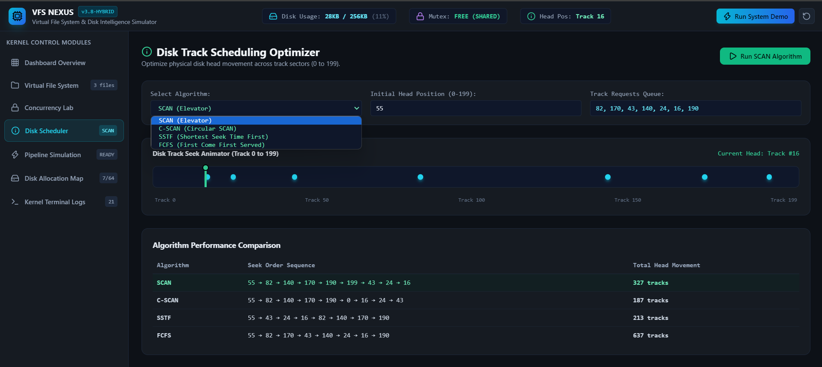
Disk Scheduling

Slide 10
INTEGRATED OPERATING SYSTEM PIPELINE
1. VFS File Operations
Creates, reads, writes and deletes virtual files.
2. Indexed Block Allocation
Maps files to specific virtual disk blocks.
3. Reader–Writer Synchronization
Controls concurrent access using shared and exclusive locks.
4. Disk Request Queue
Collects the generated disk I/O requests.
5. Disk Scheduling
Selects the order in which requests are processed.
6. Disk Head Movement
Calculates and optimizes disk-head movement using the selected scheduling algorithm.

Slide 11
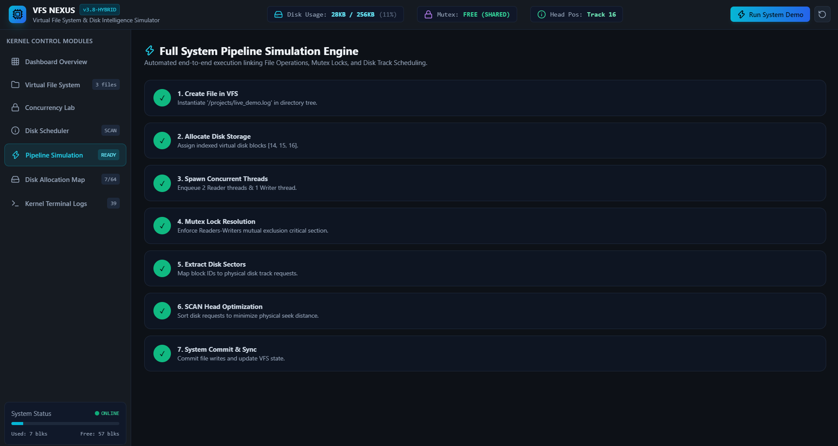
Integrated OS Pipeline

Slide 12
DISK ALLOCATION & BLOCK MANAGEMENT
Tracking how virtual disk space is used
What does it do?
Represents the virtual disk as a fixed number of blocks.
Maintains the status of each block as used or free.
Allocates free blocks when a new file is created.
Maps each file to its assigned disk blocks.
Updates the allocation map whenever file operations occur.
Indexed Block Allocation
File → Index Block → Data Blocks
Example : demo.txt → [1,2]
This allows VFS Nexus to track exactly where each file is stored in the virtual disk.

Slide 13
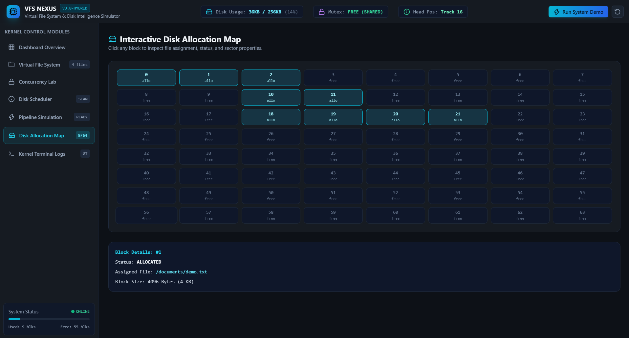
Quote

Slide 14

Quote

Slide 15
KERNEL TERMINAL & SYSTEM LOGS
Real-time visibility into OS operations
What does it provide?
Records important events generated by different OS modules.
Shows VFS file operations such as file creation and storage allocation.
Logs Reader–Writer synchronization and lock acquisition.
Records disk scheduling and sector/track requests.
Tracks the execution of the integrated system pipeline.
Helps identify the sequence of operations and debug system behavior.
Example Log Flow
VFS Operation Block Allocation Thread Creation Mutex / Lock Acquisition Disk Request Generation
Disk Scheduling
Why is it useful?
The terminal logs provide a trace of what is happening inside the simulated OS.

Slide 16
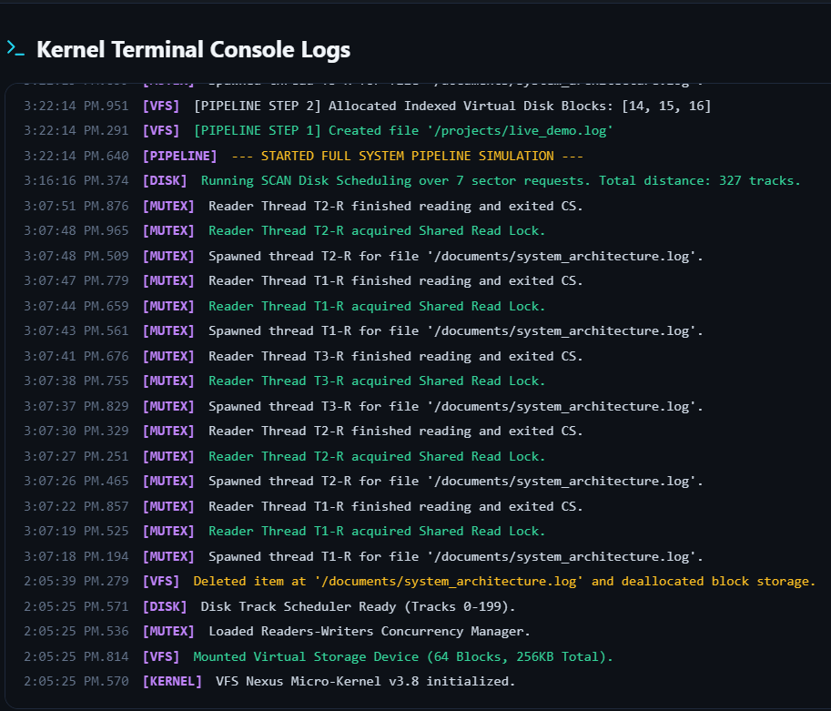
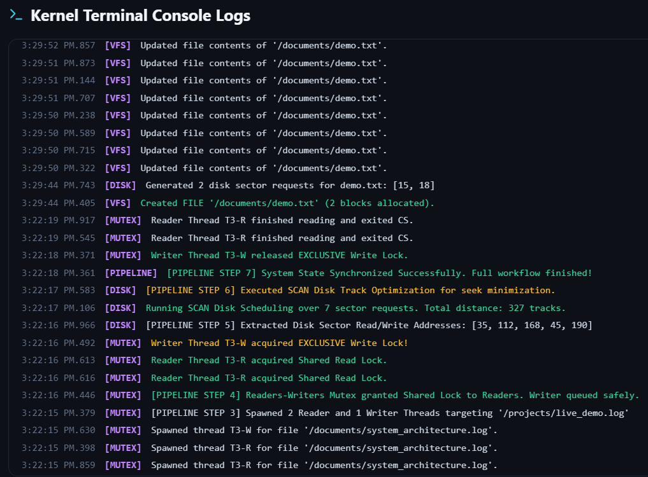
Quote
Kernel Terminal Logs

Slide 17
CONCLUSION & FUTURE SCOPE
Conclusion
VFS Nexus provides an interactive simulation of important Operating System concepts in one platform.
It demonstrates Virtual File System operations and Indexed Block Allocation.
Reader–Writer synchronization manages concurrent file access using shared and exclusive locks.
Disk scheduling algorithms optimize the order of disk requests and track movement.
The integrated pipeline shows how these components work together during system execution.
Real-time dashboards and kernel logs make internal OS operations easier to visualize and understand.
Future Scope
Add more file allocation and disk scheduling algorithms.
Introduce additional CPU scheduling and memory management modules.
Add process creation, process scheduling and deadlock simulation.
Provide detailed performance comparison charts for different algorithms.
Expand the simulator into a more complete web-based OS learning platform.

Slide 18
Thank you

