Slide 1
Foundations of Business Analytics
Analysis using Tableau
CHAVI SINGAL
MSBA 2019-20

Slide 2
SUICIDE RATES OVERVIEW 1985 TO 2016

Slide 3
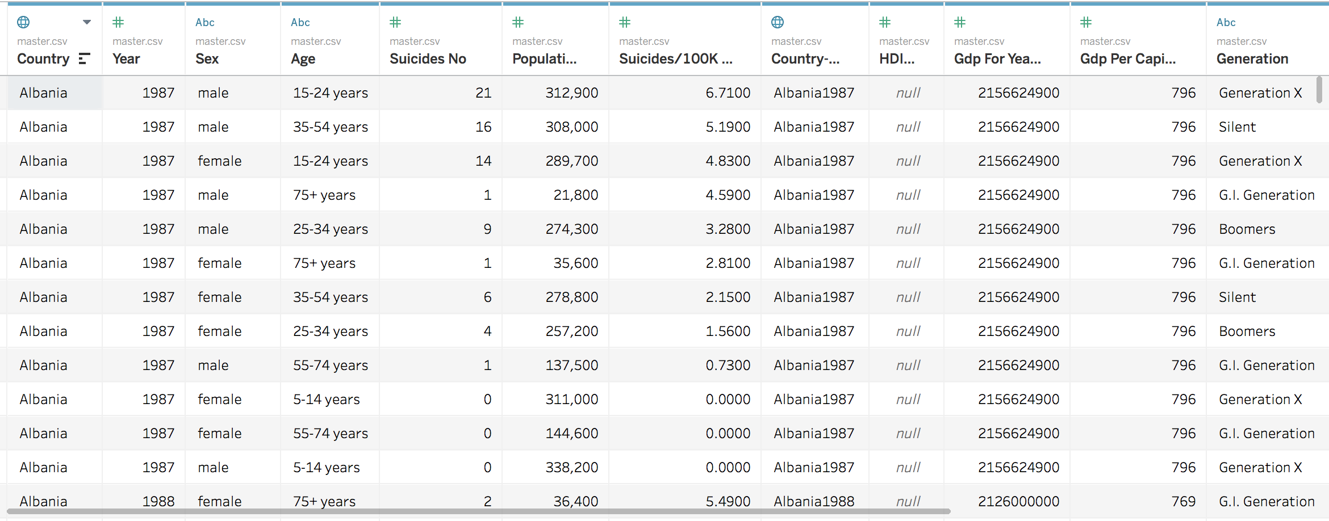
Data Overview
The data contains 12 variables and 27820 observations
The HDI variable was not used due to 2/3rd missing values
Data for the year 2016 was not used as it was missing for most countries
Generation variable is ambiguous as the age range is too large
Data not available for most of the African and South-East Asian countries

Slide 4
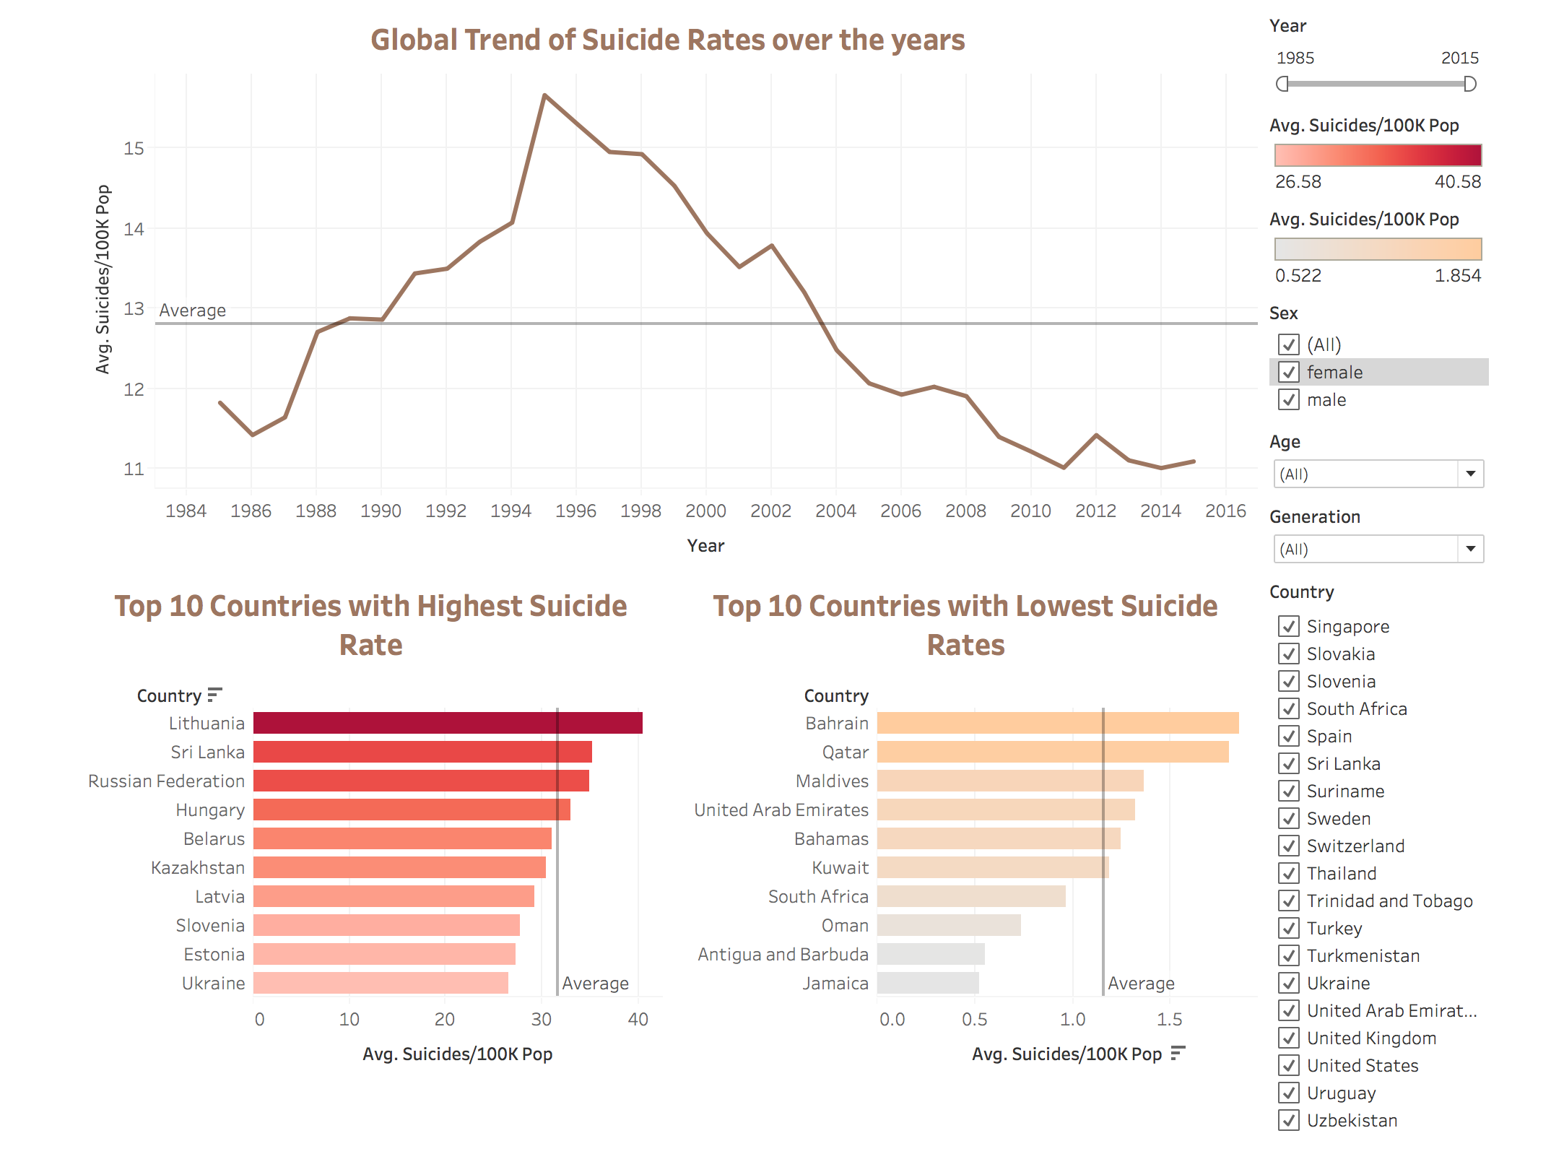
Dashboard : Overview of Suicide Rates by Countries
-The average suicide rate is 12.797 which implies that approximately 13 people suicide per 100k people.
-The suicide rate hit a peak in 1995 at 15.663 and has been declining since then.
-The average for top 10 countries with highest suicide rate is 31.64.
-The average for top 10 countries with lowest suicide rates is 1.154.

Slide 5
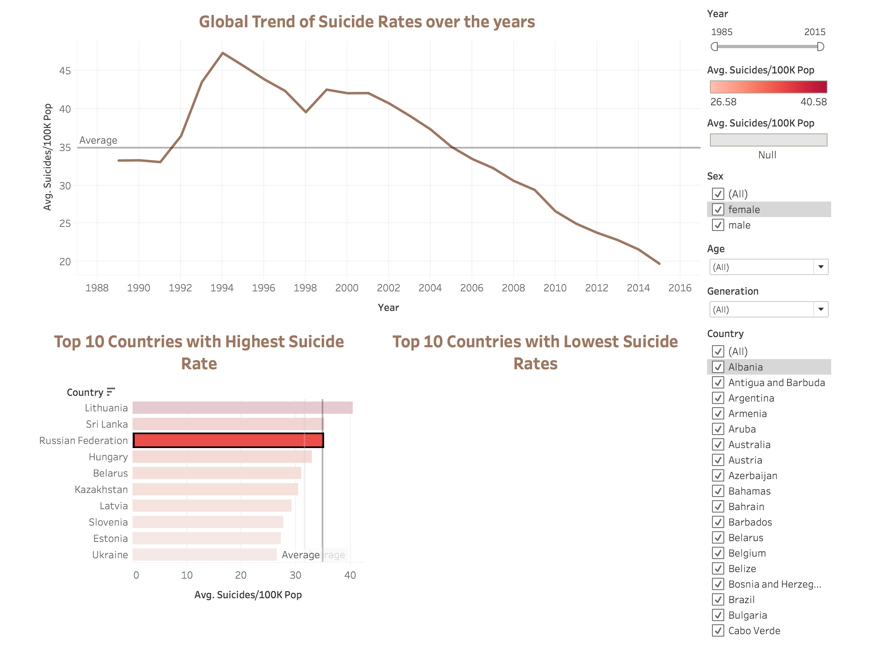
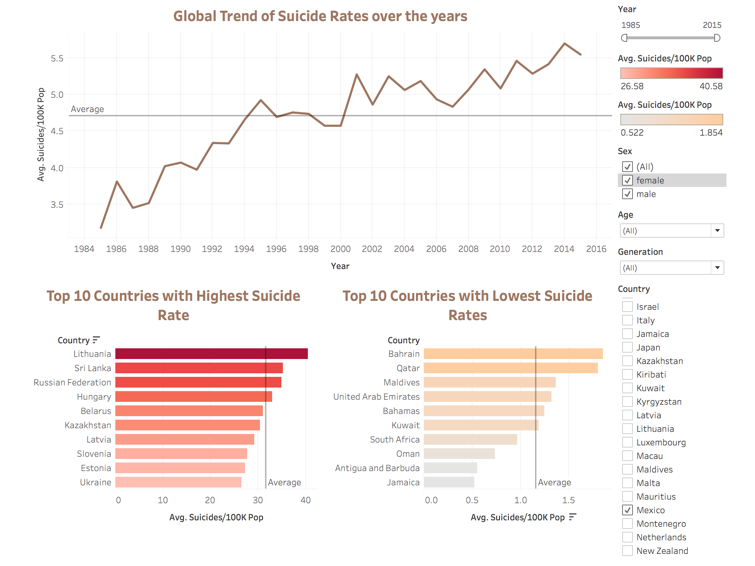
We see that while the global trend has been decreasing, it is not true for all countries. For example, while the trend for Russia has been decreasing consistently, we see that for Mexico there has been an increase in the past few years.
Similarly, we can see the individual trends for other countries using the filters on the right side.

Slide 6
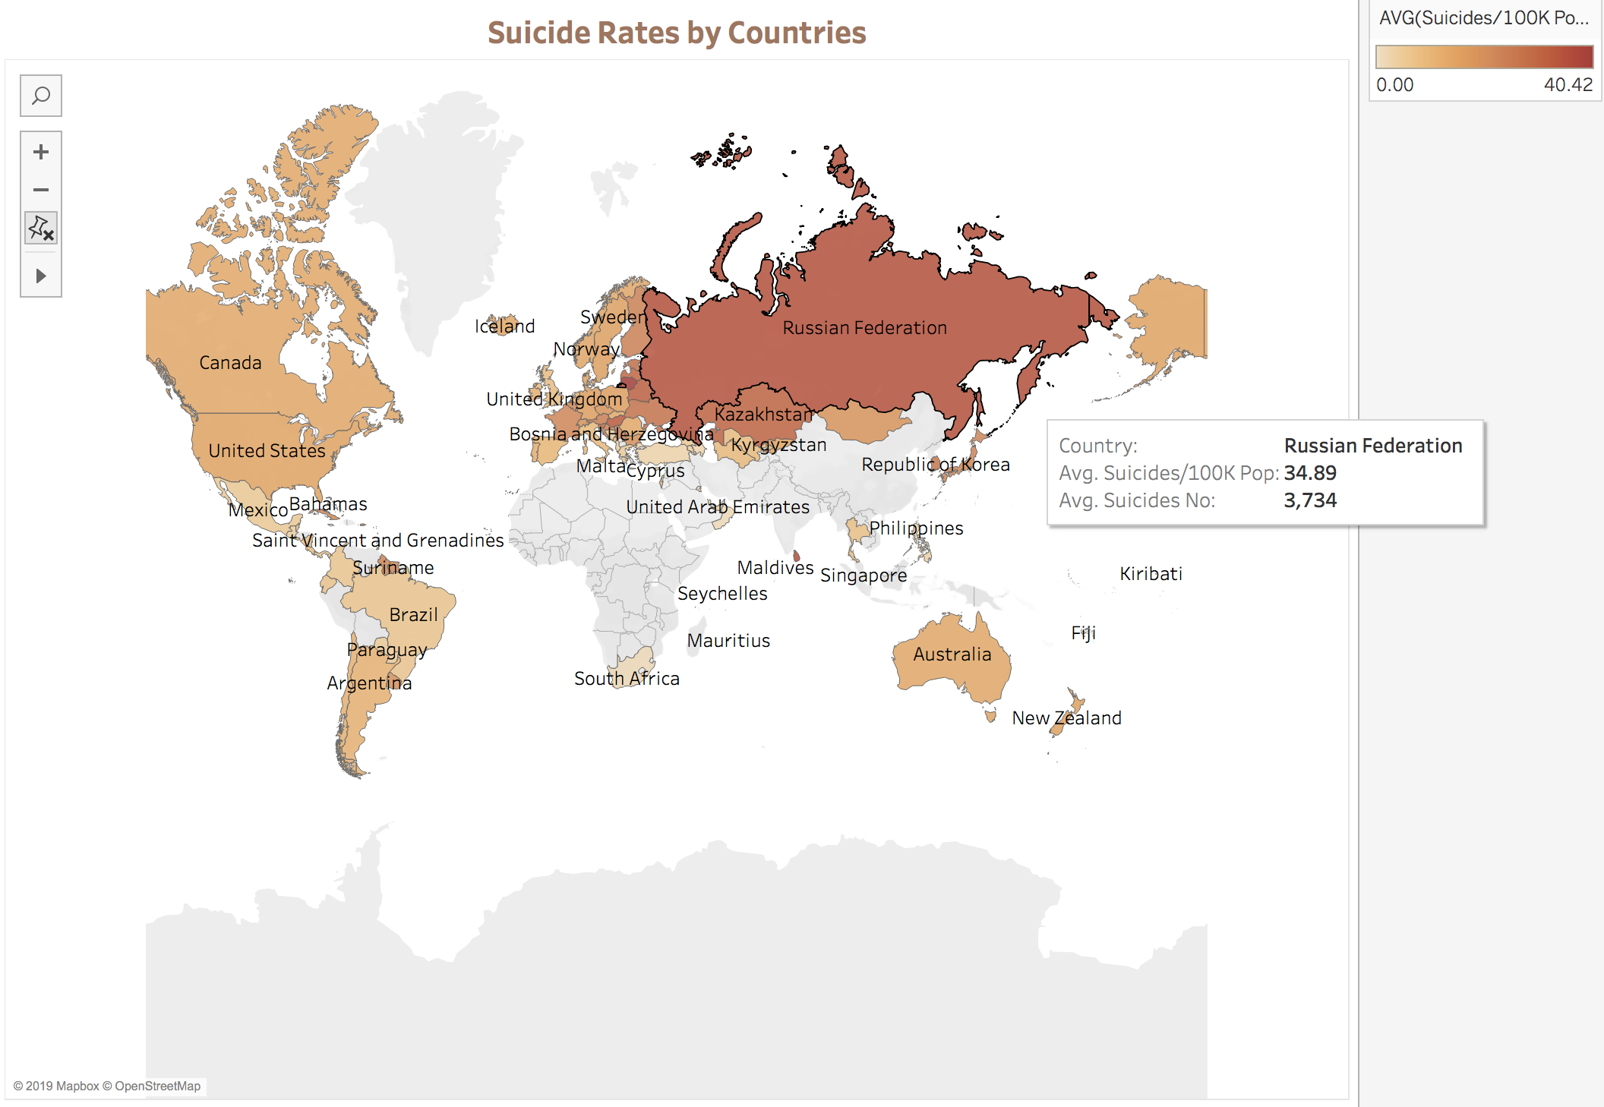
Worksheet : Heat Map of Suicide Rates by Countries
-The intensity of the color shows us the average suicide rates.
-For example, Russia has average suicide rate of 34.89 which is one of the highest in the world.
-We use average suicides/100k Population and not No. of Suicides to remove the population bias from the countries.

Slide 7
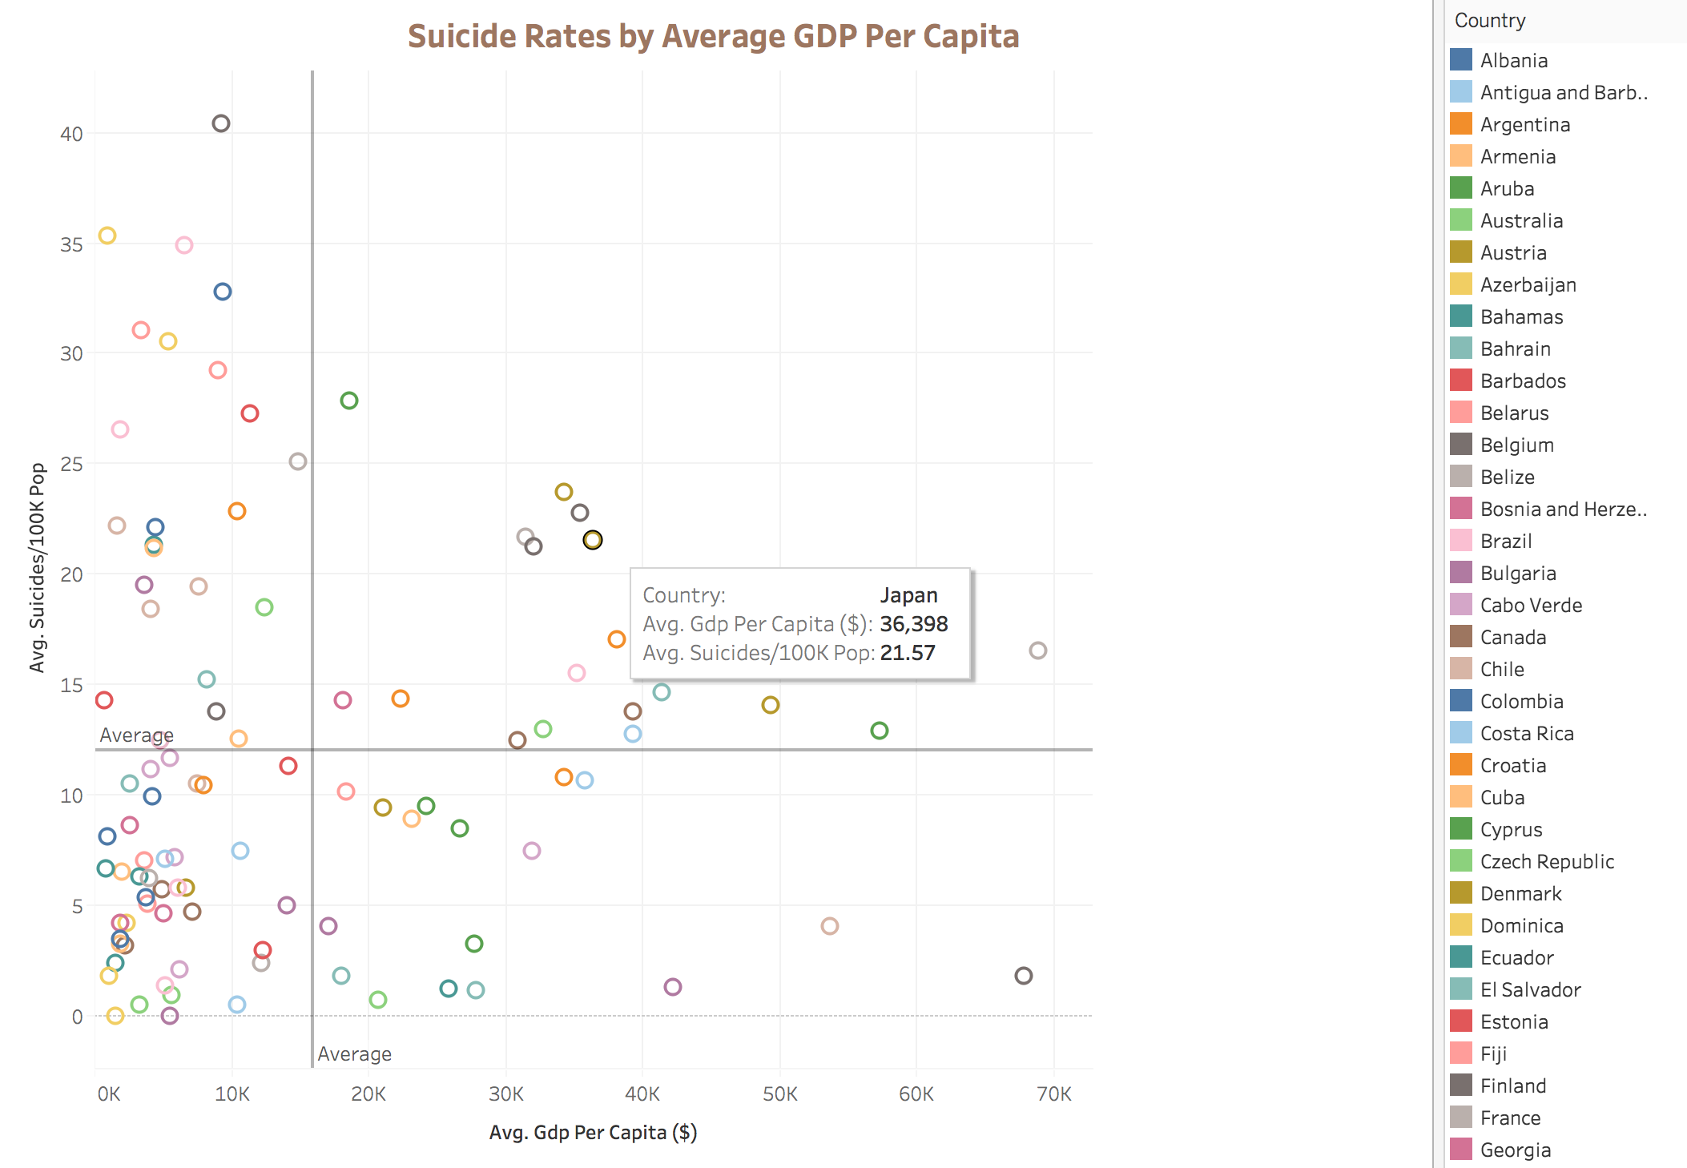
Worksheet : Is the suicide rate low for developed countries?
-We observe that there is no clear relation between the wealth of a country and its suicide rate.
-There are many countries with low GDP Per Capita which have low suicide rates (for example Mexico) as well many which have a high rate (for example Lithuania).
-Similarly there are many countries with high GDP as well as high suicide rates (for example Japan).

Slide 8
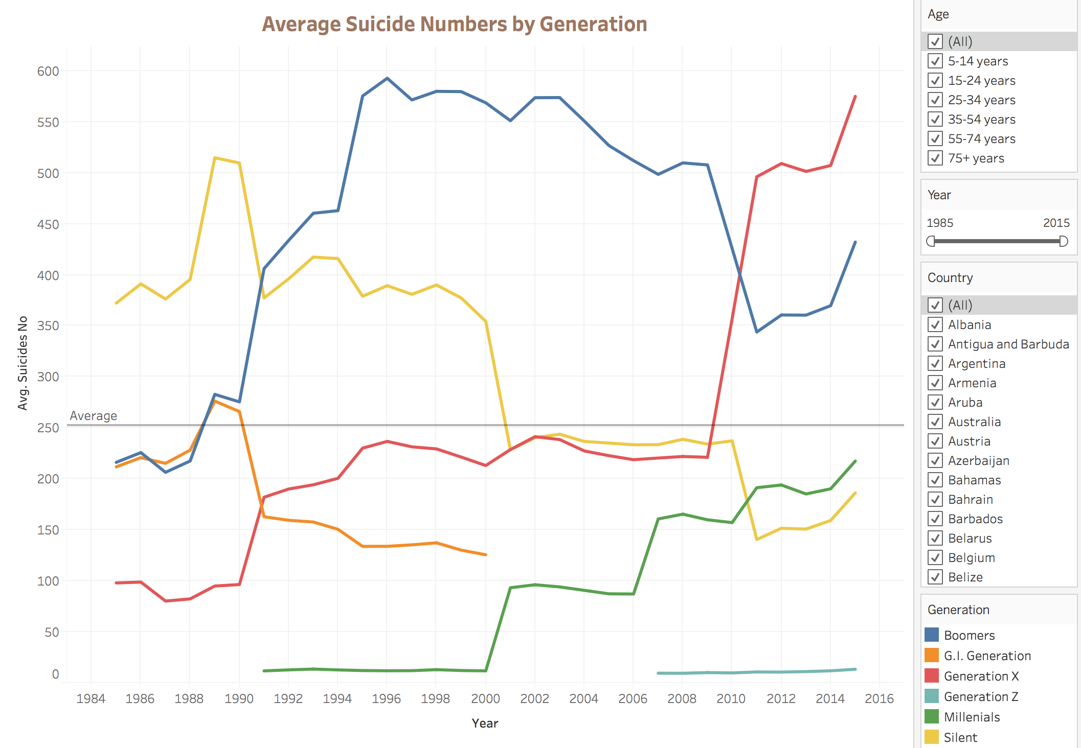
Worksheet : Overview of Suicide Rates by Generation
-The dataset includes a generation variable to indicate born year. Roughly, generation means:
1) G.I. Generation - born between 1901 - 1927
2) Silent - born between 1925 - 1942
3) Boomers - born between 1946 - 1964
4) Generation X - born between 1960 - 1980
5) Millennials - born between 1990 - early 2000
6) Generation Z - born early 2000s
-The age range is too wide in the dataset which makes the Suicide Numbers plot by generation comparatively unreliable (as a person could be from a different generation from what is stated in the dataset).
-We are using average suicide number instead of average suicide rate to see the total number of people who committed suicide in a particular year.

Slide 9
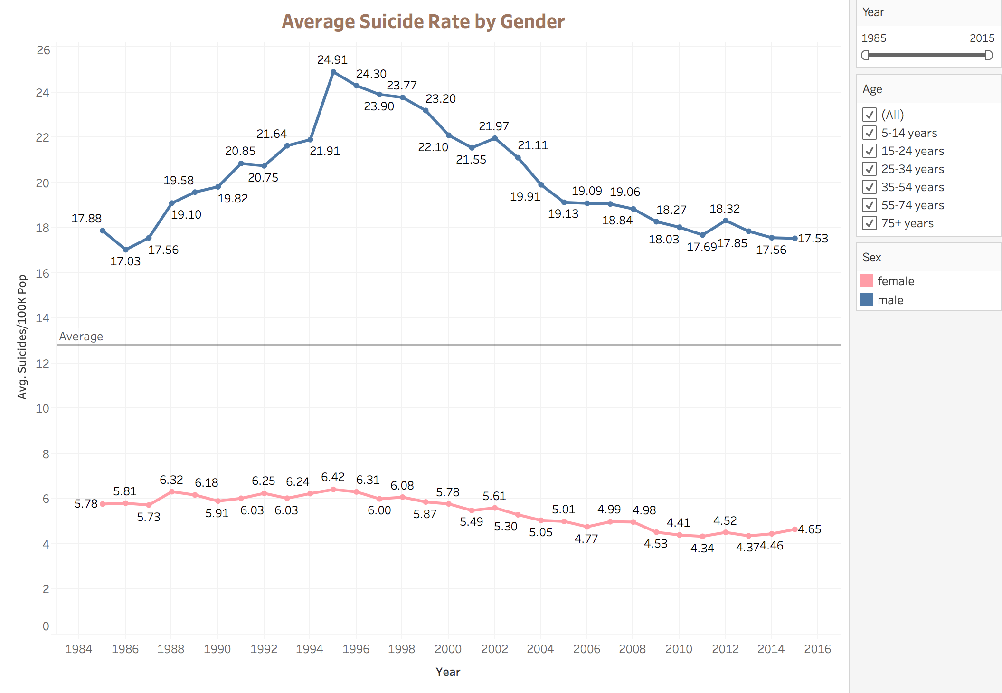
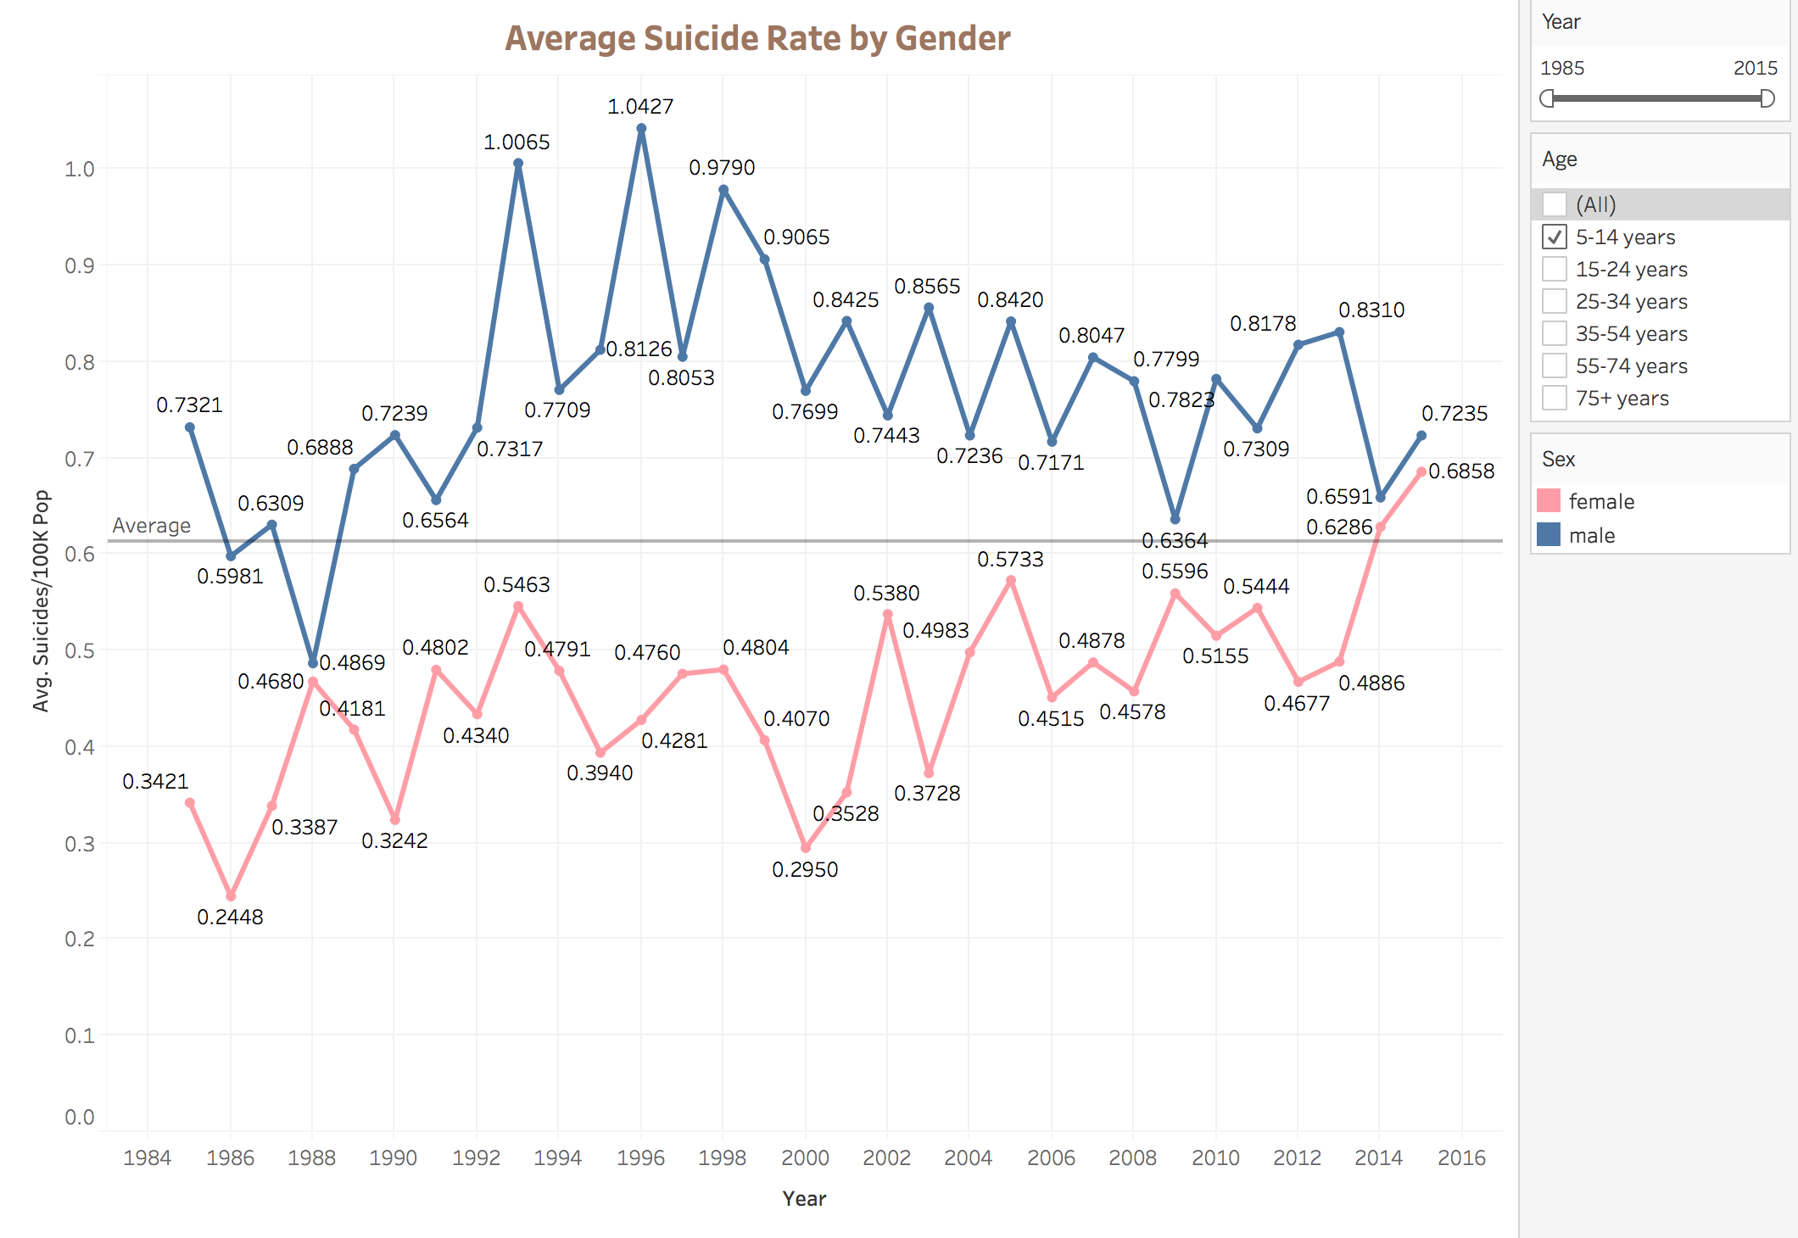
Worksheet : Overview of Average Suicide Rate by Gender
-The average suicide rate for males is much higher than females.
-However, from the age filter as shown in the second graph, we observe the difference in the suicide rate between the two genders is smaller for the younger age groups and increases as the age increases.

Slide 10
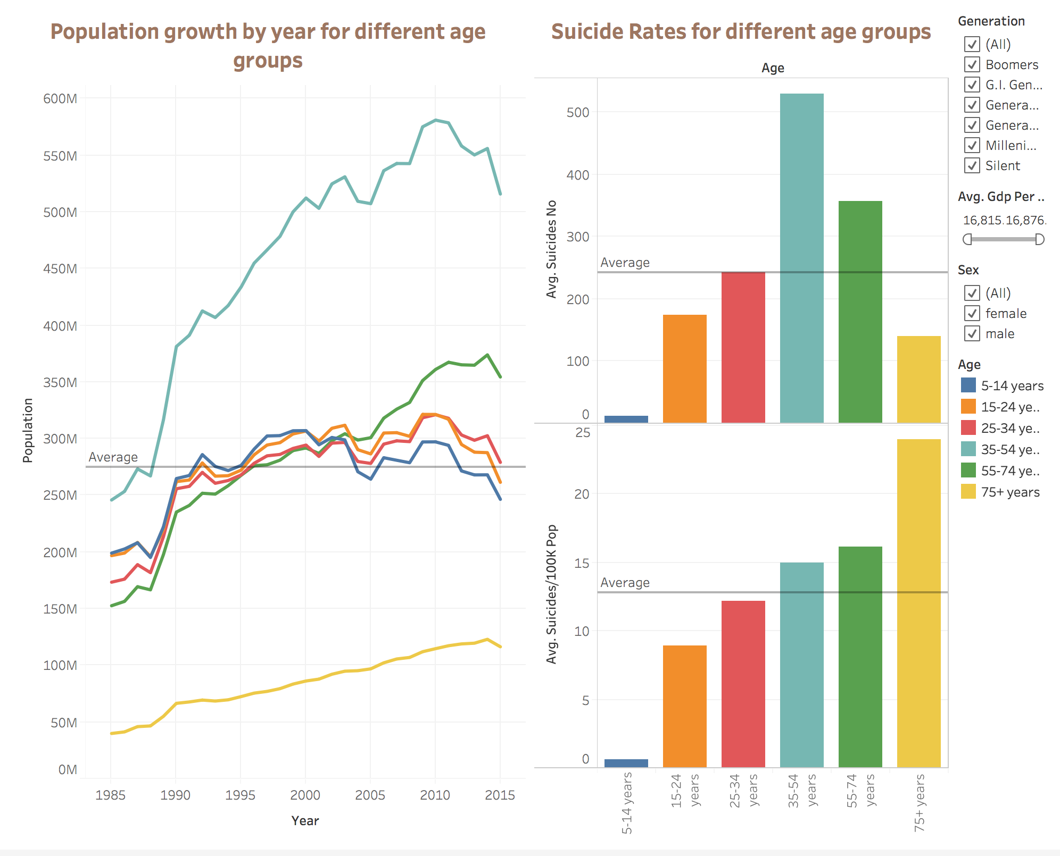
Dashboard : Overview of Suicide Rates by Age
-We observe that the people in the age group 35-54 have the greatest number of suicides.
-However, we see that the average suicide rate increases with the increase in age.
For example, the age group between 75+ has the highest suicide rate. While this may seem odd, it can be attributed to the fact that the population for this age group is significantly low which is evident from the population plot on the left. Thus, even small increase in suicide count in this age group causes a high change in the average suicide rate.

Slide 11
Insights/Hypotheses
From the above visualizations we see that there is a general decline in the average suicide rates globally. This paints a positive picture for the world. It could be attributed to the anti-depressants available in the recent years. It could also be due to the increase in awareness and help available over the past few years.
We also see that the top 10 countries with lowest suicide rate per 100k people are warm countries with higher temperatures relative to most countries which have a high suicide rate. So perhaps there could be a relation between temperatures and suicide rates.
The spikes in the suicide numbers by generation plot for the years 1990 and 2008 could be attributed to the economic recession during those years. However, because of the high age range in the dataset, the generation plot could be misleading (especially when there is a change in generations).
The high difference in suicide rate by gender could imply that women express and seek help more often. It could also be due to the substance abuse or possession of guns which is more common comparatively among men.
The number of suicides for the age group 35-54 years could be highest due to the ’mid-life crisis’ that most people go through.
However, more data and analysis would be required to conclude the above hypotheses.

