Slide 1
QuickSelect
2023/02/10
Hailey

Slide 2
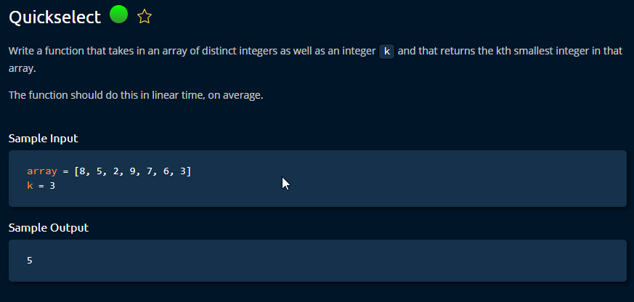

Slide 3
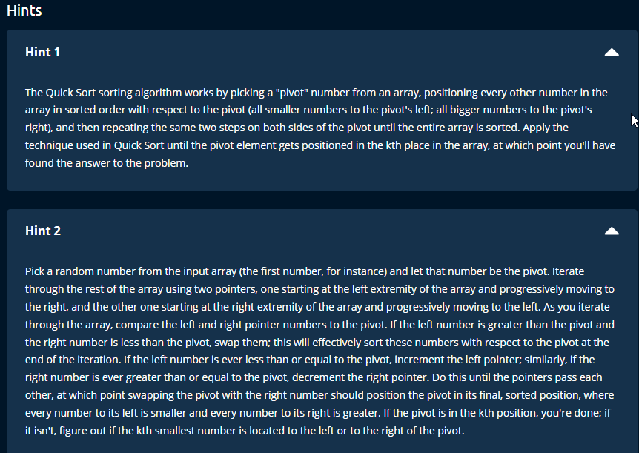

Slide 4
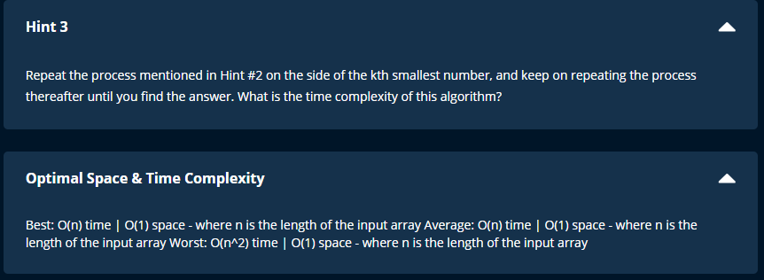

Slide 5
Notes
# modification of quicksort
# 1. position
# 2. looping
# 3. time complexity = O (n) or O (n*2)
# 4. space complexity = O(1)

Slide 6
Quickselect
It is a modification of quicksort.
Except we don't care about sorting the array.
So, the quicksort will be stopped as soon as we find our value.
Also, we will eliminate the unnecessary side to optimize time complexity.
It is recommended to read Quicksort before Quickselect.

