Slide 1
Powerset
2023/03/18

Slide 2
Process
Iterative solution
Every answer will have an empty set at first.
Time = O (n * 2^n)
Generating new subset everytime.
Number of subset = 2^n
Each subset has n/2 elements on average.
Space = O (n * 2^n)
Recursive solution
P[1,2,3,4,...x] = P[1,2,3,...,x-1]+[x]

Slide 3
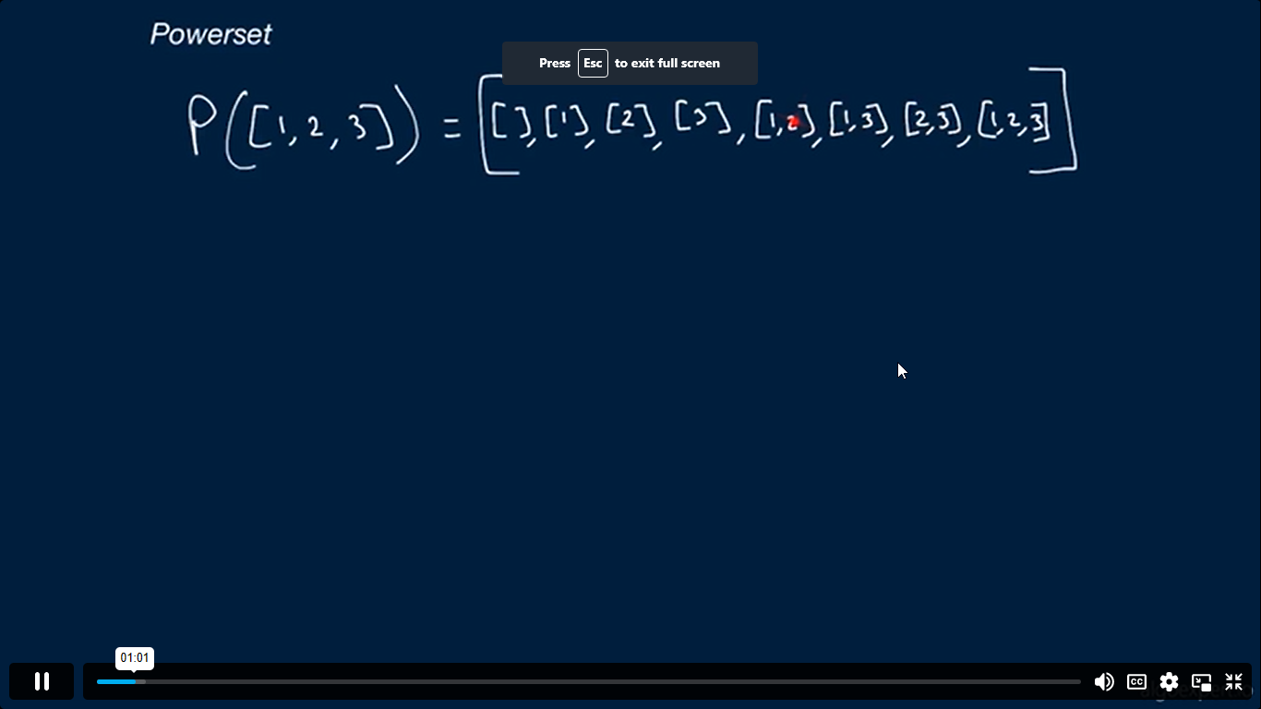

Slide 4
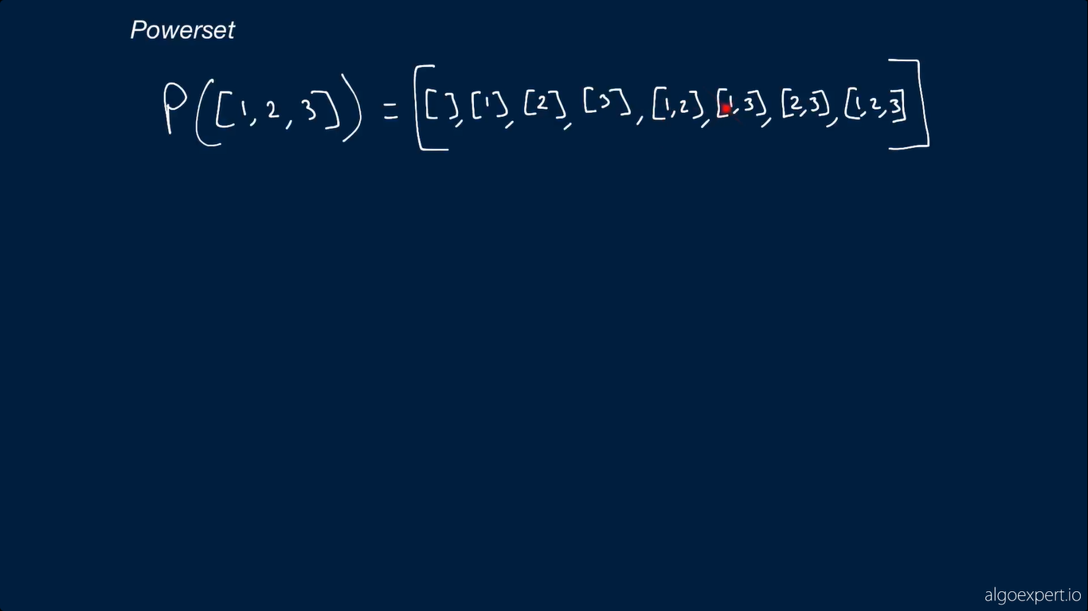

Slide 5
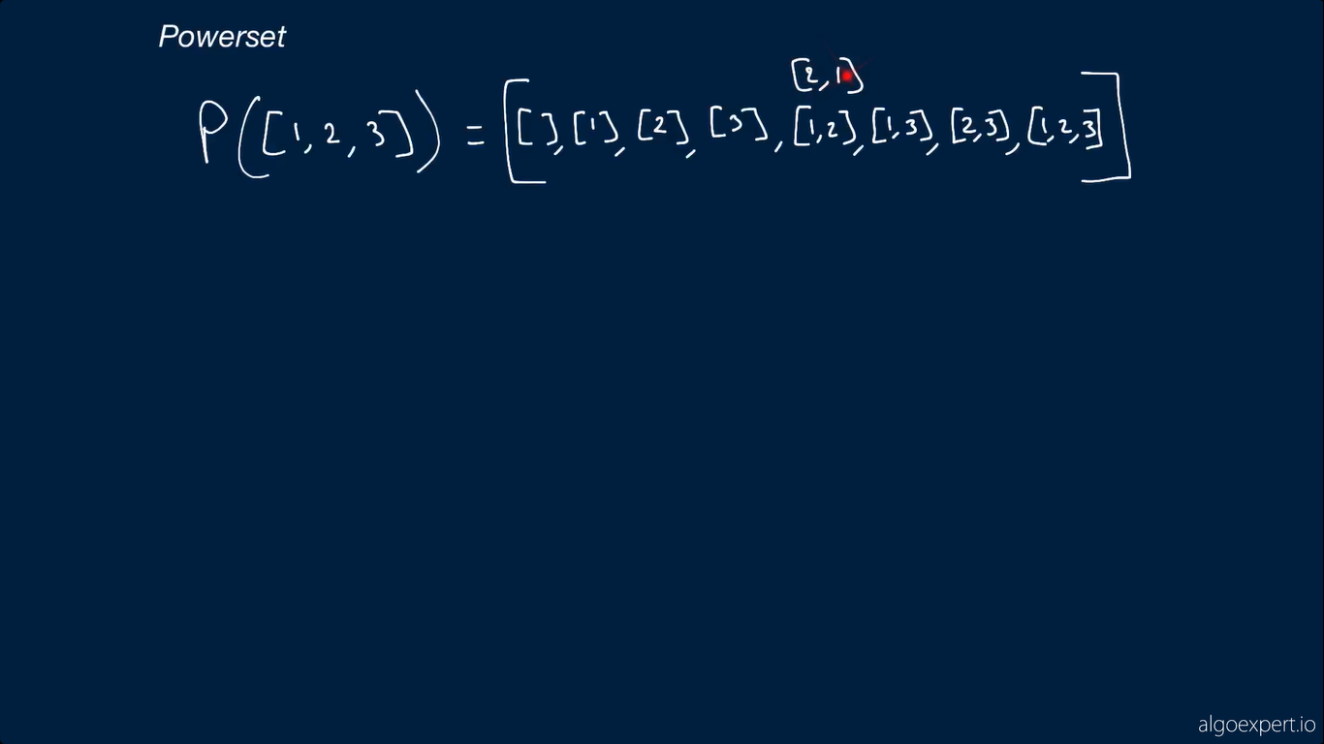

Slide 6
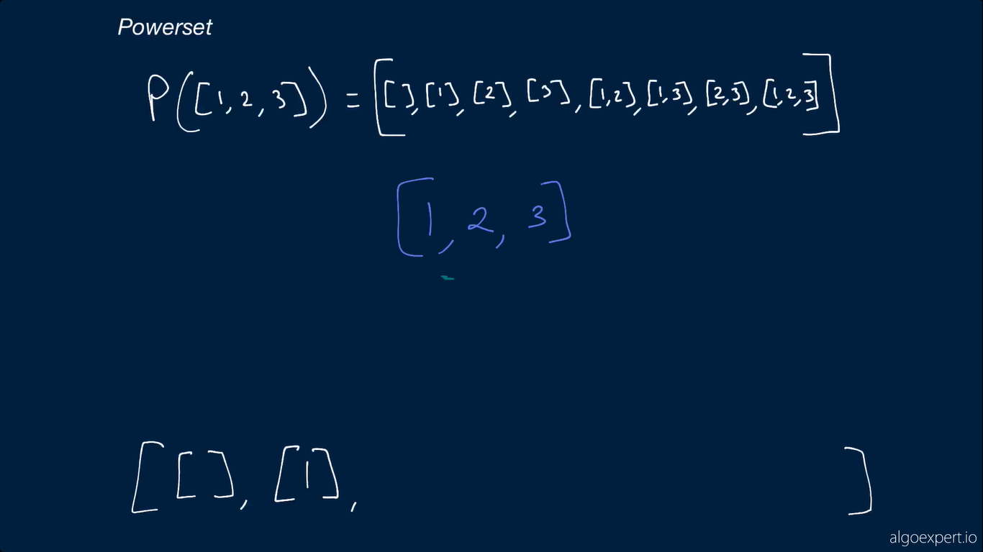

Slide 7


Slide 8
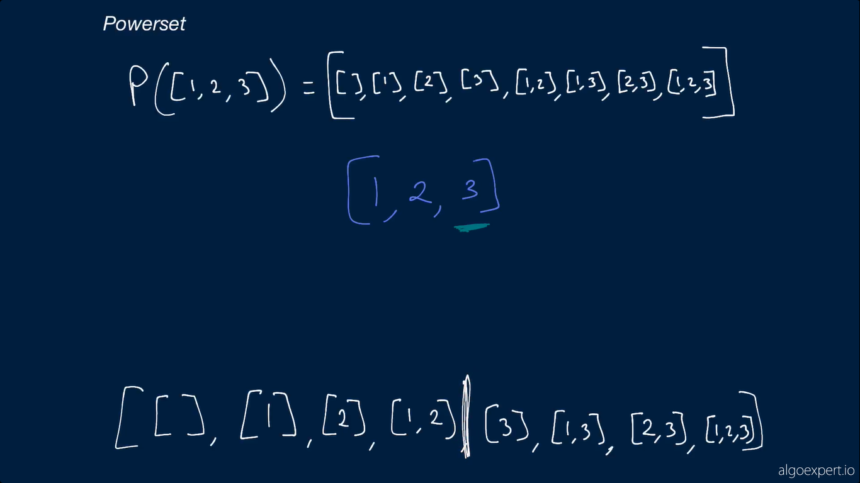

Slide 9
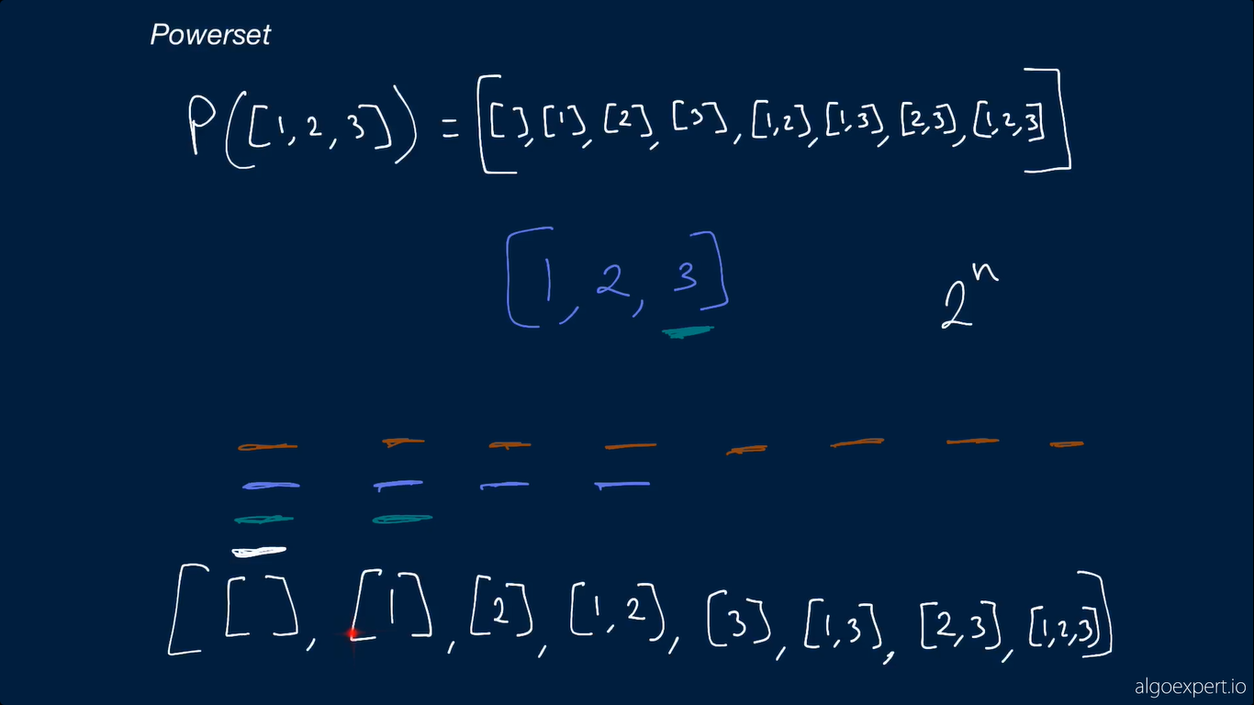

Slide 10
