Slide 1


Slide 2
INTRODUCTION
WHY Git?
Version control
Collaboration

Slide 3
WHAT IS Git?
Git is a Distributed Version Control System

Slide 4

Version Control in Git

Slide 5
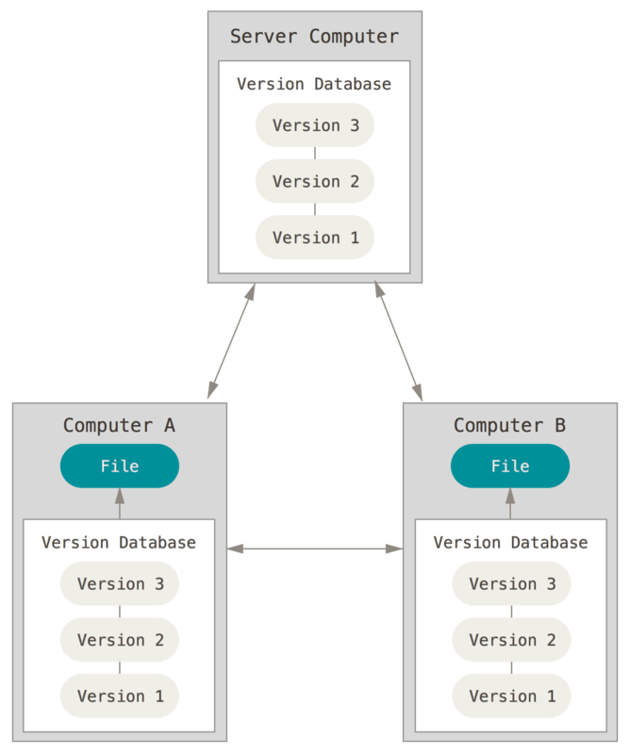

Slide 6
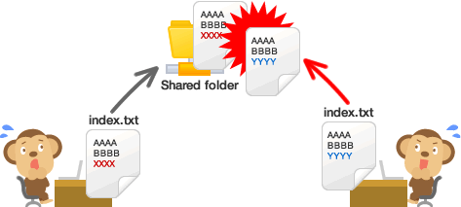
Collaboration in Git

Slide 7
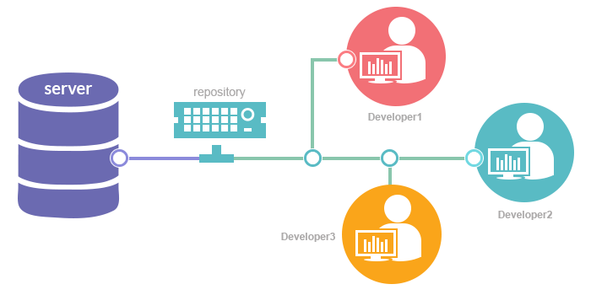

Slide 8
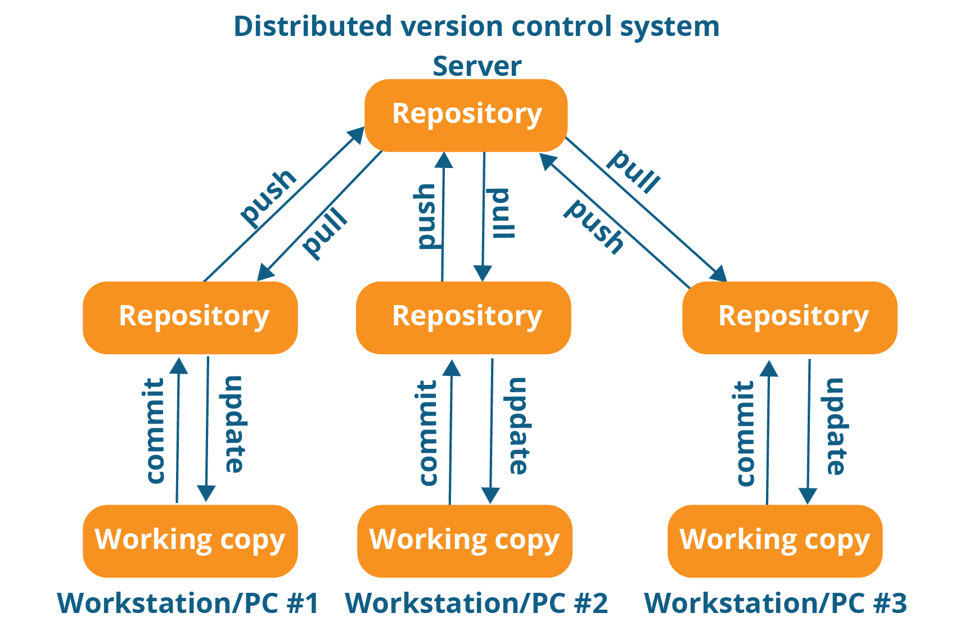

Slide 9
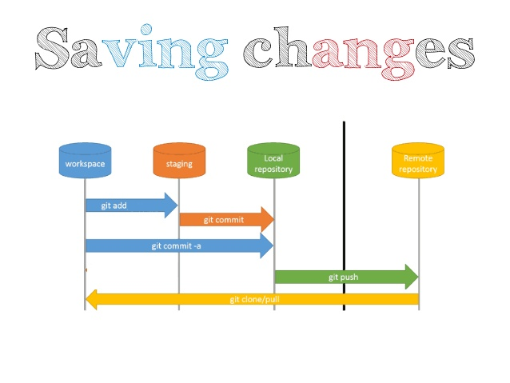

Slide 10
Configuration
C:\> git config --global user.name "milanmenezes“
C:\> git config --global user.name
milanmenezes
C:\> git config --global user.email milanmenezes@gmail.com
C:\> git config --global user.email
milanmenezes@gmail.com

Slide 11
Initialization
C:\> mkdir CoolProject
C:\> cd CoolProject
C:\CoolProject > git init
Initialized empty Git repository in C:/CoolProject/.git
C:\CoolProject > vi README.txt
C:\CoolProject > git add *
C:\CoolProject > git commit -m 'my first commit'
[master (root-commit) 7106a52] my first commit
1 file changed, 1 insertion(+)
create mode 100644 README.txt

Slide 12
Adding remote repository
C:\> git remote add origin https://github.com/nisbweb/NSOC4.git
C:\> git push origin master

Slide 13
Branches Illustrated
master
A
> git commit –m ‘my first commit’
Notes:
Now lets see what this visually looks like.
On my first commit I have A.
The default branch that gets created with git is a branch names Master.
This is just a default name. As I mentioned before, most everything in git is done by convention. Master does not mean anything special to git.

Slide 14
Branches Illustrated
master
A
B
C
> git commit (x2)
Notes:
We make a set of commits, moving master and our current pointer (*) along

Slide 15
Branches Illustrated
master
A
B
C
bug123
> git checkout –b bug123
Notes:
Suppose we want to work on a bug. We start by creating a local “story branch” for this work.
Notice that the new branch is really just a pointer to the same commit (C) but our current pointer (*) is moved.

Slide 16
Branches Illustrated
master
A
B
C
D
E
bug123
> git commit (x2)
Notes:
Now we make commits and they move along, with the branch and current pointer following along.

Slide 17
Branches Illustrated
master
A
B
C
D
E
bug123
> git checkout master
Notes:
We can “checkout” to go back to the master branch.
This is where I was freaked out the first time I did this. My IDE removed the changes I just made. It can be pretty startling, but don’t worry you didn’t lose anything.

Slide 18
Branches Illustrated
master
A
B
C
D
E
bug123
> git merge bug123
Notes:
And then merge from the story branch, bringing those change histories together.

Slide 19
Branches Illustrated
master
A
B
C
D
E
> git branch -d bug123
Notes:
And since we’re done with the story branch, we can delete it. This all happened locally, without affecting anyone upstream.

Slide 20
Branches Illustrated
master
A
B
C
D
E
F
G
bug456
Notes:
Let’s consider another scenario. Here we created our bug story branch back off of (C). But some changes have happened in master (bug 123 which we just merged) since then.
And we made a couple of commits in bug 456.

Slide 21
Branches Illustrated
master
A
B
C
D
E
F
G
bug456
> git checkout master
Notes:
Again, to merge, we checkout back to master which moves our (*) pointer.

Slide 22
Branches Illustrated
master
A
B
C
D
E
H
F
G
bug456
> git merge bug456
Notes:
And now we merge, connecting the new (H) to both (E) and (G). Note that this merge, especially if there are conflicts, can be unpleasant to perform.

Slide 23
Branches Illustrated
master
A
B
C
D
E
H
F
G
> git branch -d bug456
Notes:
Now we delete the branch pointer.
But notice the structure we have now. This is very non-linear. That will make it challenging to see the changes independently. And it can get very messy over time.

Slide 24
Branches Illustrated
master
A
B
C
D
E
F
G
bug456
Notes:
Rebase flow - Let’s go back in time and look at another approach that git enables. So here we are ready to merge.

Slide 25
Branches Illustrated
master
A
B
C
D
E
F’
G’
bug456
> git rebase master
Notes:
Instead of merging, we “rebase”.
What this means is something like this:
1. Take the changes we had made against (C) and undo them, but remember what they were
2. Re-apply them on (E) instead

Slide 26
Branches Illustrated
master
A
B
C
D
E
F’
G’
bug456
> git checkout master
> git merge bug456
Notes:
Now when we merge them, we get a nice linear flow.
Also, the actual changeset ordering in the repository mirrors what actually happened. (F’) and (G’) come after E rather than in parallel to it. Also, there is one fewer snapshots in the repository.

Slide 27

Git vs GitHub

Slide 28
Thank you!

