Slide 1


Slide 2
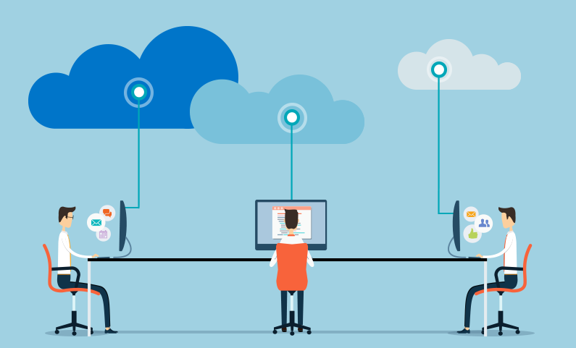

Slide 3
Architecture of Cloud
SAAS - Software As A Service
PAAS - Platform As A Service
IAAS - Infrastructure As A Service

Slide 4
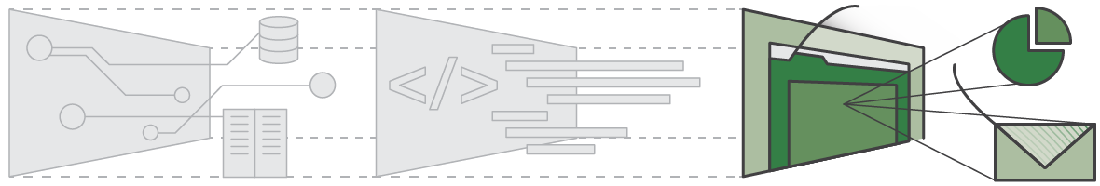
Software As A Service - SAAS

Slide 5
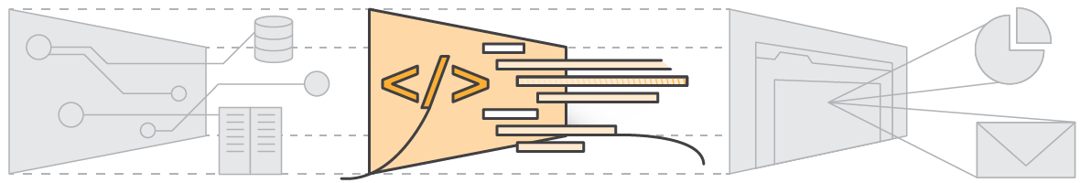
Platform As A Service - PAAS

Slide 6
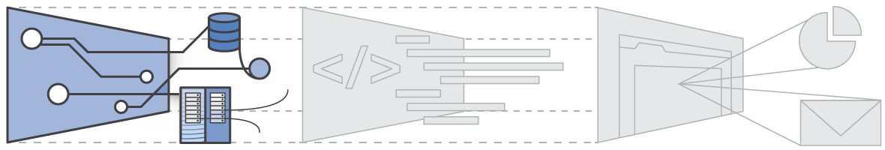
Infrastructure As A Service - IAAS

