Slide 1
Video Game Categories
Michael Wei

Slide 2
Background
23% of buyers search for games using the genre filter (e.g., action, sports, etc)
71% of buyers use advanced filters to find the types of games that appeal to them
Goal
Discover categories that group Snow Cone Games’ library of over 40,000 video games to help user search faster
Approach
Cluster our dataset by machine learning algorithms to effectively partition the data given game attributes

Slide 3
Organization of Presentation
Clustering with all features
Clustering with constrained feature space
Recommend categories
Summary
Future Directions

Slide 4
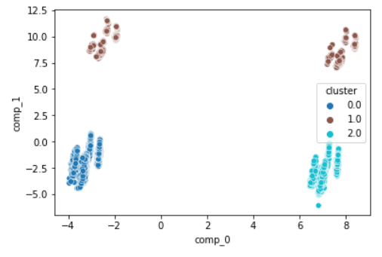
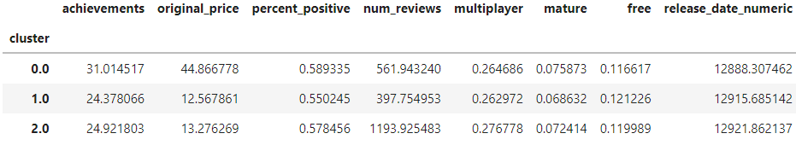
Clustering with All Features
Our K-Means algorithm can create more balanced partition
Motivation 1: the number of achievements, price, and number of reviews seem to have clear cluster structure
Two categories are immediately obvious: fulfilling, popular
Motivation 2: the other attributes seem to not have clear cluster structure
(statistically optimal under 5)

Slide 5
Constrained Feature Space
Our K-Means algorithm works better with fewer features (future direction and improvements outlined in the report)

Slide 6
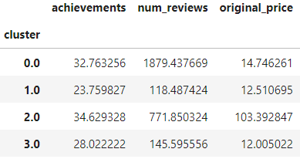
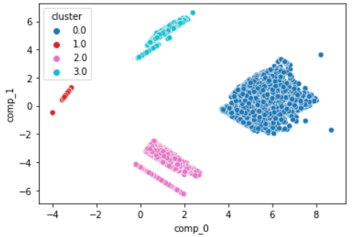
Constrained Feature Space - Motivation 1
Clusters with high number of reviews (popular) also seem to have high number of achievements in the game (fulfilling)
A category called popular and fulfilling can be formed by combining the two, saving us one spot in the home page

Slide 7
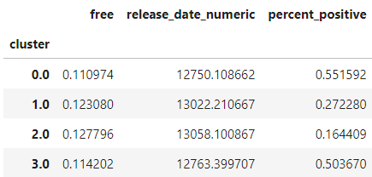
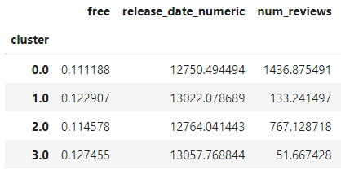
Constrained Feature Space - Motivation 1
Applications that are more expensive seem to be in the same clusters with higher number of reviews and receive greater feedbacks
Encourage us to combine the three categories to form (paid popular, paid most liked) or (paid, popular, most liked)

Slide 8
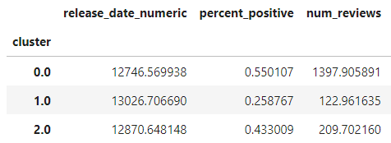
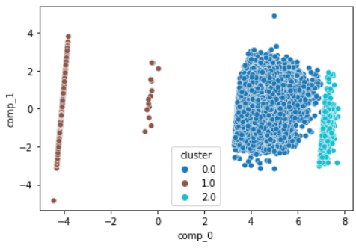
Constrained Feature Space - Motivation 1
The cluster with largest amount of reviews seem to also have the highest positive feedback percentage
Encourage us to combine the two categories to form (popular and most liked)

Slide 9
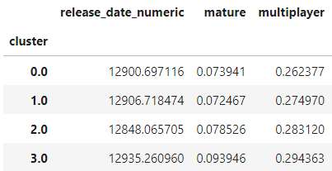
Constrained Feature Space - Motivation 2
The clusters with these three features do not have distinct characteristics
Should not prioritize these categories in our home page

Slide 10
Summary
Future Directions
The categories that should be prioritized are popular, most liked, fulfilling, and paid as they have clear cluster characteristic
A handful combinations can be used to further combine the categories proposed above based on our analysis: paid popular, paid most liked, most liked and popular, popular and fulfilling
Collect data on which advanced features the user uses to understand what could be potential new categories
Conduct A/B testing on selection rates of proposed features to figure out the best categories or best combinations

