Slide 1
Survival Prediction under Distribution Shift
QRT Data Challenge — Overall Survival Prediction for patients
diagnosed with Myeloid Leukemia
Chawki Nasrallah · PhD Researcher (Biomedical Engineering, AI/Data science in Health)
github.com/chawki-nasrallah/qrt-mds-aml-survival · chawki.gnasrallah@gmail.com

Slide 2
TL;DR
First online data-science competition.
Public leaderboard
Private leaderboard
0.7685
0.7124
Rank 11 / 743
Rank 189
The gap between those two numbers is the most interesting thing in this work.
QRT — Overall Survival Prediction for Myeloid Leukemia · Chawki Nasrallah, 2026
2 / 15

Slide 3
The problem
Predict overall survival in MDS / AML patients from clinical + genetic features.
Inputs
Target & metric
■ Clinical: BM blast %, WBC, hemoglobin, platelets
■ Cytogenetics: ISCN-format karyotype string
■ Molecular: per-mutation records (gene, effect, VAF, protein change)
■ (OS_YEARS, OS_STATUS) — time-to-event survival outcome
■ IPCW-C: censoring-aware concordance index
■ Rewards correct pairwise risk orderings, not point predictions
Constraint: 2 leaderboard submissions per day. This will matter later.
QRT — Overall Survival Prediction for Myeloid Leukemia · Chawki Nasrallah, 2026
3 / 15

Slide 4
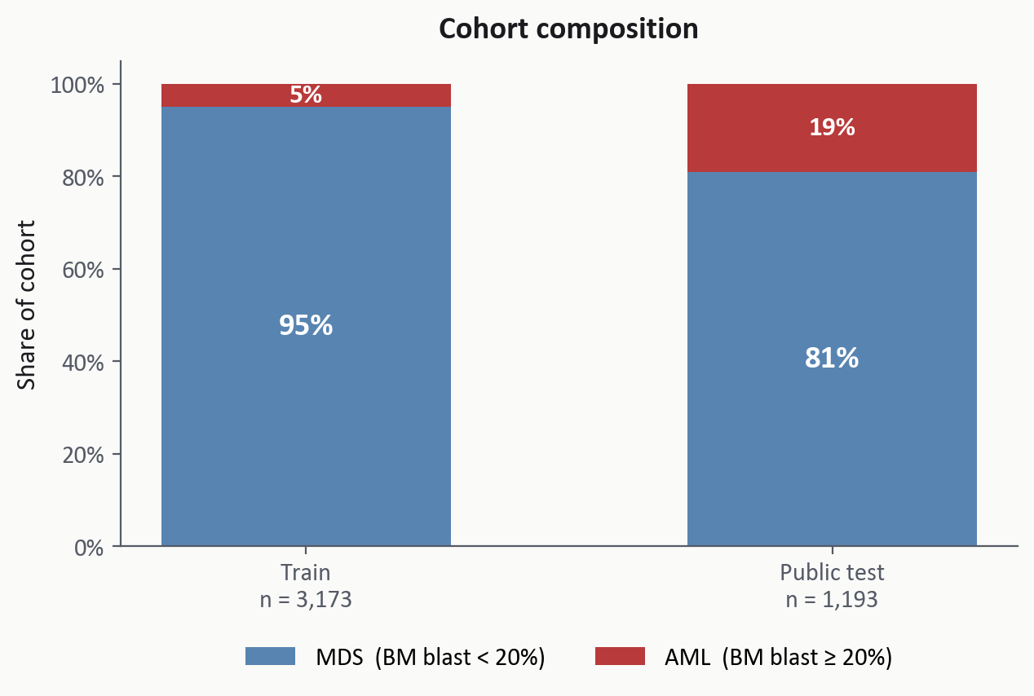
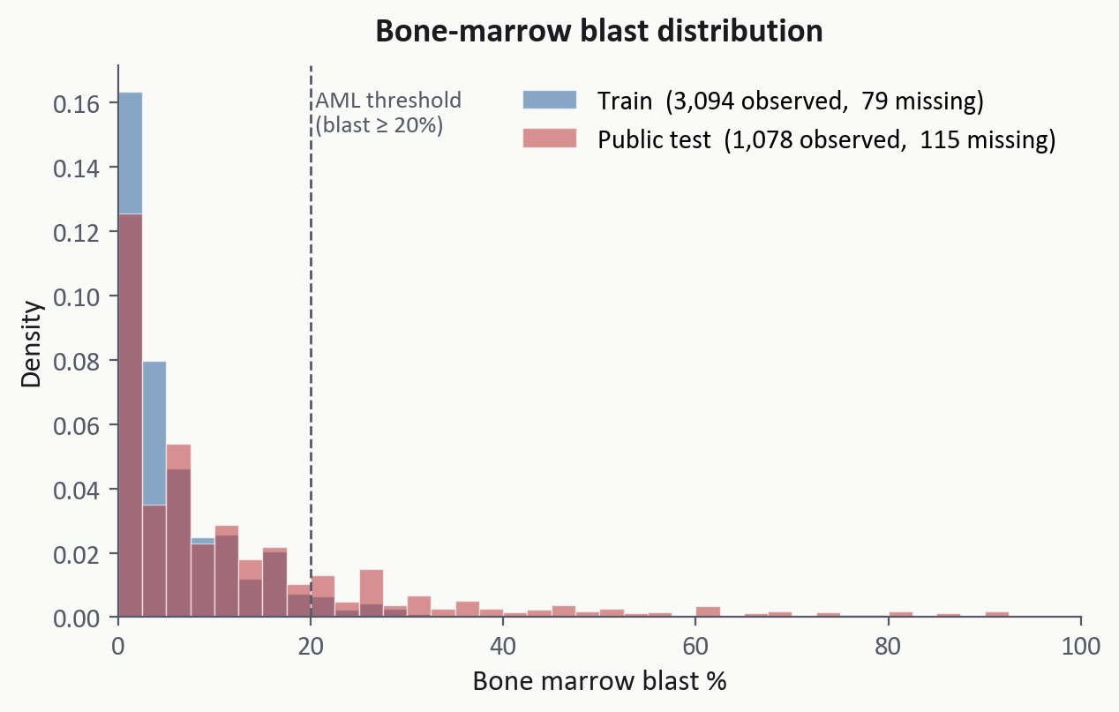
Distribution shift: cohort composition and features
Train and test were drawn from different mixtures of the same disease spectrum.
Public test has ≈4× the AML share of train (5% → 19%); median blast doubles (3% → 6%).
Standard covariate-shift fixes (reweighting, far-patient removal) all came back null on the LB — cross-cohort augmentation was the route that worked.
QRT — Overall Survival Prediction for Myeloid Leukemia · Chawki Nasrallah, 2026
4 / 15

Slide 5
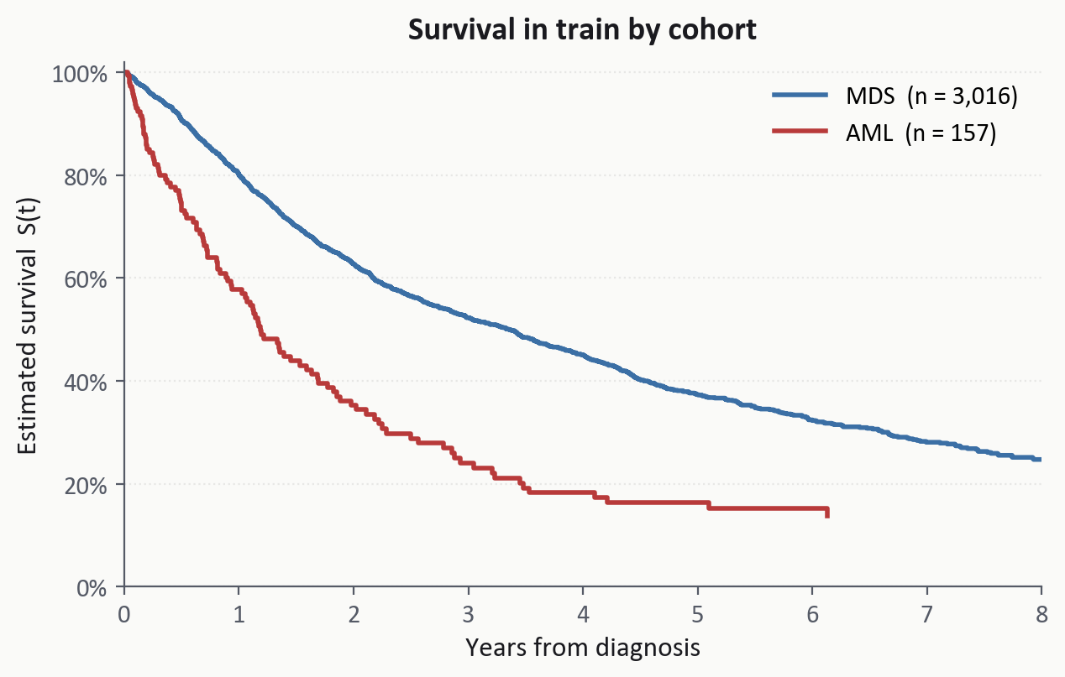
...and so do the survival outcomes those features predict
AML patients die faster — so a test set enriched for AML is implicitly enriched for early-death labels.
Train cohort (from KM curve)
■ MDS: 5-yr survival ≈ 38%
■ AML: 5-yr survival ≈ 12%
■ Median time-to-death (event): MDS 1.43 y, AML 0.86 y
IPCW-C rewards correct ordering among high-risk patients — the very ones the test set is enriched for.
QRT — Overall Survival Prediction for Myeloid Leukemia · Chawki Nasrallah, 2026
5 / 15

Slide 6
Pipeline: two complementary survival models
BASELINE (v12)
SPECIALIST (v22)
Wide features, single RSF
23 biologically-robust features
■ ~1800 features: gene one-hots × VAF, cyto one-hots, EFFECT, PROTEIN_CHANGE
■ Dense IPSS-M score (Bernard 2022 NEJM Evidence)
■ Random Survival Forest, 5000 trees
■ Clinical + curated cyto + curated genes + engineered scores
■ Trained on QRT + 583 Tazi patients (propensity-selected)
■ Single RSF (500 trees)
Public LB: 0.7637
Public LB: 0.7645 alone
FINAL = 0.30 · rank(baseline) + 0.70 · rank(specialist) → Public LB: 0.7685
rank-blend (not raw): two RSF architectures live on different scales, ~[218,2039] vs ~[127,1204]
QRT — Overall Survival Prediction for Myeloid Leukemia · Chawki Nasrallah, 2026
6 / 15

Slide 7
Baseline detail: feature engineering
Combining five sources of signal into ~1800 columns.
■ Clinical numerics — log1p transform compresses right-skewed counts (WBC, PLT) so the tree splits aren't dominated by extreme values; MICE imputation iteratively regresses each variable on the others (RandomForest as regressor) to preserve cross-feature correlations that median-fill would destroy.
■ Per-gene one-hot weighted by max VAF — captures both presence (was the gene mutated?) and allelic burden (how clonal is the mutation?).
■ Two cytogenetic parsers — a broad regex extracts every +/−, translocation and inversion (high recall, surfaces rare lesions); a curated parser produces clean IPSS-R-aligned flags (high precision).
■ EFFECT and PROTEIN_CHANGE — mutation type (missense, ITD, PTD, …) and residue position parsed from HGVS strings like p.R882H.
■ IPSS-M score (Bernard 2022) — the full Molecular International Prognostic Scoring System as a single dense feature. Carries ≈42% of tree-ensemble importance.
■ Two interaction flags — NPM1+/FLT3− (favorable AML), and TP53+ × complex karyotype (high-risk MDS/AML).
QRT — Overall Survival Prediction for Myeloid Leukemia · Chawki Nasrallah, 2026
7 / 15

Slide 8
Specialist: cross-cohort augmentation via propensity selection
Pull external patients matched to the QRT high-blast test region.
How the propensity classifier works
■ Label QRT test patients with BM blast ≥ 20% as 1; label all Tazi 2022 NEJM Evidence cohort patients as 0
■ Train LightGBM 5-fold to discriminate, on raw inputs only (no engineered scores)
■ Sort Tazi by P(label=1); keep the top 583 — most similar to underserved AML region
Why K = 583
Why raw inputs only
Sized to match the public test's AML share. Adding 583 high-blast Tazi patients to the 3,173 QRT train cohort lifts the augmented train AML share from ≈5% to ≈19% — the same AML share as the public test set.
Engineered features (IPSS-M, TP53 multihit) inside the propensity model would correlate selection criteria with the specialist's own scoring — a feedback loop that narrows the augmented distribution. Worth +0.0011 public LB.
QRT — Overall Survival Prediction for Myeloid Leukemia · Chawki Nasrallah, 2026
8 / 15

Slide 9
Rank-blending: scale-invariant complementarity
The two models output incompatible scales:
Baseline range:
~[218, 2039]
Specialist range:
~[127, 1204]
→ Raw averaging lets the baseline dominate by scale alone.
Convert to ranks, then blend.
final = 0.30 · rank(baseline) + 0.70 · rank(specialist)
Also matches IPCW-C's geometry — the metric scores pairwise orderings, not magnitudes.
QRT — Overall Survival Prediction for Myeloid Leukemia · Chawki Nasrallah, 2026
9 / 15

Slide 10
Ablation: the augmentation is the load-bearing element
Each piece earning its keep on the public LB.
Variant
Spec training
α
Public LB
Δ vs v12
v12 baseline alone
—
—
0.7637
—
Specialist alone
QRT + Tazi-583
—
0.7645
+0.0008
Spec + v12, NO augmentation
QRT only
0.50
0.7584
−0.0053
Spec + v12, with augmentation
QRT + Tazi-583
0.50
0.7674
+0.0037
Final (v22, Option C)
QRT + Tazi-583
0.30
0.7685
+0.0048
Apples-to-apples at α=0.50: Tazi augmentation alone moves the blend +0.0090 (0.7584 → 0.7674).
Without augmentation, the specialist drags the blend BELOW v12 alone (−0.0053).
QRT — Overall Survival Prediction for Myeloid Leukemia · Chawki Nasrallah, 2026
10 / 15

Slide 11
Public leaderboard: rank 11 / 743
Rank
Score
Team
1
0.7739
ocercle
2
0.7732
qrtmieuxquecitadel
3
0.7732
Astra
…
…
…
11
0.7685
chawkinas (me)
Top of the public leaderboard at 0.7739 — within 0.0054 of my score.
QRT — Overall Survival Prediction for Myeloid Leukemia · Chawki Nasrallah, 2026
11 / 15

Slide 12
Private leaderboard: a 5-point shake-up across the field
Public
Private
Drop
Top of LB (rank 1)
0.7739
0.7231
−0.0508
chawkinas (me)
0.7685
0.7124
−0.0561
The entire field shook up — top public 0.7739 → top private 0.7231 (−0.0508).
My drop is 0.0053 worse than the winner's — within ~0.005 of the rest of the top of the public LB.
For reference: organisers' benchmark scored 0.6411 on private (rank 678) — beat it by +0.0713.
QRT — Overall Survival Prediction for Myeloid Leukemia · Chawki Nasrallah, 2026
12 / 15

Slide 13
Technical lessons
Three findings that transfer beyond this project.
1. Components that fail individually can win in combination.
Specialist alone −0.0040 LB · Tazi augmentation alone −0.0033 · combined → +0.0048 over v12.
Don't drop a building block just because it loses standalone — multi-component systems with complementary errors can beat the sum of their parts.
2. Feature-schema design enables cross-cohort augmentation.
Same 583 Tazi patients: into baseline's 1,800 sparse features → −0.0033 LB; into specialist's 23 shared features → +0.0090 swing.
More data isn't enough — the feature vocabulary has to transfer across cohorts. Plan for transfer at the feature stage, not the model stage.
3. Beware feedback loops in propensity-driven selection.
v21 propensity used engineered scores (the specialist's own signals); v22 used raw inputs only; +0.0011 LB from breaking the loop.
If a selection procedure shares features with the model it serves, the model is implicitly choosing its own training data — a subtle selection bias.
QRT — Overall Survival Prediction for Myeloid Leukemia · Chawki Nasrallah, 2026
13 / 15

Slide 14
What I learned
First DS competition. The methodology I'd defend; the iteration policy I'd change.
■ Late-stage optimization against a public test set is itself a form of overfitting.
■ When CV and LB disagree, trust CV — especially once per-iteration LB deltas drop below noise band (~0.003).
■ Pick a final submission once deltas plateau; don't nudge it for marginal LB gains.
■ Treat the public LB as a sanity check, not a continuous optimization target.
■ A 0.001 improvement on a 1193-patient C-index is within sampling noise. The improvement may not be real.
QRT — Overall Survival Prediction for Myeloid Leukemia · Chawki Nasrallah, 2026
14 / 15

Slide 15
Thank you.
Code, methodology writeup, post-mortem:
github.com/chawki-nasrallah/qrt-mds-aml-survival
Chawki Nasrallah · chawki.gnasrallah@gmail.com

