Slide 1

PRESENTATION TITLE
Mirjam Nilsson

Slide 2
HYPOTHESIS
lineups with guilty suspects would be subject to shorter viewing duration of all images and fewer image looks overall than lineups with innocent suspects
confidence and accuracy would be positively correlated.

Slide 3
INTRODUCTION
traditionally only decision and confidence recorded
Given that investigators will most often lack conclusive information about whether a suspect is guilty or innocent,
we sought to explore the possibility that witness behaviors could postdict suspect guilt.

Slide 4
PRIMARY GOALS
examine which lineup navigation behaviors could be used to postdict suspect guilt in children
method
Experiment 1 included 405 children (6 –14 years; 43% female) who each made 2 eyewitness identifications after viewing 2 live targets.

Slide 5
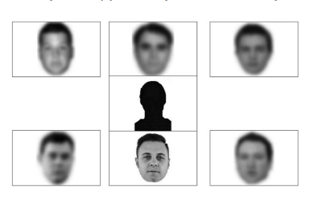
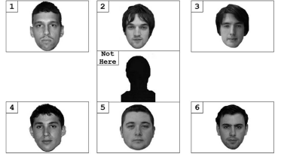
​interactive simultaneous procedure
Not eye-tracking technology (lack of mobility, cost, expertise)
Fuzzy lineup – allowed to track look time and frequency
Can change decision from fuzzy

Slide 6
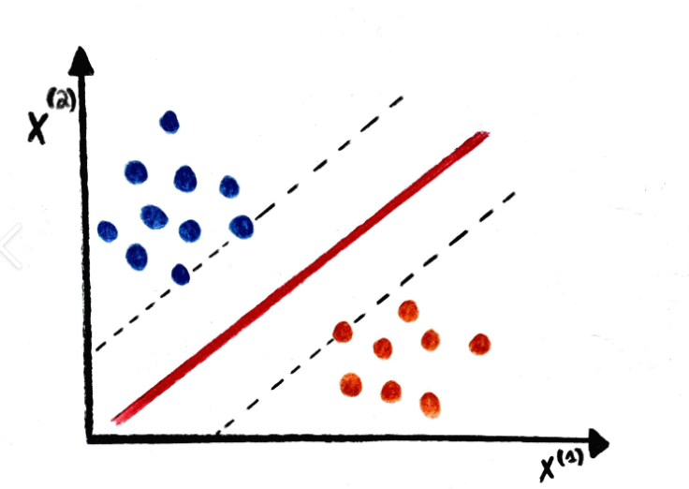
SVM – Support Vector Machine (MACHINE LEARNING ALGORITHM)
CONCEPT
Classification model
SVM finds a hyper-plane that creates a boundary between the types of data
WORKING
THEIR MODEL
The association between lineup behavior and target presence
SVM as a viable means to predict suspect guilt
plot each data item in the dataset in an N-dimensional space, where N is the number of features/attributes in the data.
find the optimal hyperplane to separate the data.

Slide 7
COMPLICATIONS: PREVIOUS RESEARCH
1
REDUCED STIMULUS SET SIZE → >ACCURACY IN CHILDREN(6-8 YEARS)
2
INCREASE IN SIMILARITY BETWEEN FILLERS, CHILDREN “GIVE UP” DUE TO TASK DIFFICULTY → LOW ACCURACY

Slide 8
HOW WE GET THERE
1. Look time (any)
2. Looks at each face
3. Filler looks
4. Suspect looks
5. Winner looks
6. Loser looks
7. Filler look time
8. Suspect look time
9. Winner look time
10. Loser Look Time
LINEUP BEHAVIORS MEASURED:

Slide 9
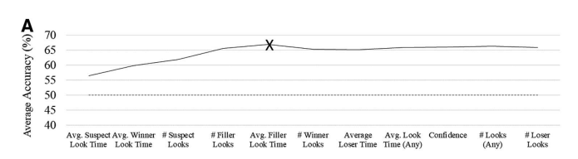
RESULTS!
B2BMARKET SCENARIOS
CLOUD-BASED OPPORTUNITIES
Iterative approaches to corporate strategy
​Establish a management framework from the inside​
SVM classification accuracy in predicting target presence (for children and adults, respectively). Each data point represents the average accuracy score when all behaviors listed to the left of the x-axis label were included in the model. Dashed line indicates chance distribution, and the X indicates the final model chosen.​

Slide 10
SUMMARY
The SVM model with the best performance predicted target presence with 67% accuracy and contained five of the 11 inputted variables: filler look time, suspect look time, suspect looks, filler looks, and winner look time​

Slide 11
THE FASCINATING POINT FOR ME!
“These patterns suggest that, for children, less looking at fillers and more looking at suspects may speak to the diagnostic value of a child’s identification (i.e. may separate guilty from innocent suspects).”
PSYCHOLOGY AND LAW!
supplementary evidence to credit or discredit the witness if huge amounts of data present.
Notes:
can be used as supplementary evidence to credit or discredit the witness if huge amounts of data present. Just like saying, "research shows clinical depression can cause suicidal thoughts in more than 70% people diagnosed ". Just like that maybe 10 years down the line we can say that longer suspect look time by the child in most cases as shown by research conveys ...

