Slide 1
Post-Discharge Readmission Prediction for Diabetic Patients
A Machine Learning Multiclass Perspective
Lambton College
Presented by:
Jennylynne Dominguez
Chaw Su Su Thin
Big Data Analytics (DSMM)
Hazel Portia Elaine Santos
Joyce Ann Murillo
Big Data Framework - BDM 3603

Slide 2
Agenda
Problem Statement and Objectives
Dataset overview
Exploratory Data Analysis
Preprocessing Steps
Feature Engineering
Model Choice and Rationale
Evaluation Metrics
UI Demo
Conclusion
Project Impact and Value In Healthcare
References
Big Data Framework - BDM 3603

Slide 3

Hospital readmissions within 30 days are a major challenge in managing chronic diseases like diabetes — contributing to increased healthcare costs, resource strain, and worse patient outcomes.
This project aims to develop a machine learning model that predicts whether a diabetic patient will be readmitted within 30 days after hospital discharge, using only clinical and demographic data available at discharge time.
The problem is framed as a multiclass classification task with three outcomes:
No Readmission
Readmission After 30 Days
Readmission Within 30 Days (primary focus)
By identifying patients at high risk of early readmission, the model supports hospitals in:
Proactively managing discharge plans
Prioritizing follow-up care
Reducing preventable readmissions
Problem Statement
Objectives
Predict Readmission Timing: Build a multiclass model to predict if a diabetic patient will be readmitted within 30 days, after 30 days, or not at all, using discharge-time data.
Demonstrate Practical Usability: Build an interactive UI that allows clinicians or discharge planners to input patient information available at the end of hospitalization—such as lab results, diagnoses, and medication changes—and receive real-time predictions of 30-day readmission risk
Support Clinical Decision-Making: Support hospital decision-making processes by providing explainable, actionable risk scores that clinicians can use to prioritize patient follow-up care and reduce costly readmissions.
Big Data Framework - BDM 3603

Slide 4
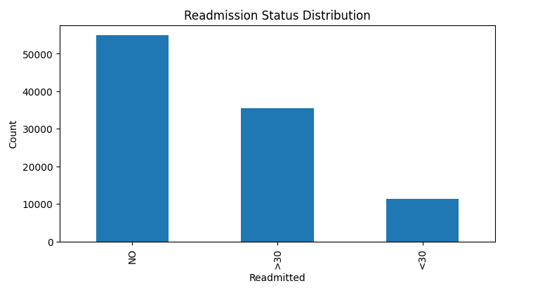
Dataset Overview
Notable Columns :
Subject Area : Health and Medicine
(👤) Race, (🎂 ) Age, (⚧️ ) Gender
Source : UC Irvine Machine Learning Repository
🧪 Lab Test Results such max_glu_serum, A1Cresult
Raw Dataset Shape: 101,766 rows × 50 columns
💊 Medications for Diabetes Management such as metformin, tolazamide , insulin etc.
Dataset Characteristics : Multivariate
🏥 Treatment Change Indicators :
change – Whether there was a change in medication during the encounter
diabetesMed – Whether any diabetes medication was prescribed
Target Variable - Categorical variable indicating patient readmission status:
NO – Not readmitted
>30 – Readmitted after 30 days
<30 – Readmitted within 30 days (target of interest)
The target variable is imbalanced, with <30 being the
minority class.
Big Data Framework - BDM 3603

Slide 5
Preprocessing Steps
Removed hospice/deceased records
▸ Based on discharge_disposition_id using isin()
Numerical Variables
We used .describe().T to generate summary statistics such as mean, standard deviation, min/max, and quartiles for all numerical features.
Filtered patients aged 20–79
▸ Parsed string ranges like "[50-60)" using apply() +
custom function
Dropped Columns: To prepare the dataset for machine learning modeling, several columns were removed based on relevance, missingness, and utility
encounter_id and patient_nbr: Unique IDs with no predictive value
weight: >97% missing data
payer_code, medical_specialty: High missingness or too many unique values
diag_1, diag_2, diag_3: Raw diagnosis codes (removed unless transformed)
Dropped missing values in key demographics
▸ dropna(subset=['gender', 'race', 'age'])
Handled missing & placeholder values
▸ Added "Unknown" to categorical types via cat.add_categories()
▸ Filled missing values using fillna('Unknown')
Categorical Variables - Used .describe(include='object').T to summarize categorical features:
Number of unique values
Most frequent category (top)
Frequency of that top category
Big Data Framework - BDM 3603

Slide 6
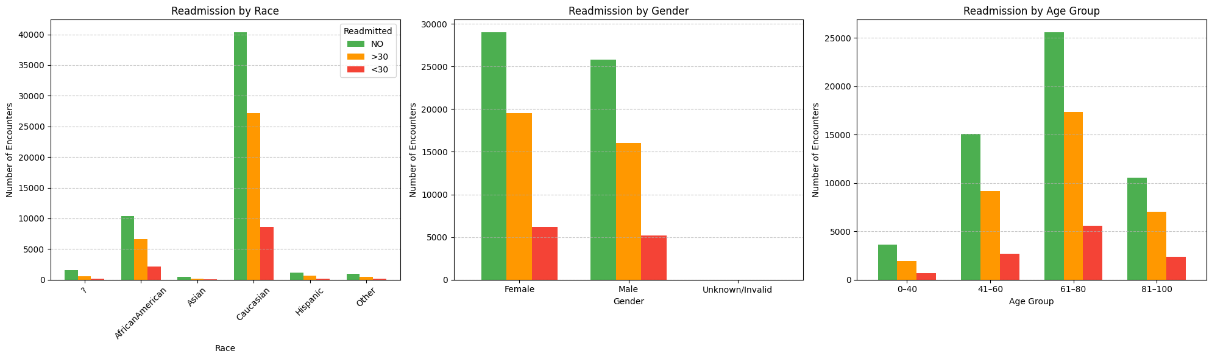
Exploratory Data Analysis
Demographics vs Target
Sociodemographic factors can influence health outcomes, access to care, and treatment adherence.
Most patients are Caucasian, followed by African American
Readmission patterns are present across all races, but smaller groups like Asian or Hispanic are underrepresented.
Female and male patients have similar readmission patterns.
<30 day readmissions are present in both groups, suggesting gender is not a strong differentiator.
61–80 is the highest-risk group
Most total encounters and most early readmissions
41–60 also contributes significantly to readmissions
0–40 shows the lowest readmission rate, suggesting lower clinical complexity
Big Data Framework - BDM 3603

Slide 7
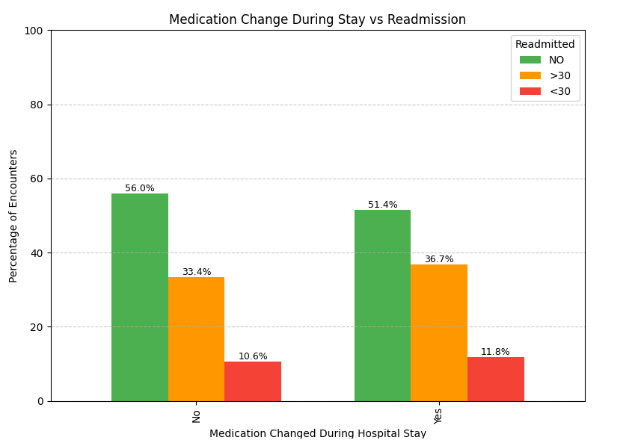
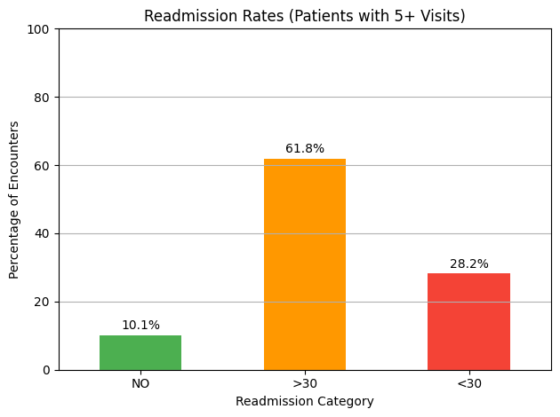
Exploratory Data Analysis
Patients who had a medication change during their hospital stay showed a slightly higher rate of early readmission (<30 days) compared to those without changes.
This may suggest greater clinical complexity, highlighting the importance of targeted follow-up for patients discharged with modified treatment plans.
Patients with 5 or more prior hospital visits have a high likelihood of being readmitted, with nearly 1 in 3 returning within 30 days.
This underscores the need for proactive discharge planning and follow-up care for high-frequency hospital users, particularly those at risk of early return.
Big Data Framework - BDM 3603

Slide 8
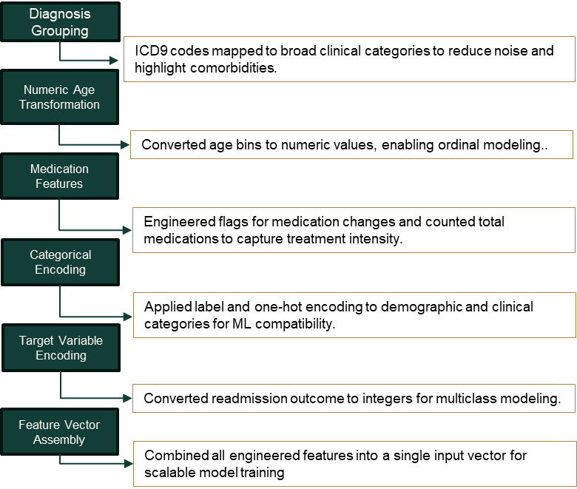
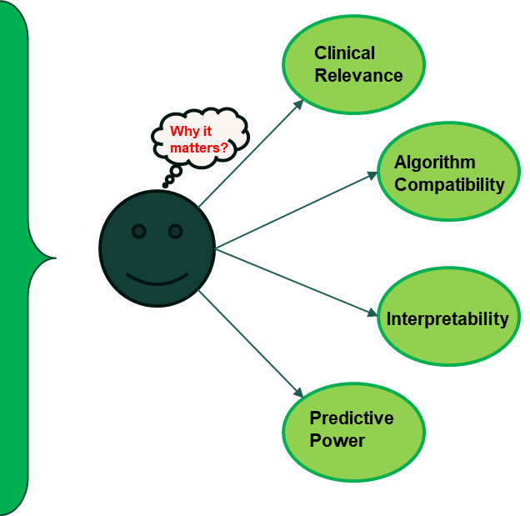
Feature Engineering
Big Data Framework - BDM 3603

Slide 9
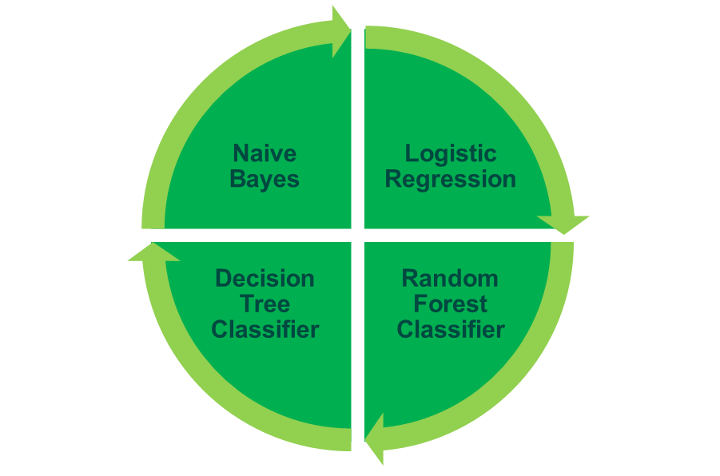
Model Choice and Rationale
Baseline Models Used
Simple, fast classifier, assuming features are independent given the class. It is especially effective for high-dimensional categorical data.
Our dataset contains many categorical variables, making Naive Bayes a good starting point to set a low-complexity baseline.
Widely used baseline for multiclass classification tasks. easy to interpret, and efficient.
This model helps us understand linear relationships between features and readmission outcomes. It can be easily regularized to avoid overfitting on noisy categorical features.
Intuitive, interpretable model that predicts outcomes by recursively splitting data using the most important features, handling both numeric and categorical variables.
Helps identify key split points (e.g., number of inpatient visits or insulin status) associated with higher risk of readmission.
Powerful ensemble method best at capturing complex, non-linear interactions among features.
Suitable for complex data like this with possible interaction effects (e.g. medications, and demographics).
Big Data Framework - BDM 3603

Slide 10
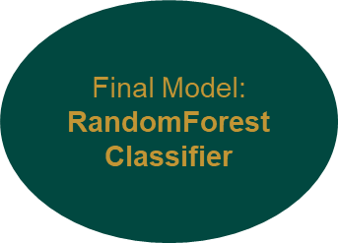






Modeling Approach
Applied class weighting to address severely class imbalance multi-class dataset.
Used grid search with k-fold cross-validation during hyperparameter tuning.
Evaluated SparkXGBoostClassifier as an advanced ensemble model to further enhance minority class prediction in the severely imbalanced multiclass dataset.
Big Data Framework - BDM 3603

Slide 11
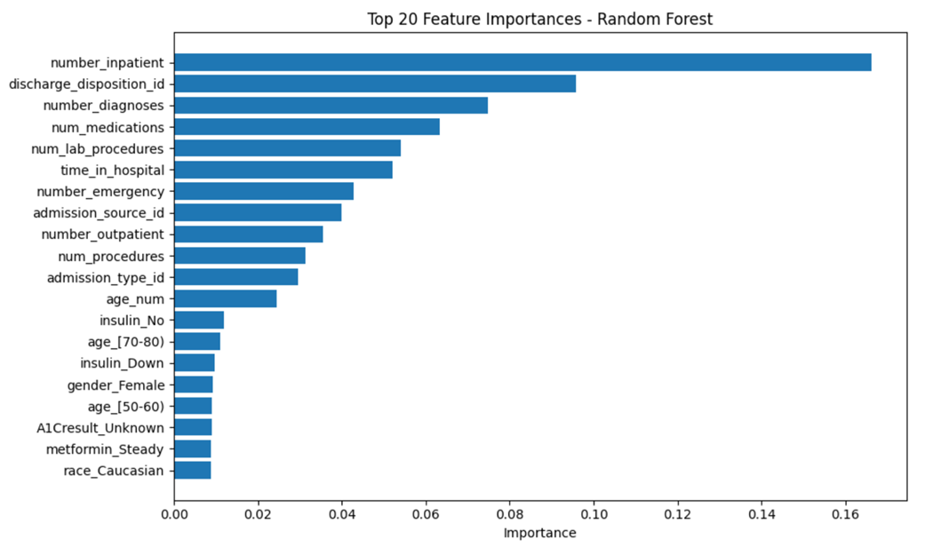
Feature Importance - Random Forest Model
Frequent prior admissions (number_inpatient) are the strongest predictors of readmission risk.
Clinical and administrative factors—like discharge disposition and number of diagnoses—are also highly influential.
Demographics and specific medications are less important than overall care utilization patterns.

Slide 12

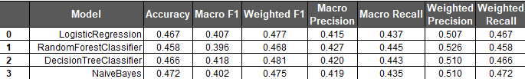
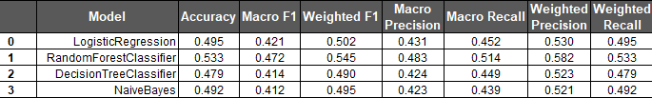
Evaluation Metrics
Baseline Model Performance :
Baseline Metrics: Before Handling Class Imbalance
Baseline Performance:
All models performed well on the majority class but failed to detect early readmissions, highlighting severe class imbalance and poor minority recall.
After Applying Class Weights:
Class weighting improved recall for underrepresented classes—especially <30 days—but slightly reduced overall accuracy due to more balanced error distribution.
Post Tuning Evaluation :
With optimized settings and class weighting combined, model performance significantly improved in both F1 score and minority class detection, with Random Forest achieving the best overall balance.
Addressing Class Imbalance - Why We Applied Class Weights?
<30 days class is clinically critical but underrepresented.
Class weighting assigns higher penalty to minority class errors.
Models biased toward “No readmission” (majority class)
Implemented in PySpark using weightCol with inverse class frequencies.
After Applying Class Weights:
Post Tuning Evaluation :
Big Data Framework - BDM 3603

Slide 13
Summary of Results
Model | Accuracy | F1 Score
RandomForestClassifier | 0.55 | 0.565
DecisionTreeClassifier | 0.481 | 0.503
LogisticRegression | 0.471 | 0.482
NaiveBayes | 0.475 | 0.48
SparkXGBoost | 0.495 | 0.515
RandomForestClassifier achieved the highest F1 Score (0.565) and accuracy (0.55), demonstrating the best balance between precision and recall among all models, and outperforming XGBoost, Logistic Regression, Naive Bayes, and Decision Tree on overall multiclass prediction performance.

Slide 14

Conclusion
After hyperparameter tuning, model performance was evaluated using F1 Score and Accuracy to assess overall predictive power and balance between precision and recall—crucial for handling class imbalance in multiclass readmission.
1
2
RandomForestClassifier
delivered the best results
F1 Score: 0.550
Accuracy: 0.539
Strong balance between precision and recall for imbalanced multiclass data
3
XGBoost
followed closely
F1 Score: 0.514
Accuracy: 0.498
Competitive and generalizes well
4
Logistic Regression
showed solid baseline performance
F1 Score: 0.502
Accuracy: 0.495
Naive Bayes and Decision Tree
underperformed
F1 Scores: 0.495 and 0.490 respectively
Lower ability to capture complex patterns
Big Data Framework - BDM 3603

Slide 15


Project Impact and Value In Healthcare
Treatment Effectiveness Analysis
By analyzing how different medications, dosage adjustments, or procedures correlate with readmission outcomes, predictive models can uncover patterns in treatment effectiveness.
Care Pathway Optimization
Identifies discharge strategies linked to higher readmission risk — even if they follow standard protocols
Flags ineffective discharge plans and follow-up structures
Reveals gaps in patient education and support systems
Helps improve care pathways to reduce preventable readmissions
Big Data Framework - BDM 3603

Slide 16
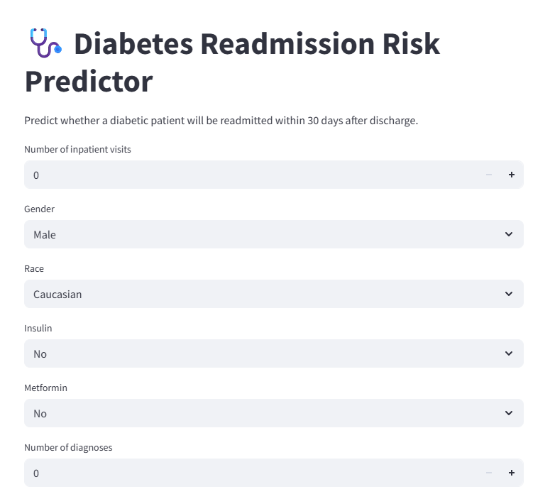
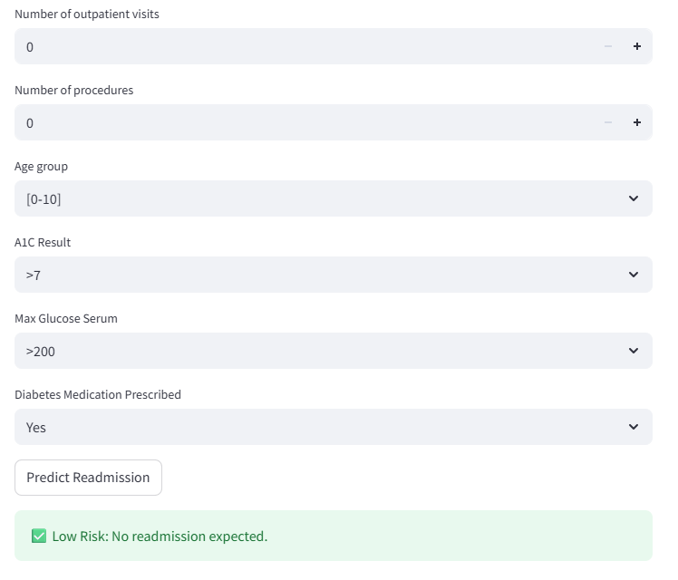
UI Demo
Big Data Framework - BDM 3603

Slide 17
References
Dungan, K. M. (2012). The effect of diabetes on hospital readmissions. Journal of Diabetes Science and Technology, 6(5), 1045–1052. https://doi.org/10.1177/193229681200600508.
Diabetes in America: prevalence, statistics, and economic impact. (n.d.). https://diabetes.org/about-diabetes/statistics/about-diabetes
Ostling, S., Wyckoff, J., Ciarkowski, S. L., Pai, C., Choe, H. M., Bahl, V., & Gianchandani, R. (2017). The relationship between diabetes mellitus and 30-day readmission rates. Clinical Diabetes and Endocrinology, 3(1). https://doi.org/10.1186/s40842-016-0040-x
UCI Machine Learning Repository. (n.d.). https://archive.ics.uci.edu/dataset/296/diabetes+130-us+hospitals+for+years+1999-2008
Big Data Framework - BDM 3603

Slide 18
Thank You

