Slide 1
Embedded Systems Design
Charlotte Heibig
Ismael Frei
EPFL - 07.06.2024

Slide 2
Overview
Part I : Software Implementation
Part II : Hardware accelerator
Part III : Profiling
Part IV : Further optimization
Part V : Dynamic Thresholding Feature
Demo
Questions

Slide 3
Part I: Sobel edge detection algorithm
Apply kernels to each pixel and its 8 surrounding pixels to detect intensity differences in every direction
Identify where the intensity changes rapidly according to a certain threshold to detect edges
Results in a new black and white image with only edges
Used already provided code

Slide 4
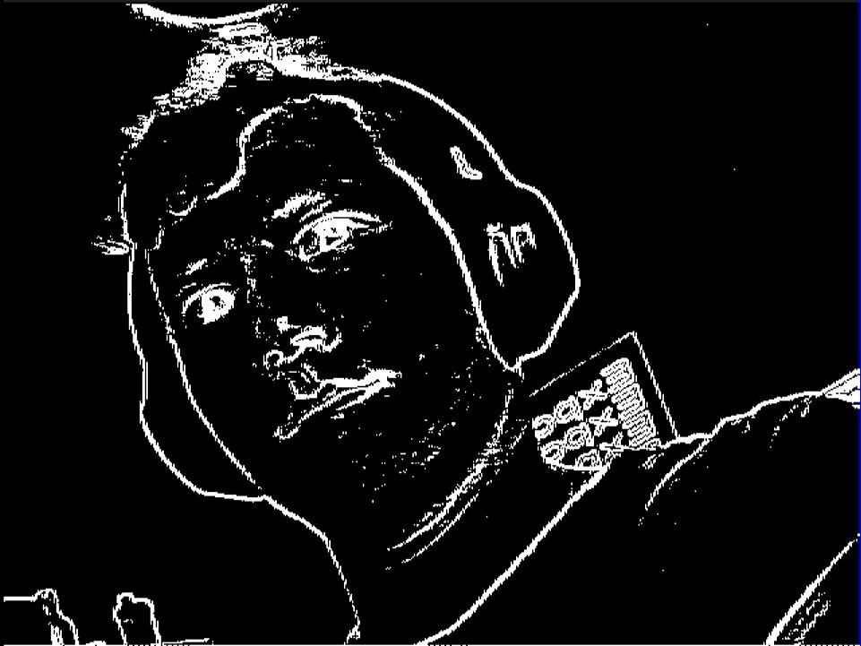
Result

Slide 5
Movement detection using Sobel
Take a grayscale picture
Perform the Sobel algorithm and store the result in memory
Take a second picture and perform the Sobel algorithm
Compare the two results pixel by pixel
If the result is different from 0, then the edge has changed, given a certain threshold (so that movement is only detected after a certain number of pixel changes)

Slide 6
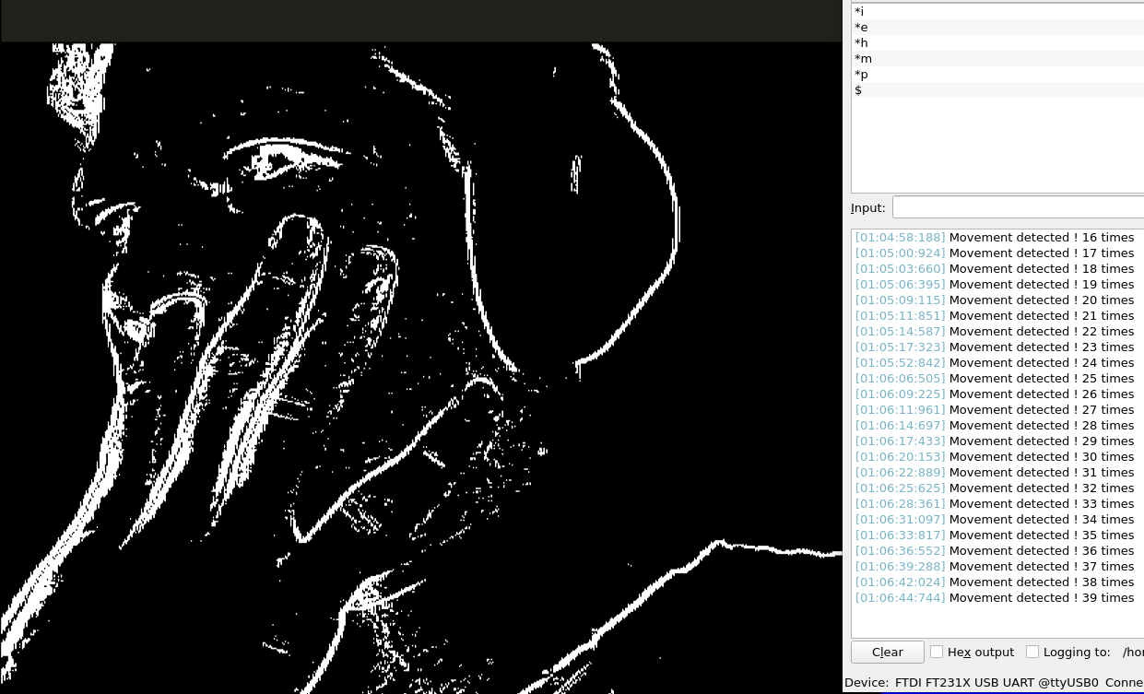
Result

Slide 7
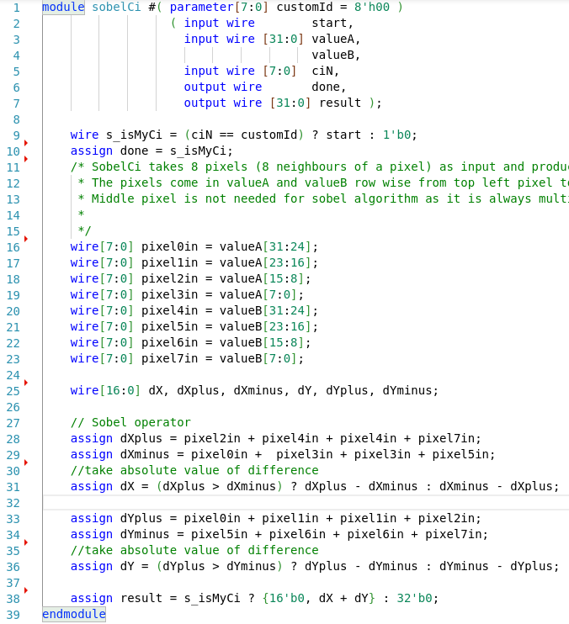
Part II: Sobel as a Custom Instruction
A simple custom Instruction can be created for sobel
valueA and valueB store 8 bytes -> perfect for 8 neighbouring pixels
No registers or clock, purely combinational logic

Slide 8
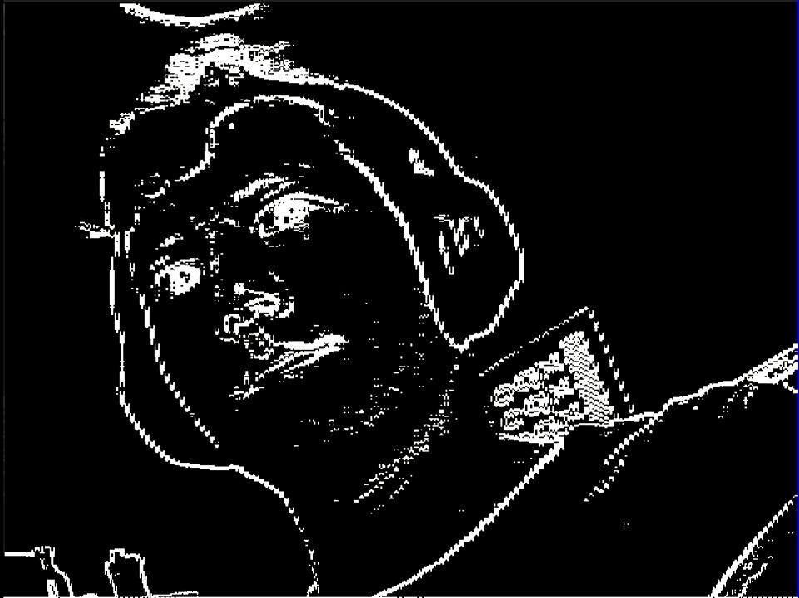
Result

Slide 9
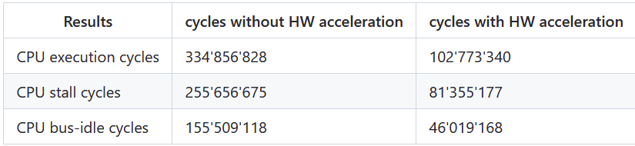
Comparison of the Sobel algorithm : hardware and software implementation
Reduces the CPU cycles by a factor of 3.25
Reduces the CPU stall cycles by a factor of 3.15
Reduces CPU bus-idle cycles by a factor of 3.38
Still room for improvement !

Slide 10
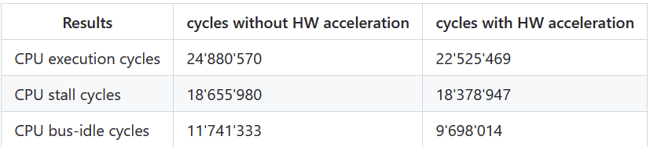
Movement detection algorithm HW implementation
Reduces CPU cycles by a factor of 1.1
10x faster than Sobel -> not really relevant

Slide 11
Part IV: Sobel algorithm optimization
Use DMA controller and SRAM as a “ping peng pang pong buffer” (divide SRAM into 4 buffers)
3 rows are in the buffer and worked with while one new row is added to the buffer in the background
Each buffer needs 640 bytes of space, which means that in total we need 640 words for the four buffers (2560 bytes)

Slide 12
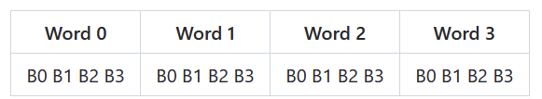
Dual port SSRAM
Problem: Pixels are saved as bytes inside words. Only entire words can be accessed.
Solution: customized SSRAM that lets user access Words with byte offset.
Example: Word 1 with offset 3 outputs {W1B3,W3B0:B2}

Slide 13
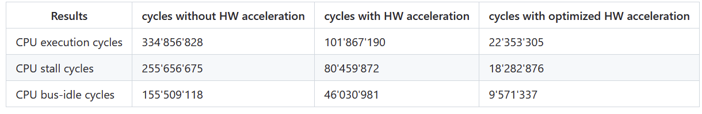
Comparison of the Sobel algorithm with and without DMA
Reduces CPU cycles by a factor of 15 !
Reduces the CPU stall cycles by a factor of 13.9
Reduces CPU bus-idle cycles by a factor of 16.2
Now the movement detection algorithm and Sobel operate at the same speed !

Slide 14
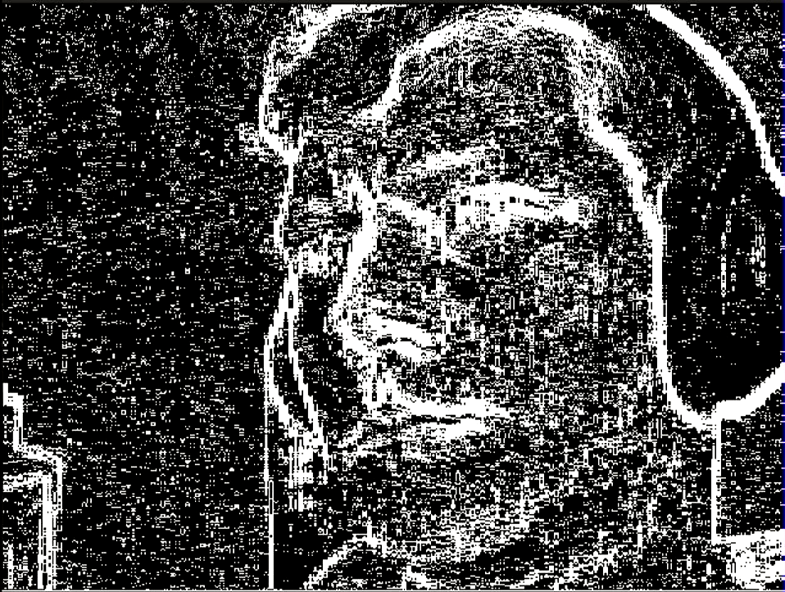
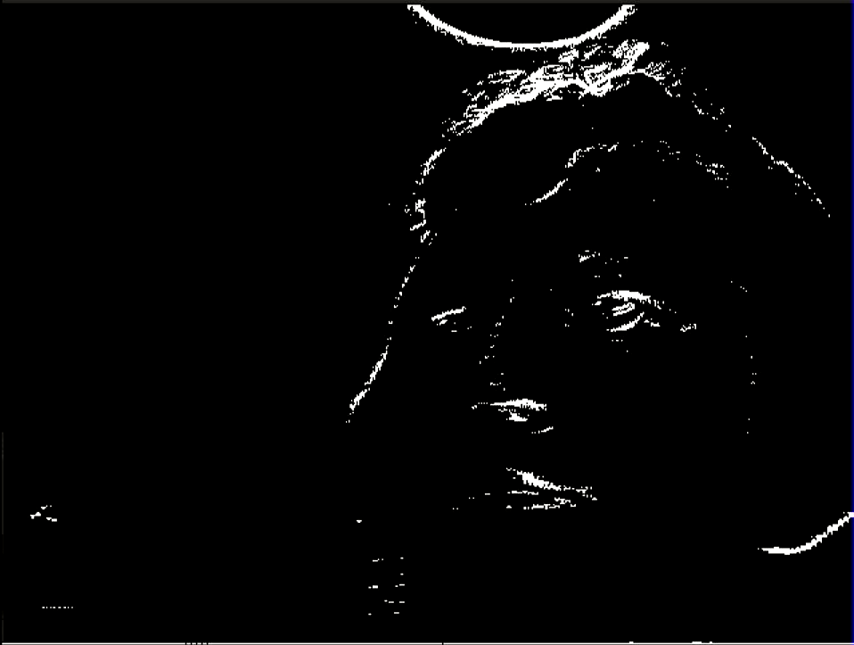
Part V: Dynamic Thresholding Feature
Too much edges detected:
increase threshold
Not much edges detected
decrease threshold

Slide 15


Questions ?
Sobel ? Why not So Belle ?

