Slide 1
NLP - PROJECT LAB EVALUATION
SUBMITTED BY –
CHAITANYA CHIKKALA (102016020)
KUNAL KUMAR (102016014)

Slide 2
TEXT SUMMARIZATION
Text summarization is a very useful and important part of Natural Language Processing (NLP).
Text summarization is the process of creating a shorter version of a given text while retaining its key information and meaning.
There are two main types of text summarization: extractive and abstractive.
Extractive summarization involves selecting important sentences or phrases from the original text and stitching them together to form a summary.
Abstractive summarization involves generating new sentences that convey the essence of the original text.
Text summarization can be done manually or using automated tools such as machine learning algorithms.

Slide 3
USE CASES
Text summarization has numerous use cases across various industries and applications. Some of the most common ones are:
News aggregation: News websites and apps use text summarization to create short summaries of news articles for readers who don't have the time to read the full article.
Social media analysis: Social media monitoring tools use text summarization to provide a concise summary of social media posts, comments, and reviews.
Legal and medical documents: Text summarization can be used to summarize lengthy legal or medical documents, saving time and effort for lawyers and doctors.
Product reviews: E-commerce websites can use text summarization to provide a concise summary of product reviews, allowing customers to quickly understand the main advantages and disadvantages of a product.
Academic research: Researchers can use text summarization to quickly summarize large amounts of academic literature, enabling them to identify relevant papers and extract key insights.

Slide 4
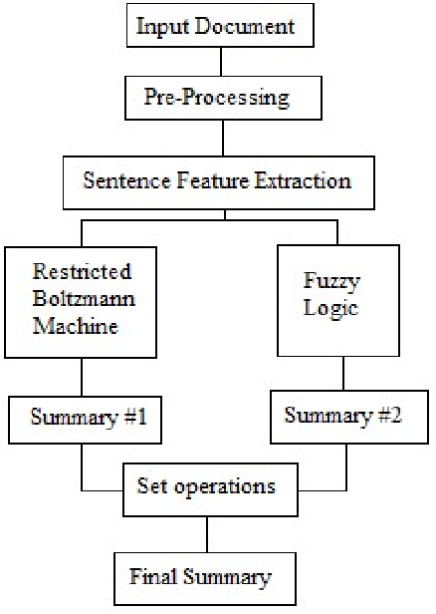

Slide 5
Models Used
Graph-based models: These models represent the text as a graph, where sentences are nodes and the relationships between them are edges. The most important sentences are then identified based on their centrality in the graph.
TextRank: TextRank is a graph-based algorithm that is similar to PageRank, the algorithm used by Google to rank web pages. TextRank represents the text as a graph and then identifies the most important sentences based on their PageRank score.

Slide 6
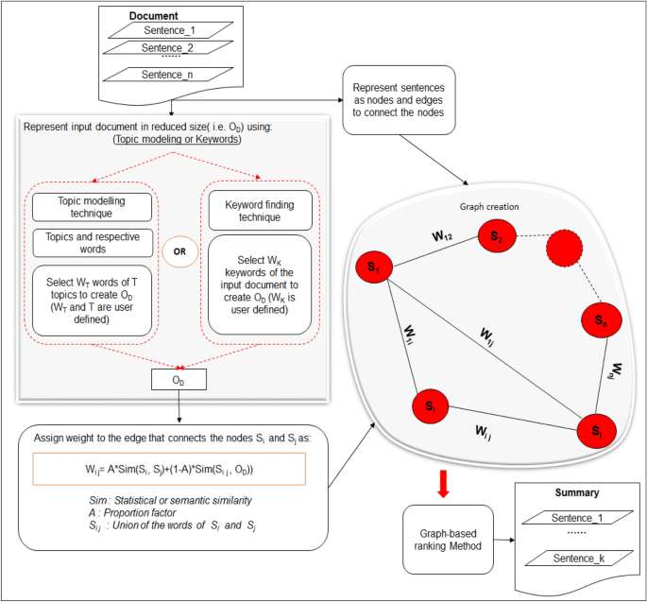

Slide 7
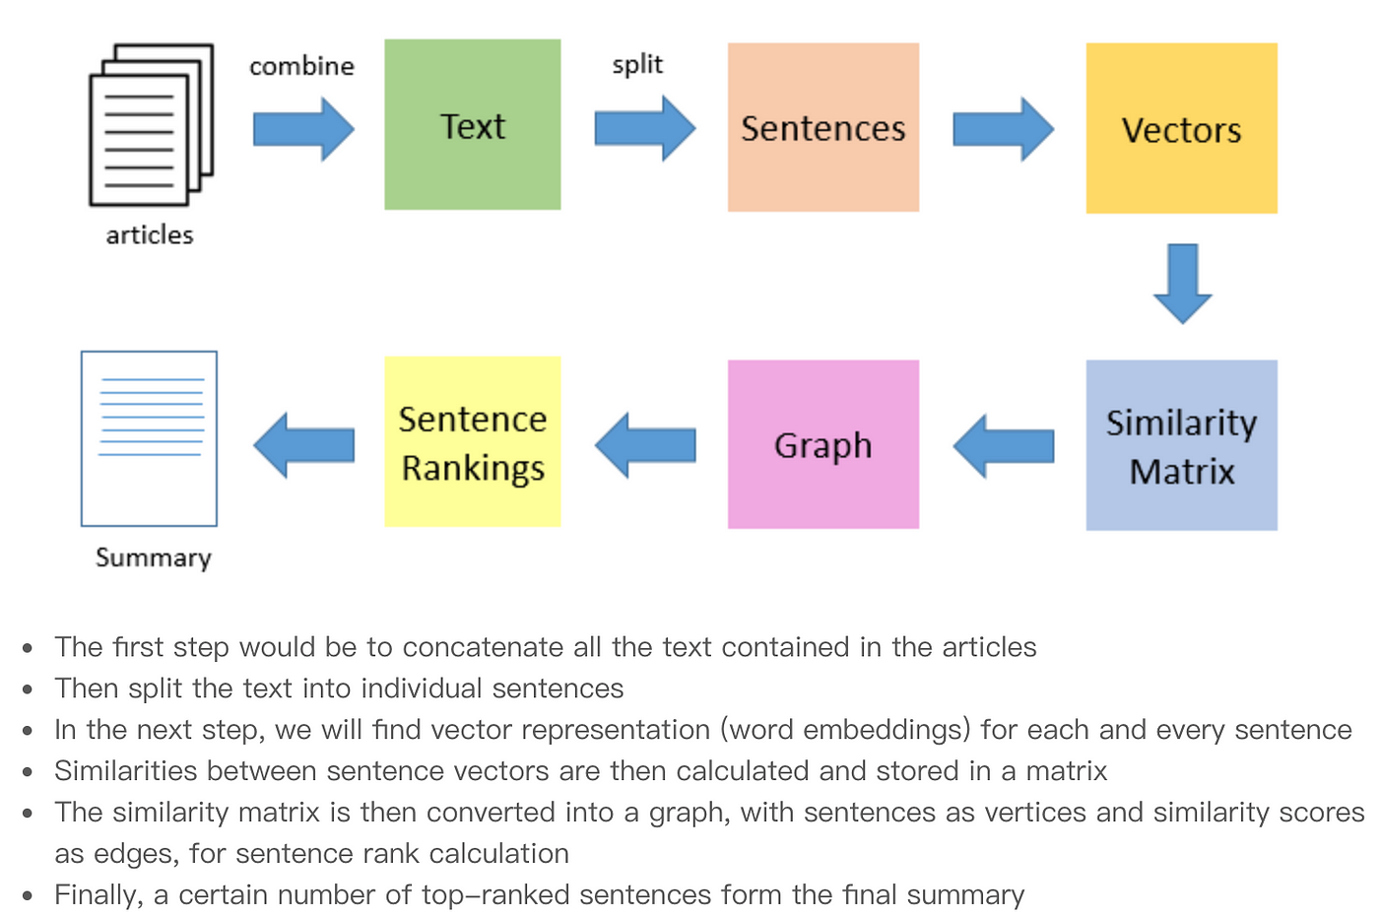

Slide 8
METRICS USED
There are several metrics used to evaluate the quality of extractive text summarization models. Here are some of the most common ones:
ROUGE (Recall-Oriented Understudy for Gisting Evaluation): ROUGE is a set of metrics that measure the overlap between the summary and the reference (original) text. The most commonly used ROUGE metrics are ROUGE-1, ROUGE-2, and ROUGE-L.
Precision, Recall, and F1-Score: These metrics are commonly used to evaluate the performance of extractive text summarization models. Precision measures the proportion of correctly identified sentences in the summary, recall measures the proportion of important sentences that were included in the summary, and F1-score is the harmonic mean of precision and recall.
Cosine Similarity: This metric measures the similarity between the summary and the reference text based on the cosine of the angle between their vector representations.
BLEU (Bilingual Evaluation Understudy): BLEU is a metric commonly used in machine translation, but it can also be used to evaluate extractive text summarization models. BLEU measures the overlap between the summary and the reference text based on n-grams (sequences of n words).
Human evaluation: In addition to automatic metrics, human evaluation is often used to assess the quality of extractive text summarization models. Human evaluators can rate the summaries based on various criteria such as coherence, relevance, and informativeness.

Slide 9
DATASETS and libraries used FOR THE PROJECT
http://mlg.ucd.ie/datasets/bbc.html (DATASET)
LIBRARIES
import numpy as np import pandas as pd
import matplotlib.pyplot as plt import tensorflow as tf from tqdm
import tqdm import os from nltk.corpus
import stopwords from tensorflow.keras
import Sequential from tensorflow.keras.models import Model from tensorflow.keras.layers
importDense,LSTM,Bidirectional,Flatten,Dropout,BatchNormalization,Embedding,Input,TimeDistributed from sklearn.model_selection
import train_test_split from tensorflow.keras.utils import plot_model

