Slide 1

Railway Reservation System

Slide 2
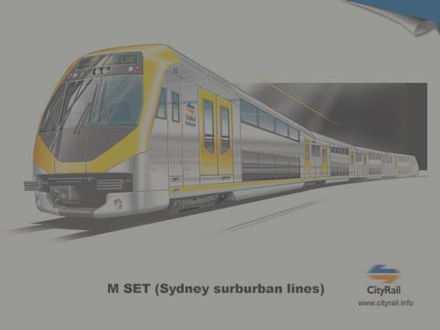

bvnvnbvmnbv
jhvbjhbk

