Slide 1
Hateful Meme Detection
Multimodal Classification: Text · Image · Fusion · CLIP
Binary Classification
12,887 Memes
0.619 (BERT Text)
4 Architectures
Task
Dataset
Best AUROC
Models
Joshua Godwin, Chayasri Kirankumar, Bansari Yadav

Slide 2
Problem & Task
What is a Hateful Meme?
Task Definition
• Memes combine image and text — each harmless alone, hateful together.
Input
Image + Caption text
• Pure text models miss visual dog-whistles and irony.
Output
• Pure image models miss slurs and coded language.
Hateful (1) / Not hateful (0)
• Requires multimodal understanding to detect hate reliably.
Metric
AUROC + F1 + Accuracy
Dataset
limjiayi/hateful_memes_expanded ~12,887 train | 1,040 val

Slide 3
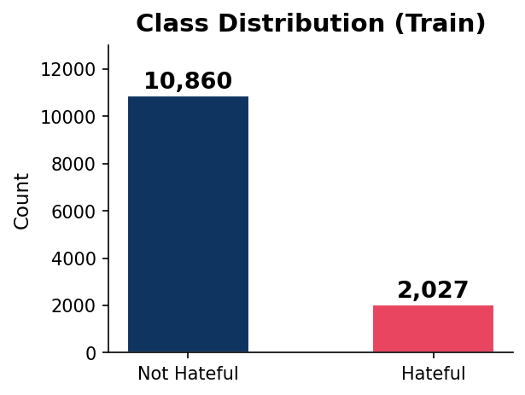
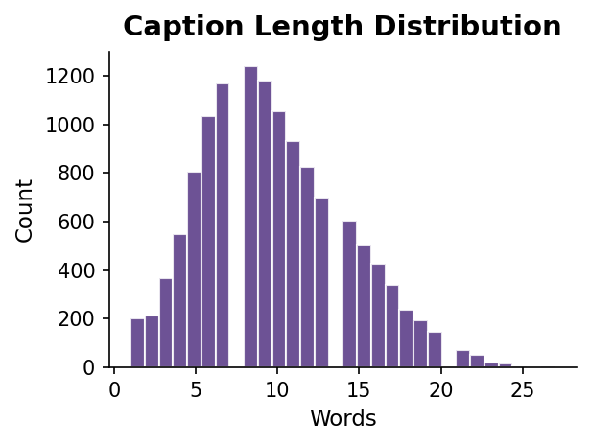
Data Exploration & Key Insights
84% not hateful — class imbalance suppresses F1 scores
Short captions (avg ~9 words) but high semantic density
Many hateful memes look benign without the paired text
→ Drove weighted loss & AUROC as primary metric

Slide 4
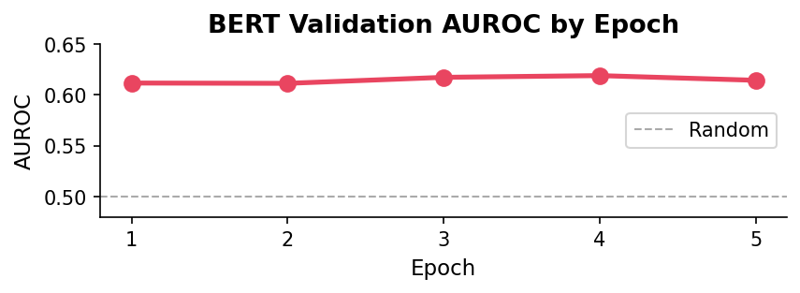
Baseline — Text-Only BERT
Why BERT as baseline?
Input:
Meme caption text
• Meme captions are short but semantically loaded
Tokeniser:
BERT-base-uncased (128 tokens)
• BERT captures context, sarcasm, and coded language
Encoder:
12-layer Transformer → [CLS]
• Strong NLP baseline before adding visual branch
Classifier:
Linear(768 → 256 → 2) + Dropout(0.3)
Params:
109.7 M trainable
• Pre-trained on large corpus — works even on small datasets
Baseline Result (Epoch 4)
0.619
60.8%
0.399
AUROC
Accuracy
F1

Slide 5
Four Architectures Compared
Text (BERT)
Image (ResNet18)
Fusion (BERT+ResNet)
CLIP (frozen)
BERT-base → [CLS] → MLP
ResNet18 → Pool → MLP
BERT + ResNet18 → Concat → MLP
CLIP ViT-B/32 → Fused → MLP
109.7M params
11.3M params
121M params
Frozen encoder
Text only
Image only
Text + Image
Text + Image (joint embedding)

Slide 6
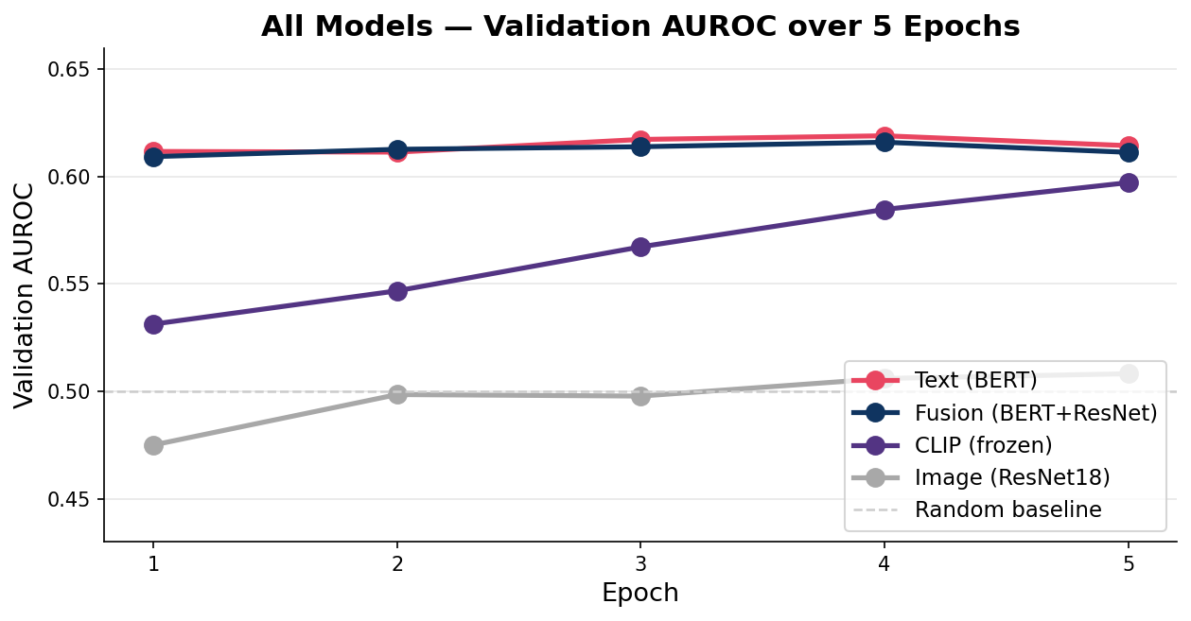
Training Progress — Validation AUROC
Text & Fusion converge fast (epoch 1)
CLIP improves steadily — still learning
Image barely exceeds random (0.508)

Slide 7
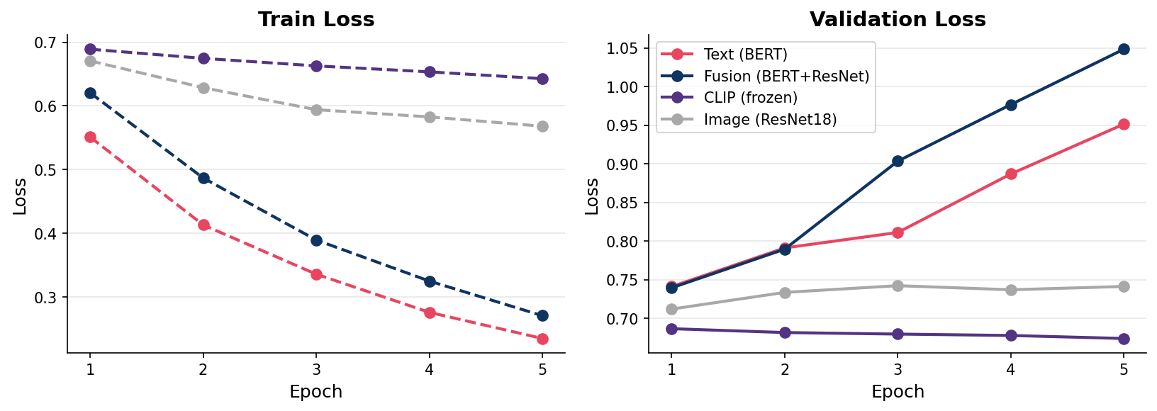
Overfitting Analysis — Train vs Val Loss
• Text & Fusion: train loss drops fast → val loss climbs → overfitting after epoch 2
• CLIP & Image: loss barely moves — too little signal or encoder frozen too aggressively

Slide 8
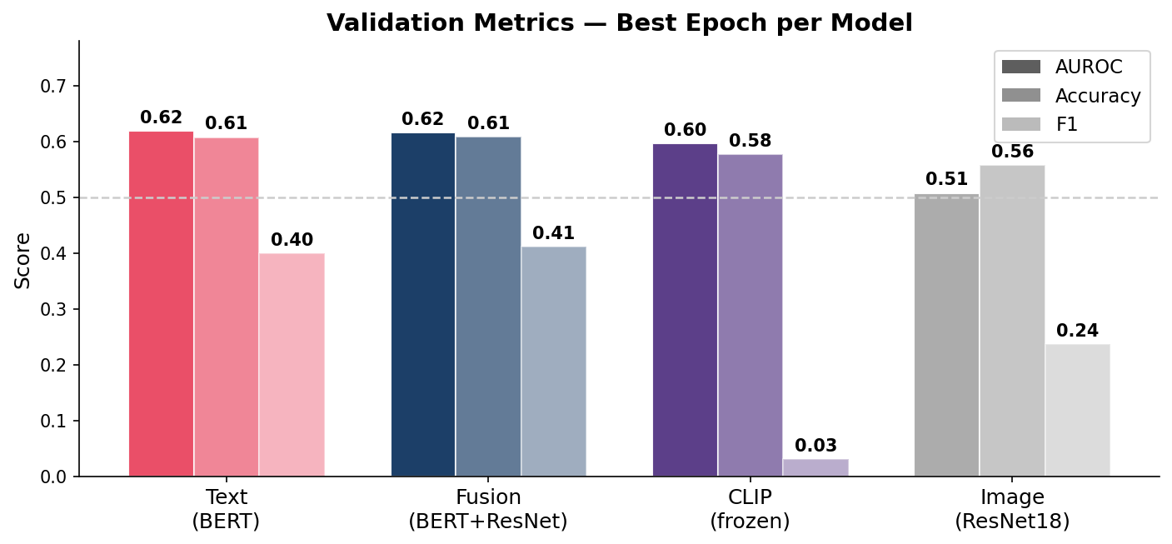
Final Results — All Models
0.619
Best AUROC
Text (BERT)
60.9%
Best Accuracy
Fusion
0.411
Best F1
Fusion

Slide 9
What Worked & What Didn't
Worked
Didn't Work
✓ BERT text encoder captured sarcasm, slurs, and coded language
✗ Image model near-random — visual features alone carry almost no signal
✓ AUROC as metric handled class imbalance better than accuracy
✗ Frozen CLIP encoder: F1 ≈ 0 for 3 epochs, model predicted all non-hateful
✓ Fusion slightly improved F1 (0.399 → 0.411) over text-only
✗ Fusion overfits severely — val loss hits 1.048 by epoch 5
✓ ResNet18 downloaded & fine-tuned without issues on CPU
✗ No early stopping — all models trained past their best checkpoint

Slide 10
Error Analysis & Limitations
Where models fail:
Pipeline Limitations:
Low recall on hateful class
• CPU-only training — severely limits model size & epochs
Class imbalance (84/16 split) → model defaults to 'not hateful'. F1 suppressed.
• No early stopping — overfitting undetected during runs
Cultural / contextual hate
Memes relying on shared cultural knowledge that BERT's pretraining didn't cover.
• Missing ~500 images from expanded dataset
Image-dependent hate
Captions that are benign but paired with hateful imagery — text models miss these.
• No hyperparameter search (fixed LR, batch, dropout)
CLIP collapse
• Evaluation on validation only — test set unused
Frozen encoder + tiny classifier head = model never commits to positive class.

Slide 11
What We'd Try Next
Unfreeze CLIP's last 2–3 layers
High impact
The frozen encoder is the bottleneck. Partial fine-tuning would unlock the joint embedding for this task.
Add early stopping
Easy win
Text and fusion best checkpoints are epoch 1–2. Early stopping recovers this automatically.
Weighted loss / oversampling
Easy win
Address the 84/16 imbalance directly — expected to improve recall and F1 significantly.
Freeze image encoder in fusion (first 2 epochs)
Medium effort
Train the classifier head first, then unfreeze. Prevents image branch from drowning text signal.
GPU training + larger batch
Infrastructure
CPU limits throughput. A single GPU would reduce epoch time from hours to minutes.

Slide 12
Key Takeaways
Language is the primary signal
Images alone carry almost no signal
Text (BERT) achieves 0.619 AUROC — best of all four models.
ResNet18 barely beats random (0.508). Hate lives in the caption.
Fusion adds noise, not knowledge
CLIP needs fine-tuning to contribute
Image branch hurts fusion's AUROC slightly and causes severe overfitting.
Frozen encoder predicts one class for 3 epochs. Partial unfreeze is the fix.
Joshua Godwin, Chayasri Kirankumar, Bansari Yadav

