Slide 1

Advance ML Project: YouTube trending video prediction using AWS (USA Dataset)
A Cloud-Based Machine Learning Project
Group – 6
Sirisha Ginnu (G27150918)
Sagar Shah (G26436634)
Chaya Chandana Doddaiggaluru Appajigowda (G35408608)
Cloud Computing - DATS 6450 George Washington University

Slide 2

Scope of the Project
Automating YouTube trending video analysis with AWS to predict future trends.
Using AWS for data ingestion, cleaning, and NLP on US YouTube Trending Data.
Deploying an ML model via API for real-time trend prediction.
Dashboard Implementation: A real-time interactive dashboard is being developed to visualize key insights from YouTube trending data.

Slide 3
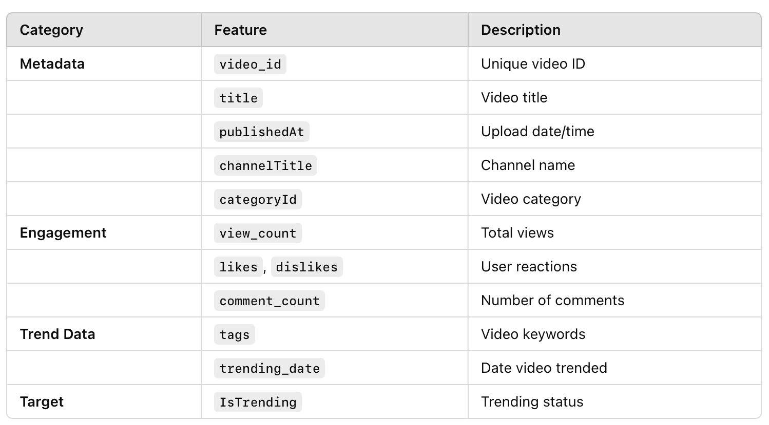
Dataset Overview – US YouTube Trending Data
Dataset Summary -
Total Entries: Large-scale YouTube video metadata (~100K+ records)
Data Source: Kaggle - US YouTube Trending Dataset
Objective: Analyze video trends and build an NLP model to predict trending content

Slide 4
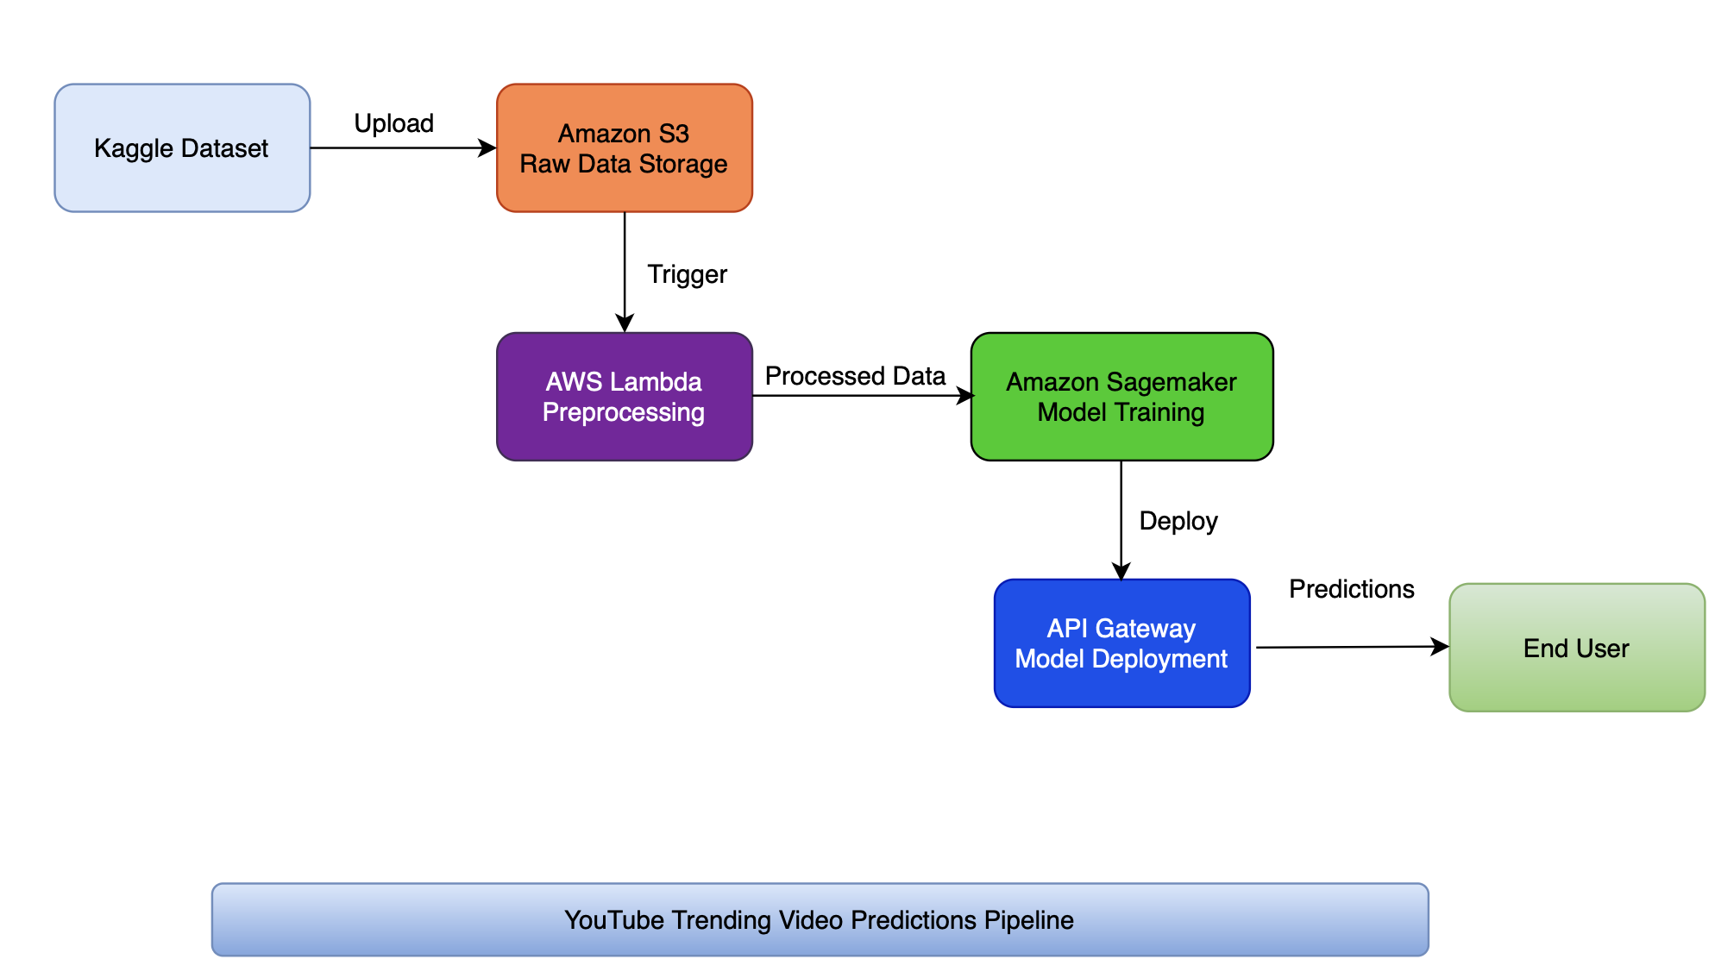
Features to be Implemented
Data Collection: Downloading YouTube trending data from Kaggle.
Storage: Uploading raw data to Amazon S3.
Data Preprocessing: Using AWS Lambda to clean and transform the dataset.
Model Training: Using Amazon Sage-Maker with pre-built NLP models.
Deployment: Exposing the trained model as an API endpoint.

Slide 5

Expected Outcomes
Automated Data Pipeline: A fully automated pipeline from data ingestion to ML predictions.
Scalable ML Deployment: A serverless NLP model accessible via API.
Cloud-Based Solution: Minimal maintenance using AWS-managed services.
Real-time Analysis: Immediate insights from YouTube trending video data.

Slide 6

Data Flow Process
Data Collection: Kaggle dataset uploaded to S3.
Data Cleaning: AWS Lambda performs preprocessing (removing duplicates, filling missing values, etc.).
Data Transformation: Preprocessed data sent to SageMaker for model training.
Model Output: Trained NLP model predictions.
Deployment: Model deployed as API using Lambda & API Gateway.

Slide 7
Interactive Dashboard for YouTube Trend Analysis
Purpose:
Provides real-time insights into YouTube video trends.
Helps visualize key metrics for trend prediction.
Dashboard Features:
Trending Categories: Identify the most popular video genres.
Engagement Metrics: Analyze likes, dislikes, comments, and shares.
Trend Frequency: Track daily/weekly trending patterns.
Sentiment Analysis: Evaluate audience reactions using NLP.

Slide 8


