Slide 1
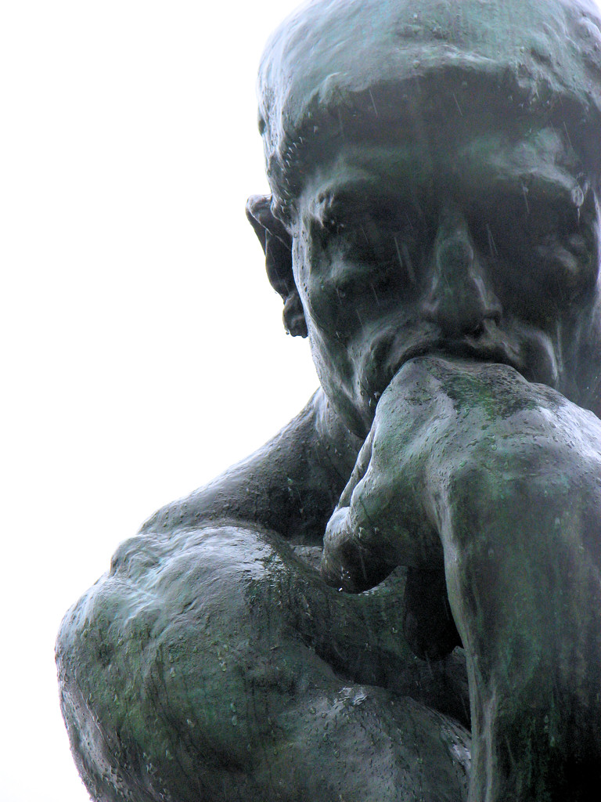
1 / 2 0 1 7: Weeks 1-7
D I S C R E T E
M A T H E M A T I C S
SIIT: ITS 201
For 2nd-Year IT/CPE Students
Instructor: EKAWIT NANTAJEEWARAWAT

Slide 2
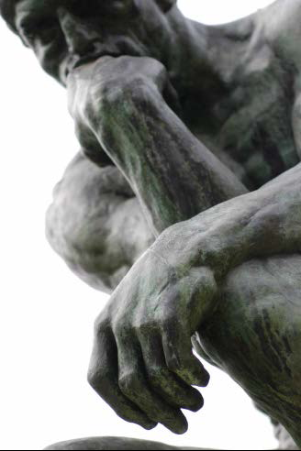
It may sound surprising that in computing, a field
which develops so fast that the future often becomes
the past without having been the present, there is
nothing more stable and worthwhile learning than
its foundations.
Jozef Gruska (1997), Foundations of Computing

Slide 3
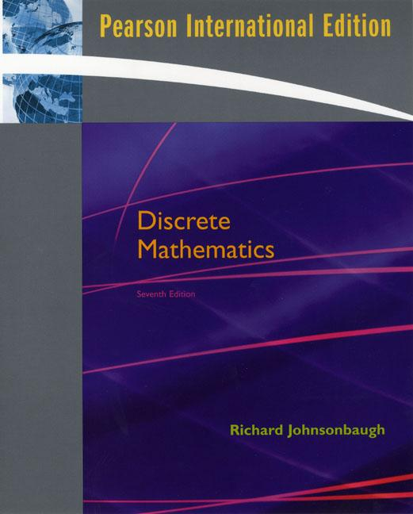

Main Text Book
Richard Johnsonbaugh
Discrete Mathematics
7th edition (2009)
ISBN 0-13-135430-2
Prentice Hall International
QA 39.2 J65 2009 C.2
7th Edition

Slide 4
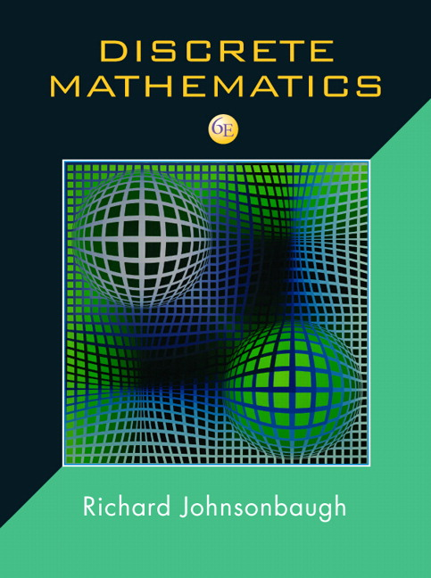
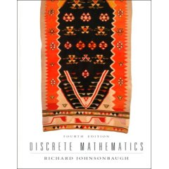
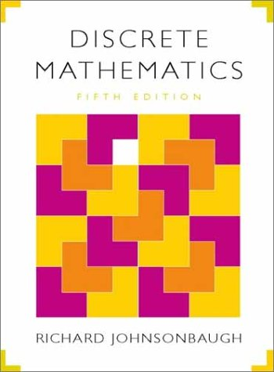
Main Text Book
You may use earlier editions of Richard Johnsonbaugh’s
Discrete Mathematics book, e.g.:
6th edition (2005), ISBN 0-13-127767-7
5th edition (2001), ISBN 0-13-089008-1
4th edition (1997), ISBN 0-13-571191-6
6th Edition
4th Edition
5th Edition

Slide 5
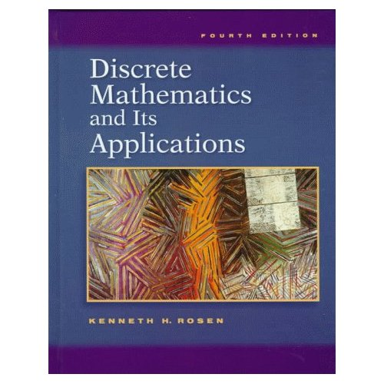
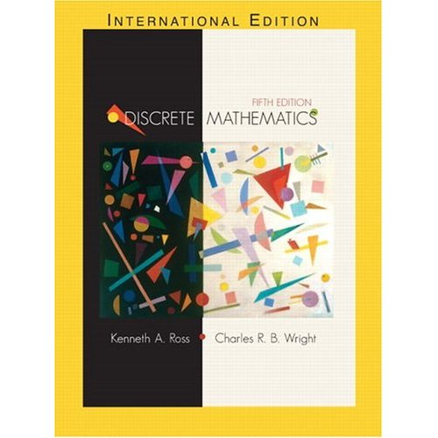
Some Useful References
K. H. Rosen, Discrete Mathematics and Its Applications, McGraw-Hill.
K. A. Ross, C. R. B. Wright, Discrete Mathematics, Prentice Hall

Slide 6
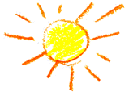
P r e r e q u i s i t e :
N o n e
Calculus is not required !!!
f ′(x) = e^{(1/x)ln x} d (1/x ln x)
dx
∫
dx
∫
=
1 cos² u du
(x² + 4)²
8
lim f(x) = L
x → c

Slide 7
C l a s s S c h e d u l e
Week
Logic
Proof Methods
Sets / Relations / Functions
Midterm Exam
Algorithms / Complexity Analysis
Counting Methods
Recurrence Relations
Graph Theory
Finite State Automata & Turing Machines
Final Exam
Topics
1-2
3-4
5-7
8
9-10
11-12
13-14
15
16

Slide 8
G r a d i n g S y s t e m
Midterm Exam 50%
Final Exam 50%
There will be sessions for practice exam questions
(1 or 2 times for each chapter).

Slide 9


W h a t I s “ D i s c r e t e M a t h ” ?
Discrete mathematics is mathematics that uses only
arithmetic and algebra, and does not involve calculus.
From Random House Dictionary
? ? ?

Slide 10
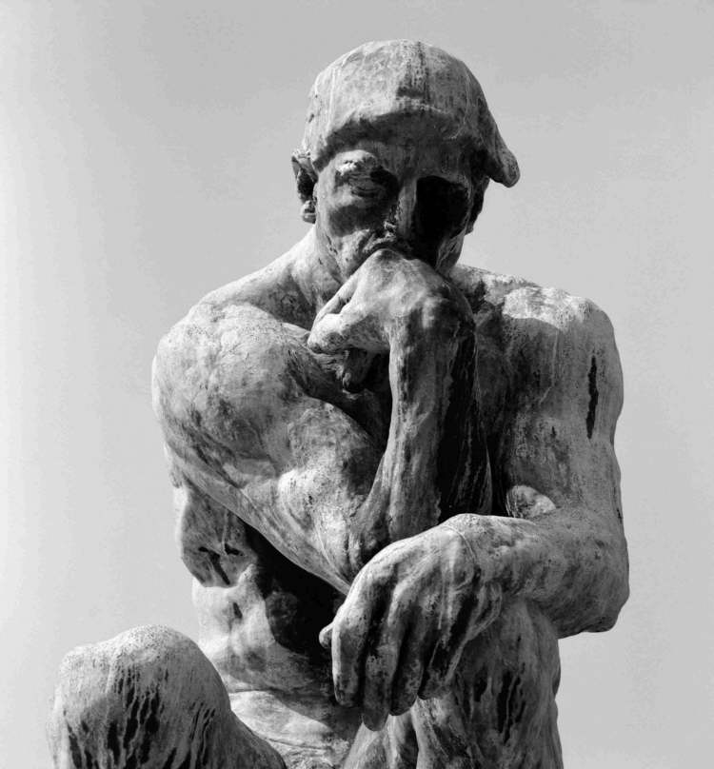
Discrete math covers:
Logic
Methods of proof
Set theory
Relations and Functions
Partially-ordered sets and lattices
Combinatorics (Theory of counting)
Graph theory
Boolean algebra

Slide 11

Why should CS/IT students study discrete math?
Discrete math is an important “theoretical foundation”
for computer science and information technology.
It is a basis for, for example:
Programming languages
Data structures and algorithms
Artificial Intelligence
Theoretical computer science
Digital signal processing
Computer hardware.

Slide 12
Programming Languages
if !((x == y) && (z > 1000))
{ … do something … }
if ((x != y) || (z <= 1000))
{ … do something … }
Data Structure & Algorithms
t(n)
Ο(n)
Ω(n)
Θ(n)
n
Tree, Graph
Complexity Analysis

Slide 13
Artificial Intelligence
Knowledge Representation and Reasoning
If it is hot and humid, then it will rain.
If it is not hot, then it is not humid.
It is humid now.
Assumed
Knowledge
Will it rain?

Slide 14
Knowledge Representation
and Reasoning
Tax cut puzzle
1: A person who has two children or more can get discounted tax.
2: Peter has a child named Paul.
3: Peter has a child, and this child is someone's mother.
4: A person's mother is always a woman.
5: Paul is a man.
6: Men and women are disjoint.
Question: Who can get discounted tax?

Slide 15

Knowledge Representation
and Reasoning
A murder mystery
1: Someone who lives at Dreadbury Mansion killed Aunt Agatha.
2: Only Agatha, the Butler, and Charles lived at Dreadbury Mansion.
3: A killer always hates his/her victim.
4: A killer is never richer than his/her victim.
5: Charles hates no one that Aunt Agatha hates.
6: Aunt Agatha hates everyone but the Butler.
7: The Butler hates everyone who is not richer than Aunt Agatha.
8: The Butler hates everyone Aunt Agatha hates.
9: No one hates everyone.
Question:
Who killed Aunt Agatha ?

Slide 16
Computer Hardware
Design of Combinatorial Circuits and Sequential Circuits
00/0
01/1
01/0
10/0
11/0
NC
C
00/1
11/1
10/1
Model a serial adder as a finite-state machine

