Slide 1
1. Logic
2. Proof Methods
3. Sets, Relations, and
Functions
4. Algorithms
5. Counting Methods
6. Recurrence Relations
7. Graphs
8. Finite-State Automata
and Turing Machines
Appendix:
Self-Test Homework
Solutions to Homework
Logic

Slide 2
Logic is “the study of reasoning”.
EXAMPLE
“Every cat can smile.”
“Tom is a cat.”
“Tom can smile.”
Tom

Slide 3
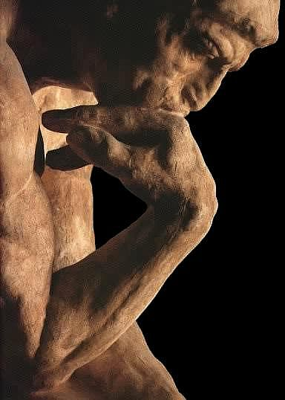
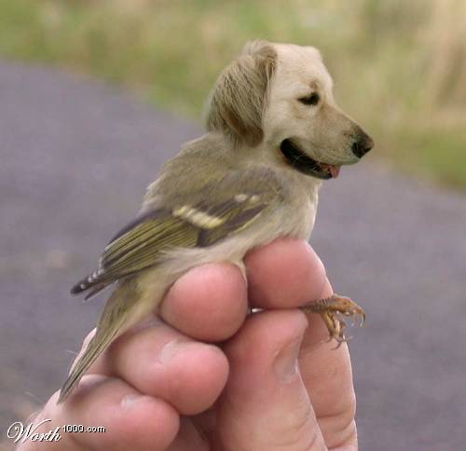
Logic is “the study of reasoning”.
It is specifically concerned with whether reasoning is correct.
Logic focuses on the “relationship among statement”
as opposed to the content of any particular statement.
EXAMPLE
“Ben is a dog.”
“Every dog has wings.”
“Ben has wings.”
Logic does not tell us whether each of the above statements is true.
But, it assures us that if the first two statements are true, the third statement is also true.

Slide 4
Logic and Proofs
Logic is used:
in mathematics
to prove theorems
in computer science
to prove the correctness of programs
to represent knowledge and to deduce information
from the knowledge
(mechanical theorem proving)

Slide 5

Propositions
A proposition is a declarative sentence that is either true or false, but not both.
Which of the following are propositions?
1. “The sun rises in the east.”
2. “8 is an even number.”
3. “1+1 = 3.”
4. “Earth is the only planet in the universe that has life.”
5. “I don’t know what you are talking about.”
6. “What are you talking about?”
7. “Who are you?”
8. “Are you sleeping now?”.
9. “Wake up and listen to me.”
Only the first five sentences are propositions.

Slide 6
Composite Propositions
We can build composite propositions from simpler
propositions by using 5 connectives:
and, or, not, implies, if and only if.
EXAMPLE
Given two propositions
p: “John loves discrete math”
q: “1+1 = 3”,
we can construct:
“John loves discrete math and 1+1 = 3”
“John loves discrete math or 1+1 = 3”
“John does not love discrete math”
“1+1 ≠ 3”
“John loves discrete math implies 1+1 = 3”
“John loves discrete math if and only if 1+1 = 3”
constituent propositions
p
∧
q
p
∨
q
¬p
¬q
p
→
q
p
↔
q
Note: In the 4th and 5th editions of the main text book, ¬p is written as p.

Slide 7
Truth Tables
The truth values of composite propositions
can be described by truth tables.
Negation
p ¬p
T F
F T
Conjunction
Disjunction
p ∧ q
p ∨ q
p q
T T T
T F F
F T F
F F F
p q
T T T
T F T
F T T
F F F

Slide 8
Conditional Proposition
p → q
p q
T T T
T F F
F T T
F F T
p implies q
(denoted by p → q)
p → q can also be read as:
“If p, then q”
“q when p”
“A sufficient condition for q is p”
“A necessary condition for p is q”
“condition part”, “hypothesis”,
“antecedent”, or “premise”
“conclusion” or “consequence”
p → q

Slide 9
Biconditional Proposition
p ↔ q
p q
T T T
T F F
F T F
F F T
p if and only if q
(denoted by p ↔ q)
p ↔ q can also be read as:
“p is a necessary and sufficient condition for q”
and sometimes written as “p iff q”.

Slide 10
Determine whether each statement is true or false.
1. 1 > 2 or 5 > 3
2. If 5 > 3, then today is Tuesday.
3. If today is Tuesday, then it is raining.
4. If (4 < 2 and 6 < 6), then 7 < 10.
5. If it is not the case that (6 < 6 and 7 is not less than 10), then 4 < 2.
6. 7 < 10 if and only if (4 < 2 and 6 is not less than 6).
7. John likes discrete math and 1+1 = 2
8. (p ∧ q) ∨ r
?

Slide 11
Logical Equivalence
Two compound propositions P and Q are logically equivalent (denoted by P ≡ Q),
when either
P and Q are both true; or
P and Q are both false,
for every combination of the truth values of their constituent propositions.
EXAMPLE
p ∨ (q ∧ r) ≡ (p ∨ q) ∧ (p ∨ r)
How to prove this?

Slide 12
EXAMPLE
Prove that:
p ∨ (q ∧ r) ≡ (p ∨ q) ∧ (p ∨ r)
Using truth tables.
p q r p ∨ (q ∧ r) (p ∨ q) ∧ (p ∨ r)
T T T
T T F
T F T
T F F
F T T
F T F
F F T
F F F

Slide 13
EXERCISE
Prove that:
(p ∧ q) → ¬r ≡ ¬p ∨ ¬q ∨ ¬r
Using truth tables.
p q r (p ∧ q) → ¬r ¬p ∨ ¬q ∨ ¬r
T T T
T T F
T F T
T F F
F T T
F T F
F F T
F F F

Slide 14
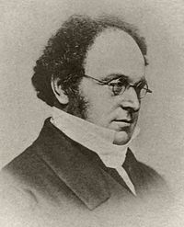
Basic Logical Equivalences
1
p ↔ q ≡ (p → q) ∧ (q → p)
Bicondition law
2
p → q ≡ ¬p ∨ q
Implication law
3
p → q ≡ ¬q → ¬p
Contrapositive law
¬(p ∨ q) ≡ ¬p ∧ ¬q
¬(p ∧ q) ≡ ¬p ∨ ¬q
De Morgan’s laws
4
Augustus
De Morgan
(1806–1871)
A British
mathematician
and logician[

Slide 15
Basic Logical Equivalences
p ∨ (q ∨ r) ≡ (p ∨ q) ∨ r
p ∧ (q ∧ r) ≡ (p ∧ q) ∧ r
p ∨ (q ∧ r) ≡ (p ∨ q) ∧ (p ∨ r)
p ∧ (q ∨ r) ≡ (p ∧ q) ∨ (p ∧ r)
5
6

Slide 16
EXERCISE
Prove that:
(p ∧ q) → ¬r ≡ ¬p ∨ ¬q ∨ ¬r
Using known basic logical equivalences.

Slide 17



Selected Exercises from the Main Text (Johnsonbaugh, 7th Ed)
EXECISES on Pages 20-21 of the Main Text
Solve Problems 17-21, 22-27, 30-32, and 66.
Answers to Problems 17-21:
17) T 18) T 19) T 20) F 21) F
EXECISES on Pages 30-31 of the Main Text
Solve Problems 13-20 and 60-69.
Answers to Problems 13-20:
13) T 14) F 15) F 16) F 17) F
18) T 19) F 20) T
Answers to Problems 60-69:
60) no 61) no 62) yes 63) no 64) no
65) yes 66) no 67) no 68) no 69) no

