Slide 1
1. Logic
2. Proof Methods
3. Sets, Relations, and
Functions
4. Algorithms
5. Counting Methods
6. Recurrence Relations
7. Graphs
8. Finite-State Automata
and Turing Machines
Appendix:
Self-Test Homework
Solutions to Homework
Proof Methods

Slide 2
Axioms
Lemma
Lemma
Theorems
Corollaries
Definitions
Lemma
. . . P r o o f . . .
M A T H E M A T I C A L S Y S T E M

Slide 3
Mathematical Systems
Axiom
A statement that is accepted to be true without a proof … an agreement
Definition
A statement that introduces a new concept in terms of existing concepts
Theorem
A statement that have been proved to be true
Lemma
A simple theorem that is used in proving another theorem
Corollary
A theorem that follows easily from another theorem

Slide 4
EXAMPLE: Axiom, definition, theorem and corollary in geometry
- Axiom
Given two distinct points, there is exactly one straight line that contains them.
- Definitions
A triangle is an equilateral triangle, if all of its sides are equal.
A triangle is an equiangular triangle, if all of its angles are equal.
- Theorem
If two sides of a triangle are equal, then the angles opposite them are equal.
- Corollary
If a triangle is equilateral, then it is equiangular.

Slide 5
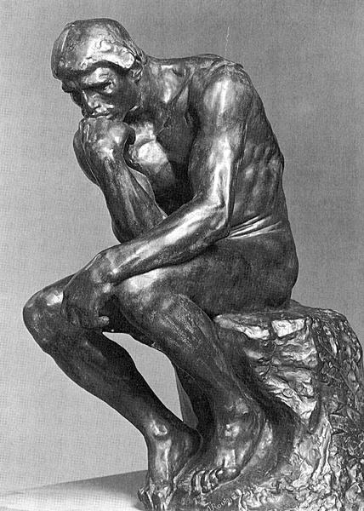
Methods of Proofs
Direct Proofs
Proof By Contradiction
Proof By Contrapositive
Deductive Reasoning
Resolution Proofs
Mathematical Induction

Slide 6
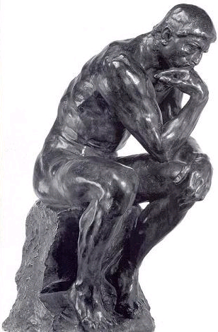
Direct Proof
To prove that “if p, then q” is true,
assume that “p is true”,
and try to derive that “q is true”.

Slide 7
EXAMPLE
Given the definition of odd number:
DEFINITION
An integer n is odd, iff there is an integer k such that n = 2k+1.
Prove that:
“For any integer n, if n is odd, then n² is odd.”

Slide 8
EXAMPLE
Let the domain of discourse be the set of all integers.
Prove that: ∀x∃y, x + y = 0

Slide 9
EXAMPLE
DEFINITION
An integer n is even, iff there is an integer k such that n = 2k.
Prove that:
“The sum of two odd integers is an even integer.”

Slide 10
EXAMPLE
Let the following definition and theorem be given:
DEFINITION
For any real numbers x, y, let
min{x, y} = x, if x ≤ y; and,
min{x, y} = y, otherwise.
THEOREM
For any real numbers x, y, z, if x ≤ y and y ≤ z, then x ≤ z.
Now prove that:
“For any real numbers d, d₁, d₂, x,
if d = min{d₁, d₂} and x ≤ d, then x ≤ d₁ and x ≤ d₂.”

Slide 11
Prove that “if p then q” is true.
Direct Proof
Proof By Contradiction
Assume that:
“p” is true and “not q” is true.
Assume that: “p” is true.
Try to derive:
Try to derive:
“q” is true.
A contradiction!

Slide 12
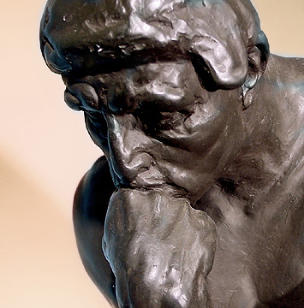
Proof by Contradiction
(Indirect Proof)
To prove that “if p, then q” is true
assume that “p is true” and “¬q is true”,
and try to derive a “contradiction”.
(q is false)
A contradiction is a proposition of the form r ∧ ¬r,
where r is any proposition.
NOTE: (p → q) ≡ (p ∧ ¬q ) → (r ∧ ¬r )

Slide 13
If we can show that
“whenever p is true and ¬q is true (q is false),
there is a contradiction”,
we can conclude that this case will not occur.
p → q
p q
T T T
T F F
F T T
F F T

Slide 14
EXAMPLE
Given two theorems:
THEOREM
If x is a real number, then x⋅0 = 0.
THEOREM
For any real numbers a, b and c, if a⋅b = a⋅c and a ≠ 0, then b = c.
Prove that: “If x⋅y = 0, then x = 0 or y = 0.”
Proof
Assume that x⋅y = 0, x ≠ 0 and y ≠ 0.
Then, by the first theorem, x⋅y = x⋅0.
Then, by the second theorem, y = 0,
which is a contradiction.
p
¬q
x⋅y = 0
x ≠ 0 and y ≠ 0
By 1st Theorem
x⋅y = x⋅0
By 2nd Theorem
y = 0
A contradiction!

Slide 15
EXAMPLE
Show that: “If 100 balls are placed in nine boxes,
then some box contains more than 11 balls.”

Slide 16
EXAMPLE
Let n be an integer.
Show that: “If 3n + 2 is odd, then n is odd”.

Slide 17
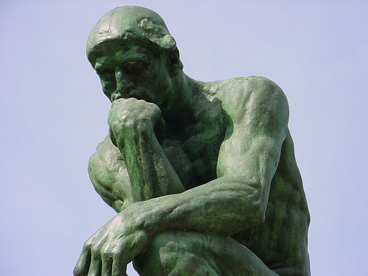
Proof by Contrapositive
(A special case of proof by contradiction)
To prove “if p, then q”
assume that q is false (¬q is true)
and try to derive “p is false” (¬p is true).
p → q ¬q → ¬p
p q
T T T T
T F F F
F T T T
F F T T
In other words,
to prove “if p, then q”,
prove “if ¬q, then ¬p” instead.
p
→
q
≡
¬q
→
¬p
Contrapositive Law

Slide 18
EXAMPLE
Let n be an integer.
Show that: “If 3n + 2 is odd, then n is odd”.

Slide 19
EXAMPLE
Prove that: “For any integer n, if n² is even, then n is even.”

Slide 20
EXAMPLE
Assume that the following theorem is given:
THEOREM
For all real numbers x1, x2, y1, y2,
if x1 < x2 and y1 < y2, then x1+ y1 < x2 + y2.
Prove that:
“For all real numbers x and y, if x+y ≥ 2, then x ≥ 1 or y ≥ 1.”

Slide 21
“Proof by contrapositive” can be seen as a special form of “proof by contradiction”.
Prove that “if p then q” is true.
Proof By
Contrapositive
Proof By
Contradiction
Prove that “if ¬q then ¬p” is true.
Assume that:
“p” is true and “not q” is true.
Assume that: “not q” is true.
A contradiction!
Try to derive:
“not p” is true.
“not p” is true.

Slide 22
“Proof by contradiction” is more powerful than “proof by contrapositive”.
Prove that “if p then q” is true.
Proof By Contradiction
Assume that: “p” is true and “not q” is true.
“r” is true.
“not r” is true.
A contradiction!

Slide 23
EXAMPLE
Another example of
“Proof by Contradiction”
Given the definition of a rational number:
DEFINITION
A rational number is a number of the form r/s,
where r and s are integers, s ≠ 0 and r and s have no common divisor.
Prove that:
“If x is a real number and x² = 2, then x is not a rational number.”

Slide 24
“If x is a real number and x² = 2, then x is not a rational number.”
Outline of the Proof:
x is a real number and x² = 2.
x is a rational number.
1
3
r²=2s²
r² is even.
4k²=2s² for some integer k.
x = r/s, where:
r and s are integers,
s ≠ 0, and
r and s have no common divisor.
4
2
r is even.
s² is even.
5
s is even.
6
r and s have a common divisor.
Contradiction!

Slide 25
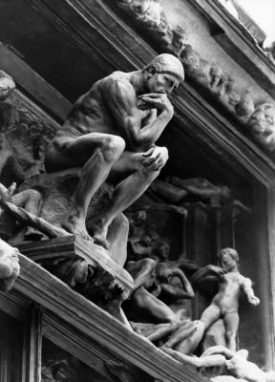
Methods of Proofs
Direct Proofs
Proof By Contradiction
Proof By Contrapositive
Deductive Reasoning
Resolution Proofs
Mathematical Induction

Slide 26

Motivation: Example
Deductive Reasoning
From these two premises (hypotheses):
If I study hard and my teacher is reasonable, then I will get a good grade.
I do not get a good grade.
Is it logical to derive the following conclusion?
My teacher is not reasonable!

Slide 27
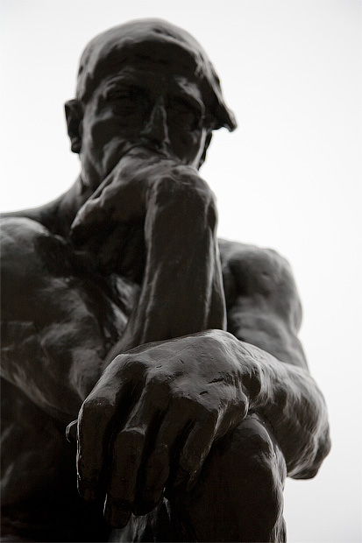
Deductive Reasoning
The process of drawing a conclusion from a sequence of propositions
p₁
p₂
.
.
.
p_{n}
∴ q
Premises
(Hypotheses)
Argument
(Deductive argument)
Conclusion
The argument is valid if and only if:
if all the premises are true, then the conclusion must be true;
otherwise, the argument is invalid.

Slide 28
Which of the following arguments are valid?
A
I study hard if and only if I get A’s
I study hard or I get A’s
∴ I study hard
B
I study hard if and only if I get A’s
I study hard or I don’t get A’s
∴ I study hard
C
I study hard if and only if I get A’s
I study hard or I don’t get A’s
∴ I don’t study hard or I get A’s
Only A and C are valid.

Slide 29
Which of the following arguments are valid?
If I study hard, then I get A’s
I study hard
∴ I get A’s
If I study hard, then I get A’s
I get A’s
∴ I study hard
Only the first argument is valid.

Slide 30
Which of the following arguments are valid?
If I study hard, then I get A’s
I don’t get A’s
∴ I don’t study hard
If I study hard, then I get A’s
I don’t study hard
∴ I don’t get A’s
Only the first argument is valid.

Slide 31
Which of the following arguments are valid?
I study hard if and only if I get A’s
I get A’s
∴ I study hard
I study hard if and only if I get A’s
I don’t study hard
∴ I don’t get A’s
Both are valid.

Slide 32
Which of the following arguments are valid?
I study hard or I get A’s
I get A’s
∴ I study hard
I study hard or I get A’s
I don’t get A’s
∴ I study hard
Only the second is valid.

Slide 33
EXAMPLE
Is this argument valid? Show how to obtain the answer.
If I study hard and my teacher is reasonable, then I will get a good grade.
I do not get a good grade.
∴ My teacher is not reasonable.

Slide 34
EXAMPLE
Is this argument valid? Show how to obtain the answer.
If I study hard and my teacher is reasonable, then I will get a good grade.
I do not get a good grade.
I study hard.
∴ My teacher is not reasonable.

Slide 35



Selected Exercises from the Main Text (Johnsonbaugh, 7th Ed)
EXECISES on Pages 35-36 of the Main Text
Solve Problems 1-5 and 11-15.
Answers to Problems 1-5:
1) Valid 2) Invalid 3) Valid
4) Invalid 5) Valid
Answers to Problems 11-15:
11) Invalid 12) Valid 13) Valid
14) Invalid 15) Valid

