Slide 1

Methods of Proofs
Direct Proofs
Proof By Contradiction
Proof By Contrapositive
Deductive Reasoning
Resolution Proofs
Mathematical Induction

Slide 2
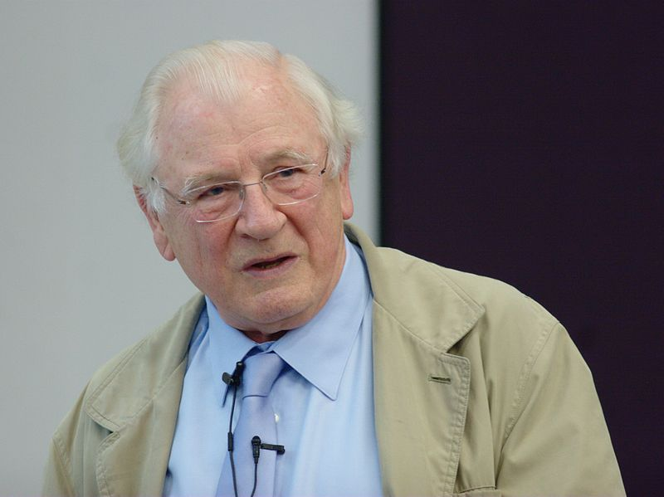
Resolution is a rule of inference for sentences in propositional
logic and first-order logic. Resolution was introduced by John
Alan Robinson in 1965. The resolution principle enabled the
efficient implementation of logic programming and automated
theorem provers.
John Alan Robinson in 2012
John Alan Robinson received the 1996 Herbrand Award for
Distinguished Contributions to Automated Reasoning.

Slide 3
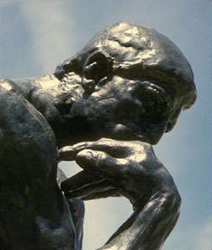

Resolution Proofs
(Invented by J. A. Robinson in 1965)
Resolution is a proof technique, which depends solely on a single rule:
Resolution
Rule
p ∨ q₁ ∨ q₂ ∨ … ∨ q_{m}
¬p ∨ r₁ ∨ r₂ ∨ … ∨ r_{n}
∴ q₁ ∨ q₂ ∨ … ∨ q_{m}∨ r₁ ∨ r₂ ∨ … ∨ r_{n}
In a proof by resolution, the hypotheses and the conclusion are written as clauses.
A clause is a disjunction of literals, where a literal is either
an atomic proposition, or
the negation of an atomic proposition.
For example, p ∨ ¬q ∨ ¬r ∨ s is a clause.

Slide 4
Special forms of resolution:
p ∨ q
¬p ∨ r
∴ q ∨ r
p ∨ q
¬p
∴ q
p
¬p ∨ r
∴ r

Slide 5
EXAMPLE Prove that this argument is valid.
(1) a ∨ b
(2) ¬a ∨ c
(3) ¬c ∨ d
∴ b ∨ d
From (1) and (2), we have
(4) b ∨ c
From (3) and (4), we have
b ∨ d
(1)
(2)
a ∨ b
¬a ∨ c
(3)
b ∨ c
¬c ∨ d
b ∨ d

Slide 6
EXAMPLE Prove that this argument is valid.
(1) a
(2) ¬a ∨ c
(3) ¬c ∨ d
∴ d
From (1) and (2), we have
(4) c
From (3) and (4), we have
d
(1)
(2)
a
¬a ∨ c
(3)
c
¬c ∨ d
d

Slide 7
EXAMPLE Prove that this argument is valid.
(i) a ∨ (¬b ∧ c)
(ii) ¬(a ∨ d)
∴ ¬b
(i) is equivalent to (a ∨ ¬b) ∧ (a ∨ c),
and, by De Morgan’s law, (ii) is equivalent to ¬a ∧ ¬d.
The argument becomes
(1) a ∨ ¬b
(2) a ∨ c
(3) ¬a
(4) ¬d
∴ ¬b
By resolving (1) and (3), we derive ¬b.

Slide 8
EXERCISE Prove or disprove that this argument is valid.
(1) w → s
(2) p
(3) (p ∨ q) → r
(4) (r ∧ s) → t
∴ w → t

Slide 9
If I study hard and my teacher is reasonable, then I will get a good grade.
I do not get a good grade.
I study hard.
∴ My teacher is not reasonable.
EXERCISE
Show that the above argument is valid by “using the resolution rule”.

Slide 10

NOTE
Is this argument valid?
p
q
∴ r ∨ ¬r
Can we use the resolution rule to show that it is valid?
What does this example tell us?
This argument is valid, but we could not obtain the conclusion r ∨ ¬r from the premises p and q using resolution.
So, while “resolution” can be used for showing that an argument is valid, it can NOT be used for showing that an
argument is invalid.

Slide 11



Selected Exercises from the Main Text (Johnsonbaugh, 7th Ed)
EXECISES on Page 93 of the Main Text
Solve Problems 2, 3, 5, and 6.

