Slide 1
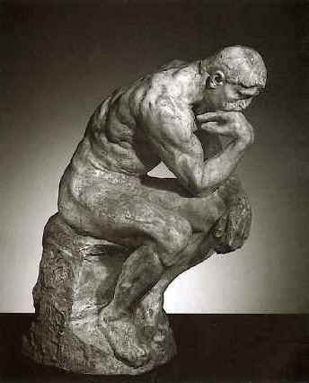
Methods of Proofs
Direct Proofs
Proof By Contradiction
Proof By Contrapositive
Deductive Reasoning
Resolution Proofs
Mathematical Induction

Slide 2
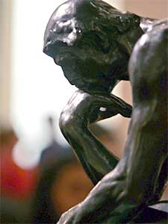
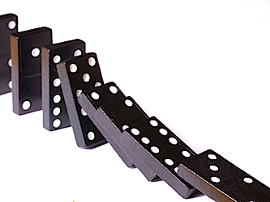
Mathematical Induction
In order to show that a statement S(n) is true for every positive integer n,
show that:
Basis Step: S(1) is true.
Induction step: If S(i) is true for each positive integer i ≤ n,
then S(n+1) is true.

Slide 3
EXAMPLE
Let S(n) denote: 1+ 2 + 3 + … + n =
Show that S(n) is true for every positive integer n.
Proof
Basis Step: Induction Step:
Is S(1) true? Assume that S(n) is true (induction hypothesis).
We want to prove that S(n+1) is true.

Slide 4
EXAMPLE
Let S(n) denote: n! ≥ 2^{n-1}
Show that S(n) is true for every positive integer n.
Proof
Basis Step: Induction Step:
Is S(1) true? Assume that S(n) is true (induction hypothesis).
We want to prove that S(n+1) is true.

Slide 5
EXAMPLE
Let S(n) denote: 3^{n} > 2n
Show that S(n) is true for all integer n = 1,2,3, ...
Proof
Basis Step: Induction Step:
Is S(1) true? Assume that S(n) is true (induction hypothesis).
We want to prove that S(n+1) is true.

Slide 6
EXAMPLE
Let S(n) denote: 5^{n} -1 is divisible by 4
Show that S(n) is true for all integer n ≥ 1.
Proof
Basis Step: Induction Step:
Is S(1) true? Assume that S(n) is true (induction hypothesis).
We want to prove that S(n+1) is true.

Slide 7
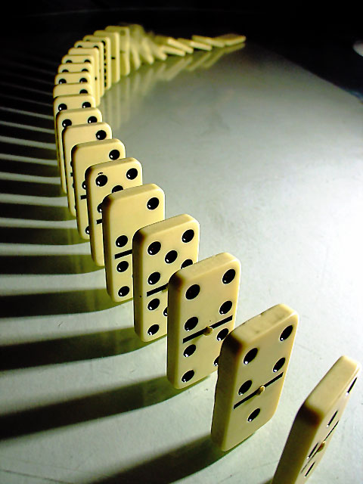
Another Form of Mathematical Induction
To show that a statement S(n) is true
for every positive integer n ≥ n₀, show that:
Basis Step: S(n₀) is true.
Induction step: If S(n) is true, then S(n+1) is true.

Slide 8
EXAMPLE
Let S(n) denote: 2^{n} < n!
Show that S(n) is true for every integer n ≥ 4.
Proof
Basis Step: Induction Step:
Is S( ) true? Assume that S(n) is true (induction hypothesis).
We want to prove that S(n+1) is true.

Slide 9
EXAMPLE
Let S(n) denote: 2^{n} ≥ n+10
Show that S(n) is true for every integer n ≥ 4.

Slide 10
EXAMPLE
Let S(n) denote: 2⁰ + 2¹ + 2² + … + 2^{n} = 2^{n+1} - 1
Show that S(n) is true for every integer n ≥ 0.
Proof
Basis Step: Induction Step:
Is S( ) true? Assume that S(n) is true (induction hypothesis).
We want to prove that S(n+1) is true.

Slide 11
EXERCISE
Let r ≠ 1.
Let S(n) denote: a + ar¹ + ar² + … + ar^{n} = a(r^{n+1}-1)/(r-1).
Show that S(n) is true for every integer n ≥ 0.

Slide 12
EXAMPLE (A Tiling Problem)
Let n be a positive integer.
Show that any 2^{n}×2^{n} chessboard with one square removed can be tiled
using L-shape pieces, each of which covers three squares.

Slide 13
For example, when n=2:
2²×2² chessboard
with one square removed

Slide 14
Depth 0
Depth 1
Depth 2
Depth 3
EXERCISE
Show that, in a binary tree, there are at most 2^{n} nodes at depth n.

Slide 15
Height 0
Height 3
EXERCISE
Show that every binary tree whose height is n has at most 2^{n+1} - 1 nodes.

Slide 16



Selected Exercises from the Main Text (Johnsonbaugh, 7th Ed)
EXECISES on Pages 102-103 of the Main Text
Solve Problems 1-6 and 21-23.

Slide 17
Selected Exercises from the Main Text (Johnsonbaugh, 7th Ed)
CHAPTER SELF-TEST on Pages 63-64 of the Main Text
Solve Problems 5-9, 11, 12, 15, 19, and 20.
CHAPTER SELF-TEST on Page 116 of the Main Text
Solve Problems 6, 9, 11, and 13-16.

