Slide 1
1. Logic
2. Proof Methods
3. Sets, Relations, and
Functions
4. Algorithms
5. Counting Methods
6. Recurrence Relations
7. Graphs
8. Finite-State Automata
and Turing Machines
Appendix:
Self-Test Homework
Solutions to Homework
Algorithms

Slide 2
Divisibility of Integers
Let a, b be integers.
We say that b divides a iff b ≠ 0 and there exists some integer q such that a = bq.
When a = bq, we call q the quotient and call b a divisor of a.
Greatest Common Divisor
Let m and n be integers, such that not both m and n are zero.
The greatest common divisor of m and n, denoted by gcd(m, n), is the largest positive integer that divides both m and n.

Slide 3
EXAMPLE
gcd(6, 4) = 2.
gcd(6, 15) = 3.
gcd(6, 18) = 6.
gcd(12, 20) = 4.
gcd(12, 30) = 6.
gcd(6, 9) = 3.
gcd(21, 14) = 7.
gcd(36, 24) = 12.
gcd(15, 20) = 5.
gcd(24, 40) = 8.
EXAMPLE
What is gcd(0, 6)?
gcd(0, 6) = 6.

Slide 4
EXAMPLE: Find gcd(30, 105).
The positive divisors of 30 are
1, 2, 3, 5, 6, 10, 15, 30
and the positive divisors of 105 are
1, 3, 5, 7, 15, 21, 35, 105.
Thus, the positive common divisors of 30 and 105 are
1, 3, 5, 15.
So gcd(105, 30) is 15.

Slide 5
THEOREM
If a is a nonnegative integer, b is a positive integer, and
a = bq + r, where q, r are integers and 0 ≤ r < b
then
gcd(a, b) = gcd(b, r).
By using the above theorem, how can we find gcd(105, 30)?
This theorem leads to the Euclidean Algorithm.

Slide 6
Algorithm: Euclidean Algorithm
(For finding the greatest common divisor of two integers)
Input: a and b (nonnegative integers, not both zero)
Output: greatest common divisor of a and b
procedure gcd(a, b)
if a < b then swap(a, b)
while b ≠ 0 do
begin
divide a by b to obtain a = bq + r, where 0 ≤ r < b
a := b
b := r
end
return(a)
end gcd

Slide 7
EXERCISE
Use the Euclidean algorithm to find the greatest common divisors
of the following pairs of integers.
1) 90, 60
2) 220, 1400
3) 315, 825
4) 110, 273
5) 331, 993
Answers
1) 30
2) 20
3) 15
4) 1
5) 331

Slide 8
Recursive Algorithm
A recursive procedure is a procedure that invokes itself.
Recursion is a powerful and elegant way to solve problems,
using divide and conquer technique.
Decompose a problem into smaller problems
of the same type as the original problem.
EXAMPLE
Base case
Problem Simplified Problem
5! 5⋅4!
4! 4⋅3!
3! 3⋅2!
2! 2⋅1!
1! 1⋅0!
0! None
Recursive definition of n factorial
1 if n = 0,
n! =
n⋅ (n-1)! if n > 0.
Every recursive definition must have base cases.

Slide 9
Algorithm: Computing n Factorial
Input: n, an integers greater than or equal to 0
Output: n!
procedure factorial(n)
if n = 0 then
return(1)
return(n × factorial(n − 1))
end factorial
Recursive definition of n factorial
1 if n = 0,
n! =
n⋅ (n-1)! if n > 0.
EXERCISE
Prove that above algorithm outputs the value of n!, for any n ≥ 0.
Note:
The Basis Step of a proof by mathematical induction corresponds to the base cases of a recursive
procedure; and, the Inductive Step of a proof by mathematical induction corresponds to the part of
a recursive procedure where a procedure calls itself.

Slide 10
Algorithm: Recursively Computing the Greatest Common Divisor
Input: a and b (nonnegative integers, not both zero)
Output: greatest common divisor of a and b
procedure gcd_recurs(a, b)
if a < b then
swap(a, b)
if b = 0 then
return(a)
divide a by b to obtain a = bq + r, where 0 ≤ r < b
return(gcd_recurs(b, r))
end gcd_recurs

Slide 11

Complexity of Algorithms
“Complexity of an algorithm” refers to:
“the amount of time and space required to execute the algorithm”.
“Analysis of an algorithm” refers to:
“the process of deriving estimates for the time and space needed
to execute the algorithm”.
In this chapter, we discuss how to estimate the time required to execute algorithms.

Slide 12
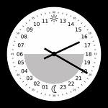
The time needed to execute an algorithm is usually
estimated as a function of the size of input.
Given an algorithm, we can ask for:
The best-case time for inputs of size n
- The minimal time needed to execute the algorithm among all inputs of size n.
The worst-case time for inputs of size n
- The maximum time needed to execute the algorithm among all inputs of size n.
The average-case time for inputs of size n
The average time needed to execute the algorithm over some finite set of inputs all of size n.

Slide 13
Algorithm: Finding the Largest Element in a Finite Sequence
Input: The sequence s₁, s₂, …, s_{n} and the length n of the sequence
Output: large, the largest element in this sequence
procedure find_large(s, n)
large := s₁
i := 2
while i ≤ n do
begin
if s_{i} > large then
large := s_{i}
i := i + 1
end
return(large)
end find_large

Slide 14
We could measure the time required by an algorithm by counting
the number of instruction executed.
Alternatively, we could use a cruder time estimate, such as the
number of times each loop is executed.
EXAMPLE
Consider the procedure find_large in the previous page.
The execution time needed to execute this procedure may be estimated by
the number of iteration of the while loop.
Then the worst-case, best-case, and average case times for this algorithm for
input of size n are all n-1, since the loop is always executed n-1 times.

Slide 15
Algorithm: Searching an Unordered Sequence
Input: s₁, s₂, …, s_{n} , n, and key (the value to search for)
Output: The location of key, or 0 if key is not found
procedure linear_search (s, n, key)
for i := 1 to n do
if key = s_{i} then
return(i)
return(0)
end linear_search
EXERCISE
What are the worst-case, best-case, and average case times for the above algorithm for input of size n ?
…
1; n; (1+2+ +n) + n
n+1

Slide 16
We are often less interested in the exact time
required for an algorithm to execute than we are in
“how the required time grows
as the size of the input increases”.
For example, suppose that the worst-case time of an algorithm is
t(n) = 60n² + 5n +1
for input of size n.
For large n, t(n) is approximately equal to 60n².
In this sense, t(n) grows like 60n² as n increases.

Slide 17
n 60n² + 5n +1 60n²
10 6,051 6,000
100 600,501 600,000
1,000 60,005,001 60,000,000
10,000 6,000,050,001 6,000,000,000

Slide 18
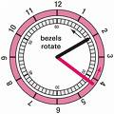
Now, suppose that
t(n) = 60n² + 5n +1
measures the worst-case time for input of size n in seconds.
Then,
T(n) = n² + 5n/60 +1/60
measures the worst-case time for input input of size n in minutes.
The change of unit of time does not affect
“how the worst-case time grows as the size of input increases”.
Therefore we may also ignore the constant coefficient 60.
Under these assumptions,
t(n) grows like n² as n increases.

Slide 19
The basic idea is to replace an expression, such as
t(n) = 60n² + 5n +1
with a simpler expression, such as
n²
which grows at the same rate as t(n).
Big oh notation, O
Omega notation, Ω
Theta notation, Θ
In order to do this, we use

Slide 20
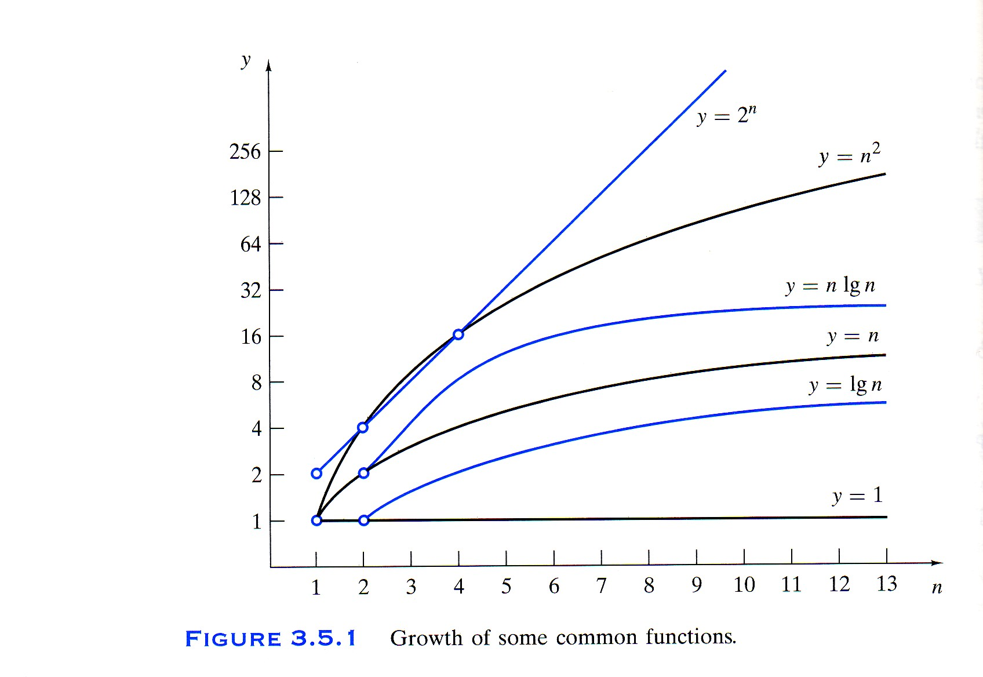

Slide 21
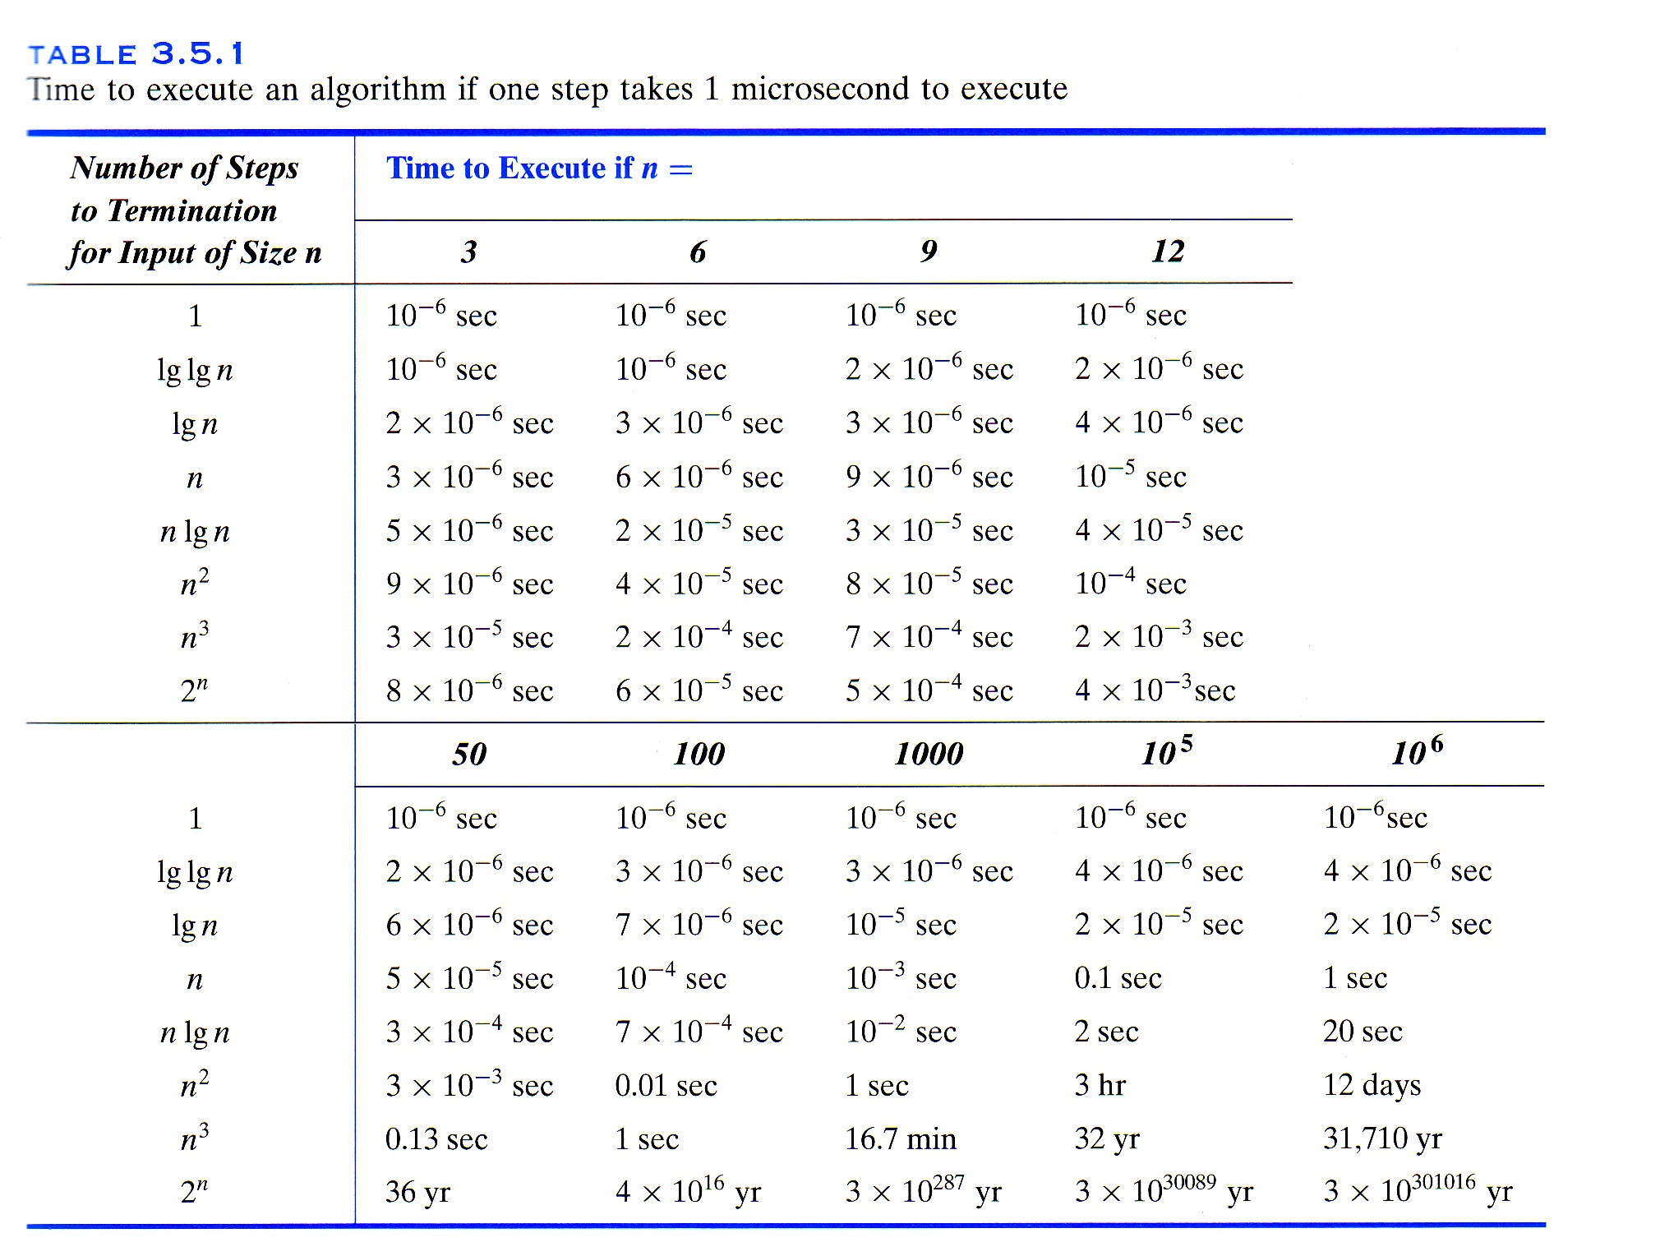

Slide 22
O
Big Oh Notation
DEFINITION
Let f and g be functions with domain {1, 2, 3, ….}.
We write
f(n) = O(g(n))
and say that f(n) is of order at most g(n) if there exists a positive constant C₁
such that
| f(n) | ≤ C₁| g(n) |
for all but finitely many positive integers n.
Loosely speaking:
f(n) = O(g(n)) if, except for constants and a finite number of exceptions,
f is bounded above by g.

Slide 23
EXAMPLE *A (I)
Let f(n) = 60n² + 5n +1.
For n ≥ 1.
60n² + 5n +1 ≤ 60n² + 5n² + n²
= 66n²
Therefore, we may take C₁= 66 to obtain
f(n) = O(n²).

Slide 24
Ω
Omega notation
DEFINITION
Let f and g be functions with domain {1, 2, 3, ….}.
We write
f(n) = Ω(g(n))
and say that f(n) is of order at least g(n) if there exists a positive constant C₂
such that
| f(n) | ≥ C₂| g(n) |
for all but finitely many positive integers n.
Loosely speaking:
f(n) = Ω(g(n)) if, except for constants and a finite number of exceptions,
f is bounded below by g.

Slide 25
EXAMPLE *A (II)
Let f(n) = 60n² + 5n +1.
For n ≥ 1.
60n² + 5n +1 ≥ 60n²
Therefore, we may take C₂ = 60 to obtain
f(n) = Ω(n²).

Slide 26
Θ
Theta notation
DEFINITION
Let f and g be functions with domain {1, 2, 3, ….}.
We write
f(n) = Θ(g(n))
and say that f(n) is of order g(n) if
f(n) = O(g(n)) and f(n) = Ω(g(n)).
Loosely speaking:
f(n) = Θ(g(n)) if, except for constants and a finite number of exceptions,
f is bounded above and below by g.

Slide 27
EXAMPLE *A (III)
Let f(n) = 60n² + 5n +1.
Since f(n) = O(n²) and f(n) = Ω(n²),
we have f(n) = Θ(n²).

Slide 28
THEOREM
Suppose that
a_{k}n^{k} + a_{k-1}n^{k-1} + … + a₁n + a₀
is a polynomial in n of degree k, where each a_{i} is nonnegative.
Then
a_{k}n^{k} + a_{k-1}n^{k-1} + … + a₁n + a₀ = Θ(n^{k})
EXAMPLE
4n⁵ + 3n⁴ + 5n + 17 = Θ(n⁵)
3n⁴ + 2n³ + 5n² + 7n + 3 = Θ(n⁴)
6n⁷ + 3n⁵ + 2n³ + 5n² + 3n + 4 = Θ(n⁷)

Slide 29
EXERCISE
Let f(n) = (n+3)(n+7). Find a theta notation for f(n).
n+5

Slide 30
Let lg n denote log₂ n (the logarithm of n to the base 2)
EXAMPLE
Let f(n) = 2n + 3(lg n). Find a theta notation for f(n).
For n ≥ 1, lg n < n.
Therefore, for n ≥ 1
2n + 3(lg n) < 2n + 3n
= 5n.
Thus 2n + 3(lg n) = O(n).
Also, for n ≥ 1,
2n + 3(lg n) ≥ 2n.
So 2n + 3(lg n) = Ω(n).
Hence 2n + 3(lg n) = Θ(n).
O
Ω

Slide 31
EXAMPLE *B
Let f(n) = 1 + 2 + … + n. Find a theta notation for f(n).
For n ≥ 1,
1 + 2 + … + n ≤ n + n + … + n = n⋅n = n².
Hence f(n) = O(n²).
Next we try to obtain a lower bound.
1 + 2 + … + n ≥ 1 + 1 + … + 1 = n
That is, one lower bound is: f(n) = Ω(n).
But, here we cannot deduce a theta notation for f.
We now try to get a sharper lower bound.
n
n

Slide 32
EXAMPLE *B (Continue ...)
f(n) = 1 + 2 + … + n.
To get a sharper lower bound, we first throw away about the first half of the terms.
Then we obtain
1 + 2 + … + n ≥ ⎡n/2⎤ + … + (n-1) + n
≥ ⎡n/2⎤ + … + ⎡n/2⎤ + ⎡n/2⎤
= ⎡(n+1)/2⎤ ⎡n/2⎤
≥ ((n+1)/2)(n/2)
≥ (n/2)(n/2)
= n²/4
Therefore,
f(n) = Ω(n²).
Now we have
f(n) = Θ(n²).

Slide 33
NOTATION
Ceilings and Floors
Read as the ceiling of x
⎡ x ⎤ denotes the least integer greater than or equal to x.
For example,
⎡ 4.3 ⎤ = 5 ⎡ 4.7 ⎤ = 5 ⎡ 4 ⎤ = 4
That is, ⎡ x ⎤ rounds x up.
Read as the floor of x
⎣ x ⎦ denotes the greatest integer less than or equal to x.
For example,
⎣ 4.3 ⎦ = 4 ⎣ 4.7 ⎦ = 4 ⎣ 4 ⎦ = 4
That is, ⎣ x ⎦ rounds x down.

Slide 34
Let k be a positive integer.
Let f(n) = 1^{k} + 2^{k} + … + n^{k}. Find a theta notation for f(n).
For n ≥ 1,
1^{k} + 2^{k} + … + n^{k} ≤ n^{k} + n^{k} + … + n^{k}
= n ⋅ n^{k}
= n^{k+1}
So f(n) = O(n^{k+1}).
Next, 1^{k} + 2^{k} + … + n^{k} ≥ ⎡n/2⎤^{k} + … + (n-1)^{k} + n^{k}
≥ ⎡n/2⎤^{k} + … + ⎡n/2⎤^{k} + ⎡n/2⎤^{k}
= ⎡(n+1)/2⎤ ⎡n/2⎤^{k}
≥ ((n+1)/2)(n/2)^{k}
≥ (n/2)(n/2)^{k}
= n^{k+1}/2^{k+1}
EXAMPLE
So f(n) = Ω(n^{k+1}). Hence f(n) = Θ(n^{k+1}).

Slide 35
C o m m o n G r o w t h F u n c t i o n s
Theta Form Name
Θ(1) Constant
Θ(lg n) Logarithmic
Θ(n) Linear
Θ(n lg n) n lg n
Θ(n²) Quadratic
Θ(n³) Cubic
Θ(n^{m}) Polynomial
Θ(m^{n}), m ≥ 2 Exponential
Θ(n!) Factorial

Slide 36
EXAMPLE
Select a theta notation for f(n) + g(n).
A) f(n) = Θ(1), g(n) = Θ(n³)
B) f(n) = Θ(n²), g(n) = Θ(n lg n)
C) f(n) = Θ(n), g(n) = Θ(n lg n)
D) f(n) = Θ(n^{3/2}), g(n) = Θ(n^{7/2})

Slide 37



Selected Exercises from the Main Text (Johnsonbaugh, 7th Ed)
EXECISES on Page 207 of the Main Text
Solve Problems 1-10 and 13-15.
Answers:
1) Θ(n) 2) Θ(n²)
3) Θ(n³) 4) Θ(n²)
5) Θ(n lg n) 6) Θ(n⁶)
7) Θ(n²) 8) Θ(n²)
9) Θ(n lg n) 10) Θ(n)
13) Θ(n²)
14) Θ(n³)
15) Θ(n^{5/2})

