Slide 1
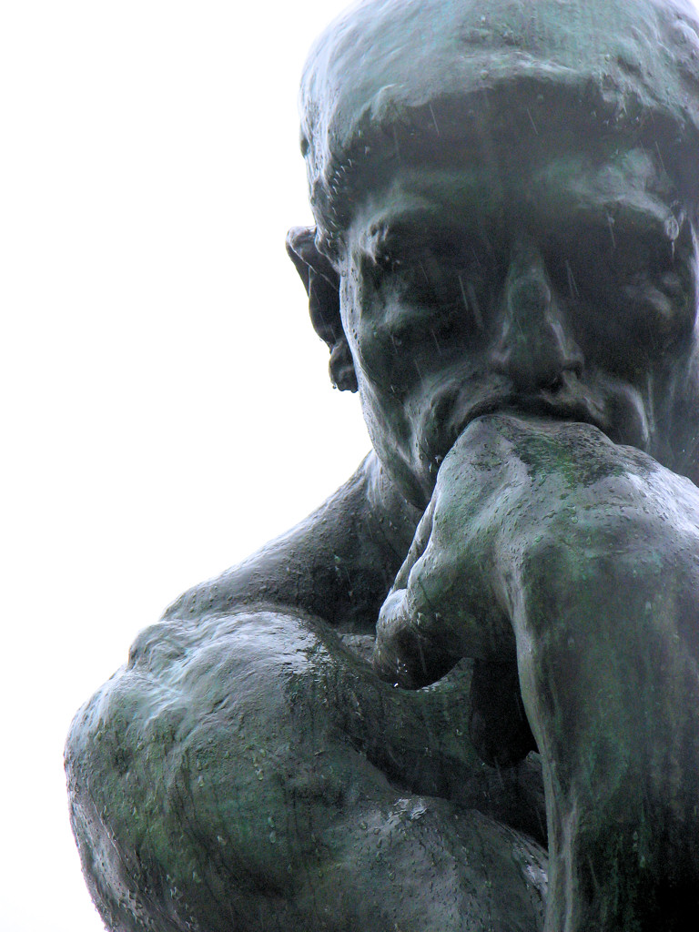
1 / 2 0 1 7
Weeks 8-16
D I S C R E T E
M A T H E M A T I C S
SIIT: ITS 201
For 2nd-Year IT/CPE Students
Instructor: EKAWIT NANTAJEEWARAWAT

