Slide 1
Problems
Unsolvable
Problems
Solvable
Problems
No algorithm
Tractable
Problems
Intractable
Problems
No worst-case
polynomial-bounded time
algorithm

Slide 2
Unsolvable Problems
A problem which is so hard that there is no algorithm for it is said
to be unsolvable.
Example of unsolvable problems
The halting problem:
Given an arbitrary program and a set of inputs, will the program
eventually halt?

Slide 3
Tractable Problems
Intractable Problems
Solvable Problems
Tractable Problems
A solvable problem that has a worst-case polynomial-bounded algorithm
is considered to have a “good” algorithm.
This means, it can be solved efficiently.
The Class P
The class of solvable problems that have worst-case
polynomial-bounded algorithms is called the class P.
Intractable Problems
A solvable problem that does NOT have a worst-case polynomial-bounded
algorithm is said to be intractable.
An intractable problem can be solved only when the size of input is small.
P

Slide 4
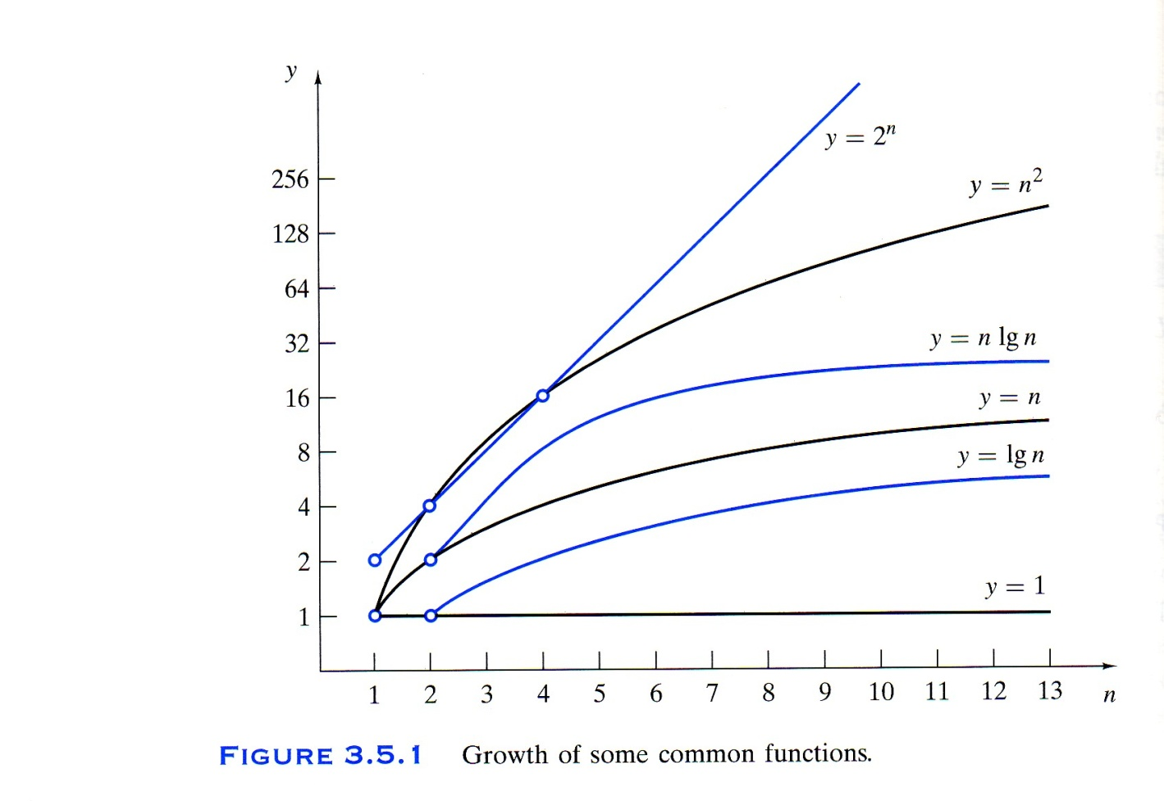
Time Complexity
Θ(1) Constant
Θ(lg n) Logarithmic
Θ(n) Linear
Θ(n lg n) n lg n
Θ(n²) Quadratic
Θ(n³) Cubic
Θ(n^{m}) Polynomial
Θ(m^{n}), m ≥ 2 Exponential
Θ(n!) Factorial
Polynomial-Bounded

Slide 5
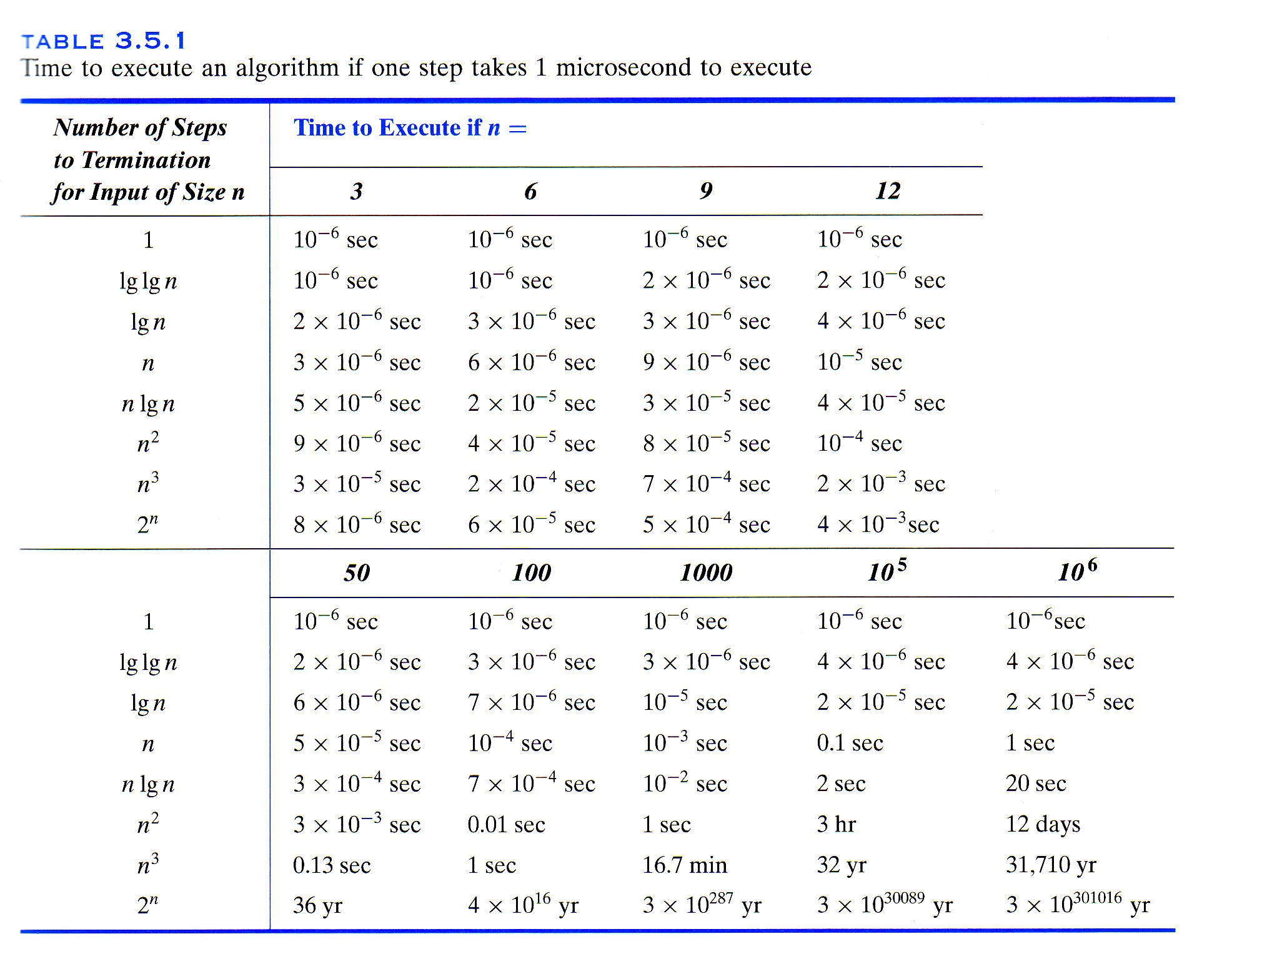

Slide 6
Class P
. . .
. . .
. . .
Tractable Problem
Intractable Problem

Slide 7
The Class NP (Nondeterministic Polynomial-bounded).
A large number of solvable problems, such as
Hamilton path problem,
traveling salesperson problem,
graph coloring problem,
knapsack problem, etc.
are believed to be intractable (but none of them have been proved intractable.)
These problems belong to the class NP (Nondeterministic Polynomial-bounded).
“Problems in this class can be solved in polynomial time
if we have an exponentially large number of processor.”
(But we do not have such a large number of processors.)
NP

Slide 8
Examples of NP Problems
Hamilton Path Problem
Given a graph, determine whether there is a Hamilton path
(i.e. a path that passes through every vertex exactly once).
Traveling Salesperson Problem
Given a weighted graph, find a minimum weighted Hamilton path.

Slide 9
20
B
C
Hamilton path
10
15
10
18
18
18
A
10
D
10
E
20
B
C
10
15
10
18
18
18
A
Minimum weighted
Hamilton path
10
D
10
E

Slide 10
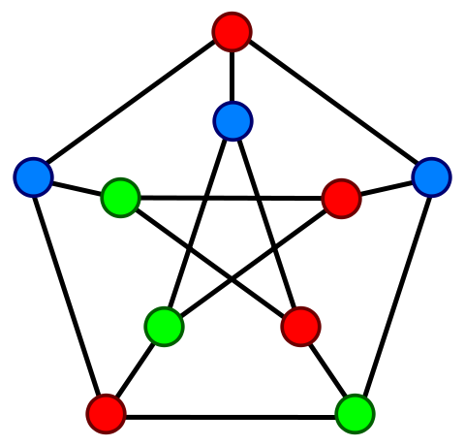
Another Example of an NP Problem
Graph Coloring Problem
Given a graph, determine the smallest number of colors needed to color the graph
in such a way that adjacent vertices do not have the same color.

Slide 11
. . .
. . .
. . .
Class P
Class NP
???
No polynomial-bounded time
algorithm exists, or no one has invented one yet?
Is Class P truly different from Class NP?
Most computer scientists believe that the answer is “Yes”.
This is one of the seven Millennium Problems selected by the Clay Mathematics Institute in 2000.
A solution to any of the problems will result in a US$1,000,000 prize being awarded.

Slide 12
P & NP
-Quote-
CLASS P. Easy problems belong to complexity class P, for polynomial time, meaning that algorithms exist to
produce an answer in a time that rises no faster than some power of the size of the input. Many everyday
computational tasks, such as list sorting and optimization by linear programming, belong to class P.
CLASS NP. A wide variety of more demanding problems do not seem to belong to P, but belong to a class
labeled NP. The distinguishing characteristic of these problems is that the validity of a proposed solution can be
checked in polynomial time, even though there isn’t an algorithm for generating that solution in the first place.
An alternative definition of NP problems is that they can be solved in polynomial time on what’s called a
nondeterministic Turing machine. This hypothetical machine branches to different computational paths at every
step, giving rise to an exponentially growing tree of computations. If one path through that tree arrives at the
desired result, the machine has solved the problem.
IS NP TRULY DIFFERENT FROM P? Showing that a problem is NP-complete means proving that no known
algorithm can solve it in polynomial time. But does that mean no such algorithm exists, or no one has invented
one yet? Is the class NP truly different from P? This question is one of the seven Millennium Problems whose
solution the Clay Mathematics Institute In Cambridge, MA, has deemed worthy of a million-dollar prize.
The majority opinion among mathematicians and computer scientists is that NP is not identical to P. This would
mean that NP problems are genuinely hard and that in all likelihood there is no easy method for solving them.
However, no proof currently exists.
David Lindley, “The Limits of Computability”,
Communications of the ACM, Vol. 51, No. 11, 2008.

