Slide 1
Permutation An ordering of objects
DEFINITION
A permutation of n distinct elements x₁, … , x_{n} is an ordering of
the n elements x₁, … , x_{n}.
EXAMPLE
There are six permutations of three distinct elements.
If the three elements are denoted A, B, C, the six permutations are
ABC, ACB, BAC, BCA, CAB, CBA.
THEOREM
There are n! permutations of n elements.
This theorem can be proved using the Multiplication Principle.

Slide 2
EXAMPLE
How many permutations of the letters ABCDEF contain the substring DEF?
4!
EXAMPLE
How many permutations of the letters ABCDEF contain the letters DEF together
in any order?
4! ⋅ 3!
EXERCISE
From the five letters A, B, C, D, E,
how many strings which contain the substring DB or the substring BE
can be formed?
4! + 4! − 3!

Slide 3
EXAMPLE
In how many ways can three persons be seated around a circular table?
A
A B C
A C B
C A B
C B A
B C A
B A C
A
C
B
B
C
C
C
B
A
Same order
clockwise
A
B
B
B
A
C
C
A
2 ways

Slide 4
EXAMPLE
D
E
C
In how many ways can six persons be seated
around a circular table?
F
B
A
Denote the six person as A, B, C, D, E, F.
Since seatings obtained by rotations are considered to be identical, we might
first, seat A arbitrarily, and, then
order the remaining five persons (there are 5! ways to do this), and, then,
seat them in this order clockwise from A.
Thus there are 5! ways to seats six persons around a circular table.
In general:
There are (n-1)! ways that n persons can be seated around a circular table.

Slide 5
r-Permutation An ordering of r elements selected from n available elements
DEFINITION
An r-permutation of n distinct elements x₁, …, x_{n} is an ordering of an
r-element subset of { x₁, …, x_{n} }.
The number of r-permutations of a set of n distinct elements is denoted P(n, r).
EXAMPLE
Consider three distinct elements A, B, C.
2-permutations of these three elements are
AB, AC, BA, BC, CA, CB.

Slide 6
THEOREM
The number of r-permutations of a set of n distinct objects is
P(n, r) = n(n – 1)(n – 2) … (n – r + 1), r ≤ n.
P(n, r) can also be writen in terms of fatorial:
EXAMPLE
In how many ways can we select a chairperson, vice-chairperson, secretary, and
a treasurer from a group of 10 persons? (No person takes more than one position.)
P(10, 4) = 10 ⋅ 9 ⋅ 8 ⋅ 7

Slide 7
EXAMPLE
In how many ways can seven boys and four girls wait in line if no two girls
stand together?
B₁ B₂ B₃ B₄ B₅ B₆ B₇
7!⋅ P(8, 4)

Slide 8
Combination A selection of objects without regard to order
DEFINITION
Given a set X = { x₁, …, x_{n} } containing n (distinct) elements.
An r-combination of X is a selection (unordered) of r-element subset of X.
The number of r-combinations of a set of n distinct elements is denoted by C(n, r).
THEOREM
=
P
(
n
,
r
)
=
n
!
r ≤ n
C
(
n
,
r
)
r
!
(
n
−
r
)!
r
!

Slide 9
(Note: A committee is considered as an unordered group.)
EXAMPLE
In how many ways can we select a committee of three persons from a
group of 10 persons?
C(10, 3)
EXAMPLE
In how many ways can we select a committee of two women and three men
form a group of five distinct women and six distinct men?
C(5, 2) ⋅ C(6, 3)

Slide 10




8 distinct books
Mary
(2 books)
Tom
(4 books)
John
(2 books)
EXAMPLE
In how many ways can 8 distinct books be divided among three persons, Tom, John, and Mary, if
Tom gets four books,
John gets two books, and
Mary gets two books.
C(8, 4) ⋅ C(4, 2)

Slide 11
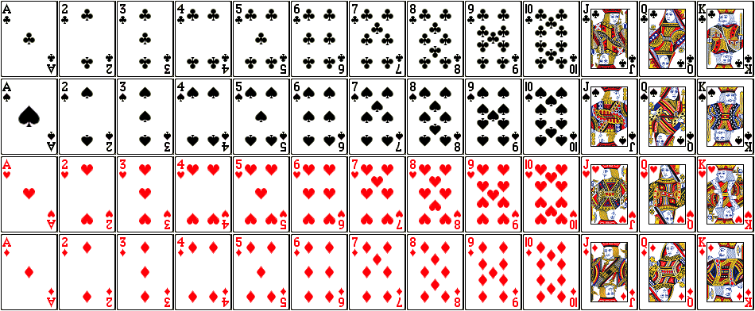
An Ordinary Card Deck: 52 cards
Club Spade Heart Diamond
♣ ♠ ♥ ♦
Four suits:
13 denominations:
Ace, 2, 3, 4, 5, 6, 7, 8, 9, 10, Jack, Queen, King.

Slide 12
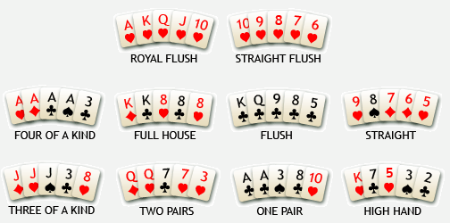
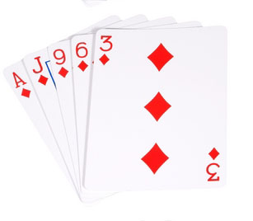
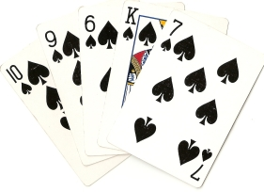
EXAMPLE
A “poker hand” is a set of 5 cards
(i.e., an unordered collection of 5 cards).
(A) How many (unordered) five-card poker hands, selected from an ordinary
52-card deck, are there?
(B) How many poker hands contain cards all of the same suit? (Flush)

Slide 13

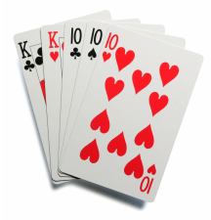
(C) How many poker hands contain three cards of one denomination
and two cards of a second denomination? (Full House)
(D) How many poker hands contain three cards of one suit and two cards of a second suit?

Slide 14

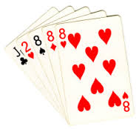
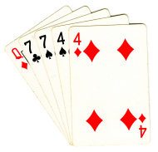
(E) How many poker hands contain three cards of one denomination,
one card of a second denomination, and one card of a third denomination? (Three of a Kind)
(F) How many poker hands contain two cards of one denomination,
two cards of a second denomination, and one card of a third denomination?
(Two pairs)
C(52, 5) (B) 4 ⋅ C(13, 5) (C) 13 ⋅ C(4, 3) ⋅ 12 ⋅ C(4, 2)
(D) 4 ⋅ C(13, 3) ⋅ 3 ⋅ C(13, 2) (E) 13 ⋅ C(4, 3) ⋅ C(12, 2) ⋅ 4 ⋅ 4 (F) C(13, 2) ⋅ C(4, 2) ⋅ C(4, 2) ⋅ 11 ⋅ 4

Slide 15

EXERCISE
From the five letters A, B, C, D, E,
how many strings in which A appears before C and C appears before E
can be formed?
C(5, 3) ⋅ 2!
EXAMPLE
How many eight-bit strings contain exactly four 1’s?
C(8,4)

Slide 16


EXERCISE
How many routes are there from the lower left corner of an n×n square grid
to the upper right corner if we are restricted to traveling only to the right or
upward?
C(2n, n)

Slide 17



Selected Exercises from the Main Text (Johnsonbaugh, 7th Ed)
EXECISES on Pages 288-289 of the Main Text
Solve Problems 1-26, 28-30, and 33-38.
Answers to Problems 1, 3, 5-25, and 28-30 (Page 288):
1) 4! 2) 3) P(4,3)
4) 5) 11! 6) P(11,5)
7) P(11,3) 8) P(12,4) 9) P(12,3)
10) 3! 11) 3! ⋅ 3! 12) 3!
13) 2⋅4! 14) 5!/2 15) 5! - (4! + 4! - 3!)
16) 5! - (4! + 4! - 3!) 17) C(5,3)⋅2! 18) 4! + 4! - 3!
19) 8!P(9,5) 20) 18!P(19,5) 21) 10!
22) 9! 23) 4!5! 24) 7!P(8,5)
25) 4 26) 27)
28) C(11,3) 29) C(12,4) 30) C(44,6), C(48,6)

Slide 18
Selected Exercises from the Main Text (Johnsonbaugh, 7th Ed)
Answers to Problems 33-38 (Page 289):
33) C(13,5) 34) C(6,3)C(7,4)
35) C(13,4) - C(6,4) 36) 6⋅C(7,3) + C(7,4)
37) C(13,4) - [C(6,4) + C(7,4)] 38) C(13,4) - C(11,2)

