Slide 1
1. Logic
2. Proof Methods
3. Sets, Relations, and
Functions
4. Algorithms
5. Counting Methods
6. Recurrence Relations
7. Graphs
8. Finite-State Automata
and Turing Machines
Appendix:
Self-Test Homework
Solutions to Homework
Recurrence Relations

Slide 2
EXAMPLE
Initial Condition
a₁ = 5
a_{n} = a_{n-1} + 3, n ≥ 2.
Recurrence Relation
An equation which relates a_{n} to its predecessors.
The above recurrence relation and initial condition together define
the following sequence:
a₁ a₂ a₃ a₄ a₅ a₆ . . .
5 8 11 14 17 20 . . .

Slide 3
DEFINITION
A recurrence a relation for the sequence
a₀, a₁, a₂ …
is an equation that relates a_{n} to certain of its predecessors a₀, a₁, …, a_{n-1}.
Initial Conditions for the sequence a₀, a₁, a₂, … are explicitly given values
for a finite number of terms of the sequence.

Slide 4
EXAMPLE
f₁ = 1
f₂ = 1
f_{n} = f_{n-1} + f_{n-2}, n ≥ 3
Initial conditions
Recurrence relation
This recurrence relation together with the initial conditions define
the Fibonacci sequence
f₁ f₂ f₃ f₄ f₅ f₆ f₇ f₈ f₉ f₁₀ . . .
1 1 2 3 5 8 13 21 34 55 . . .
Recurrence relation

Slide 5



EXAMPLE
A person invests $1000 at 12 percent compounded annually,
If A_{n} represents the amount at the end of n years,
find a recurrence relation and initial conditions that define the sequence {A_{n}}.
Initial condition
A₀ = 1000.
A_{n} = (1.12)A_{n-1}, n ≥ 1
Recurrence relation
A₀
A₁
A₂
A₃
A₄
A₅
A₆
1000.0 1120.0 1254.4 1404.9 1573.5 1762.3 1973.8 . . .

Slide 6

Recurrence Relations & Recursive Algorithm
Recurrence relations and recursive algorithms are closely related.
From the recurrence recurrence relation and the initial condition of the previous
example, we can directly write the following recursive algorithm
procedure compound_interest(n)
if n = 0 then
return (1000)
return (1.12 * compound_interest(n-1))
end compound_interest

Slide 7


A₀ = 1000.
A_{n} = (1.12)A_{n-1}, n ≥ 1.
(Initial condition)
(Recurrence relation)
We can derive an explicit formula.
Explicit formula
A_{n} = (1.12)^{n}(1000)
This is NOT a recurrence relation.
One of the main reasons for using recurrence relation is that it is often easier to determine the nth term of
a sequence in terms of its predecessors than it is to find an explicit formula for the nth term in terms of n.
However, it is usually more efficient to compute then nth term by means of explicit formulas.

Slide 8
Suppose we want to determine
the nth-term of a sequence.
A Problem
1
Write a recurrence relation,
along with some initial condition
2
Solving the recurrence relation
Derive an explicit formula

Slide 9
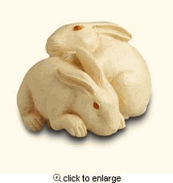

EXAMPLE I Rabbits and the Fibonacci Numbers
Consider the following problem, which was originally posed by Leonardo di Pisa,
also known as Fibonacci, in the 13th century in his book Liber abaci.
A young pair of rabbits (one of each sex) is placed on an island.
A pair of rabbits does not breed until they are 2 months old.
After they are two months old, each pair of rabbit produces another pair each month.
Assume that no rabbits ever die.
Find a recurrence relation for the number of pairs of rabbits on the island after
n months.

Slide 10
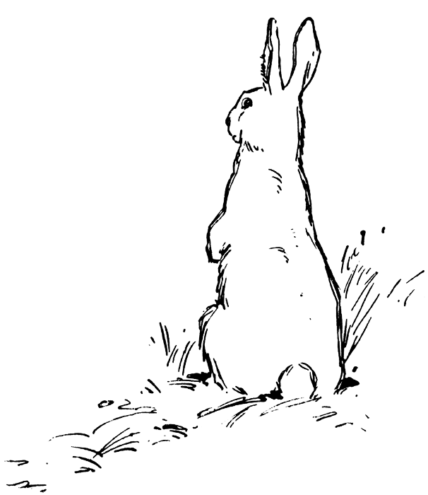
EXAMPLE I (Continue …)
Month
Newborn
pairs
Total
pairs
1 0 1
2 0 1
3 1 2
4 1 3
5 2 5
6 3 8
7 5 13
… … …

Slide 11
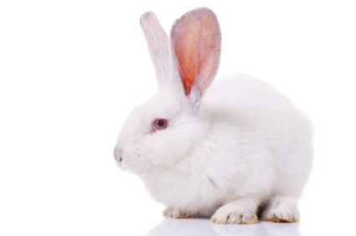
EXAMPLE I (Continue …)
Solution:
Denote by f_{n} the number of pairs of rabbits after n months.
We will show that f_{n}, n = 1, 2, 3, …, are the terms of the Fibonacci sequence.
At the end of the first month, the number of pairs of rabbits is f₁ = 1.
Since this pair does not breed during the second month, f₂ = 1 also.
To find the number of pairs after n months, add the number of pairs in the previous
month, f_{n-1}, and the number of newborn pairs, which equals f_{n-2}, since each newborn
pair comes from a pair at least two months old.
So f_{n} = f_{n-1} + f_{n-2}, for n > 2.
Detailed Explanation

Slide 12

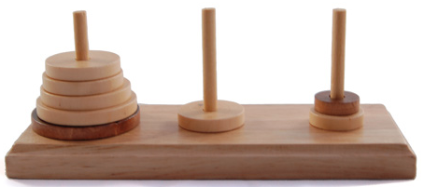
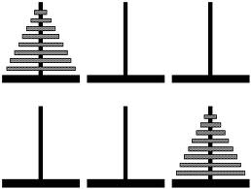
EXAMPLE II
Tower of Hanoi
There are three pegs. There are n disks of various sizes.
On top of a disk, only a smaller disk can be placed.
Given all the disks stacked one one peg,
the problem is to transfer the disks to another peg
by moving one disk at a time.
A B C

Slide 13
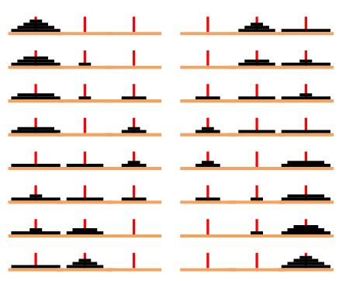
Consider the case when n=4.
Transfer 3 disks
Move 1 disk
Transfer 3 disks

Slide 14
Consider the case when n=4.
8
9
10
11
12
13
14
15
1
2
3
4
5
6
7
14

Slide 15

A l g o r i t h m
To move n disks from peg x to peg y:
Let z be the remaining peg.
If n = 1, then move the disk from peg x to peg y.
If n > 1, then
- move the top n-1 disks from peg x to peg z (using this algorithm recursively),
- move the remaining disk from peg x to peg y,
- move the n-1 disks from peg z to peg y (using this algorithm recursively).

Slide 16

Let c_{n} denote the number of moves the algorithm takes
to solve the n-disk problem.
Using a recurrence relation, we have:
c₁ = 1
c_{n} = 2c_{n-1} + 1, n > 1.

Slide 17

EXAMPLE III
Let S_{n} denote the number of n-bit strings that do NOT contain the pattern 111.
How to define S_{n}?

Slide 18
EXAMPLE III (Continue …)
Solution:
An n-bit string that does not contain the pattern 111 has one of the following
three forms:
(1) 0 followed by an (n-1)-bit string that does not contain the pattern 111.
(2) 10 followed by an (n-2)-bit string that does not contain the pattern 111.
(3) 110 followed by an (n-3)-bit string that does not contain the pattern 111.
The sets of strings of forms (1), (2), and (3) are disjoint.
Detailed Explanation

Slide 19
EXAMPLE III (Continue …)
So we have
S_{n} = S_{n-1} + S_{n-2} + S_{n-3}, n ≥ 4.
By inspection, we also have the initial conditions:
S₁ = 2
S₂ = 4
S₃ = 7.

Slide 20



Selected Exercises from the Main Text (Johnsonbaugh, 7th Ed)
EXECISES on Page 342 of the Main Text
Solve Problems 1-18.

Slide 21
Selected Exercises from the Main Text (Johnsonbaugh, 7th Ed)
1) a₁ = 3; a_{n}= a_{n-1} + 4, for n > 1
2) a₁= 3, a₂ = 6; a_{n} = a_{n-1}+ a_{n-2}, for n > 2
3) a₁ = a₂ = 1; a_{n} = 2a_{n-1}a_{n-2}, for n > 2
4) A_{n} = (1.14)A_{n-1}
5) A₀ = 2000
7) A_{n} = (1.14)^{n}⋅2000
8) 5.29
9) A_{n} = 1.10A_{n-1} + 2000
10) A₀ = 2000
12) 20000(1.10^{n+1} - 1)
13) A_{n} = (1.03)⁴⋅A_{n-1}
14) A₀ = 3000
15)
16) A_{n} = (1.03)^{4n}⋅3000
17) 5.86
18) S₁ = 2, S₂ = 4, S₃ = 7; S_{n} = S_{n-1} + S_{n-2} + S_{n-3}, for n > 3
Answers to Problems 1-5, 7-10, and 12-18 (Pages 342):

