Slide 1

Stock Market Prediction
Chayon Saha
Enrollment No: 12019002004118
Reg No: 000028
Dipro Gosh
Enrollment No: 12019002004116
Reg No: 000045
Supervised By: Prof. Subindu Saha
Department of Information Technology
Institute of Engineering & Management

Slide 2

INTRODUCTION
Basically, quantitative traders with a lot of money from stock markets buy stocks derivatives and equities at a cheap price and later on selling them at high price.
There are two types to analyze stocks which investors perform before investing in a stock, first is the fundamental analysis, in this analysis investors look at the intrinsic value of stocks, and performance of the industry, economy, political climate etc. to decide that whether to invest or not.
In the recent years, increasing prominence of machine learning in various industries have enlightened many traders to apply machine learning techniques to the field, and some of them have produced quite promising results.
This paper will develop a financial data predictor program in which there will be a dataset storing all historical stock prices and data will be treated as training sets for the program. The main purpose of the prediction is to reduce uncertainty associated to investment decision making.

Slide 3

PURPOSE
In Stock Market Prediction, the aim is to predict the future value of the financial stocks of a company. The recent trend in stock market prediction technologies is the use of machine learning which makes predictions based on the values of current stock market indices by training on their previous values. Machine learning itself employs different models to make prediction easier and authentic. The paper focuses on the use of Regression and LSTM based Machine learning to predict stock values. Factors considered are open, close, low, high and volume.

Slide 4

FEATURES
LSTM models are capable of handling sequential data, making them well-suited for time series analysis.
They can capture both short-term and long-term dependencies in the data, allowing them to predict trends and patterns over time.

Slide 5

LIBRARIES
NumPy
Pandas
Matplotlib
sklearn

Slide 6
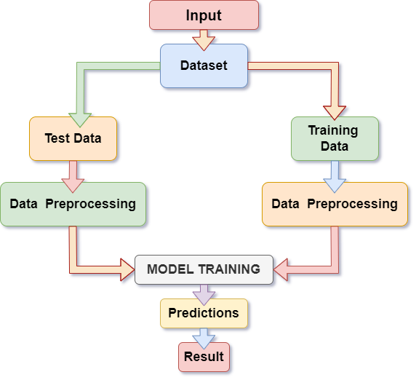
FLOWCHART

Slide 7
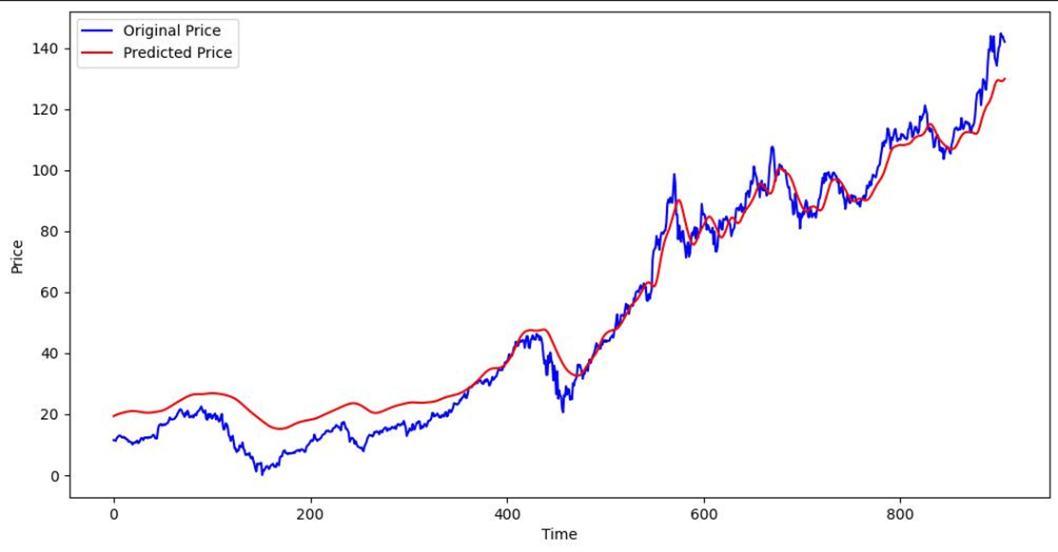
RESULT
Original Price and Predicted Price

Slide 8
RESULT
The graph of original price versus predicted price is a key output of a stock market prediction project using LSTM model, as it provides valuable insights into the accuracy and reliability of the model's predictions and can inform investment decisions.

Slide 9

APPLICATIONS
Replace with your own text
Stock-Market Prediction
Portfolio Optimization
Risk Management

Slide 10
CHALLENGES
Our model accuracy is currently quite low we are planning to increase it so that we can get more accurate result.We are trying to improve it with the help of the advanced algorithms.

Slide 11
REFERENCE
[1] “Stock market prediction using LSTM, RNN and CNN-sliding window model - IEEE Conference Publication.” https://ieeexplore.ieee.org/document/8126078 (accessed Dec. 27, 2019).
[2] J. Jagwani, M. Gupta, H. Sachdeva, and A. Singhal, “Stock Price Forecasting Using Data from Yahoo Finance and Analysing Seasonal and Nonseasonal Trend,” in 2018 Second International Conference on Intelligent Computing and Control Systems (ICICCS), Madurai, India, Jun. 2018, pp. 462–467, doi: 10.1109/ICCONS.2018.8663035.
[3] I. Parmar et al., “Stock Dec. 2018, pp. 574–576, doi: 10.1109/ICSCCC.2018.8703332.
[4] Y. Lei, K. Zhou, and Y. Liu, “Multi-Category Events Driven Stock Price Trends Prediction,” in 2018 5th IEEE International Conference on Cloud Computing and Intelligence Systems (CCIS), Nanjing, China, Nov. 2018, pp. 497–501, doi:10.1109/CCIS.2018.8691392.

Slide 12
THANK YOU

