Slide 1
NALgen
NALgen (Neutral and Adaptive Landscape Genetics) is a method for modeling the process of gene flow and predicting the resulting pattern of (neutral and adaptive) genetic variation across (continuous) landscapes.

Slide 2
To evaluate the NALgen method of modeling neutral and adaptive genetic variation across continuous landscapes:
Generated several landscapes, and then simulated genotypes based on the generated landscapes
Used multivariate analyses
to infer population structure in the simulated data
to find covariance between genetic and environmental data.
Modeled neutral and adaptive genetic variation across continuous landscapes
Information about population structure used to create response variable
Transformed environmental data (based on genetic-environmental covariance) used as predictors
Evaluated performance of model (using subsets of 20 randomly-distributed populations)
Compared against original landscape used to simulate genotypes
Compared against inferred map of ancestry based on genotypes simulated for each cell (all 884 populations)
NALgen: Analysis Steps

Slide 3
Generating simple (low-complexity) landscapes and simulating genotypes
landscapeR package: simulating simple landscapes (barrier and two different values of carrying capacity/habitat suitability): landscape 1 has low permeability cells (carrying capacity = 5) between habitable patches (carrying capacity = 100), while landscape 2 has high permeability cells (carrying capacity = 25), in addition to barriers (carrying capacity = 0)
popRange package: simulating 50 selected and 500 neutral SNPs based on the landscapeR-generated landscape.
Generating high-complexity landscapes and simulating genotypes
virtualspecies package: landscape generation based on Bioclim data
Collinearity removed from climatic variables,
PCA of remaining variables performed,
Ranges of PCA values specified (for three metapopulations).
popRange package: simulating 50 selected and 500 neutral SNPs based on the virtualspecies-generated landscape.
Landscape Genetic Simulations
Simulated genotypes (50 selected and 500 neutral biallelic loci (SNPs), separately and combined): two migration coefficients (m=0.1 and 0.5) x two levels of landscape complexity (low and high) x two levels of landscape permeability (low and high)

Slide 4
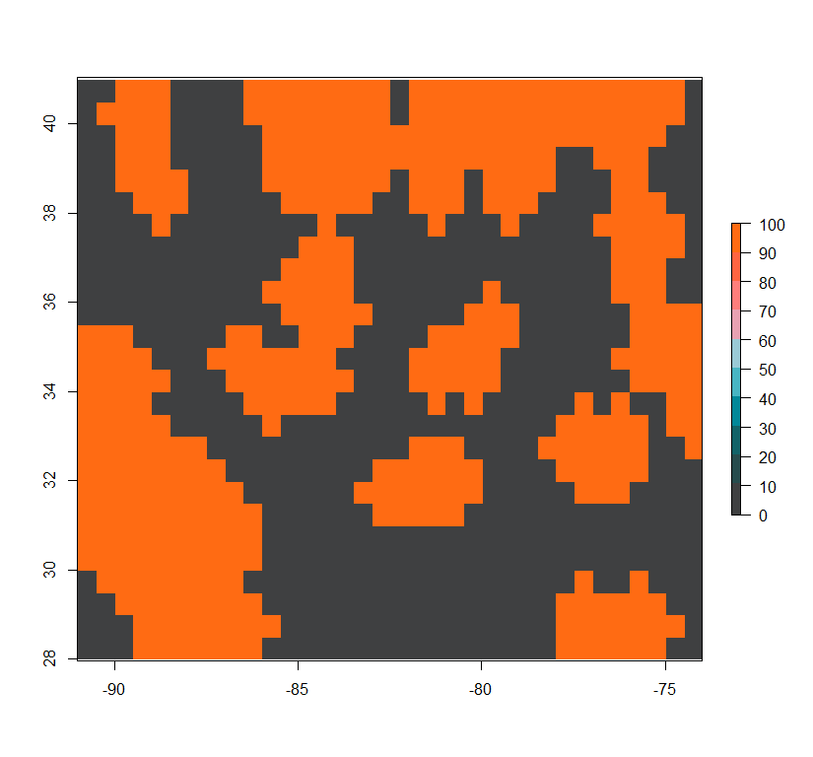
Low-Complexity Low-Permeability (LCLP) landscape

Slide 5
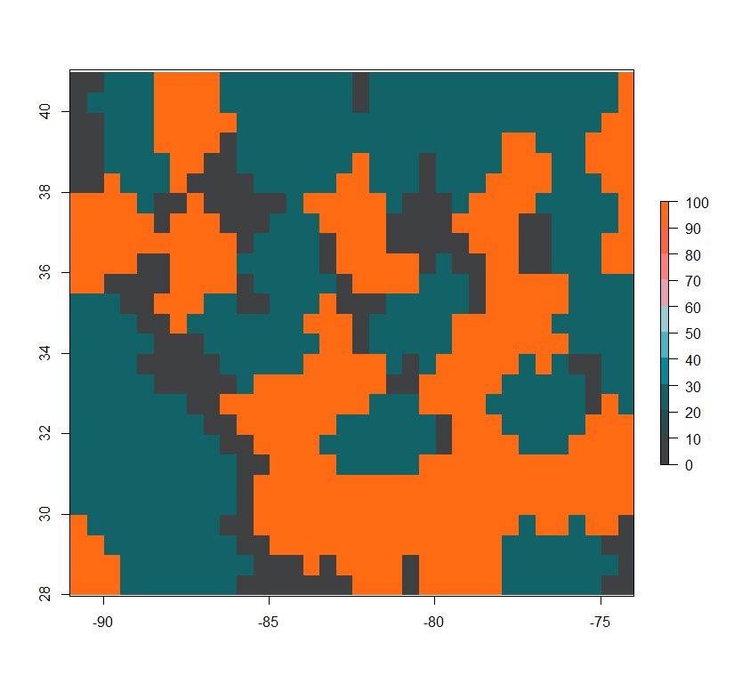
Low-Complexity High-Permeability (LCHP) landscape

Slide 6
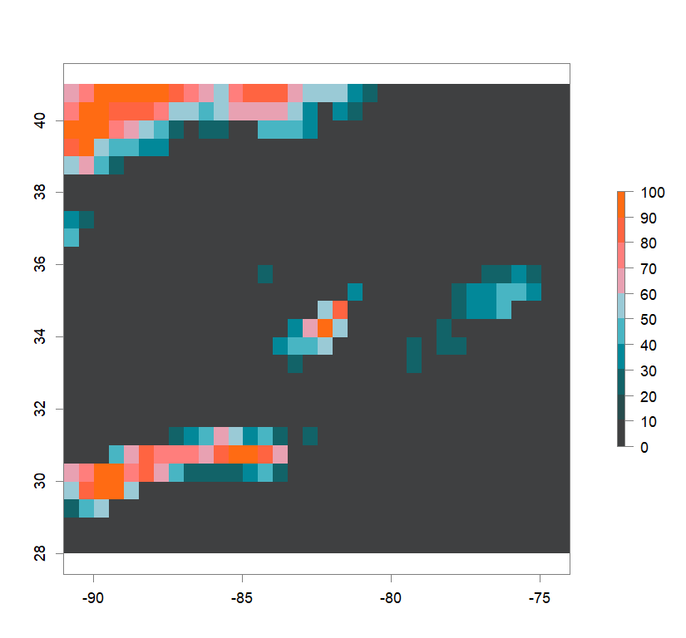
High-Complexity Low-Permeability (HCLP) landscape

Slide 7
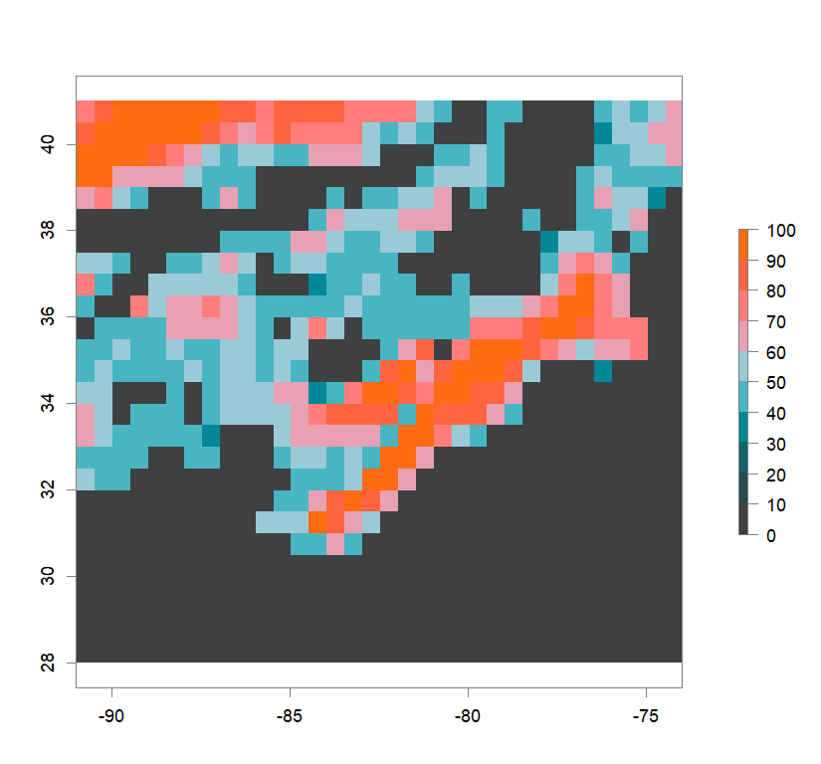
High-Complexity High-Permeability (HCHP) landscape

Slide 8
Setup of Evaluation Step:
884-population reference
The original landscapes used to simulate the genetic data, as well as population structure results obtained from these complete genetic datasets, will be used in evaluating the NALgen method.
Presented hereinafter are the reference results (mapped ancestry coefficients) that NALgen modeling based on 20 randomly-distributed populations will be compared against.

Slide 9
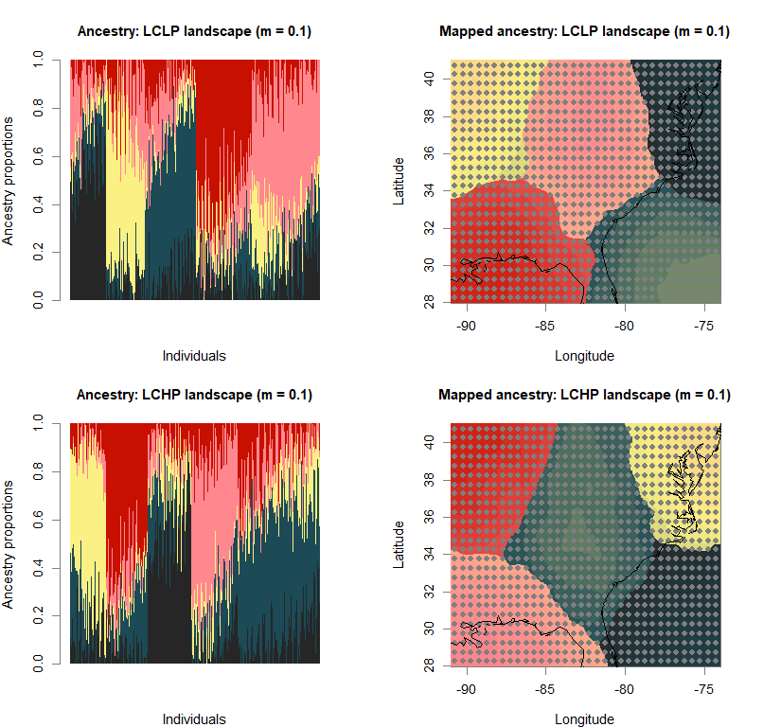

Slide 10
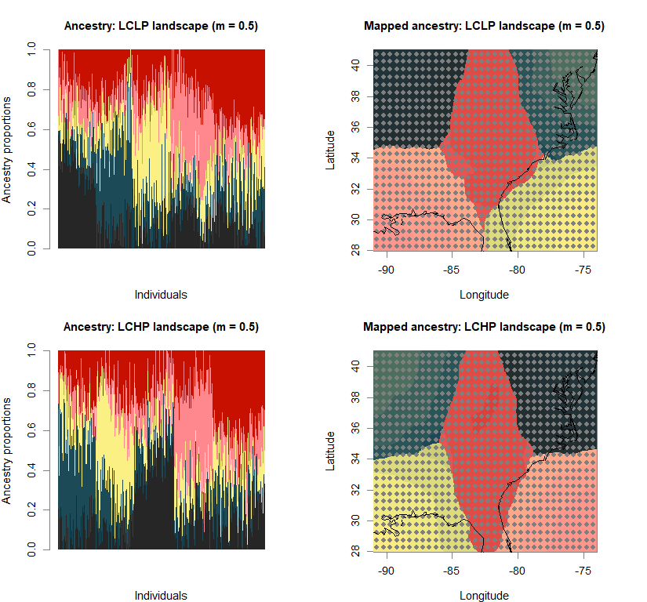

Slide 11
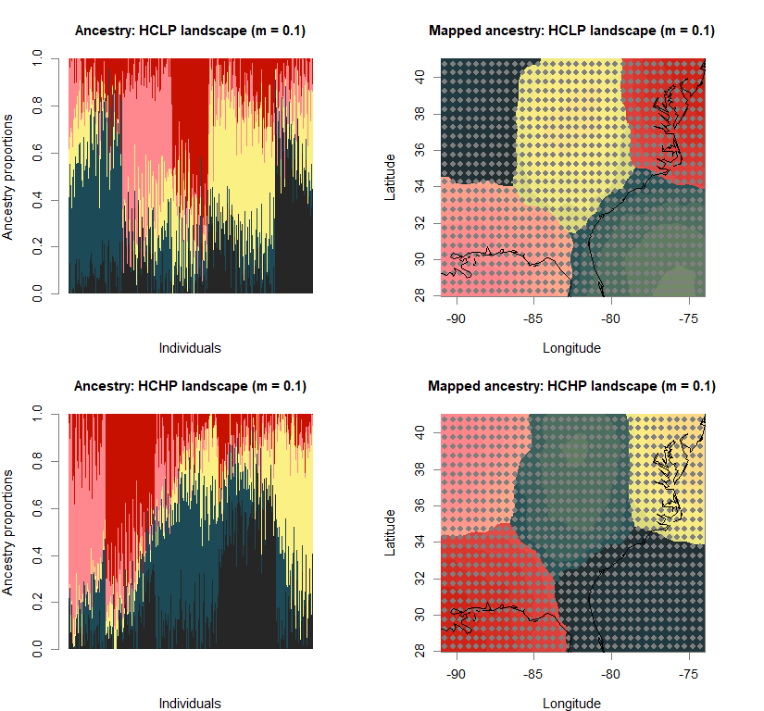

Slide 12
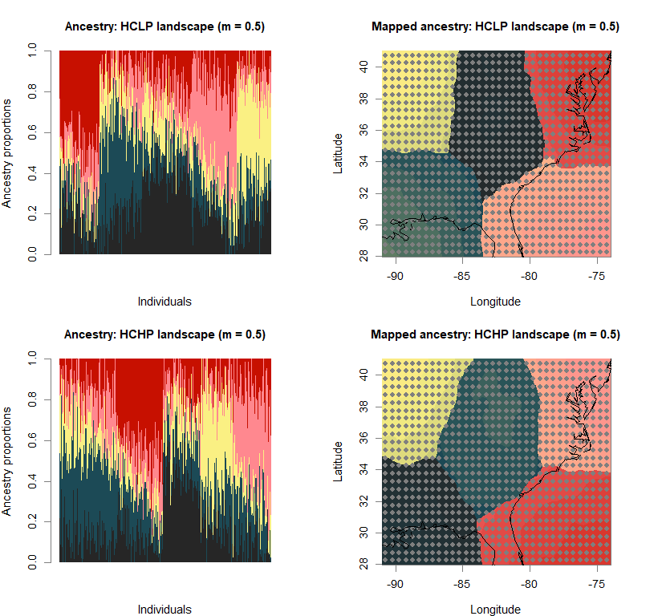

Slide 13
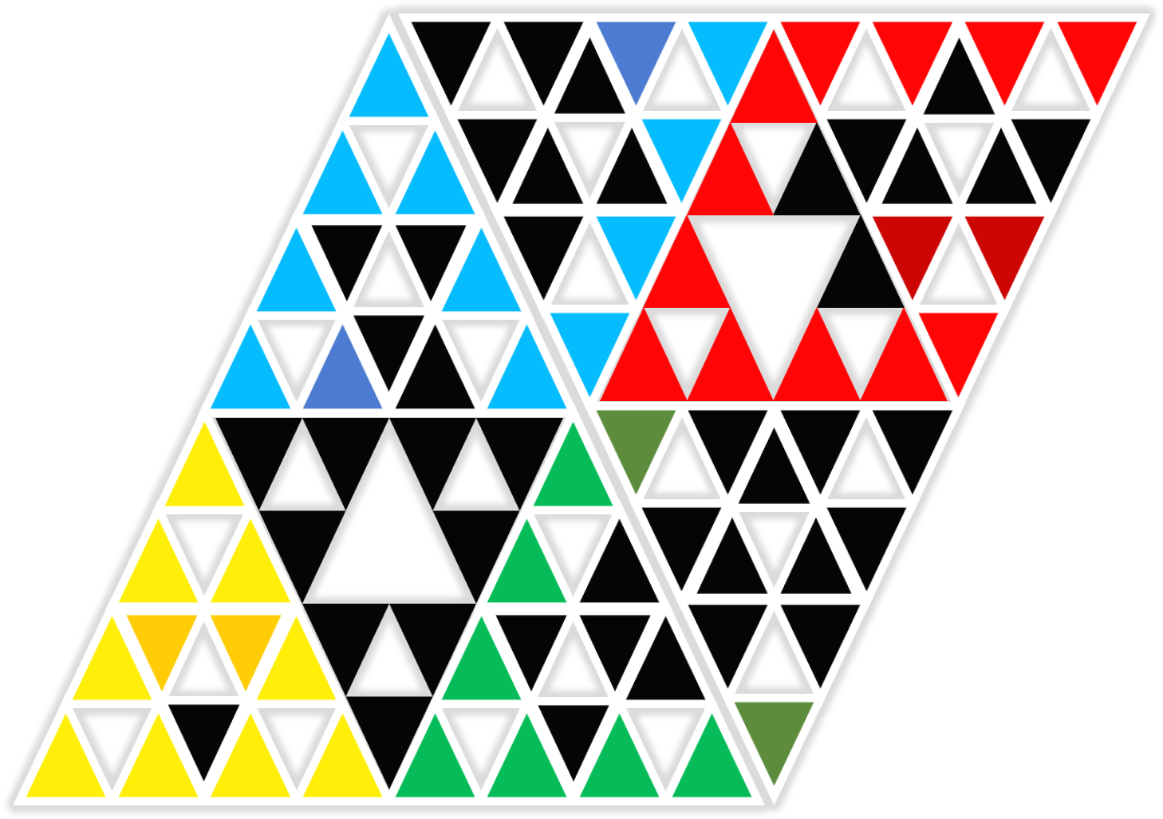
NALgen Method
To determine the maximum genetic-environmental covariance, the raw data is first transformed: these transformed environmental scores form the predictors in NALgen modeling
The response variables are measures of genetic variation (neutral and adaptive): these are newly-developed metrics

