Slide 2
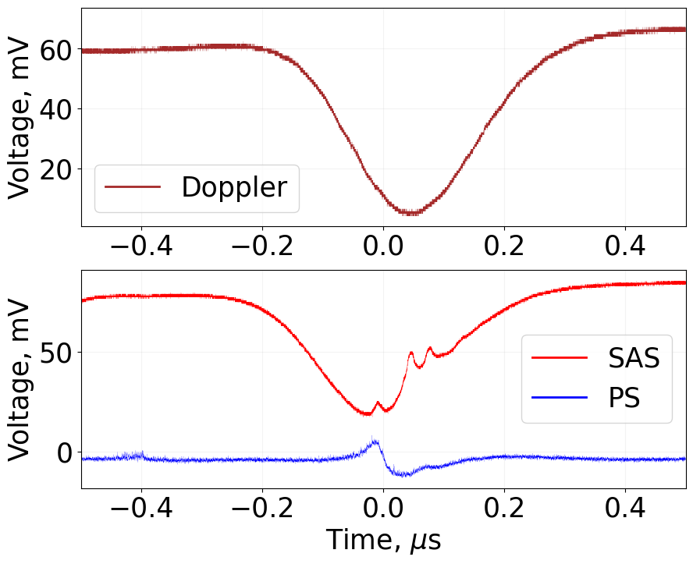
(a)
(b)
CO13
F’ = 2
CO23
F’ = 3

Slide 3
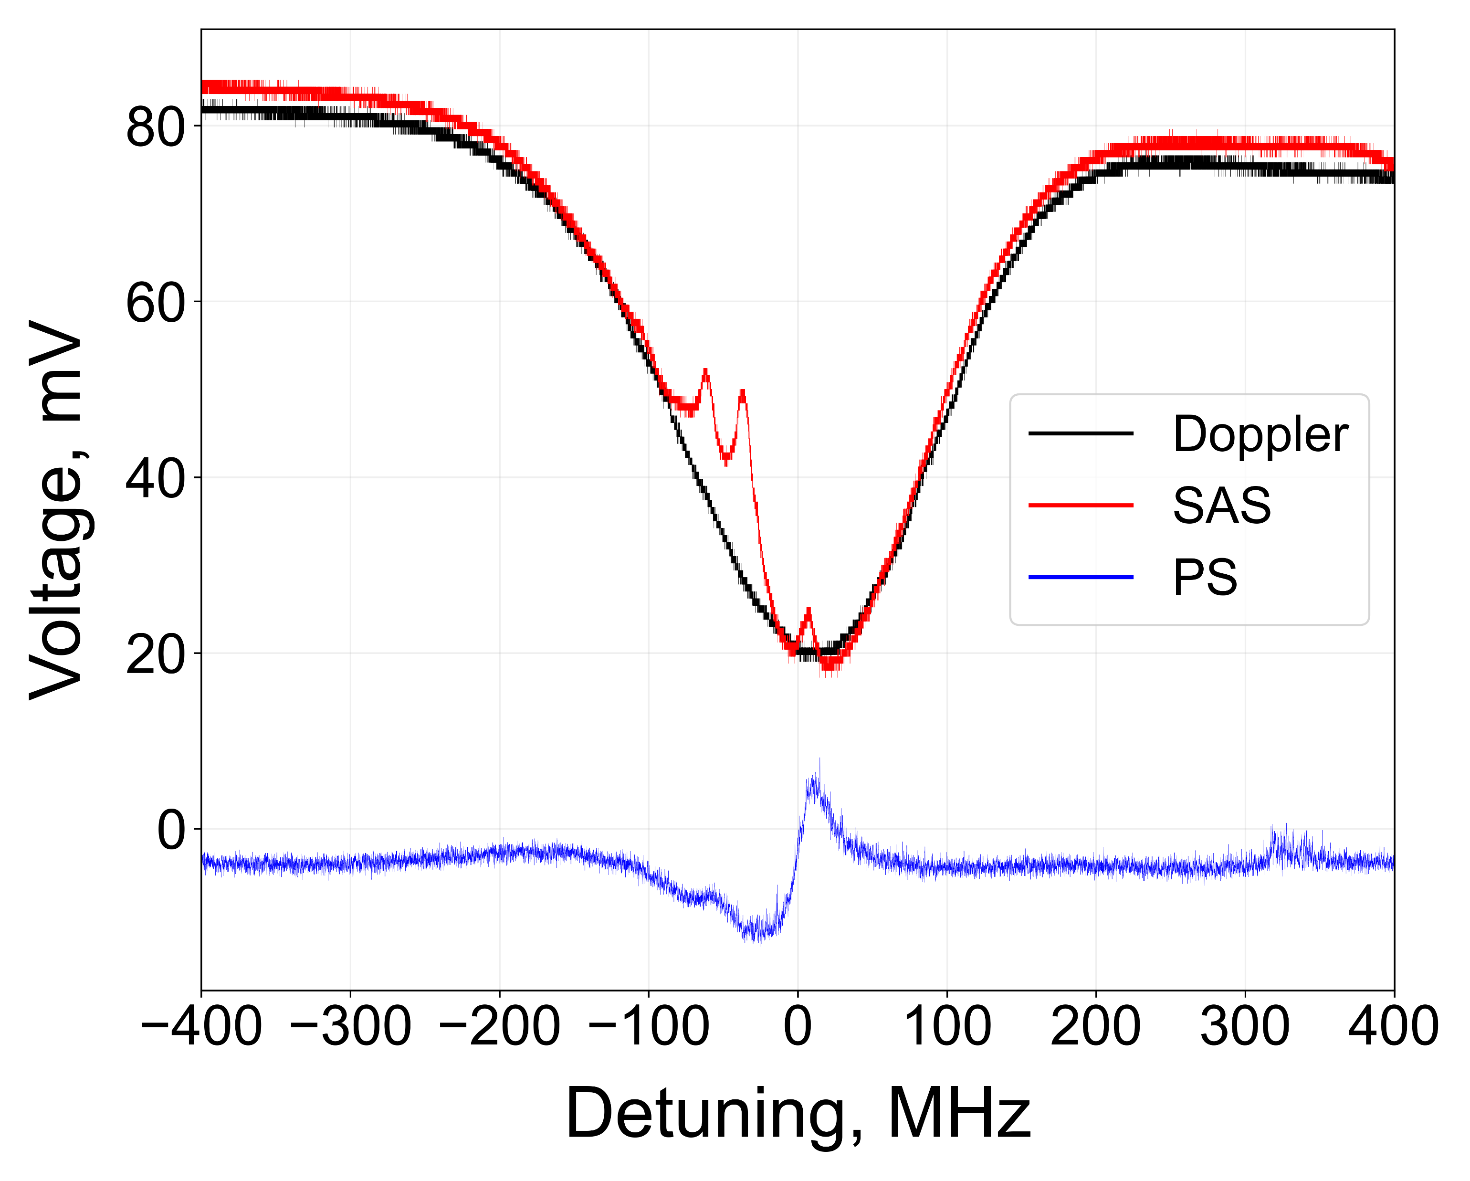
F’ = 2
CO13
CO23
F’ = 3

