Slide 1

Machine Learning Capstone Project
Recommender System for Online Courses
Charles D. Milligan, Ph.D.
April 6, 2023

Slide 2

Outline
Introduction and Background
Exploratory Data Analysis
Content-based Recommender System using Unsupervised Learning
Collaborative-filtering based Recommender System using Supervised learning
Conclusion
Appendix
Notes:
This presentation has five major parts, beginning with Introduction and Background, followed by a section that describes the data and the initial steps used to gain insight into the data. In the next section, we explore several unsupervised machine learning methods to recommend courses based on course content and user previous enrollments. Then, we evaluate several supervised machine learning approaches to building a recommender system. In the final section, the results and key findings are summarized and recommendations for next steps are provided.

Slide 3
Introduction
The goal of this project is to develop a recommender system that will help students find new courses aligned with their interests and learning goals.
The enhanced user experience will result in increased enrollments, new users and increased revenue for the company.
Hypothesis: we can use data from user’s previous enrollments and data on course characteristics to identify new courses that would be of interest to the user.

Slide 4
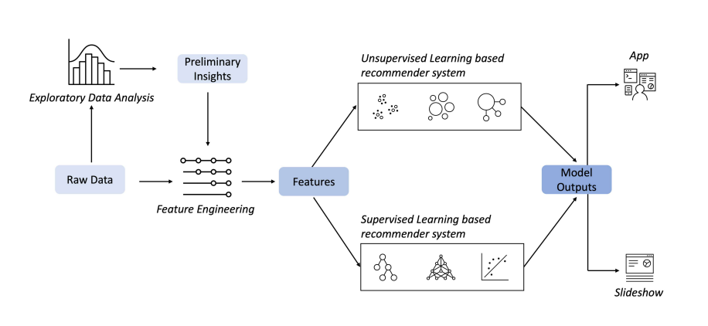
Technical Approach
Notes:
The technical approach is to obtain the data and perform exploratory data analysis to gain preliminary insights. Next, feature engineering is performed to create user and item feature vectors. Then, we explore different recommender approaches based on both supervised and unsupervised machine learning techniques, The results are then analyzed and the key findings are summarized.

Slide 5
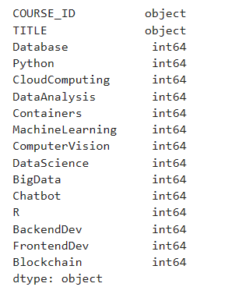
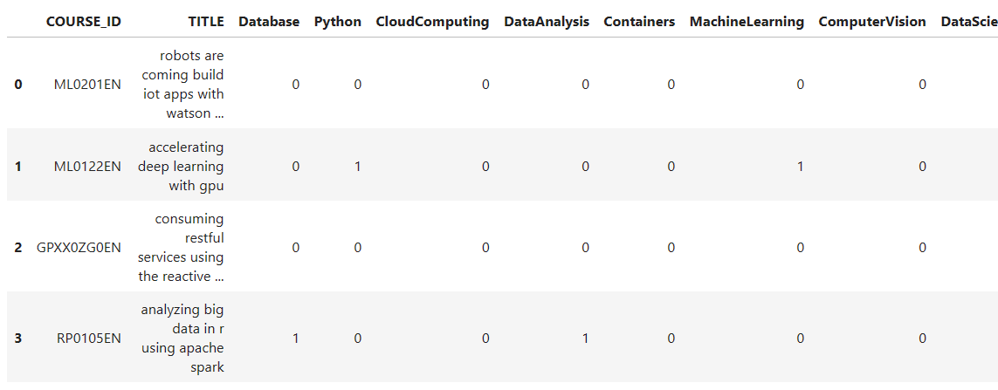
Data Sources: Course Genres
course_genre.csv
307 courses
16 features
Notes:
The course genres dataset provides information on 16 features for 307 courses. A value of 1 indicates the course involves a particular genre, while a feature value of 0 indicates the course does not involve a particular genre.

Slide 6
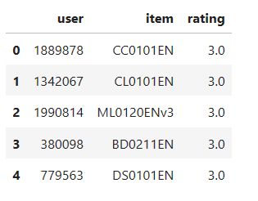
Data Sources: Course Ratings
ratings.csv
233306 enrollments
33901 users
0.0 – No interaction
1.0 – Browsed Course
2.0 – Audited Course
3.0 – Completed Course
Notes:
The course rating dataset provides a user id (user) course id (item) and a rating value (3.0 – completed course, 2.0- audited course, 1.0 – browsed course and 0.0 – no interaction)

Slide 7

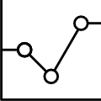
Exploratory Data Analysis

Slide 8
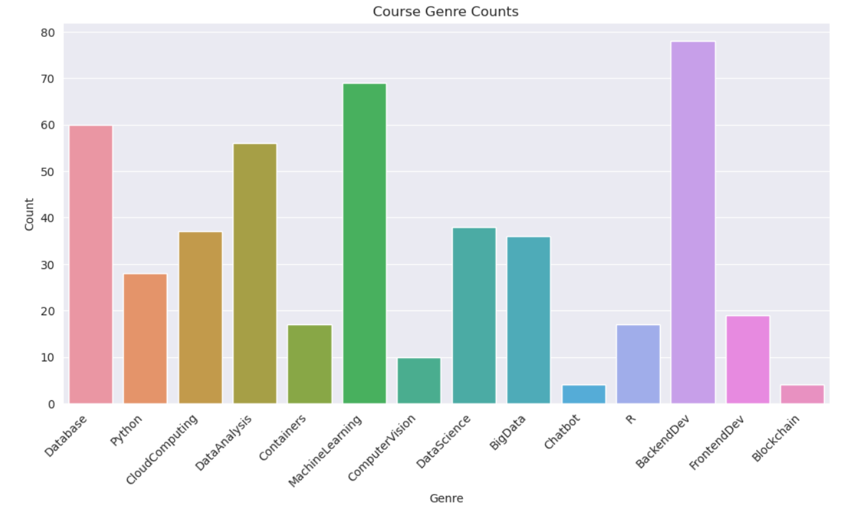
Course counts per genre
Notes:
The chart shows the number of courses containing content in a variety of genres. The chart indicates the most common genres are Back end Development, Machine Learning, Data Analysis and Database. It is interesting to note that back-end development did not appear as prominently in the Word Cloud that was created from course titles.

Slide 9
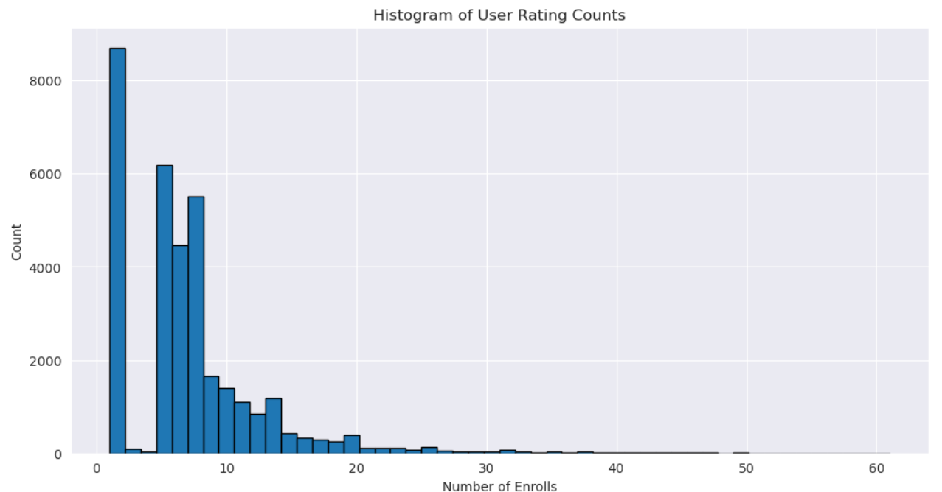
Course enrollment distribution
Notes:
The histogram of enrollment distributions shows that while over 9000 users enrolled in just one course, a surprisingly small number of users enrolled in 2 or 3 courses. It seems that users are likely to enroll in just one or four or more courses. Course enrollments drop off rapidly above 14 courses. Very few users enrolled in 25-50 courses.

Slide 10
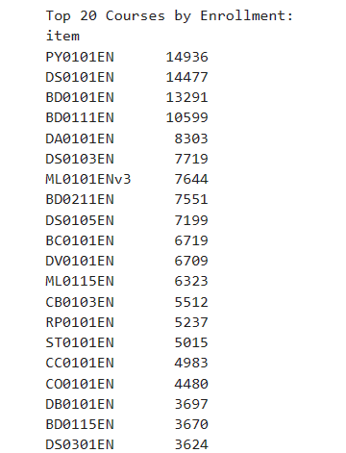
20 Most Popular Courses
Notes:
The list shows the 20 most popular courses in descending order. Python was the most popular course followed by a data science class and then two backend development courses. This list is consistent with the bar chart showing course enrollments.

Slide 11
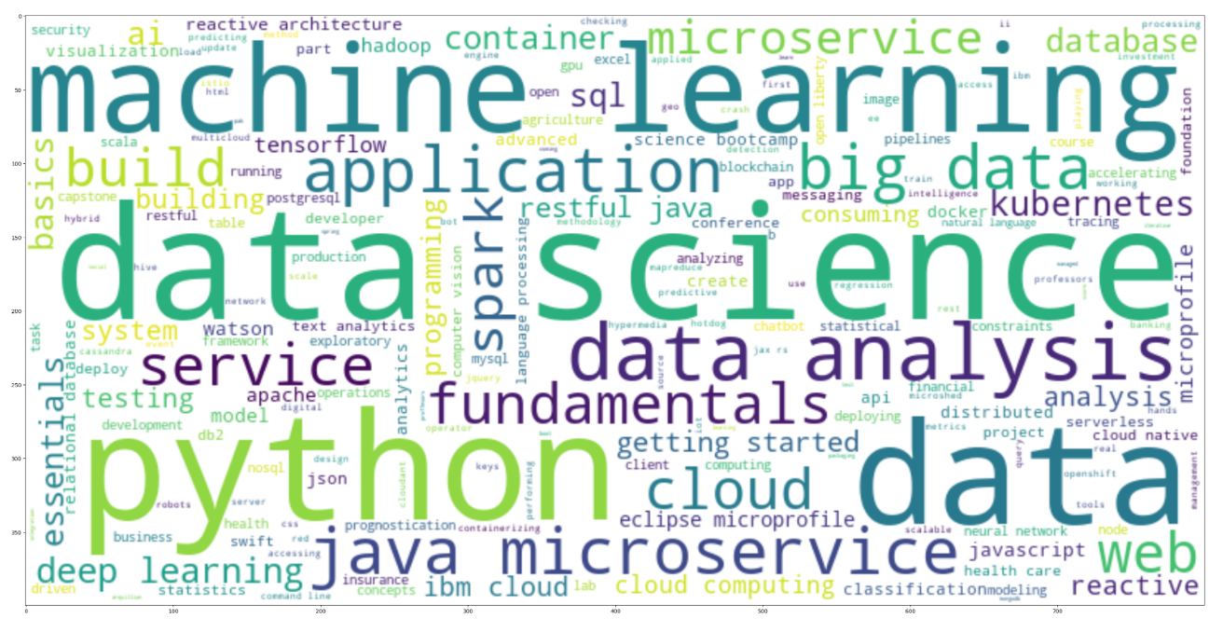
Word Cloud of Course Titles
Notes:
The Word Cloud indicates the most repeated terms in the course titles were “machine learning,” “data science”, “python”, and “data”. Other significant terms include “big data”, “data analysis”, and “microservice.” These will be significant contributors to item feature vectors.

Slide 12
Content-based Recommender System using Unsupervised Learning
Cluster2
Cluster1

Slide 13
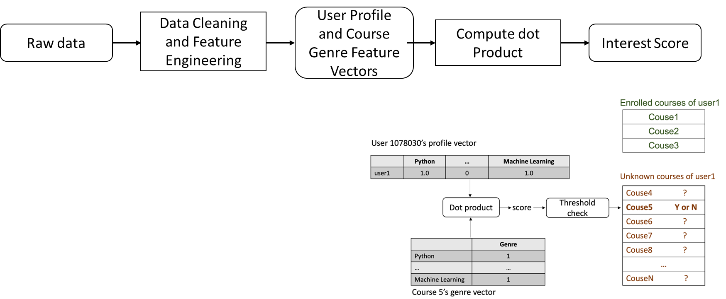
Flowchart of content-based recommender system using user profile and course genres
Notes:
Data read into pandas dataframes from course_genre.csv and ratings.csv
Dataframes cleaned normalized and converted to feature vectors
Dot product matrix operation performed to compute interest score
Interest score compared to a threshold to determine whether or not course is recommended to the user

Slide 14
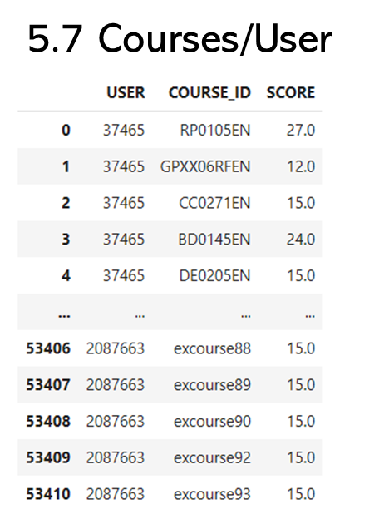
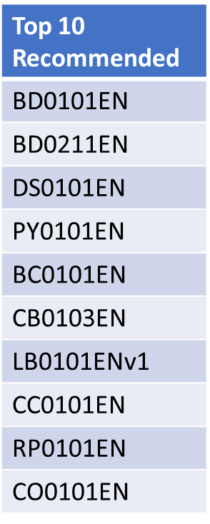
Evaluation Results of User Profile-Based Recommender System
Score Threshold = 10.0
Notes:
The recommender suggested an average of 5.7 courses per user. The most often recommended courses were in the back end development, python and data science genres. Courses were recommended to the user when the recommendation score was higher than 10.0

Slide 15
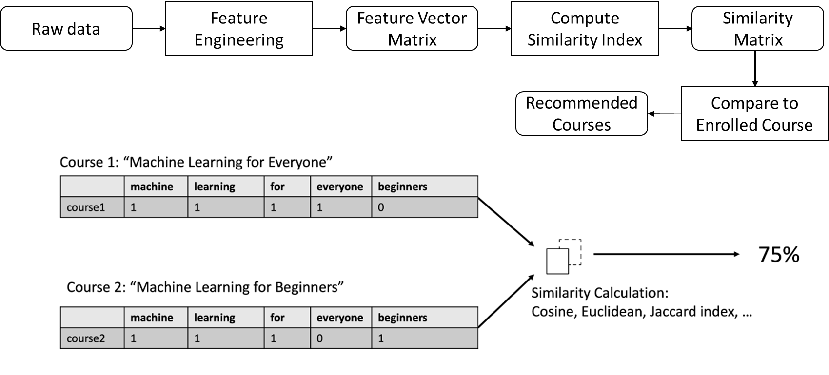
Flowchart of Content-based Recommender System Using Course Similarity
Notes:
Ingest course_genre into padas dataframe
Perform feature engineering: BOW and to create feature matrix
Compute similarity indices using Cosine, Euclidean or Jaccard
Assemble Similarity Matrix
Identify courses with similarity index above pre-set threshold when compared to enrolled courses
- Briefly explain the flowchart in the slide note

Slide 16
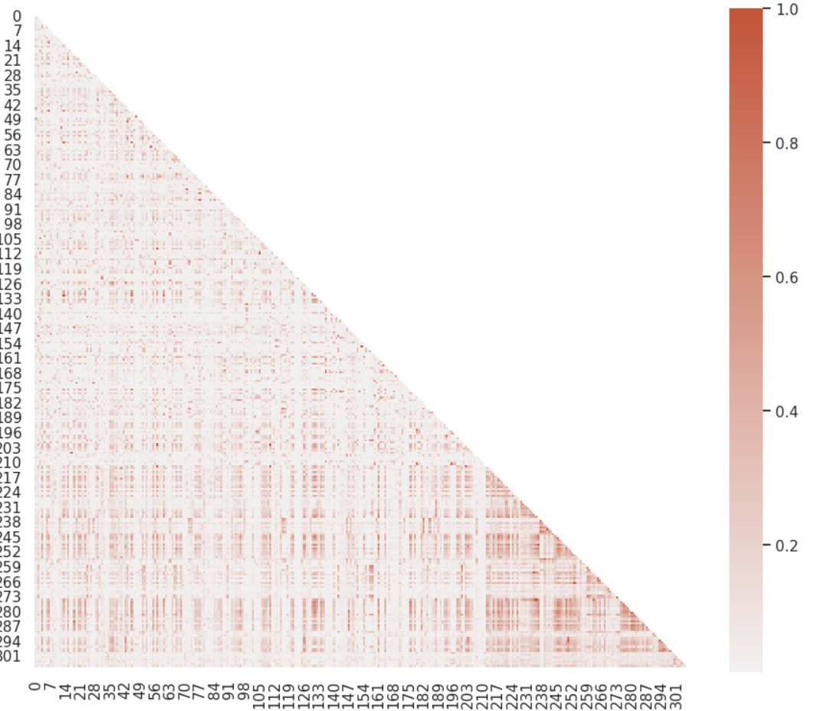
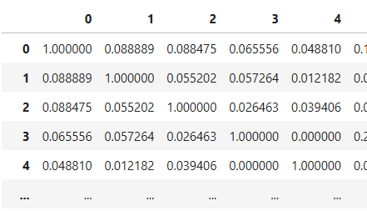
Content-Based Recommender System Using Course Similarity
Course Similarity Matrix and Heatmap
Notes:
The course similarity heatmap allows us to visually identify courses that have similar content. The course similarity matrix is symmetric and all diagonal elements have value 1.0 as this represents a self comparison.

Slide 17
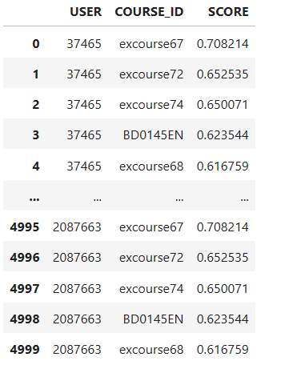
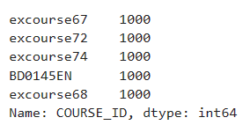
Evaluation Results of Course Similarity Based Recommender System
5000 Recommendations (5/User)
Most Frequently Recommended Courses
Course Similarity Score Threshold = 0.60
Notes:
5000 Recommendations were produced. Average 5 recommendations/user
5 courses recommended to all 1000 users in the test group
Recommendations were made when the computed course similarity score exceeded 0.60

Slide 18
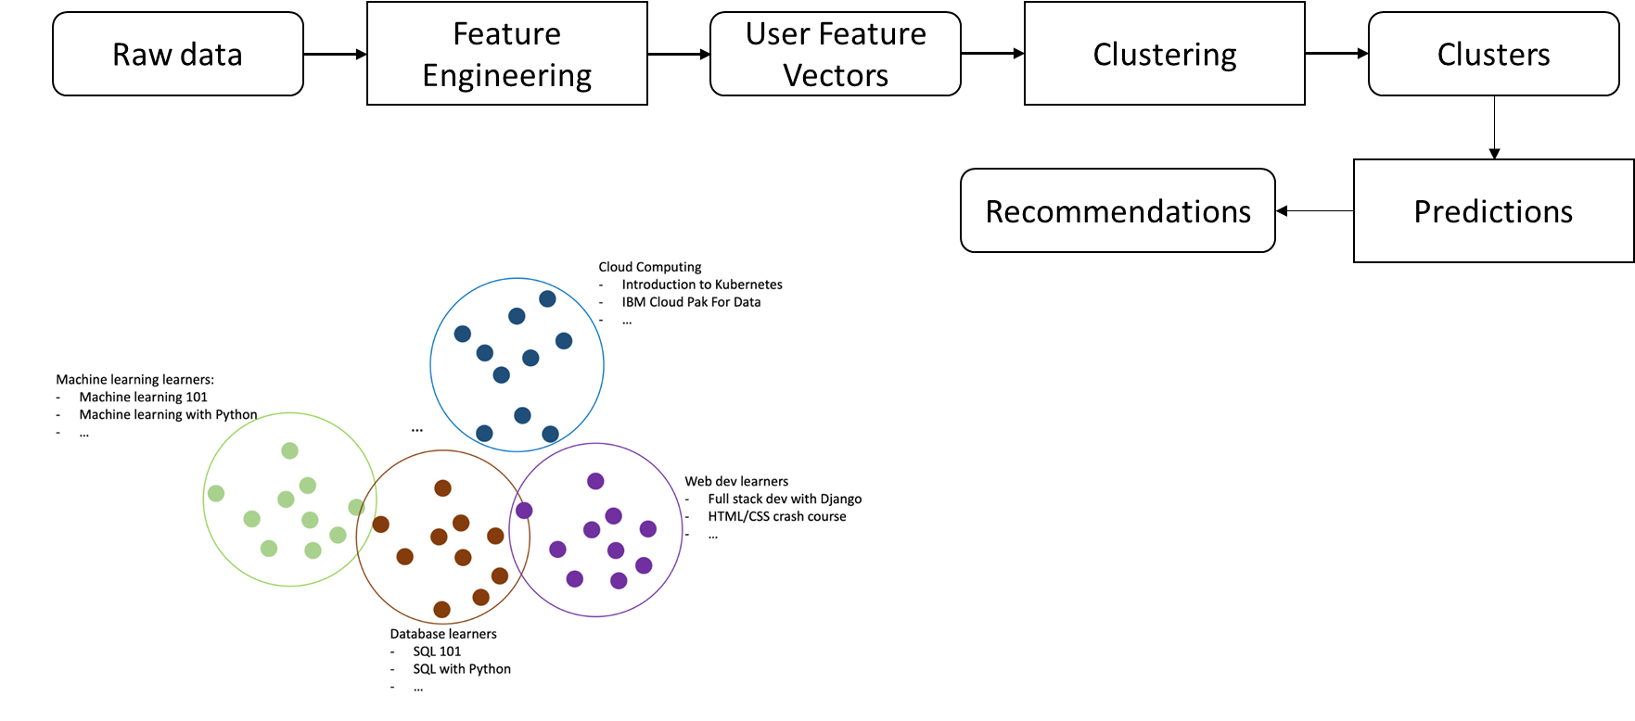
Flowchart of Clustering-Based Recommender System
Notes:
Convert raw data into feature vector
Normalize vector and perform PCA
Perform clustering algorithm
Use identified clusters to predict best courses for users

Slide 19
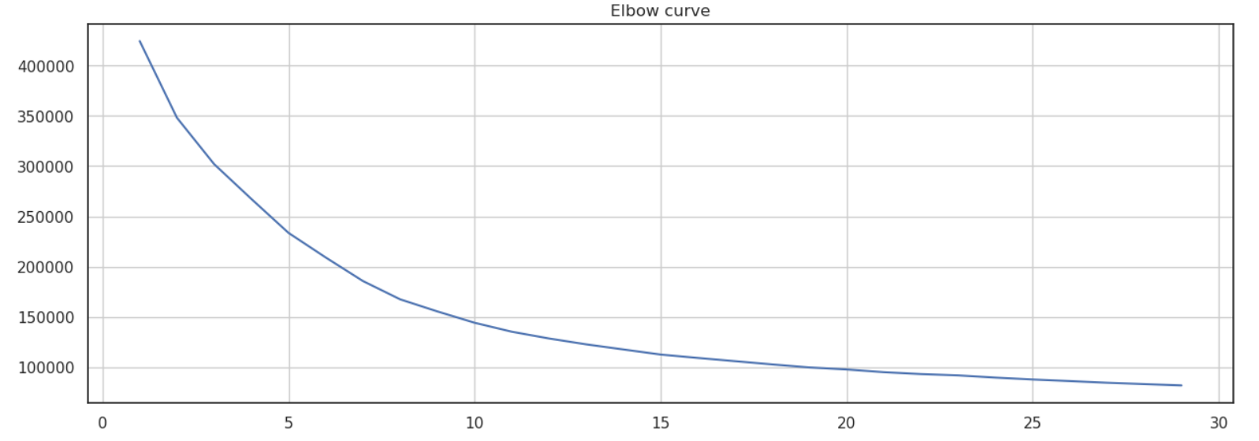
Clustering-Based Recommender System
Inertia
Number of Clusters
Notes:
The elbow curve is intended to help select the appropriate number of clusters for the model. We are looking for the place on the curve where it begins to flatten out (little change in inertia with increasing number of clusters). In this case, there is no distinct elbow and we’ll need at least 25 clusters

Slide 20
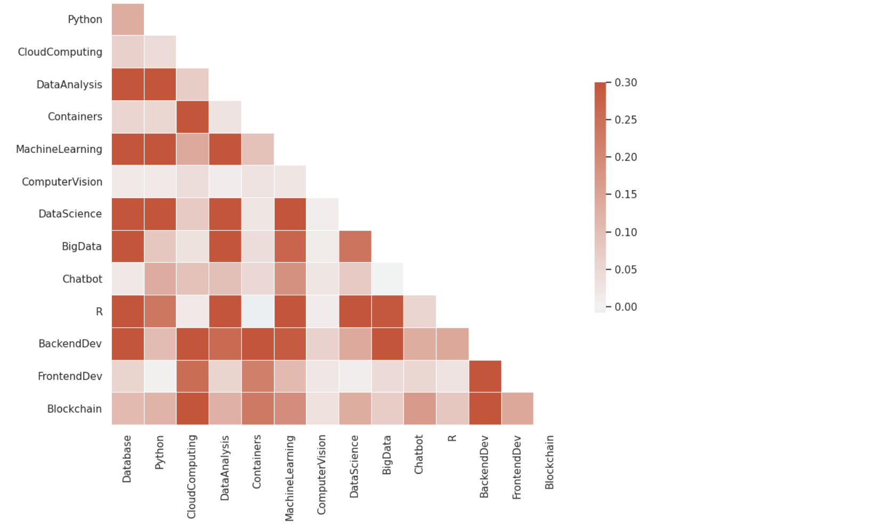
Covariance Matrix and Principal Components
Notes:
The covariance matrix heatmap helps us visualize important features impacting variance. The bar chart on the right shows the effect of considering increasing numbers of principal components in the model. We can see that with 9 principal components we have captured more than 90% of the variance. Hence, we can transform from 14 features to 9 principal components and still account for most of the variance.

Slide 21
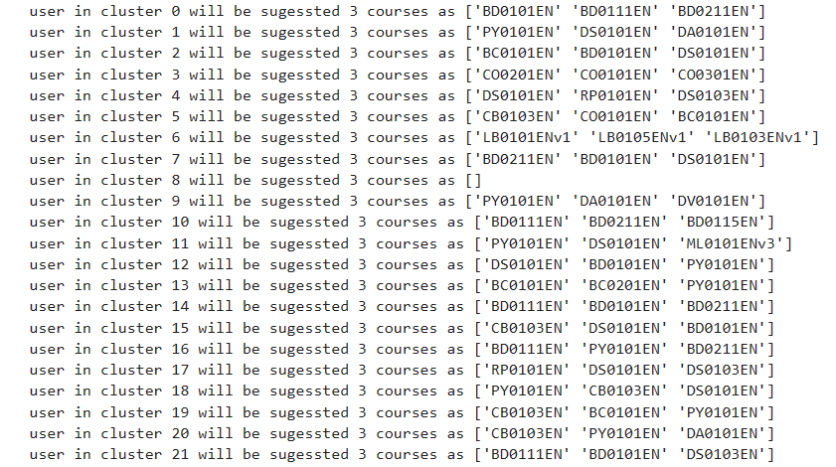
Evaluation Results of Clustering-Based Recommender System
hyper-parameter settings; k=25, Number of Principal Components = 9
Top 10 Recommended
BD0101EN
BD0211EN
DS0101EN
PY0101EN
BC0101EN
CB0103EN
LB0101ENv1
CC0101EN
RP0101EN
CO0101EN
3 courses recommended per user
Notes:
The feature vector was transformed into 9 principal components (it was determined that 8 Principal Components account form at least 90% of variance). We used 25 clusters and made 3 recommendations per user.

Slide 22
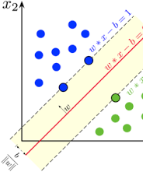
Collaborative-filtering Recommender System using Supervised Learning

Slide 23
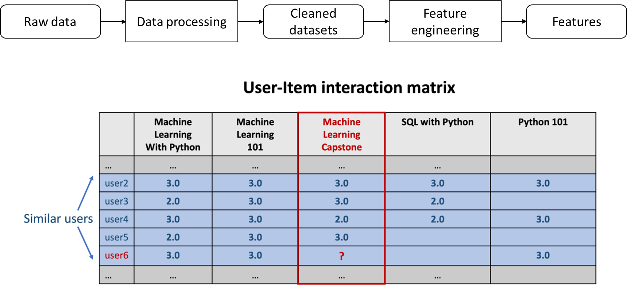
Flowchart of KNN based recommender system
Notes:
Create a model by calling `KNNBasic()` class.
Split data into training and test sets
Fit model on trainset `model.fit(trainset)`.
Produce predictions using `model.test(testset).
Compute the accuracy by using `accuracy.rmse(predictions)

Slide 24
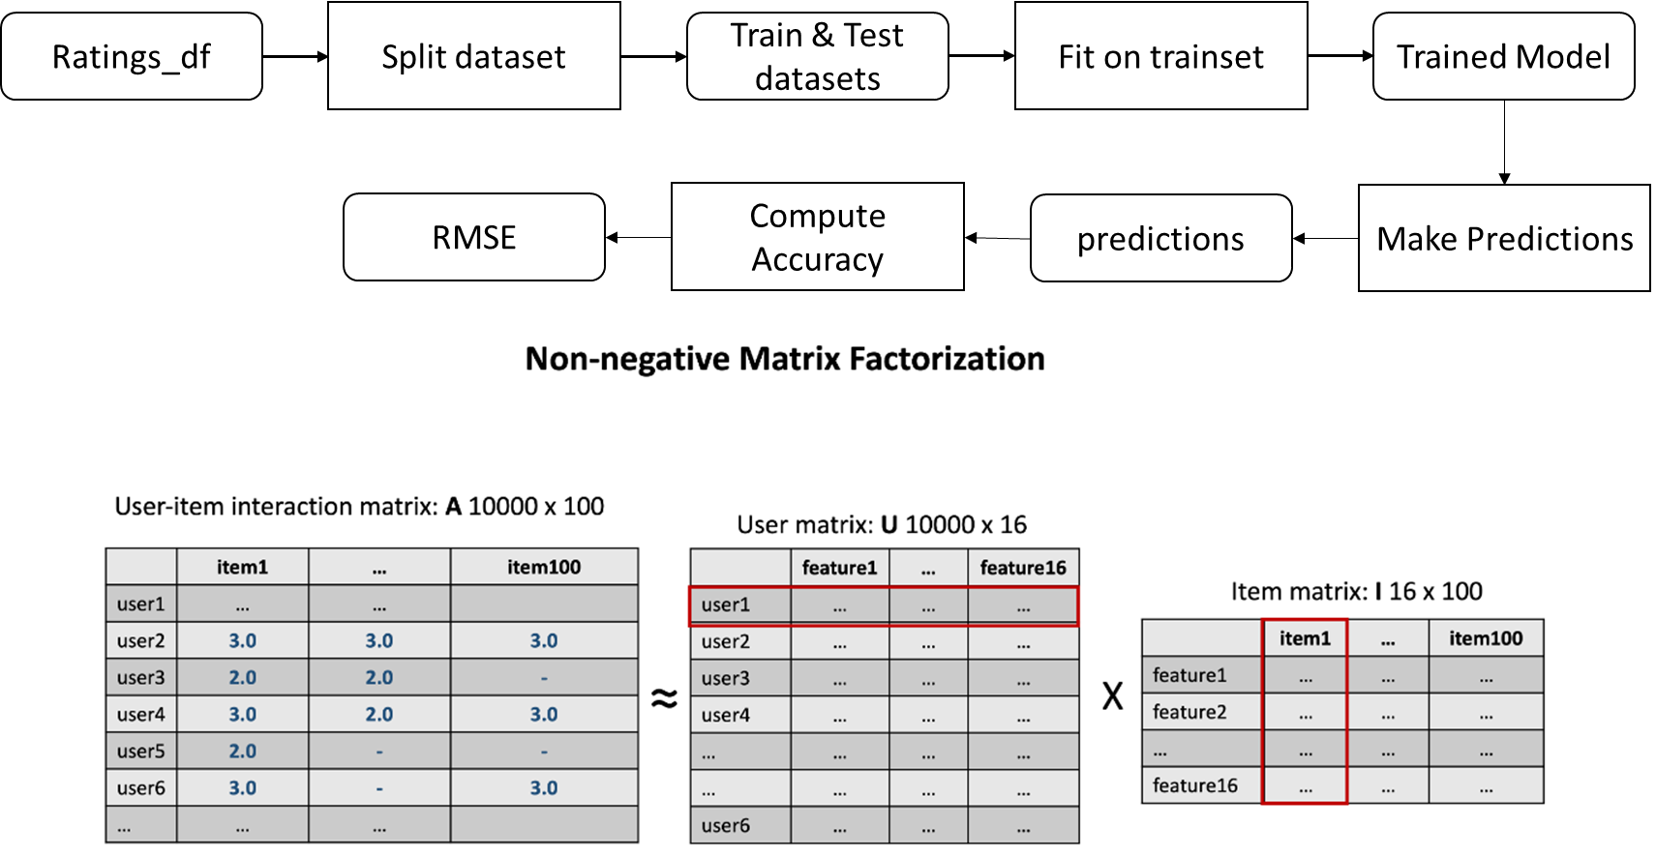
Flowchart of NMF Based Recommender System
Notes:
Split data into training and test sets and define model (model=NMF(verbose=True, random_state=123)
Train model (model.fit(trainset)
Make predictions (predictions=model.test(testset))
Compute accuracy accuracy.rmse(predictions)

Slide 25
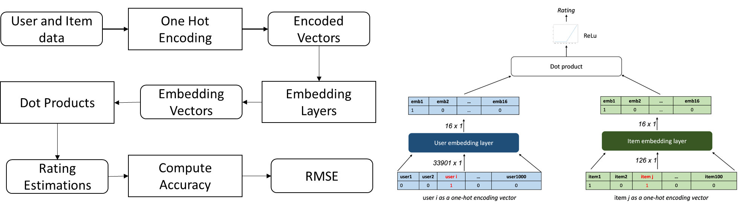
Flowchart of Neural Network Embedding Based Recommender System
Notes:
One hot encode the user feature and item feature vectors
Embed the one-hot encoded vectors into latent feature space
Compute ratings estimations from the dot product of the latent feature vectors
Compute the Root Mean Squared Error

Slide 26
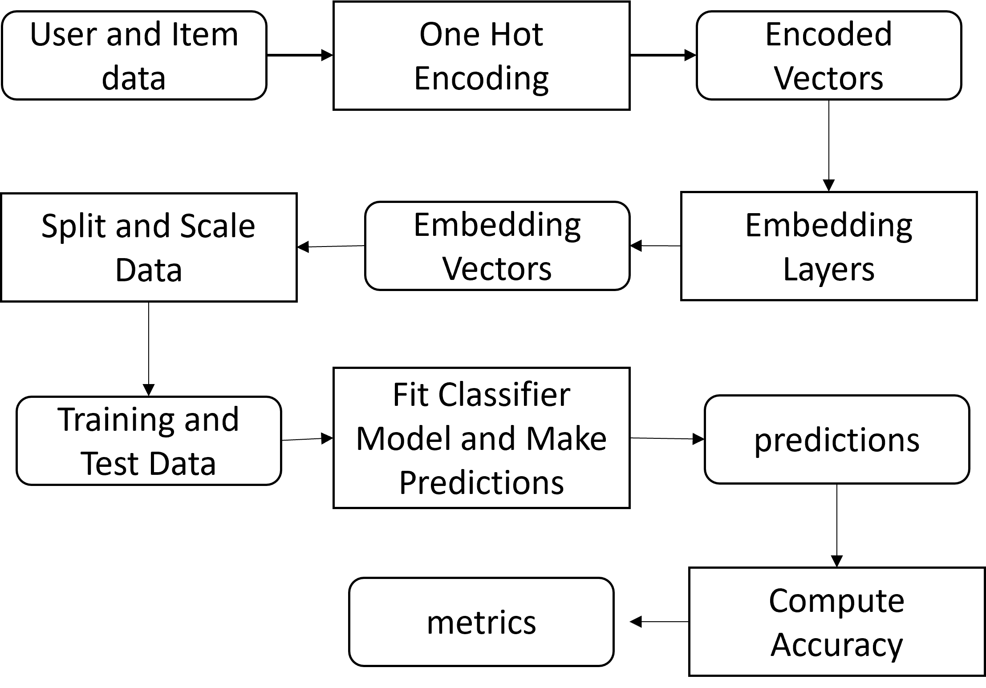
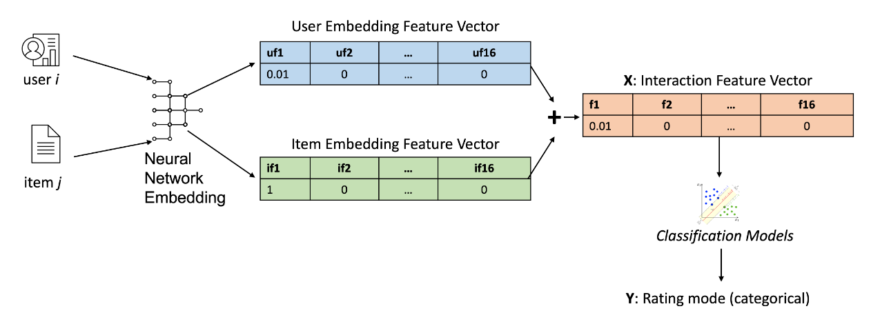
Flowchart of Classification-based Recommender Using Embedding Features
Notes:
Data one hot encoded
Processed the Neural Network Embedding layers
Embedding Vectors split into training and test data
Model fit on training data
Model run on test data for predictions
Accuracy calculated

Slide 27
Comparison Collaborative-Filtering Model Performance
Model | RMSE
KNN | 0.1924
NMF | 0.1944
Neural Network | 0.2062
Customized Neural Network | 0.1700
Linear Regression w/Embedding | 0.2077
ElasticNet w/Embedding | 0.2084
Notes:
The table and bar chart show the root mean square error for various collaborative filtering models. They all had similar performance, but three (KNN, NMF and Customized Neural Network) had RMSE <0.20. The customized Neural Network featured the lowest RMSE (0.1700)

Slide 28
Conclusions
The data were ingested and analyzed using standard exploratory data analysis techniques
Two classes (supervised and unsupervised) of machine learning methods were used to create recommender systems
The unsupervised models used similarity metrics (Euclidean, Gaussian, Jaccard, ..) to identify similarities between new courses and previously enrolled courses. Similarity scores were computed and 3-6 courses were recommended for each user
RMSE scores were computed for a variety of supervised learning-based recommenders. All produced RMSE around 0.20, but the approach that used a customized neural network produced RMSE=0.17
The unsupervised approaches required more upfront feature engineering than did the supervised models
The unsupervised approaches tended to be more explainable than the unsupervised methods

Slide 29
Future Work
All of the models were based on item or user feature details, so they would recommend a course just because it was similar to others or to courses the user had already enrolled.
This does not allow for consideration of progression where for example a user completed a beginner python course, and should not be recommended additional beginner courses, but rather the user should be recommended intermediate or advanced python courses.
Hence, the models would be improved by removing all enrolled and similar courses to the enrolled from the candidate course dataset.

Slide 30
Appendix
chazzd24/MachineLearningCapstoneProject: This repository contains the Jupyter Notebooks Used to Complete the IBM Machine Learning Capstone Project (github.com)
Linkedin: (32) Charles Milligan | LinkedIn

