Slide 1
Building a Better Live Music Economy
Charles J. Anderson

Slide 2
The Music Economy Relies on Live Music
“Live events are quickly shaping up to be the most lucrative space for musicians in the digital-music era, and for good reason: As listeners become inundated with cheap access to music provided by streaming services, dedicated music fans crave more intimate experiences with their favorite artists.”
-Amy Wang, Rolling Stone
https://www.rollingstone.com/pro/features/how-musicians-make-money-or-dont-at-all-in-2018-706745/

Slide 3
Better Booking Means Higher Profits
Labels and bands alike pour lots of resources into booking live shows.
Successful booking comes down to selecting the right venue.
Record labels, management, and artists would all monetarily profit from a streamlined booking system.

Slide 4
Data Acquisition and Cleaning
Venue name and location data from Foursquare
Venue capacity and genre data from https://www.indieonthemove.com/
Extracted 100 total venues and 7 features total
Cleaned data contains 49 venues, 11 features

Slide 5
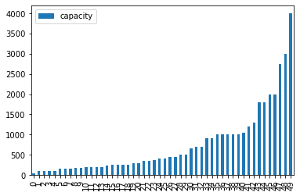
Venue Capacities

Slide 6
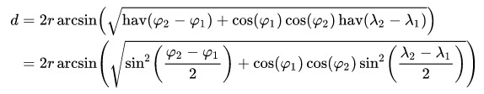
Proximity Score
Haversine Distance Formula:
Proximity Score- How close are the closest venues?

Slide 7
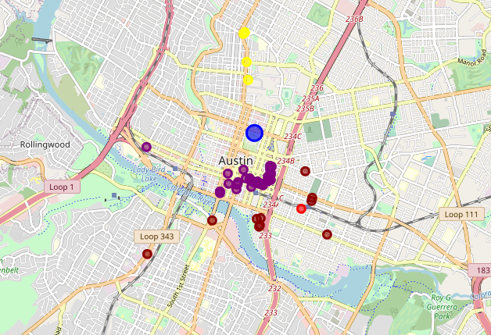
Mapping Proximity Score by Location

Slide 8
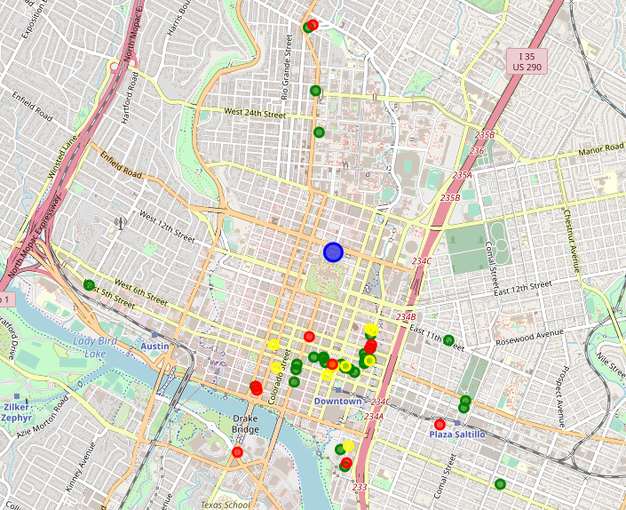
Mapping Size by Location

Slide 9
Size Categories
Small Venues: 30 – 500 capacity, prioritize proximity score
Medium Venues: 500-1000 capacity, proitize user rating
Large Venues: 1000+ capacity, prioritize capacity

Slide 10
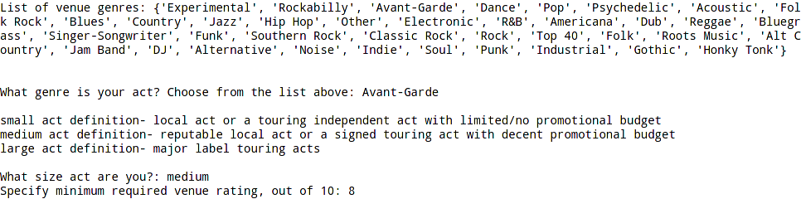
Recommendation Engine

Slide 11

Result

Slide 12
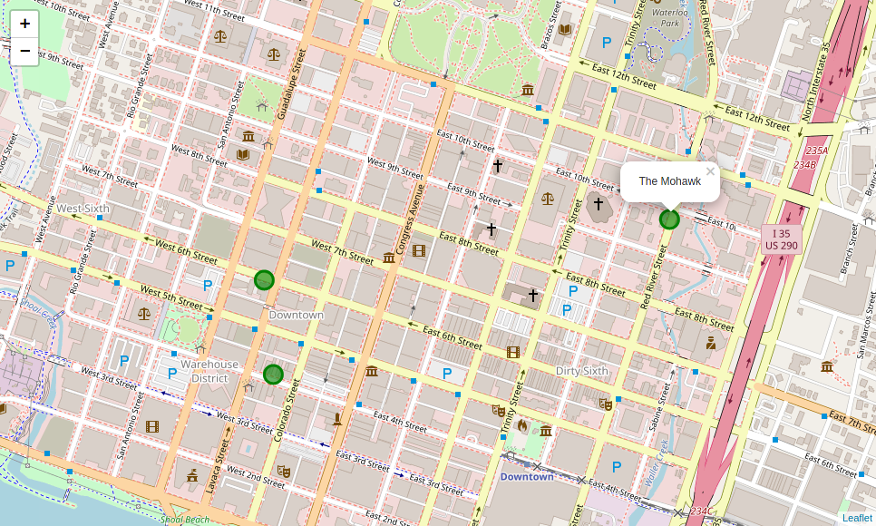
Result (Cont’d)

Slide 13
Further Research
More venues
Adjust Parameters (Proximity Score, Size Bins)
Look at better fit features for medium and large size venues

Slide 14
Scaling the Service
Include venues across the United States
Find foreign databases for venue capacity and genre info
Account for “temporary” venues: festivals, pop-ups, etc.

Slide 15
Integration
Module of larger booking infrastructure
How to get venues and artists involved?
Existing platforms to integrate with

Slide 16
Conclusion
Booking shows is challenging!
A better booking platform would increase live music profits for everyone.
Further research could lead to even better recommendations.
Integration with other modules could contribute to a revolution of the industry.

Slide 17
Q&A

