Slide 1
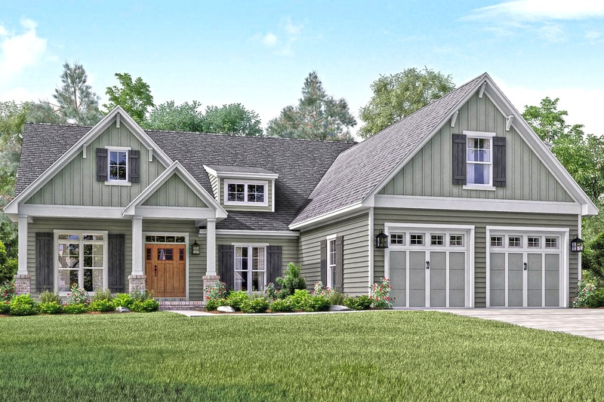
House price prediction machine learning model
By Group – Agent H

Slide 2
Project outline:
Why this project?
Project structure and EDA processing
Feature Engineering and different models used
Model training and cross-validation
Results
Conclusion and future direction

Slide 3
Why this project?
House is a lifetime investment
How the price of house are affected by different features in the house?
People want to know the actual price of house on the basis of features
before reaching out to agent
How we did this and how can we apply to predict the real world problem?

Slide 4
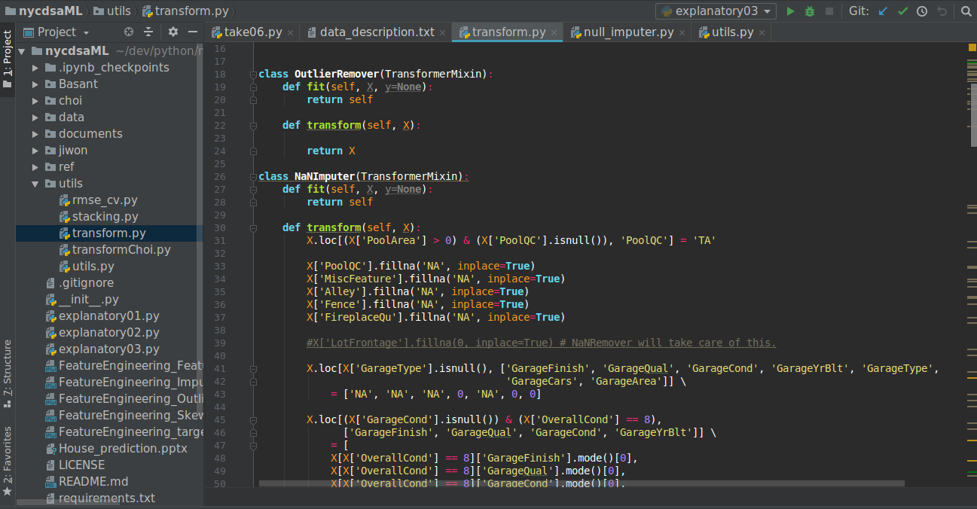
Project structure 1:
A Simple but efficient co-op environment
Each members do his own research
And share new idea freely.
When an idea became mature,
It is deployed to specific directory
And maintained rather strictly.

Slide 5
Project structure 2:
2 SKLearn Pipelines for Fast iteration
Numbers of transformers such as
NaNRemover and Scaler.
Data
Data Transforming Pipeline
Transformed Data
Hyper parameter optimizers
and Model Stackers
Kaggle
Model Building Pipeline
Prediction

Slide 6
Project Result:
Achieved Rank 500 by moving fast, failing fast

Slide 7
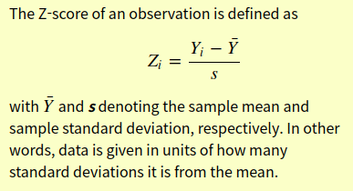
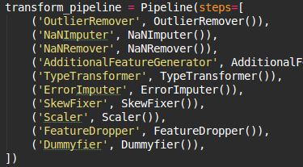

Data Transformations:
Tried to automate the process as much as possible
For an instance, to detect outliers
Explore the theory
Create an effective strategy
Implement as an pipeline element

Slide 8
Data Transformations:
But most of null imputation is done manually
since Auto imputer performed poorly
Hardcoded NaN Imputer engages first,
And then,
simple auto NAN imputer takes care of the rest.

Slide 9

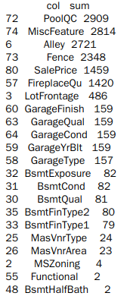
Data Transformations:
Used data_descriptions.txt and common sense to impute NAN data
Imputed NaN for garage related data
By assuming that have similar value with
those have same overallcond
31 out of 35 NAN containing columns are taken care of by manual NAN Imputer
And this made big difference in kaggle score
List of NAN containing columns

