Slide 1
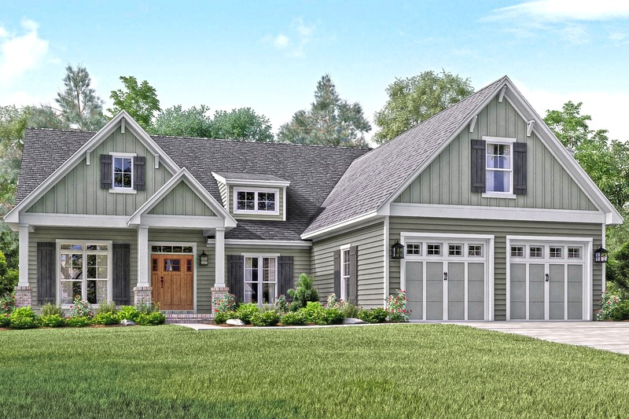
House price prediction machine learning model
By Group – Agent H

Slide 2
Project outline:
Why this project?
Project structure and EDA processing
Feature Engineering and different models used
Model training and cross-validation
Results
Conclusion and future direction

Slide 3
Why this project?
House is a lifetime investment
How the price of house are affected by different features in the house?
People want to know the actual price of house on the basis of features
before reaching out to agent
How we did this and how can we apply to predict the real world problem?

Slide 4
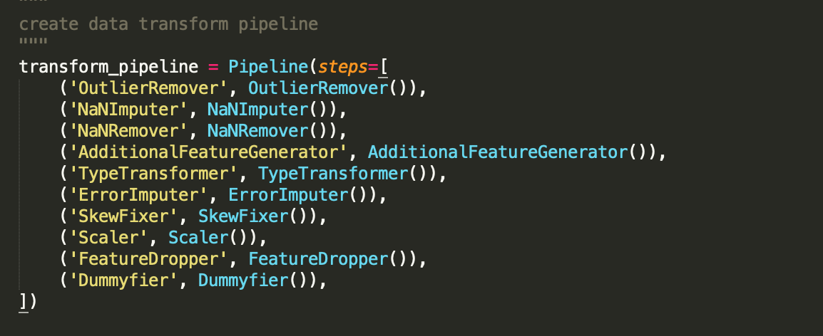
Project structure and EDA processing:
We built two pipe lines for this project:
a) Transform pipeline

Slide 5
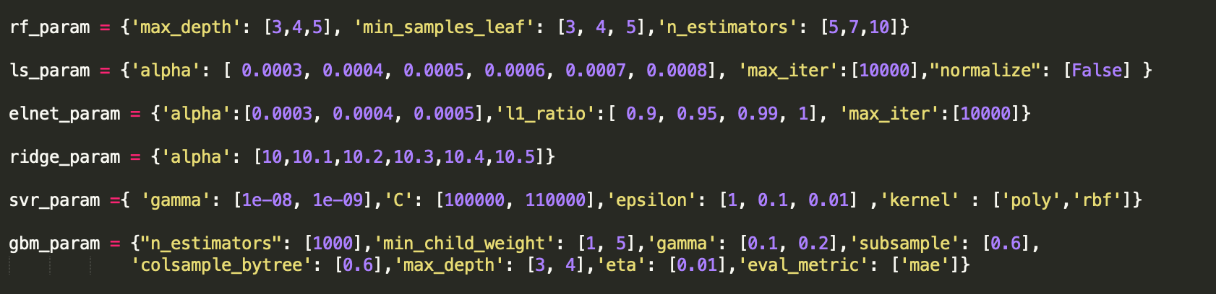
b) Model pipeline

