Slide 1

House price prediction machine learning model
By Group – Agent H

Slide 2
5. Predict Model
1) Model Selection Concept
Start with Lasso ( Test / Feature Selection )
Fast and Good result
A few Parameter
Add Supervised Learning ML
Ridge / RandomForest / Boost ..
Comparison of results between various algorithms
Make Stacking / Average Model
To reduce residual, Make a Integrated model

Slide 3
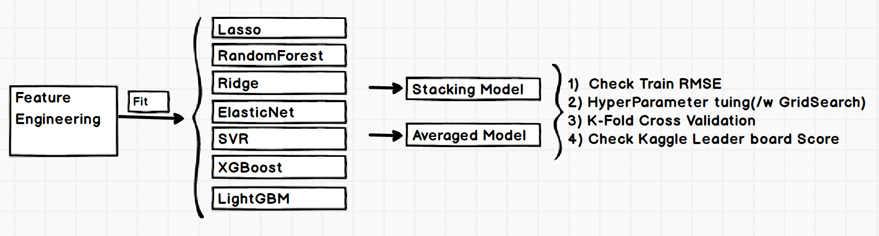
5. Predict Model
2) Process
Workflow for Model selection
Used Various Algorithm
GridSearch for finding Hyperparameter
Made a Model ( Stacking / Averaged )

Slide 4
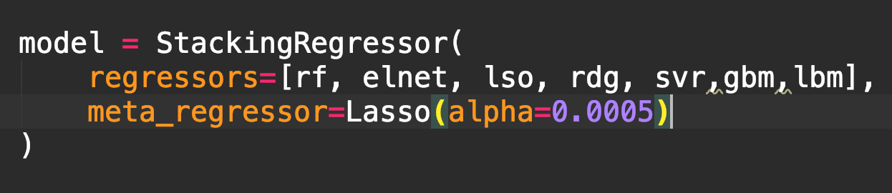
5. Predict Model
3) Stacking Regression
: Two heads are better than one
Stacking is a method that combines
predictions of several different models
Various ML Algorithms can be mixed
Meta Regressor
An algorithm that combines different models
<http://rasbt.github.io/mlxtend/user_guide/regressor/StackingRegressor/>

Slide 5
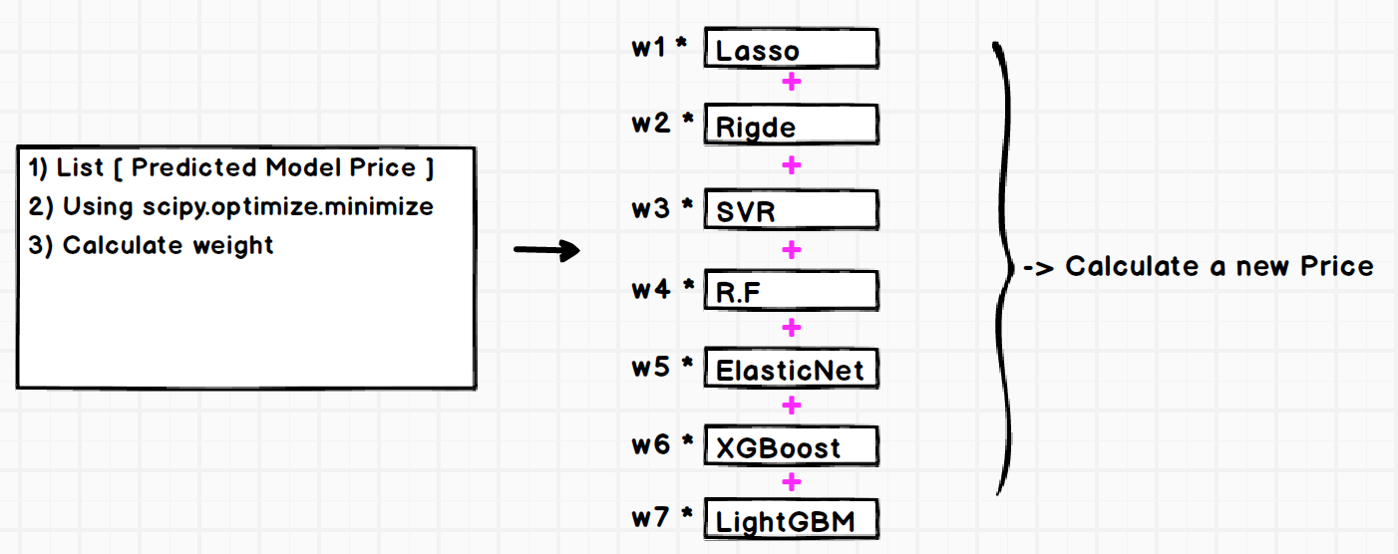
5. Predict Model
4) Averaged Model

Slide 6
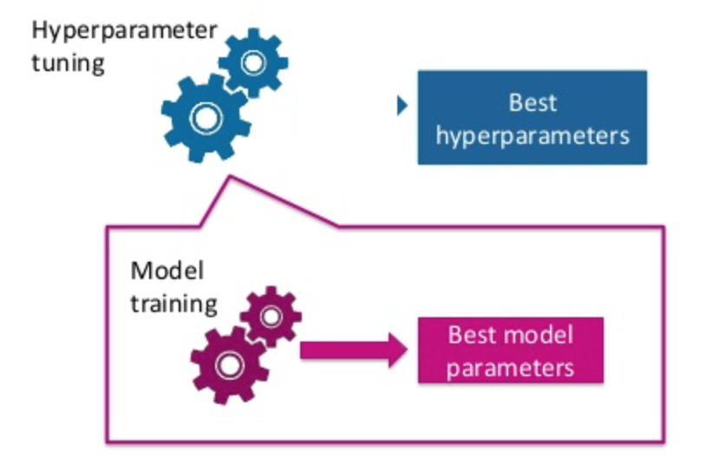
6. Tuning Hyper Parameter
To make a better model is a very important process.
Basically we can 3-way
GridSearch
RandomSearch
Bayesian Optimization
We use the GridSearch.. Why?
Many Reference
Small train data
apply whole range

Slide 7
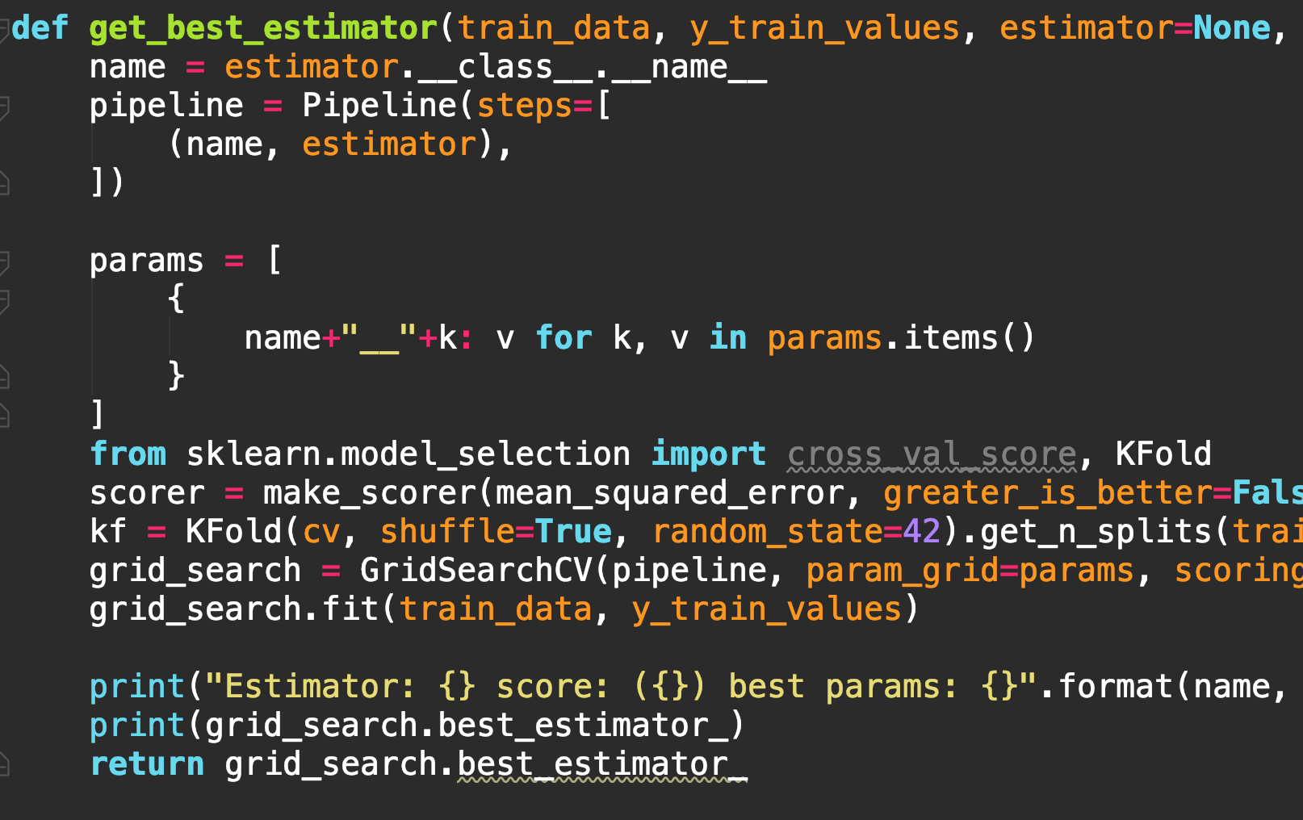
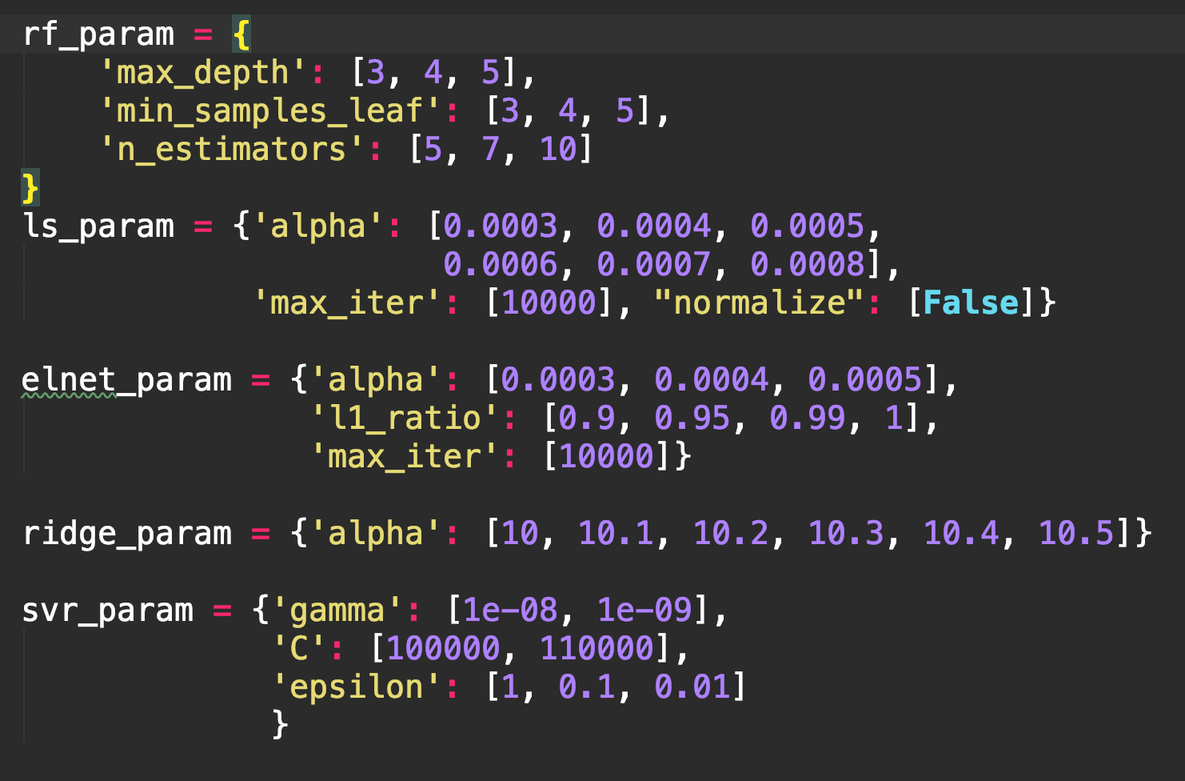
6. Tuning Hyper Parameter
Make a Module
: Use K-fold Cross validation = 5

Slide 8
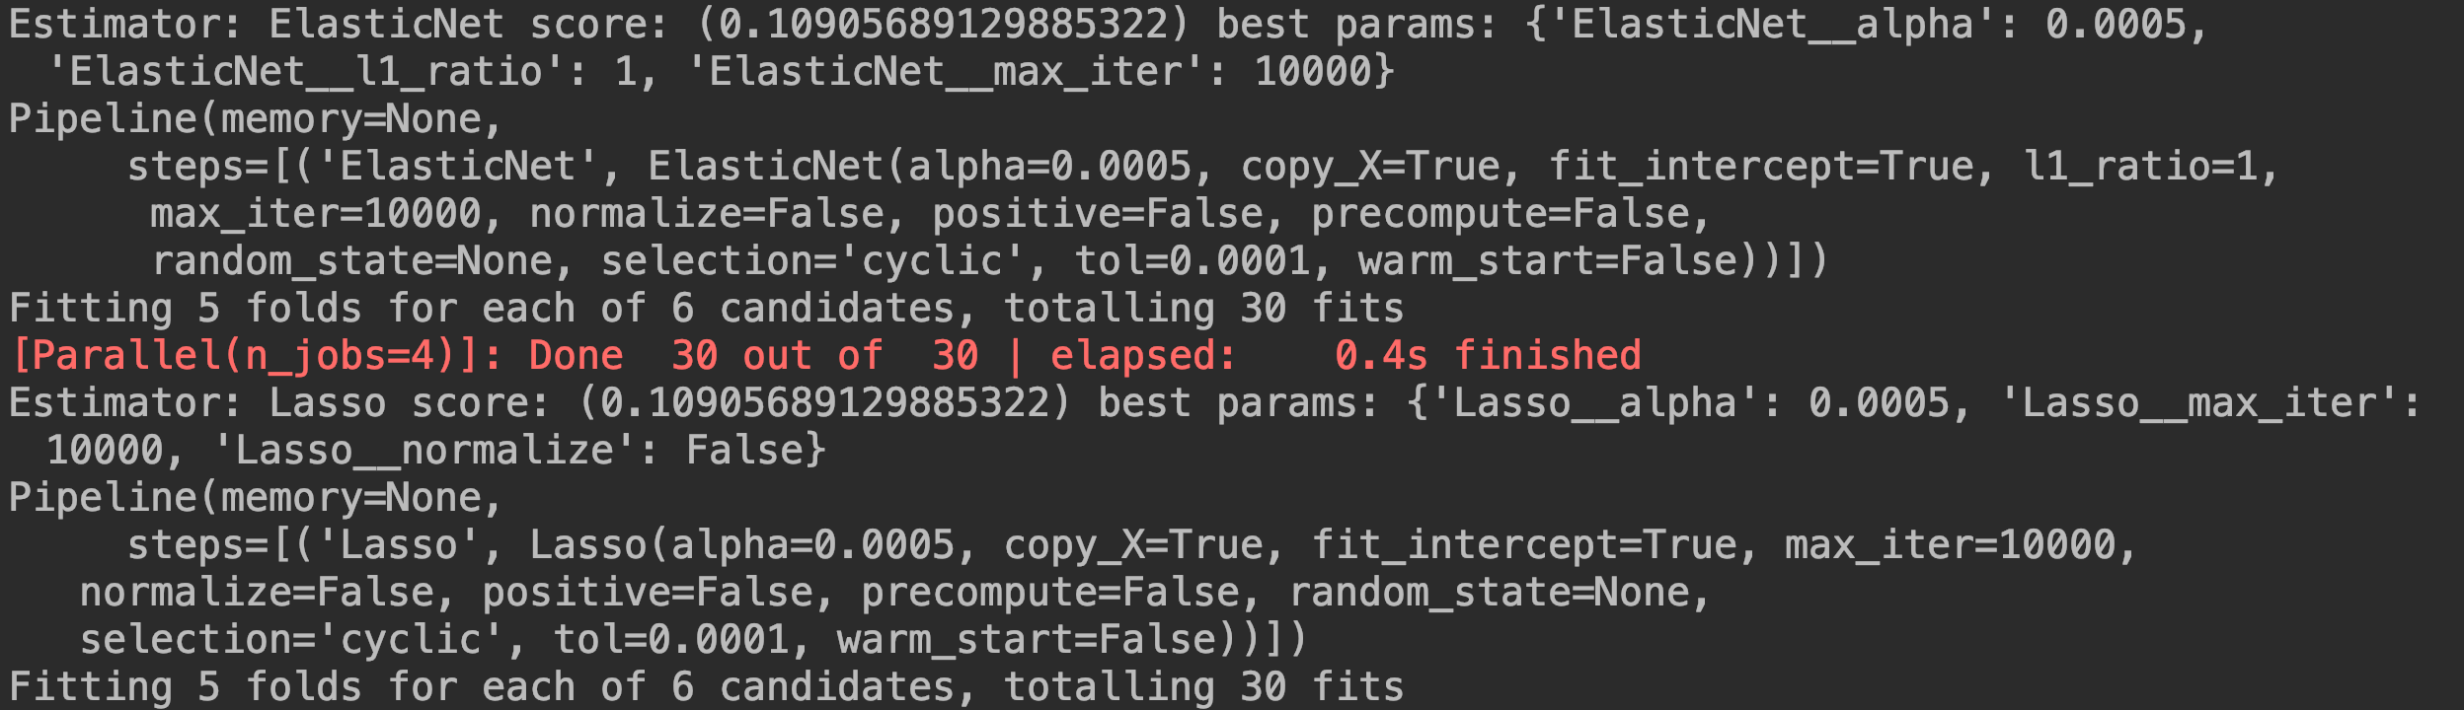
6. Tuning Hyper Parameter
2) Find best Parameter

Slide 9
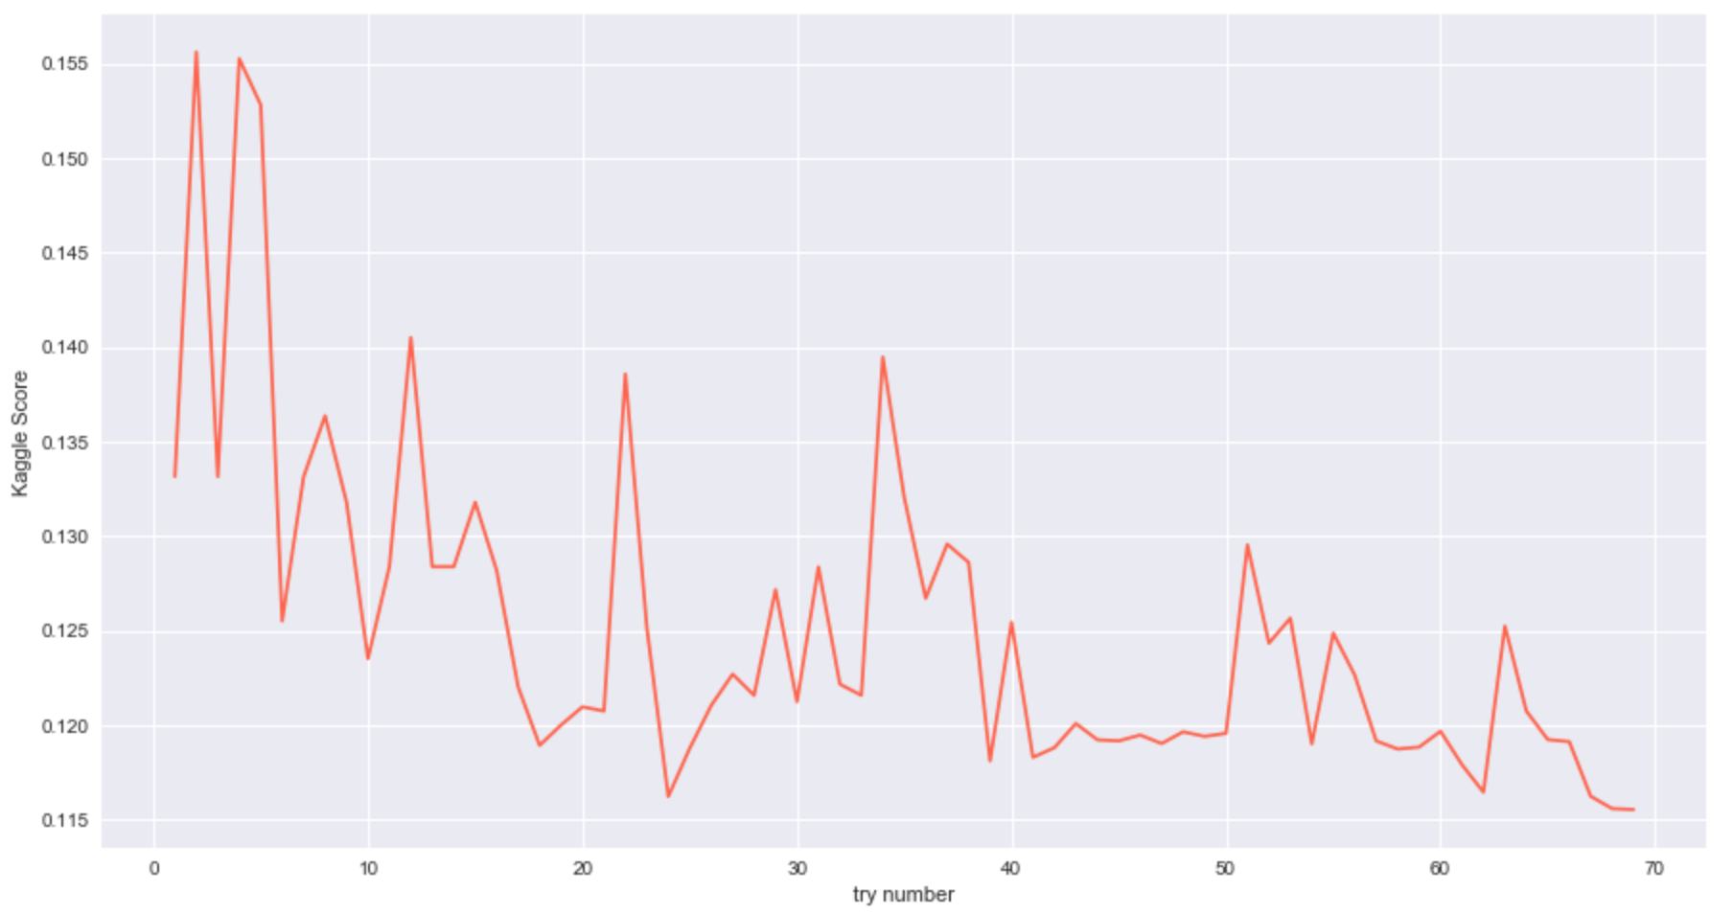
7. Conclusion
1) Final Score
Final Kaggle Score : 0.11554
Top 8% ( 11/17, 2018 )

Slide 10
7. Conclusion
2) Detailed Score
Model | Train RMSE | Kaggle Score
Randomforest | 0.15893652
ElasticNet | 0.10879657
Lasso | 0.10869445
Ridge | 0.11043459
SVR | 0.11368618
XGboost | 0.12115257 | 0.12965
lightGBM | 0.13731836 | 0.14344
StackingRegressor | 0.11069786 | 0.11554
Averaged | NA
In our Case
Stacking is Best
boost algorithm was not a good score.
Need to Tune the Parameter
Better linear than tree

Slide 11
7. Conclusion
3) Impression
All of Parameter is Importance
Skew , Zscore and so many variable to select
Model hyperparameter
Feature engineering is most important to predict price
FillNa ( 0 , Mode , median )
binning
Using Domain Knowledge
If the data is huge..
Use the feature Selection
Feature Importance
Use the feature Extraction
PCA ( for reduce )
RandomSearch for finding Parameter

