Slide 1
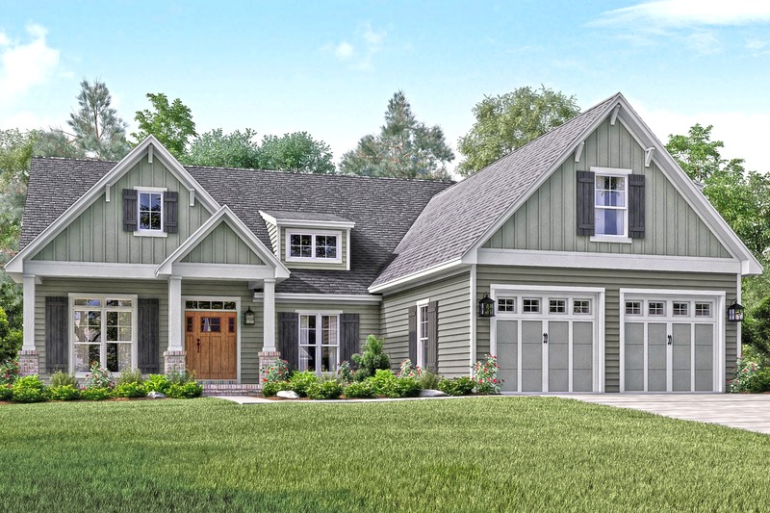
House price prediction machine learning model
By Group – Agent H

Slide 2
Project outline:
Why this project?
Project structure and EDA processing
Feature Engineering and different models used
Model training and cross-validation
Results
Conclusion and future direction

Slide 3
Why this project?
House is a lifetime investment
How the price of house are affected by different features in the house?
People want to know the actual price of house on the basis of features
before reaching out to agent
How we did this and how can we apply to predict the real world problem?

Slide 4
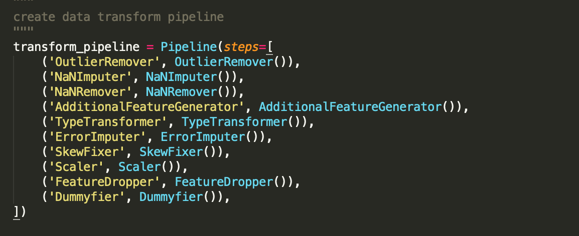
Project structure and EDA processing:
We built two pipe lines for this project:
a) Transform pipeline

Slide 5
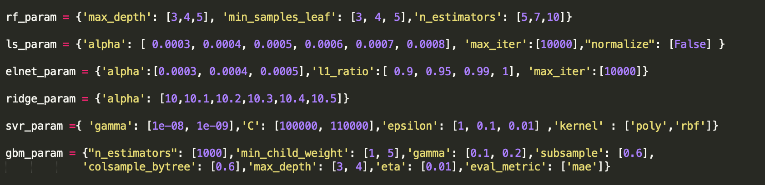
b) Model pipeline

Slide 6
5. Predict Model
1) Model Selection Concept
Start with Lasso ( Test / Feature Selection )
Fast and Good result
A few Parameter
Add Supervised Learning ML
Ridge / RandomForest / Boost ..
Comparison of results between various algorithms
Make Stacking / Average Model
To reduce residual, Make a Integrated model

Slide 7
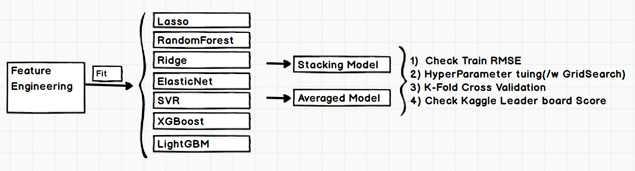
5. Predict Model
2) Process
Workflow for Model selection
Used Various Algorithm
GridSearch for finding Hyperparameter
Made a Model ( Stacking / Averaged )

Slide 8
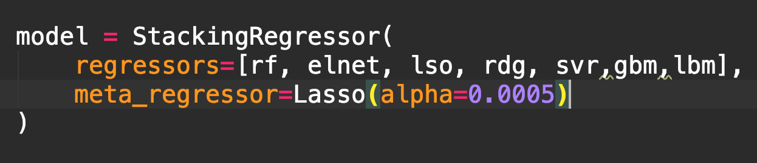
5. Predict Model
3) Stacking Regression
Stacking is a method that combines
predictions of several different models
Various ML Algorithms can be mixed
Meta Regressor
An algorithm that combines different models
<http://rasbt.github.io/mlxtend/user_guide/regressor/StackingRegressor/>

Slide 9
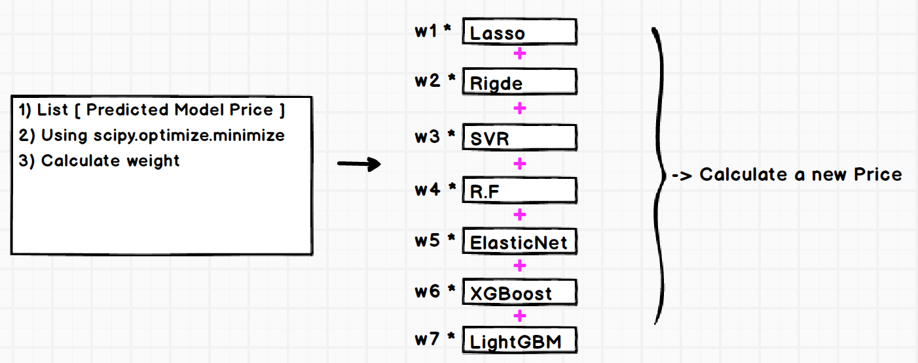
5. Predict Model
4) Averaged Model

Slide 10
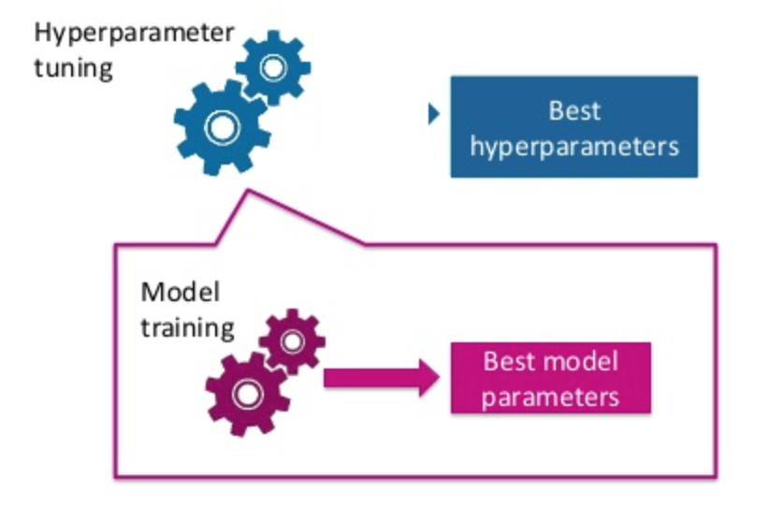
6. Hyper Parameter
To

Slide 11
6. Predict Model
1) Basic Concept

Slide 12
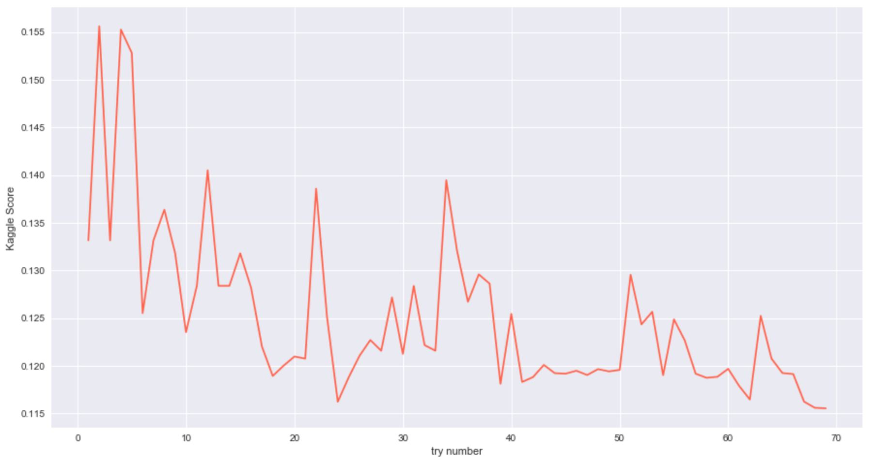
8. Conclusion
1) Score
Final Kaggle Score : 0.11554
Top 8% ( 11/17, 2018 )

Slide 13
8. Conclusion
1) Hyperparameter는 모델에만 국한되는 것이 아니다.
Final Kaggle Score : 0.11554
Top 8% ( 11/17, 2018 )

