Slide 1
What industry do you want to work for?
trying to find out which industry is growing,
based on PR News
Oct 2018
Jiwon, Cha

Slide 2

PR(Public Relations)
Using the news or business press to carry positive stories about your company or your products; cultivating a good relationship with local press representatives.

Slide 3


Basic Idea
The more, The better
Growing industries publishes more PR News.
More PR News
Less PR News

Slide 4
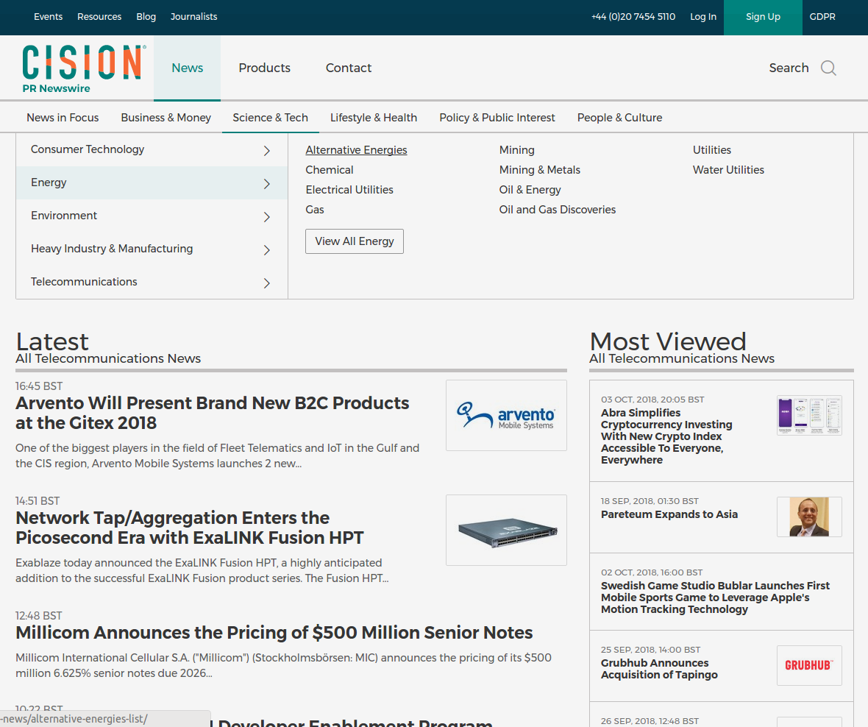
Web scraping
http://www.prnewswire.co.uk
177 Industries
95459 news
From April to October – 2018
34Mb (News Title only)
Industry | News Title | Release Date
Blockchain | Millicom Announces... | 10/11/2018 13:00:00
Chemical | ... | ...
Blockchain | ... | ...
Mining | ... | ...

Slide 5
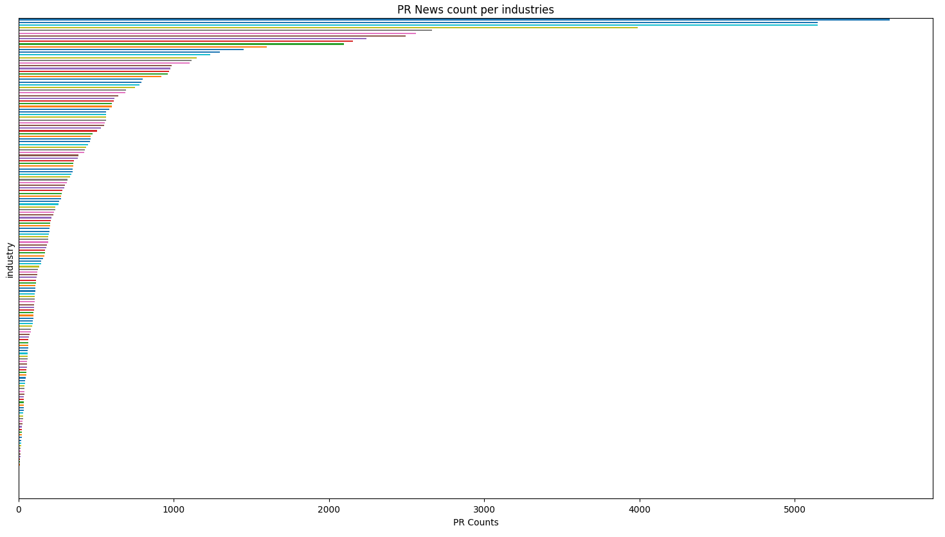
PR News Count

Slide 6
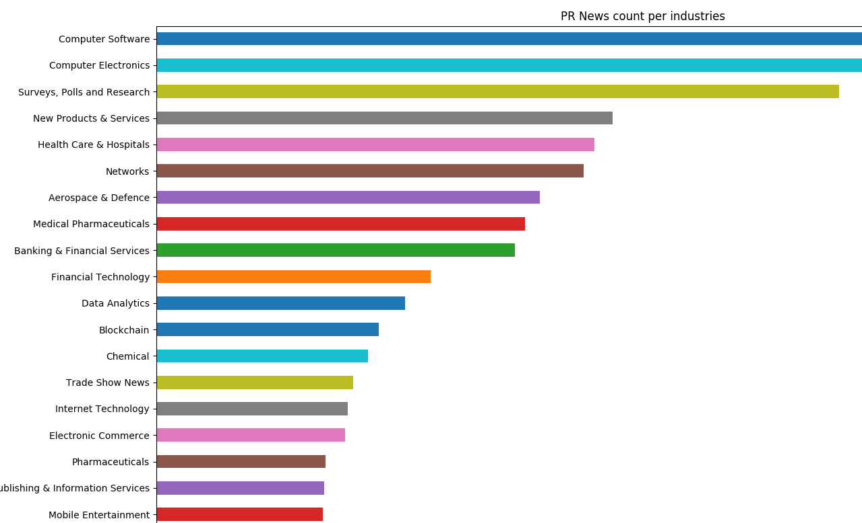
Top

Slide 7
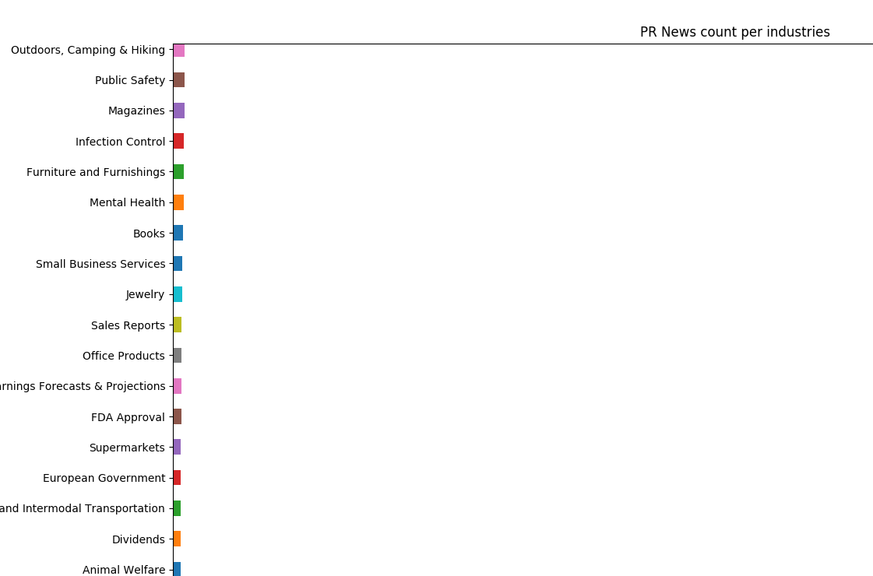
Bottom

Slide 8
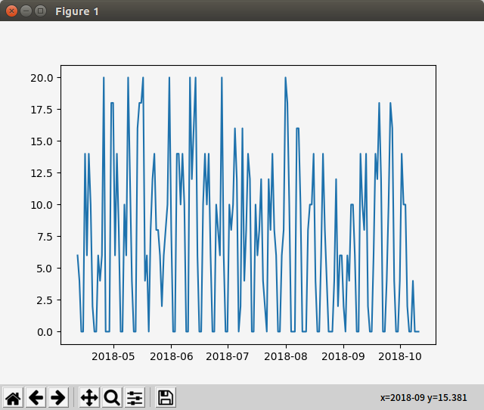
Lets find trend for each industry.
Plot for Blockchain Industry

Slide 9

Nature of PR news...
"""
day_of_week
Friday 9370
Monday 14824
Saturday 590
Sunday 711
Thursday 17890
Tuesday 18448
Wednesday 17126
"""

Slide 10

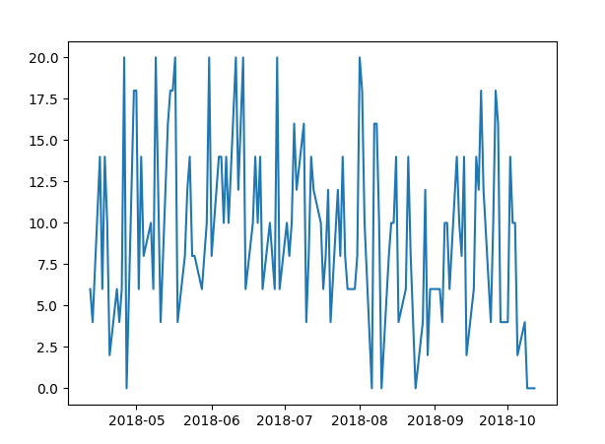

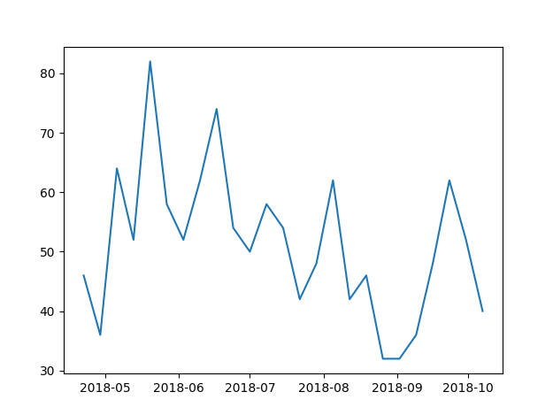

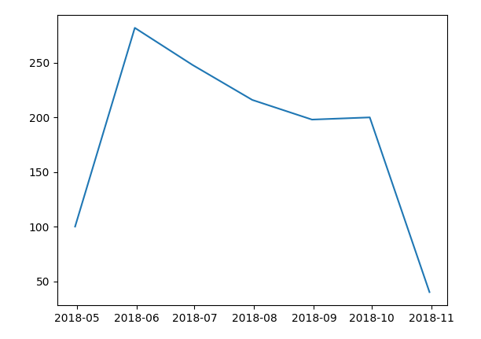
Can you see the trend?
Removed weekends
Resampled (weekly)
Resampled (Monthly)

Slide 11
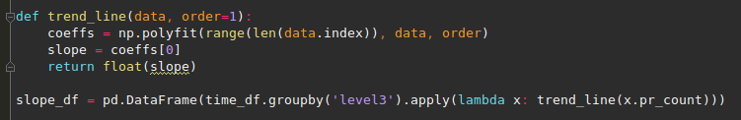
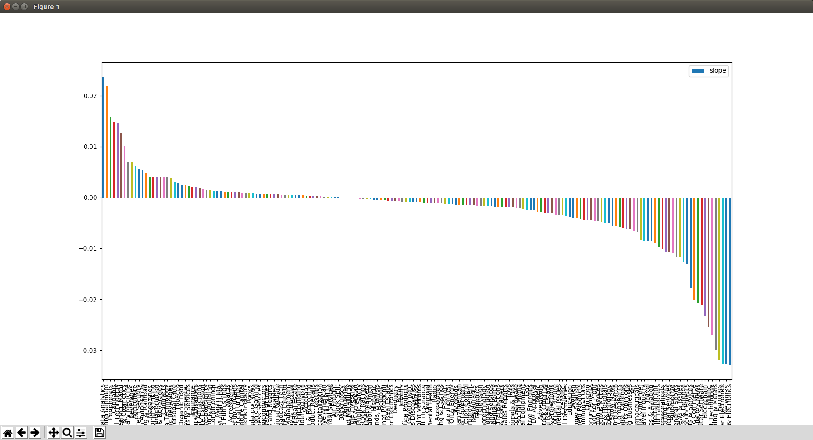
PR News count trend per industries

Slide 12
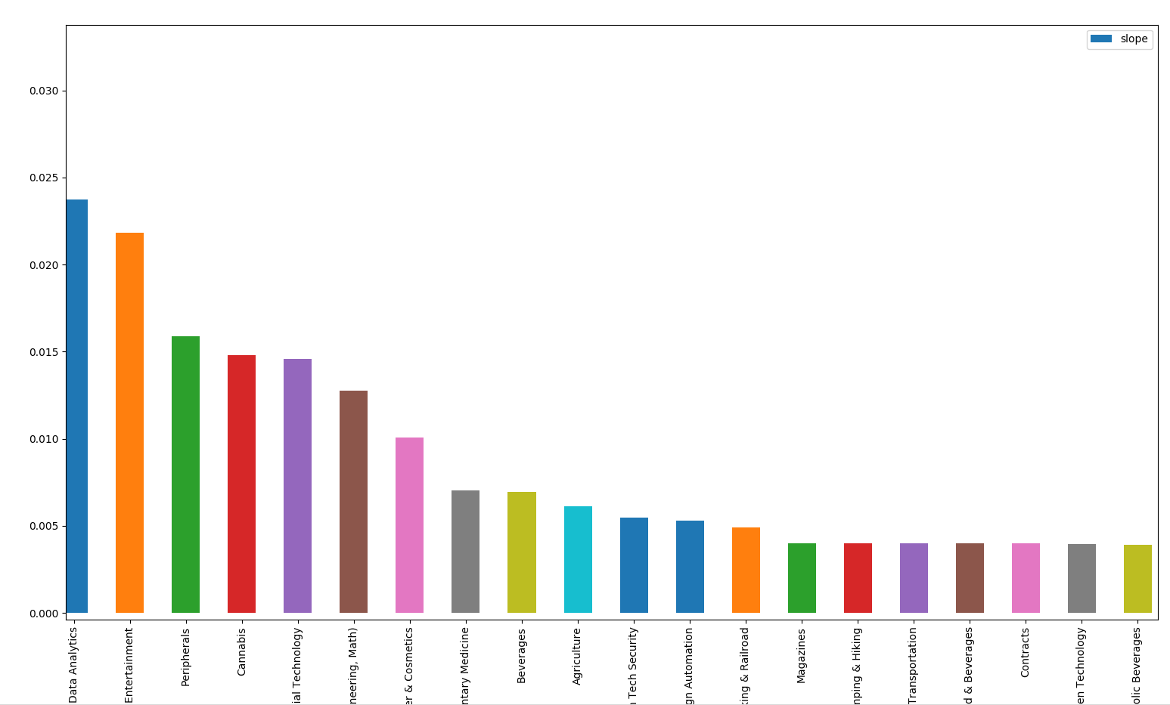
Top

Slide 13
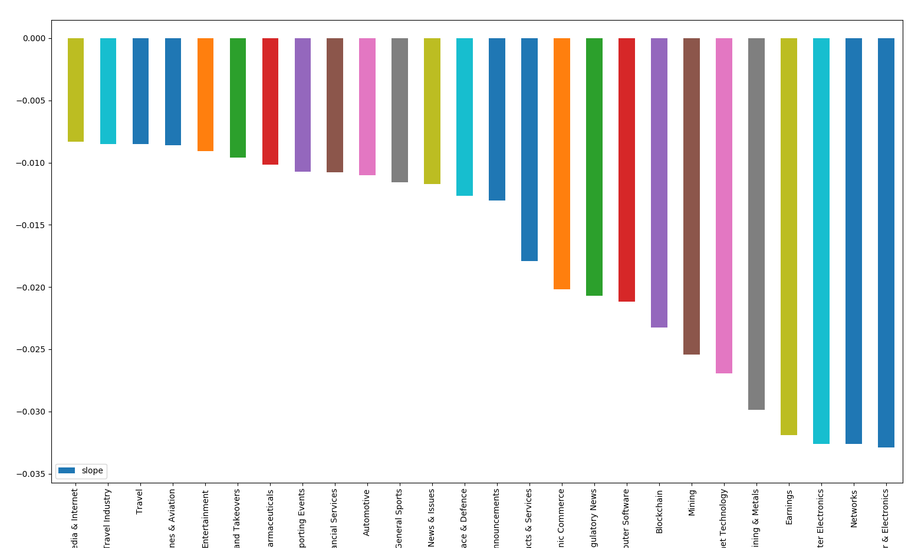
Bottom

Slide 14
So, What industries have the most promising future?
Get the trend for each industry
High rank in PR_Count + Upward slope = good industry
Financial Technology 1602
Data Analytics 1452

Slide 15
Future Improvements
Implementing DB storage for daily batch
NLP for categorization

